Slide 1
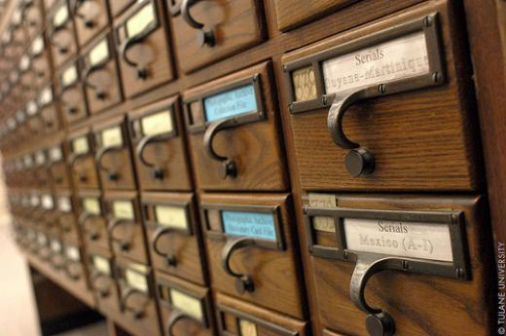
Evaluating Faculty and Student Use of Digital Resources for Teaching and Learning
Researchers (in alphabetical order)
Chuck Dziuban, University of Central Florida, charles.dziuban@ucf.edu
Flora McMartin, Broad-based Knowledge, flora.mcmartin@gmail.com
Glenda Morgan, University of Illinois Urbana, gmorgan@illinois.edu
Josh Morrill, University of Wisconsin at Madison, jmorrill@wisc.edu
Patsy Moskal, University of Central Florida, patsy.moskal@ucf.edu
Alan Wolf, University of Wisconsin at Madison, alanwolf@wisc.edu
ELI- 2013

Slide 2

A STUDY BEGINS … A STUDY EVOLVES
Faculty Baseline: Faculty use of Digital Resources (2006)
Faculty in Context Physics, Social Science, Geoscience (2008-2011)
General Student Baseline (2012)
?

Slide 3
FOCUS GROUPS
Faculty Use of Digital Resources
Student Use of Digital Resources

Slide 4
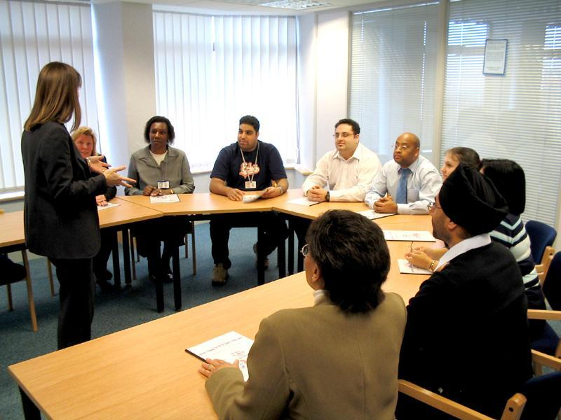

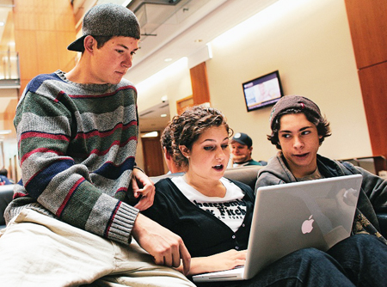
Focus Group Findings
Research Questions
RQ1 - How do students use digital learning resources?
RQ2 - Why do students use these resources?
RQ3 - What is the impact of this use on students’ learning?
RQ4 - What are the barriers to their use?
Findings
Very information literate (savvy)
Used Web as supplement to class materials (text books still very important)
Social networking important, but most worked alone
Iterative use of Wikipedia - Google - friends - textbooks
Notes:
We are going to focus on 4 of the cogs that are influencing organizational culture, but there are potentially other things that impact culture. However, these are generally regarded as key influencers and receivers of organizational culture.

Slide 5
Survey
Survey Administration
Student Use of Digital Resources

Slide 6
Survey Administration
Us
Marketing Sample Vendor
Student Sample (N= 1,749)
Serendipity: We now have 3 useful groups to compare:
1) Current students (full time part time, etc.)
2) Past students / Alumni
3) Never students/ Never went to college.

Slide 7
Information Seeking Behavior Survey
Seek out faculty and TAs
Seek out friends
Seek out a tutor or the learning center
Post question on an Internet message board
Text or IM friends
Email experts not at your institution
Consult textbooks
Notes:
Cut- just talk?

Slide 8
Information Seeking Behavior Survey
Ask a librarian
Consult supplemental readings
View an online lecture
Review relevant Wikipedia entries
Review results from a Google search
Use online library resources (e.g. online journals, e-reserves, or subject guides)
Notes:
Cut –Just Talk?

Slide 9
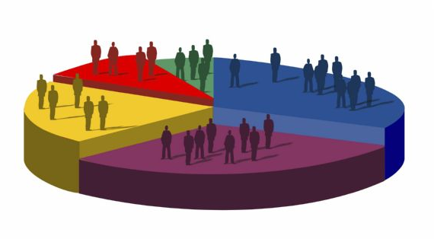
Some demographics…
Notes:
Which of these demos do we need/ want?

Slide 10
Age (n=1711)
Notes:
Which of these demos do we need/ want?

Slide 11
Student status (n=1740)

Slide 12
STEM/Non-STEM major (n=1564)

Slide 13
Employment (n=1043)

Slide 14
Academic standing (n=1041)
Freshman
Sophomore
Junior
Senior
Other
Graduate

Slide 15
Most frequently taken course modalities
STEM
(n=346)
Non-STEM
(n=656)

Slide 16
Preferred class modalities
STEM
(n=346)
Non-STEM
(n=654)

Slide 17
Technologies used in class
STEM
(n=361)
Non-STEM
(n=682)
Video/
audio
Wikis/
blogs
E-books
Sims/
Animations
Mobile apps
External websites
Social networks
Online library
resources

Slide 18
Technologies preferred frequently used in class
STEM
(n=346)
Non-STEM
(n=649)
Video/
audio
Wikis/
blogs
E-books
Sims/
Animations
Mobile apps
External websites
Social networking

Slide 19
Student information seeking behavior: Class vs. Interest
Interest
Means
Class

Slide 20
How STUDENTS SEE THEIR SEARCH ENVIRONMENT
Survey
Student Use of Digital Resources

Slide 21

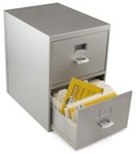


Student Self-Perception Dimensions
Agency
Organization
Preparedness
Engagement
MSA = .82
Residual MSA = .59
Average r = .42

Slide 22



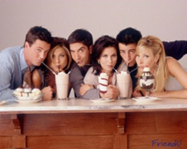
Difficulty in Class Dimensions
Internet Search
Course Related Resources
Seek Expertise
Friends, Social Networks
MSA = .71
Residual MSA = .54
Average r = .29

Slide 23
Seeking Information About a Topic of Interest Dimensions
Blended Resources
Friends, Social Network
MSA = .82
Residual MSA = .51
Average r = .30
Internet Search

Slide 24
Smallest Space Analysis of Student Self-Perception and Search Technique
Traits
Agency
Preparedness
Organization
Engagement
Experts
Internet
Friends, Social Networks
Friends, Social Networks
Course Related Materials
Blended Resources
Skills
Internet
Structure
Berry Picking

Slide 25
Personas
Survey
Student Use of Digital Resources

Slide 26

How Were Personas Derived?
Started with the questions on learning / studying preferences (same questions used for factor development)
Conducted a Latent Class Analysis on these items
Found different, internally consistent subgroups. Developed “narratives” or personas to help explain these subgroups.

Slide 27
Student Personas

Slide 28
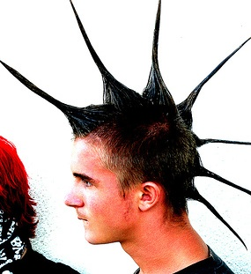
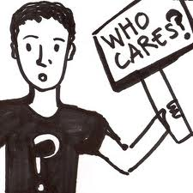


Persona Demographics
 | Ambivalent Learners | Adaptive Learners | Free Form Learners | Time Sensitive Learners
-% full time student | 54% | 55% | 39% | 47%
-% former students | 30% | 33% | 44% | 33%
School/ Institution
-2 year/ community college | 13% | 15% | 21% | 28%
-4 year college/ university | 72% | 57% | 51% | 55%
Race
-% White/ Caucasian | 74% | 75% | 73% | 48%
Is / Was Major
-Business, Marketing | 17% | 14% | 17% | 25%
-Humanities & Fine Arts | 8% | 11% | 20% | 8%
-Engineering | 10% | 13% | 7% | 10%

Slide 29
Personas And Blended Learning
% within each persona desiring…All face-to-face, half-and-half, or all online courses
Time Sensitive
Free Form
Entirely Face-to-face
An equal mix
(Online and face-to-face)
Adaptive
Entirely Face-to-face
Ambivalent

Slide 30
Personas And Technology
 | Ambivalent Learners | Adaptive Learners | Free Form Learners | Time Sensitive Learners
Wikipedia
% using Wikipedia (for school or work) | 56% | 57% | 62% | 47%
Technology Preferences
% wanting FREQUENT wiki or blog use in their classes | 10% | 13% | 21% | 26%
% wanting FREQUENT e-book or eText use in their classes | 23% | 40% | 34% | 45%
% wanting FREQUENT content from websites outside of campus used in their classes | 24% | 48% | 53% | 45%
% wanting FREQUENT social media (Facebook, Twitter, etc.) use in their classes | 10% | 18% | 11% | 32%

Slide 31
Personas, Support and Searching
 | Ambivalent Learners | Adaptive Learners | Free Form Learners | Time Sensitive Learners
Class Difficulties
% Very Likely to ask FRIENDS for help | 46% | 59% | 45% | 65%
% Very Likely to seek out a TUTOR | 14% | 18% | 18% | 54%
% Very Likely to seek out a LIBRARIAN | 5% | 17% | 11% | 42%
Resources/ Searching
% STRONGLY AGREE; ”I prefer sites where others have determined the reliability/ accuracy of content” | 30% | 47% | 53% | 78%
% STRONGLY AGREE: “I prefer searching for one large resource first when I do not know where to look” | 24% | 50% | 42% | 68%

Slide 32
Now What?
Survey
Student Use of Digital Resources
Factors & Personas

Slide 33
Where Do We Go Next?
Follow-ups with the Ambivalent Learners
  - Who are they, ways that their ambivalence manifests itself etc
  - How can we help overcome the ambivalence
Questions of all types of learners
  - More about the types of digital resources they use
  - The importance of brand
  - More on the importance of curation and personal geographies of learning
  - Use of resources in class and to help outside of class – what prompts it and how can we expand it? (Motivational triggers)

Slide 34
Implications of this Information
We have a more nuanced view of learners (Historically this is overly simplistic, and this is just the start of understanding learner behaviors)
Student preferences for technology use and course mode (many guesses and suppositions out there)
Expands the notion of digital fluency to include “learning to learn”
Libraries…
Textbooks…
And that’s just the beginning….

Slide 35

Questions and Comments
Glenda Morgan gmorgan@illinois.edu
@morganmundum
Or one of the other researchers on the project
Chuck Dziuban, University of Central Florida, charles.dziuban@ucf.edu
Flora McMartin, Broad-based Knowledge, Flora.McMartin@gmail.com
Josh Morrill, University of Wisconsin at Madison, jmorrill@wisc.edu
Patsy Moskal, University of Central Florida, patsy.moskal@ucf.edu
Alan Wolf, University of Wisconsin at Madison, alanwolf@wisc.edu
Support for this project was provided by the National Science Foundation DUE award no. 1049537 Any opinions, findings, and conclusions or recommendations expressed are those of the authors and do not necessarily reflect the views of the National Science Foundation

