Slide 1
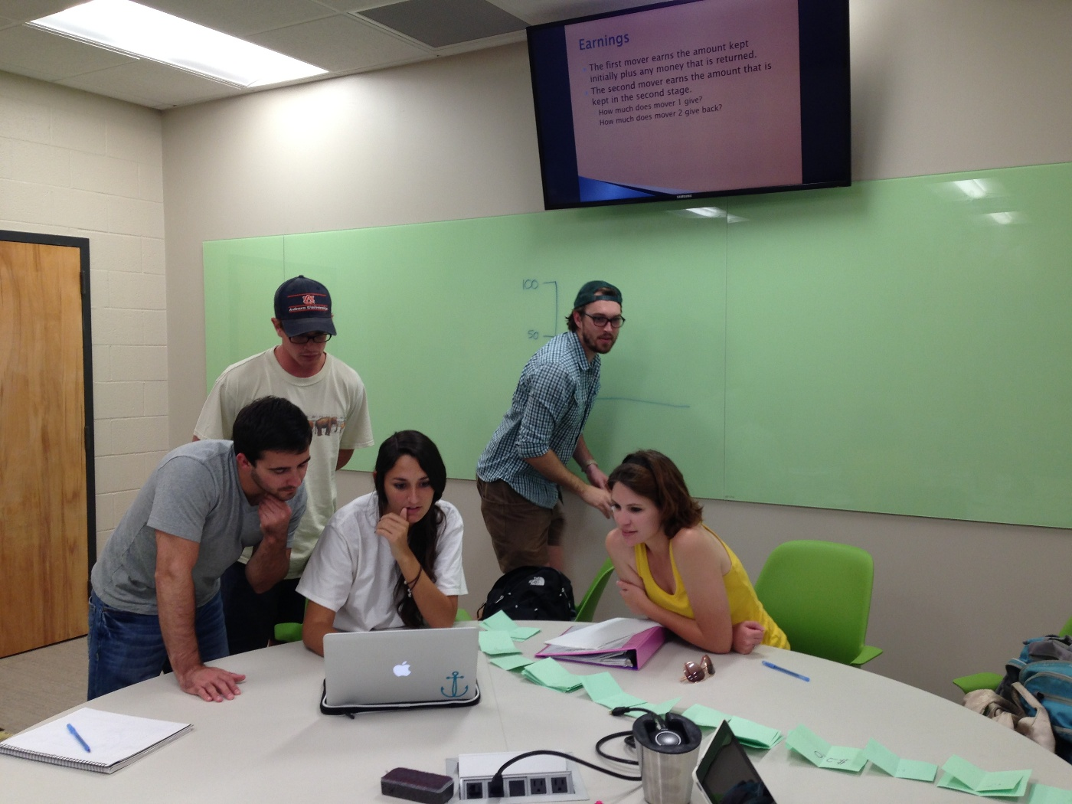
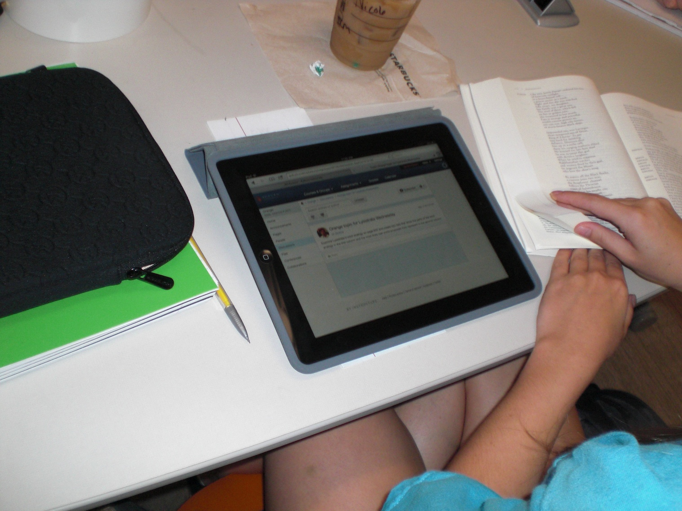
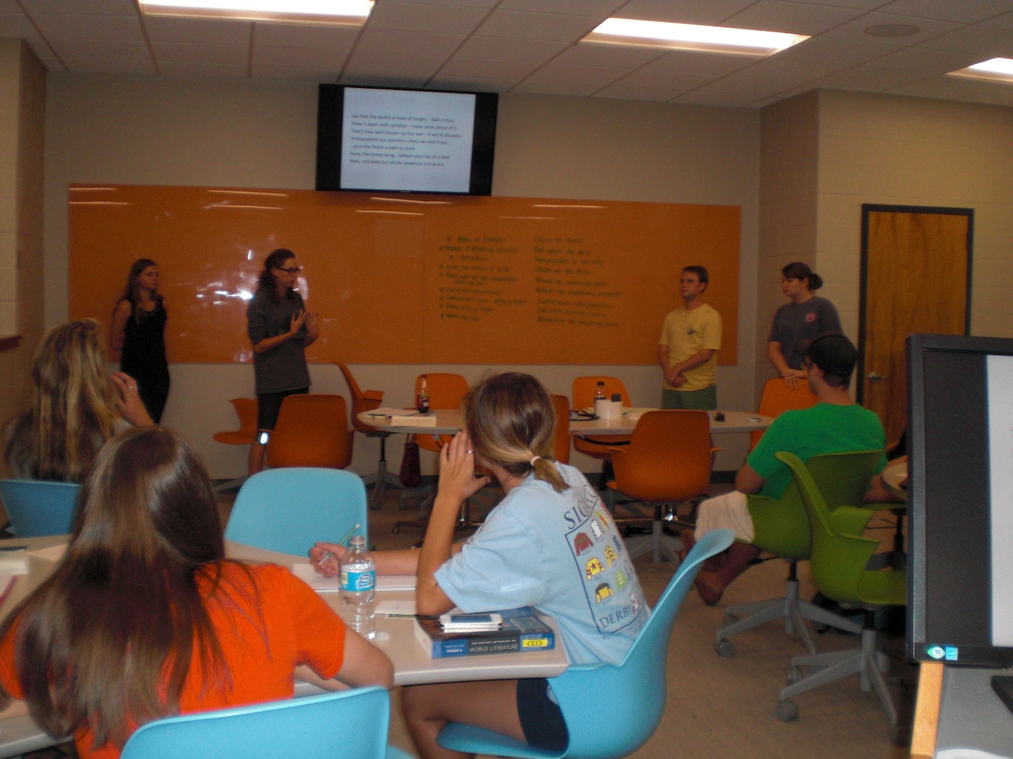
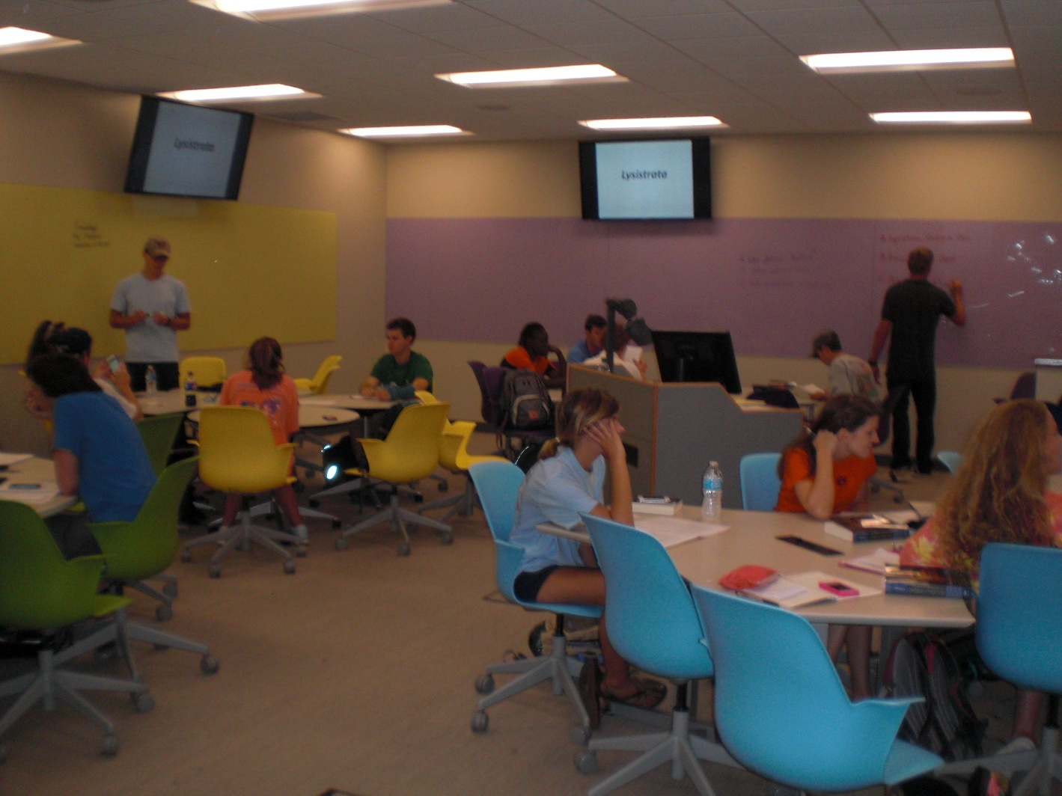
EASL
Changing the Culture of Learning One Class at a Time
Dr. Wiebke Kuhn & Anna Ruth Gatlin | Auburn University, Auburn Alabama
Room Design
Changing the Culture Process
Faculty
Fall: Call for Proposals
Late Fall: Decision making based on course scheduling
Room Design
Fall: Stakeholder Identification
Late Fall: Invitation to participate
Spring: Workshops focusing on Collaborative Learning, Student Expectations, Assessment
Spring: Sub groups focusing on furniture/design, instructional technologies, faculty development
Summer: Informal checking on progress of course redesign
Summer: Renovation of room
Fall: Teaching of course monthly meetings assessment
Fall: Troubleshooting of room minor adjustments assessment
5 table designs
5 colors: chairs and glass boards
Sustainability: carpet, glass boards, chairs, tables
Wireless sharing of BYOD (Clickshare)
Each table has 55” monitor
45 seats
Teaching station with computer, document camera, touch panel for monitor controls
Option of Virtual lab for special software
Raised Floor for Flexible Room Design/Cable Management
Faculty Voices
Next round of faculty and room
“I love the classroom, and my students loved the classroom. I wish I could teach all of my courses in a room like this one. I think it created an atmosphere more similar to a work environment rather than replicating the classroom experience of K-12 as the typical classroom in Haley Center.”
No clear preferences for a particular color or table shape
Feedback on Furniture Features
Disciplines Teaching in Space
Students have no clear color preference (41 responses)
Students prefer Circle and Oval Table Shapes (42 responses)
Animal Science, Art, Communication, English, Education, History, Health Administration, Italian, Philosophy, Political Science, Polymer and Fiber Engineering, Psychology, Public Relations, Research methods
It involves a massive restructuring of most of what I know about teaching, and it is a lot of work--mainly because you have to be honest about when things aren't working and how much you are responsible for that. Having said that, I have truly had fun, and I think the students would say the same--I feel like it was a really valuable experience, and with a few more tries I might actually get good at it!!
Notes:
Changing the Culture of Learning One Class at a Time: At Auburn University, we are getting ready to build two large classroom facilities with a number of active learning spaces – we have named them EASL = Engaged Active Student Learning spaces. In order to get faculty and student feedback on the design and technology and to ensure that faculty and students are ready to teach in these kinds of spaces, Auburn set aside one classroom space in an older building as an incubator space. The room holds 45 students, at 5 tables of different designs, with each table having 9 chairs and a few feet of glass board color coordinated to the chairs and a larger monitor above the glass board that students can connect their BYOD through Clickshare.
This poster shows our planning and implementation time line for the first room for both the design of the room and the faculty development. Student and faculty feedback after the first semester has been extremely positive, and Auburn is building now its second space, twice the size, with the same model of faculty and student involvement and faculty development.

