Slide 1
Vision and Action
A Three-Year Retrospective on a Large-Scale Mobile Initiative
David Ernst
Alison Link
University of Minnesota

Slide 2
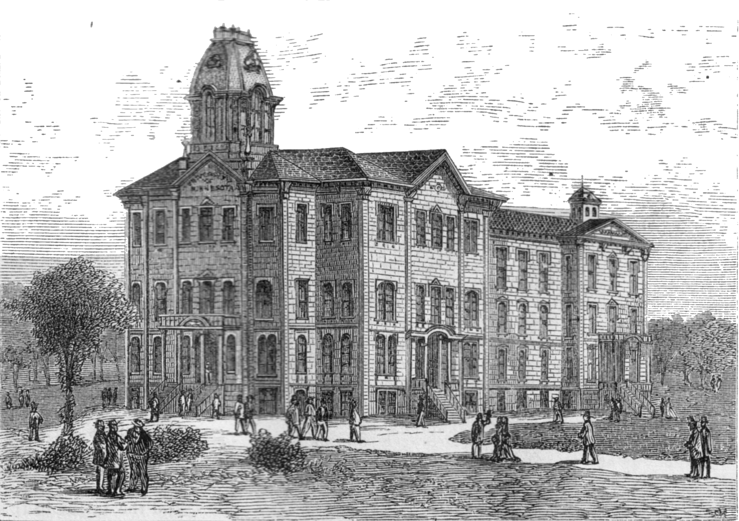
College of Education & Human Development
University of Minnesota
~450 first year students
First Year Experience program taught within the department of Postsecondary Teaching & Learning (~30 instructors)

Slide 3
Data Sources
Administrative artifacts
Student surveys
  2011: 252 responses (56%)
  2012: 274 responses (60%)
  2013: 284 responses (55%)
Faculty interview/focus groups

Slide 4
July 20, 2010

Slide 5

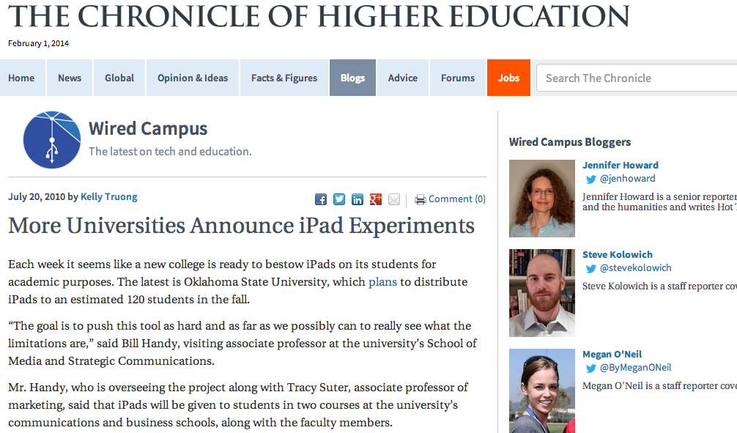

Slide 6
July 21, 2010
Should we consider giving ipads to certain students or programs????? Jean
http://chronicle.com/blogs/wiredcampus/more-universities-announce-ipad-experiments/25646

Slide 7
July 21, 2010
Dave - I would be very interested in this....we bring in about 450 freshman and then would also need to supply the faculty who teach them so we are looking at 450 - 470 if we did everyone.
Notes:
Why not give iPads to ½ the students and study the differences?
The dean wanted every student in the First Year Experience to have an iPad.
This is not a controlled experiment. It is exploration.

Slide 8
Personal Thoughts
We do everything we can to NOT lead with technology.
Yet, is there a need for some space for exploration around this “new” technology?
But that’s a lot of money!
I need to make this purposeful

Slide 9
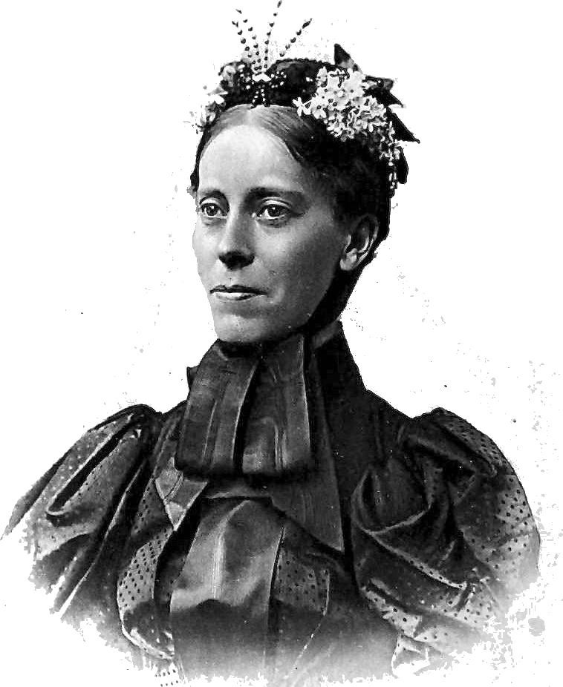
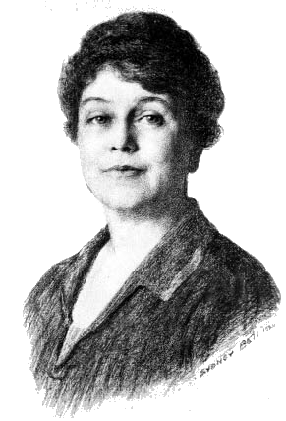
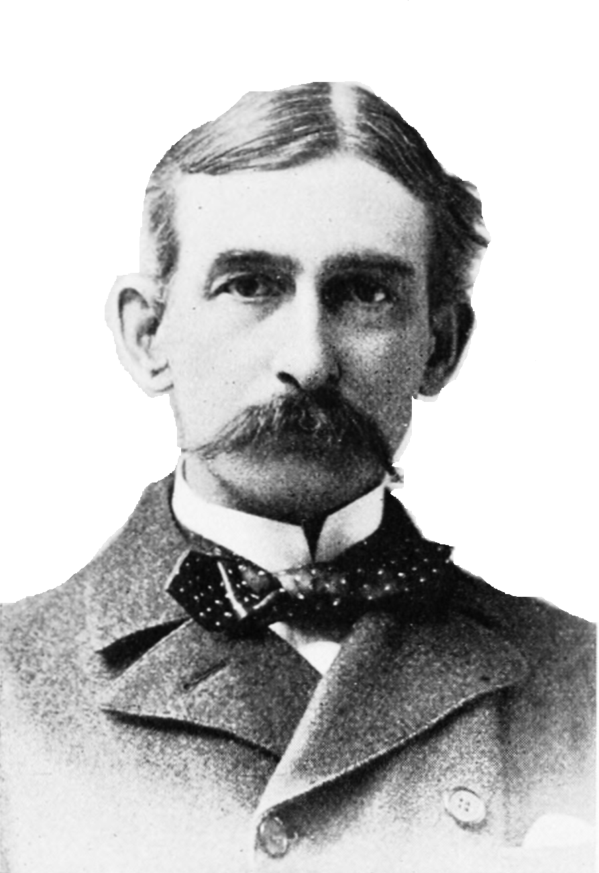
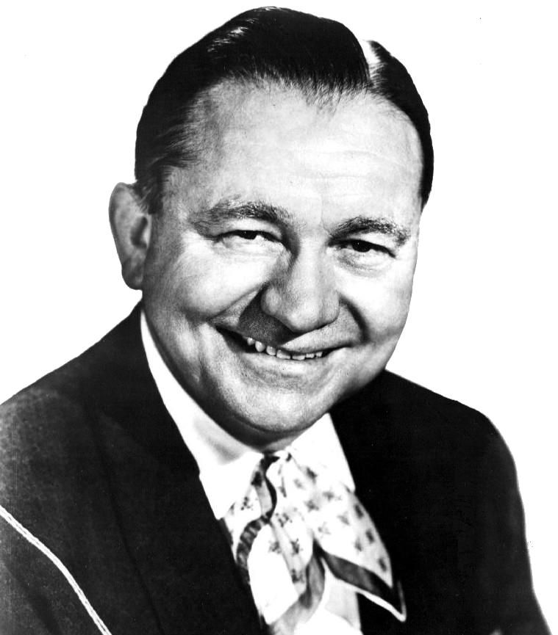
What will faculty think?

Slide 10
Getting Faculty On Board
Make involvement voluntary
Give them time before there are expectations
Give them freedom to fit it into their instruction as they see fit
Give them administrative access to the device
Give them
an iPad!
Notes:
Shielding faculty from coersion – encourage, support – not force
Start in spring (time)
Can’t require

Slide 11





















Dean’s App of the Week
118 since November, 2010
Notes:
Administrative - tone (dean’s exploratory tone)

Slide 12

An Administrator’s Vision
What about
classroom
management?
eTexts (save students money)
Bridge the digital divide
Student retention, engagement, and learning outcomes

Slide 13
What about classroom management?
“It's a zoo - I love it, I actually love it - I love having students with all sorts of electronic gadgets about in classes, because they have to learn how to use those and to ignore them, that's part of growing up.”
I’m having
technical
problems!
“It's a challenge. I...it's almost like you introduce those iPads, and then suddenly the level of chaos in the class goes up. … I implemented the "iPad Monday" because I wanted to limit the amount of time that technology is out on the table, and so I tell them to put them away, and then when we do the iPad Mondays, we pull 'em out, everyone's using them, we have a goal in mind, and then once that goal is accomplished, I ask them to put them away again.”
Notes:
Most instructors saw the iPads as part of a more general trend of learning to manage and create expectations about student devices in the classroom—be it laptops, phones, iPads, etc.
iPads were part of an inexorable trend towards more device chaos. RESPONSE? Keep devices “in their place” through deliberate community-building and goal-directed use of devices

Slide 14
I’m having technical problems!
“Right now, for me, operationally...I've had more clunks than I've had successes. So it's frustrating for me. For example, yesterday I was giving a...I had twenty students in the classroom, everybody had an iPad, and it was a fifteen-question quiz and half of the students couldn't access the quiz because of block-ups or pop-ups or whatever ...so I had half taking it on their iPads, and I had to scramble and get some hard copies of things and I just...it makes me look bad, you know, so I'm frustrated with that.”
The iPad
won’t
project!
Notes:
Helping faculty manage setbacks and potential for embarrassment

Slide 15
The iPad won’t project!
But it’s not
a laptop!
“I got briefly excited about apps when I first got the iPad and was playing with things, but I think the real barrier for me was realizing that, unlike the laptop, all apps don't project, so it's just a lot easier for me, if I discover something cool, to just do it on my laptop. And then, you know, I have a guarantee that I know how to use that.”
Notes:
Role of academic tech staff to help manage expectations?

Slide 16
But it’s not a laptop!
What can I do when not all students have one?
“It's also really helpful to know what the iPad can't do, so you don't try to make it into a laptop and then get frustrated because you're like ‘It won't do it’. It's like ‘No, it's not... you know, it won’t’. So…’Good, now I know that. I can move on.’ ”
Notes:
If it’s not as good as a laptop, they’ll switch back to what works

Slide 17
What can I do when not all students have one?
Is it even worth spending time learning it?
“I was all jazzed about it in the first week of class, but my two sections of speech, less than 50% of the students have iPads, and then there were awkward e-mails back and forth with students saying "Well, do I have to get one? Where do I get one?" and I guess, a $500 thing, you're not gonna go get one. So, I kind of tamed that down a little bit [...] I didn't like leading the class that way. I felt bad about it, because I felt like it was kind of like a...I was dividing the class into those who had them and those who didn't.”
Notes:
Instructors (at least in our setting) were VERY attuned to the concept of “fairness”
This “all or nothing” attitude was one of the most overwhelmingly consistent sentiments that came out in our interviews

Slide 18
Is it even worth spending time learning it?
“I would like to know if this is ever going to happen again, because I'm going to kind of quit doing more work at trying to figure it out if it's never going to happen again, because it's just not... spending that much time probably isn't worth spending even more time than I've already put into it.”

Slide 19
What can I do when not all students have
one?
Is it even worth my time?
What about classroom management?
But it’s not a laptop!
I’m having technical problems!
Notes:
Alison puts on her “academic tech support hat”
Classroom management: seemed to make faculty nervous to varying degrees, but I was surprised in the end by how consistently they saw this as part of a broader trend of increased number of devices in class that they have to create expectations around
Technical problems: Faculty who were willing to be embarrassed, to put themselves out there as learners WITH their students seemed to have good success. A lot of faculty expressed different ways they “bounded” the iPads or “kept them in their place”—iPad Mondays, creating deliberate community without iPads, etc. Defining a specific space for the iPads actually seemed to make them more positive about their use.
But it’s not a laptop!: Heard this statement (in its various forms) a lot, and I believe academic tech support staff has a huge role to play in helping faculty reframe expectations. In a support role, I’ll admit I was frequently surprised by what the iPad COULDN’T do—especially in the very first year. This statement was usually it was phrased a complaint—what if it were an opportunity?
What can I do when no all students have one?: In the interview research, I was surprised by how prevalent this concern was; they were concerned not just about “majority” coverage (“most students have one”), but “absolute” coverage (“every student has one”) before they felt comfortable using it on official class projects. The absence of even one iPad was felt. I believe a lot of this was concern about equity and access in a college and department that has a history in developmental education, and a commitment to access programs. But this question is interesting, because it is central in the BYOD discussion. We don’t have a good answer to this (and we didn’t exactly have a BYOD context)—but this is an ongoing question in the BYOD discussion and a tablet project like ours.

Slide 20
Adjustments
The Dean said “This is how we will work moving forward.”
Make a cart of iPads available for students to check out
Hire grad students to support student media production
Give “next year’s” iPads to faculty in the spring – time to experiment and learn
Don’t promote eTexts – give guidance
iPad changes – projection & camera!

Slide 21
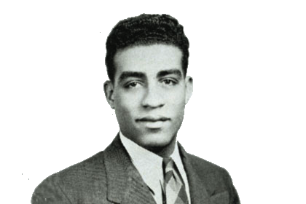
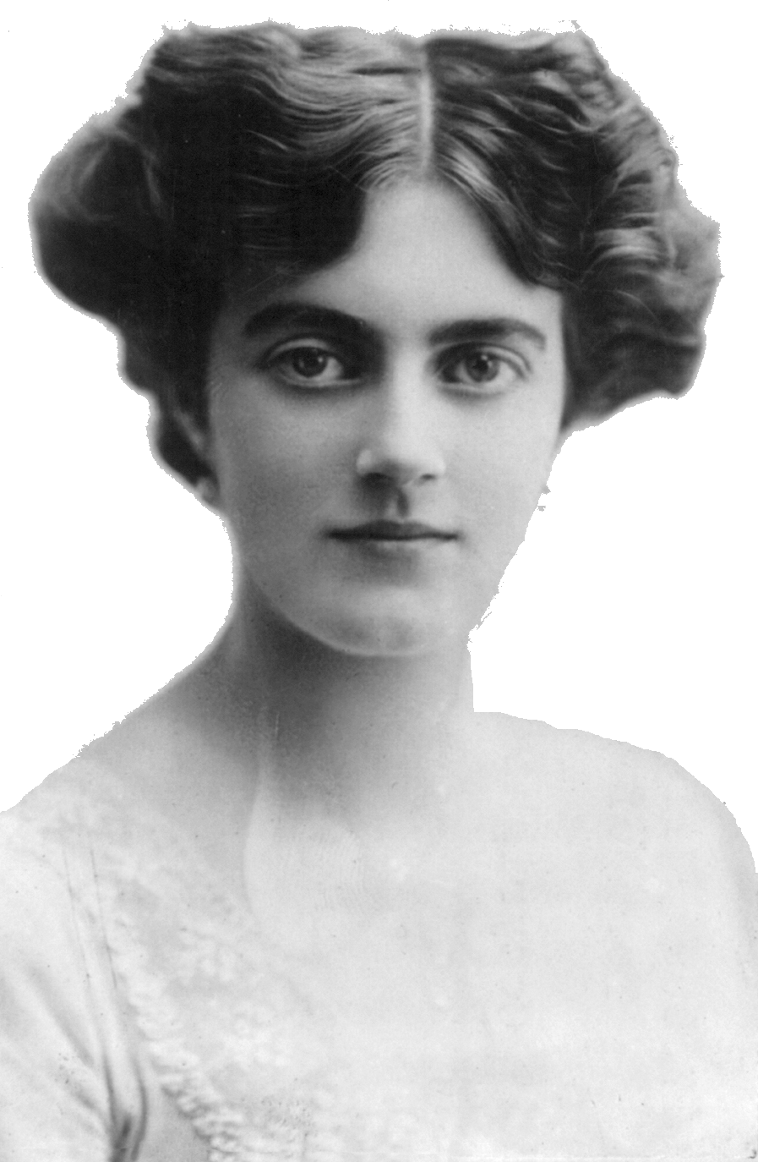
An Administrator’s Vision
Sustainable classroom
Bridge the digital divide
Media production
Personal productivity
Information literacy
Learning beyond the classroom

Slide 22
What do you think students will say iPads are good for?

Slide 23
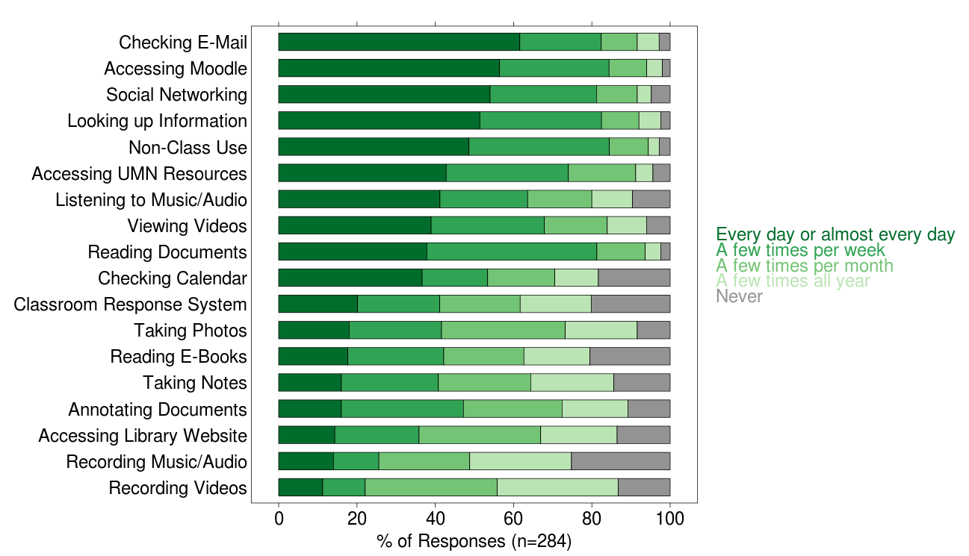
How often, if ever, did you use your iPad for the following? (2013)

Slide 24
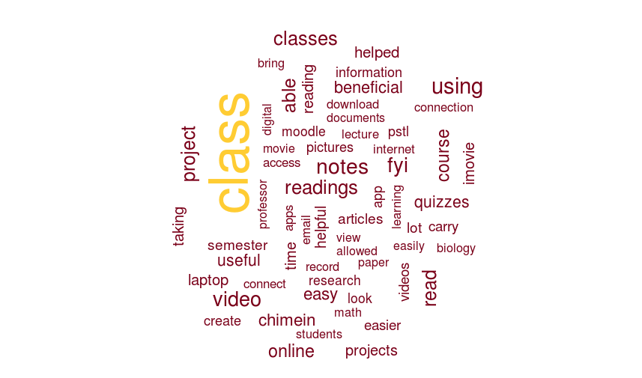
Think about the BEST way that the iPad was used in connection with one of your classes this year. Describe how it was used and why it was beneficial. (2011 & 2013)

Slide 25
Think about the BEST way that the iPad was used in connection with one of your classes this year. Describe how it was used and why it was beneficial. (2011 & 2013)
“It was good for using iMovie to make a digital film. I don't own a video camera, so I wouldn't have been able to do the assignment otherwise.”
“[I used] the iPad to download the reading materials to read it and make notes. It is much easier because I do not need to print the materials any more, going to the library.”
“Taking quizzes on moodle was cool because it gives you your results right away. This is beneficial because you know how you do right away and it allows you to plan out how much you should study.”
“I used it in statistics for a project asking people around campus to do a short survey on my ipad.”

Slide 26
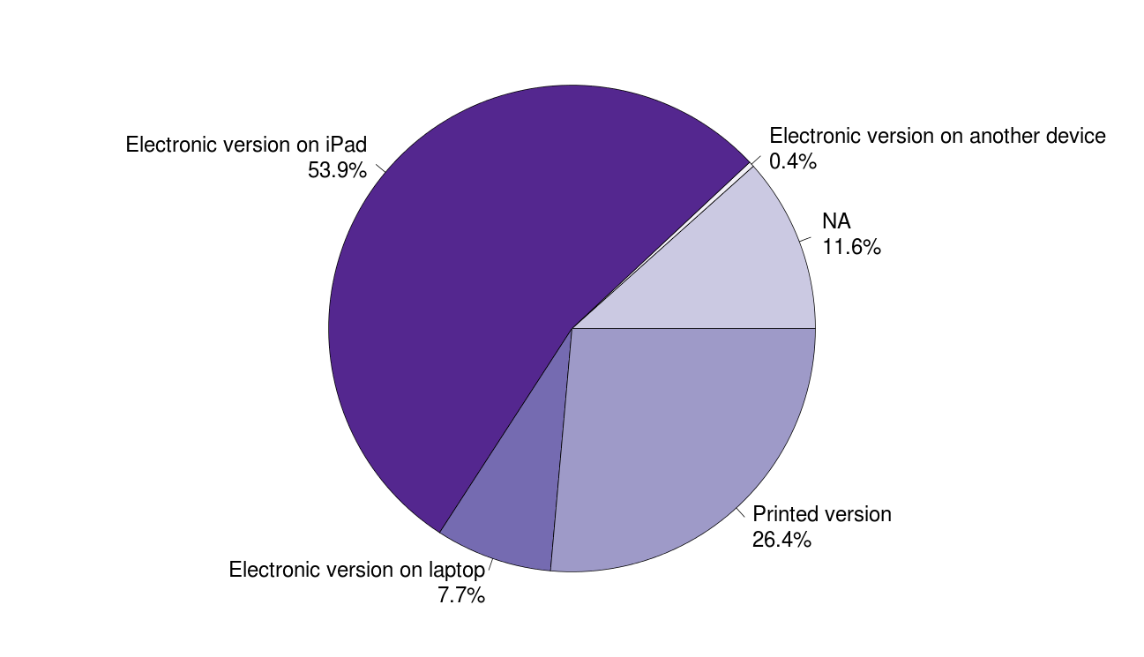
For courses that made reading material available electronically what was your preferred format for reading? (2013)
% of Responses (n=284)

Slide 27
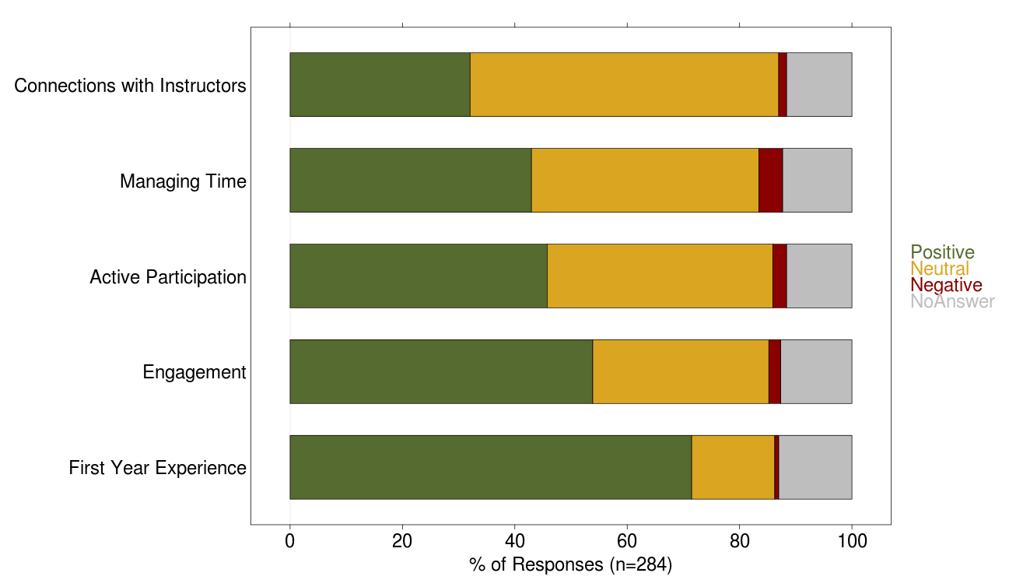
How did your use of the iPad impact…? (2013)

Slide 28
A Few Reflections
Clarify to students: “You can keep it until you leave.”
Clarify to faculty: “This project will continue.”
Clarify to students and faculty: Personal uses are OK! Even encouraged!
Exploratory tone from leadership was key
Give faculty control: Voluntary adoption, don’t lock down, let them find their own space for use.
Engage deeply with faculty – listen and adjust
Why not BYOD? According to faculty, it would be too difficult to manage and support.

Slide 29
Did Valuable Things Emerge?

Slide 30
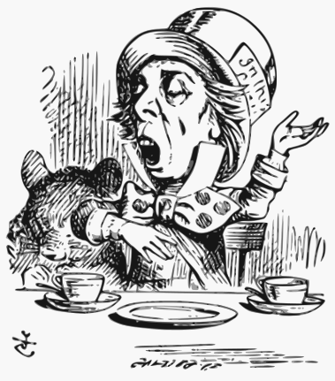
Did Valuable Things Emerge?
Common Digital Storytelling Assignment

Slide 31

Did Valuable Things Emerge?
Wireless Classroom Projection

Slide 32
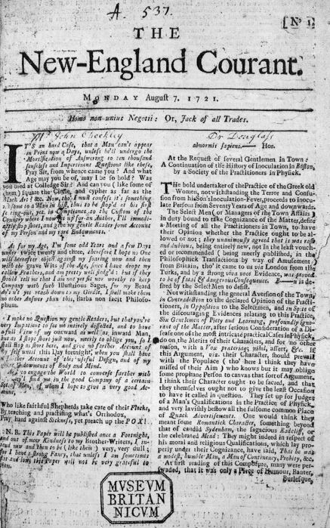
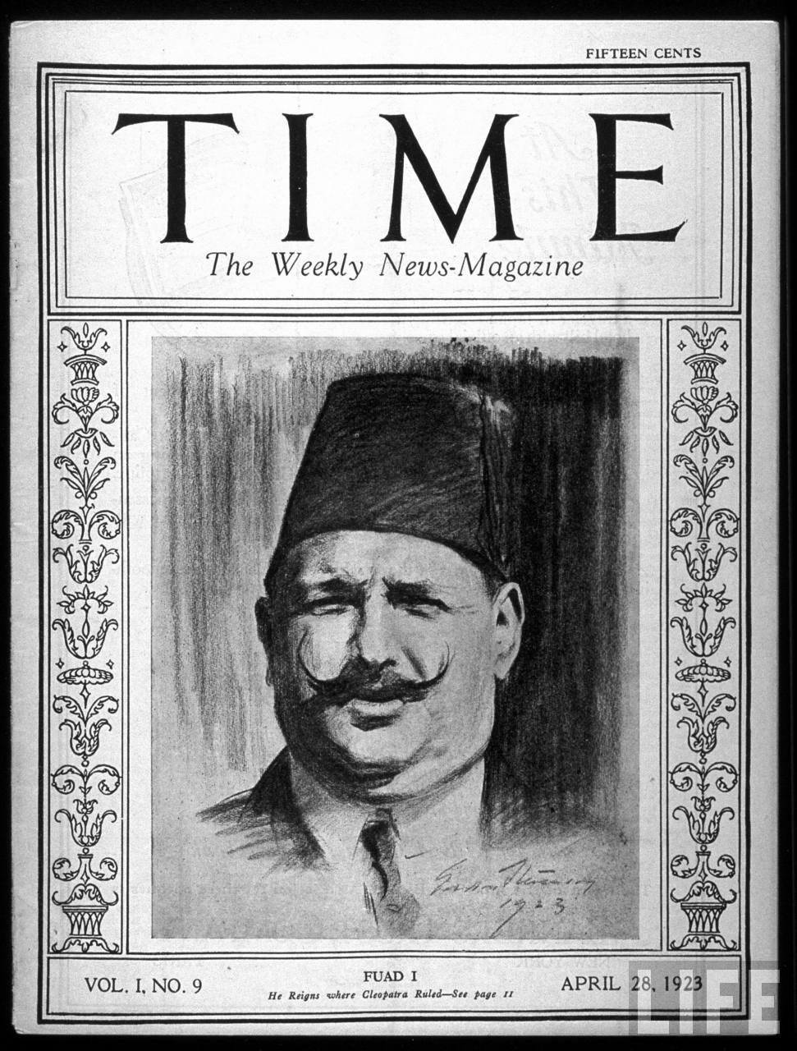
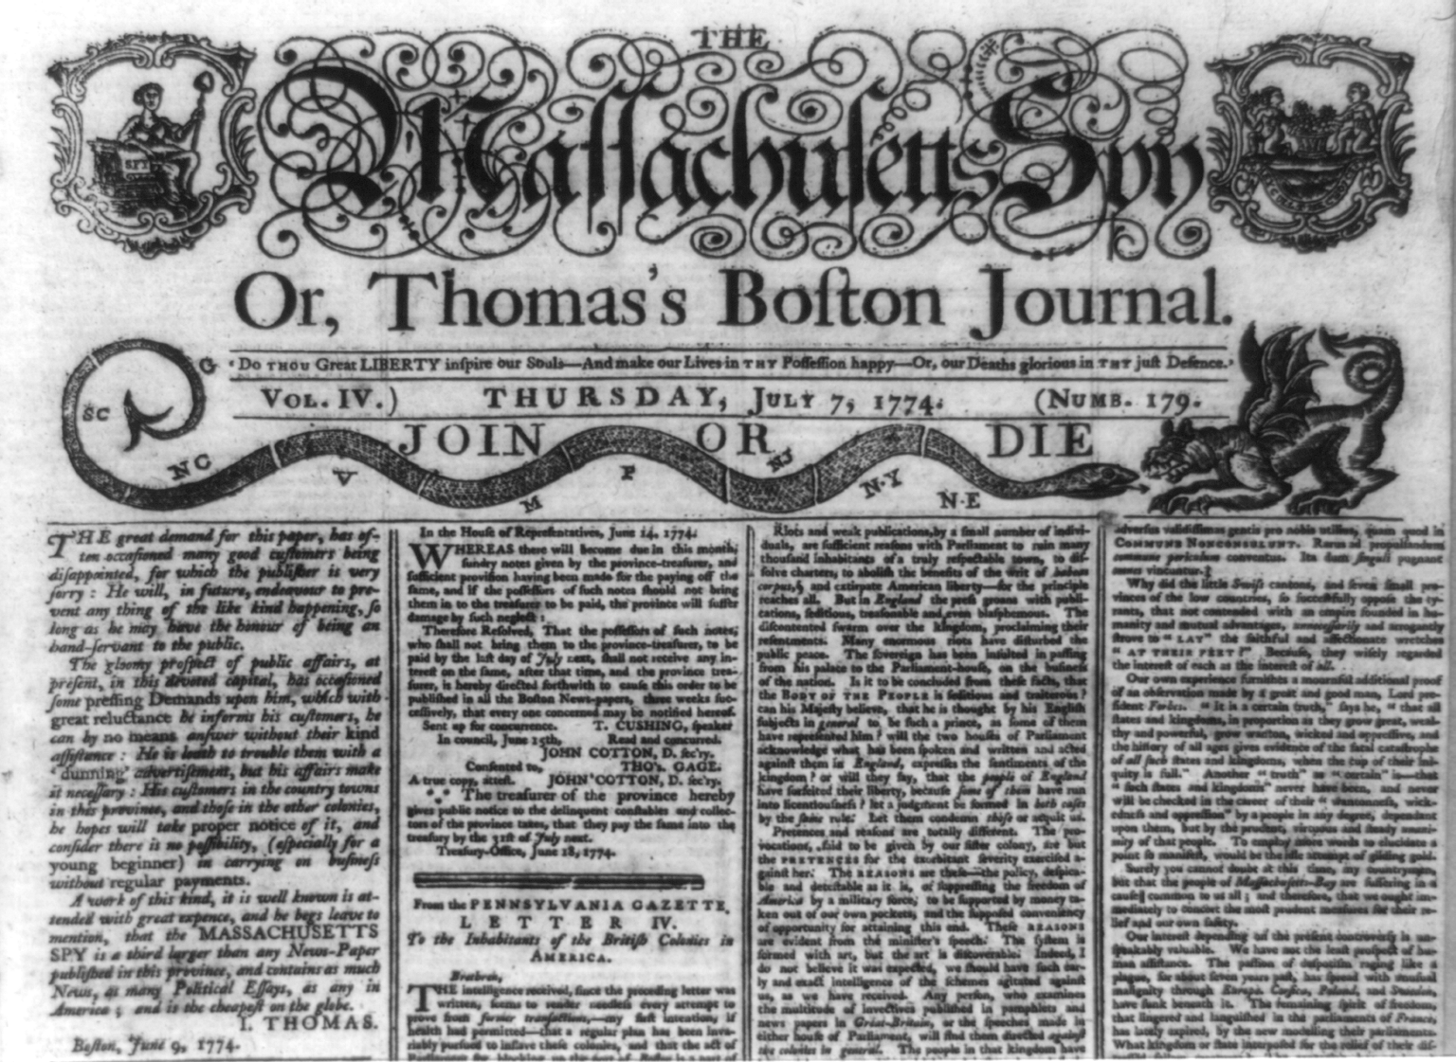
Did Valuable Things Emerge?
Digital Course Pack Project

Slide 33

Did Valuable Things Emerge?
Open Textbook Project

Slide 34


Vision
Action

Slide 35
Thank you!
David Ernst
dernst@umn.edu
Alison Link
alink@umn.edu

