Slide 1
Please Don’t Make Me Buy a Textbook!
Lisa Young
Scottsdale CC
Paul Golisch
Paradise Valley CC
Phoenix, AZ
Notes:
Professor Golisch goes to visit Dr. Young.

Slide 2
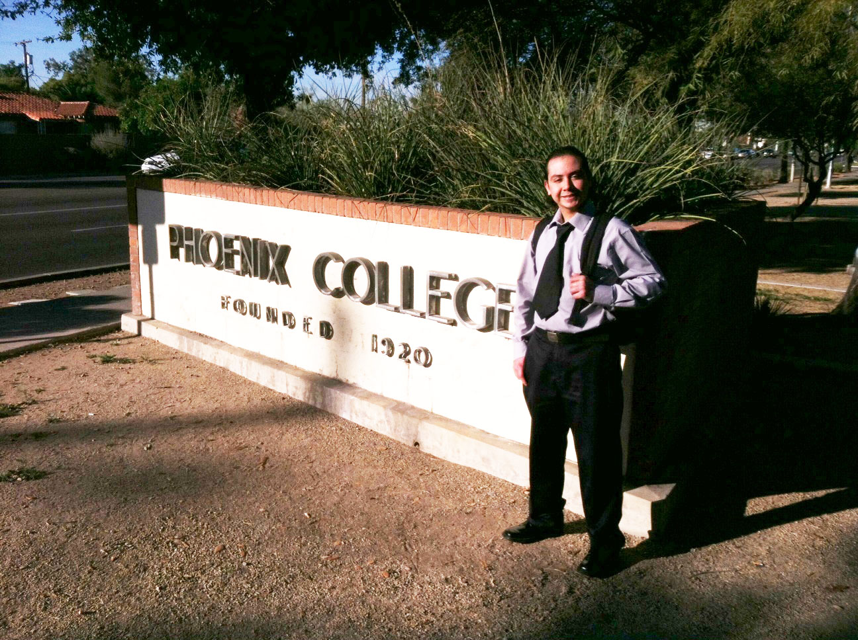
Manuel Ordonez
Major: Business
“Open Educational Resources allow everyone in class to have all the materials on day one. Many students have to postpone the purchase of the course materials because of financial aid.”
Notes:
Prof. G: Okay, but that is one student. What about other students?

Slide 3
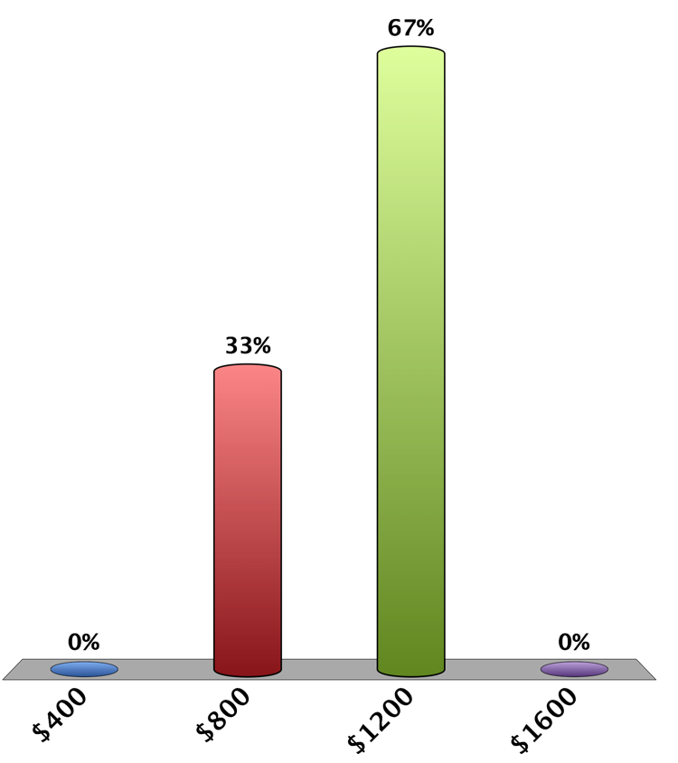
How much money do full-time college students spend on textbooks each year?
$400
$800
$1200
$1600
Notes:
Prof. G: Oh, I didn’t realize it was that much. Okay, maybe it is a hardship for a few students, but they figure it out.

Slide 4
Many students do not
buy textbooks
Photo by Jupiterimages - Getty Royalty-Free License http://www.gettyimages.com/Corporate/LicenseAgreements.aspx
Created with Haiku Deck
Notes:
Prof. G: Wow … so what can be done? Students need to have textbooks.

Slide 5
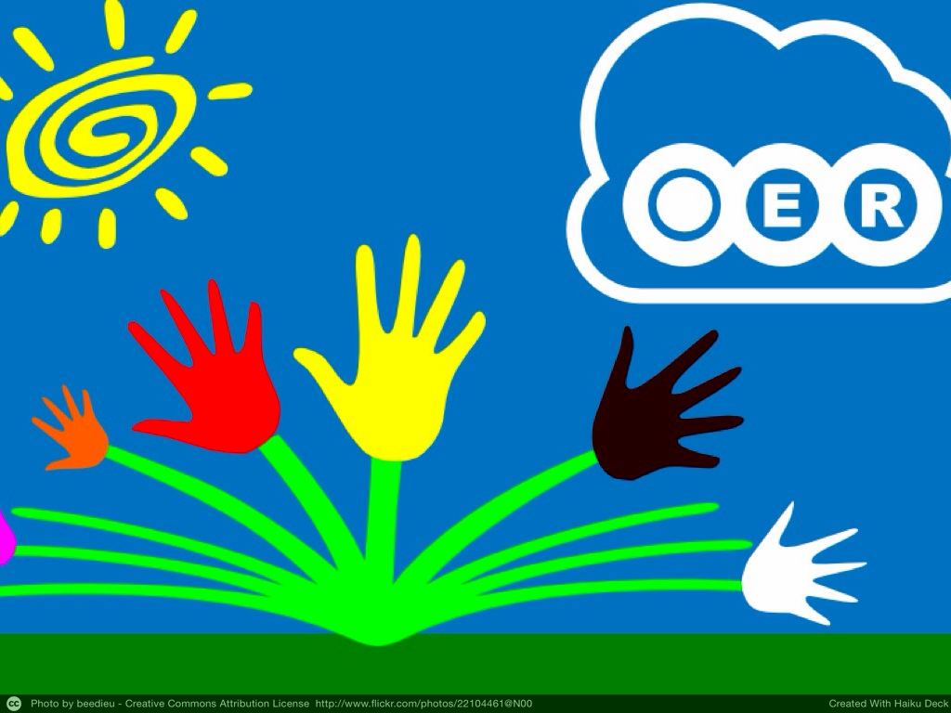
Notes:
Dr. Young: Open Educational Resources
Prof. G: Open what?

Slide 6
Notes:
Prof G: Looks expensive. Isn’t that why publishers pay textbook authors so much?

Slide 7
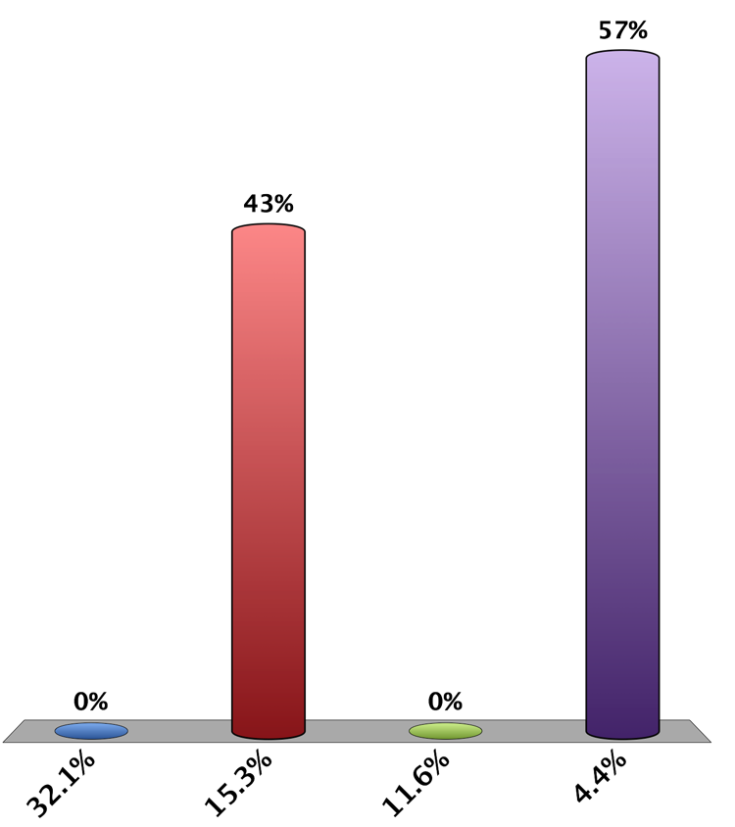
What % of publisher textbook $ goes to the author?
32.1%
15.3%
11.6%
4.4%
Notes:
Prof G: 11.6% Where does the rest of the money go?

Slide 8
http://www.sdsubookstore.com/Bookstore/Textbooks/PricingPolicy/WheretheNewTextbookDollarGoes/tabid/143/Default.aspx
Notes:
Prof G: You still need funding to produce these Open Educational …

Slide 9
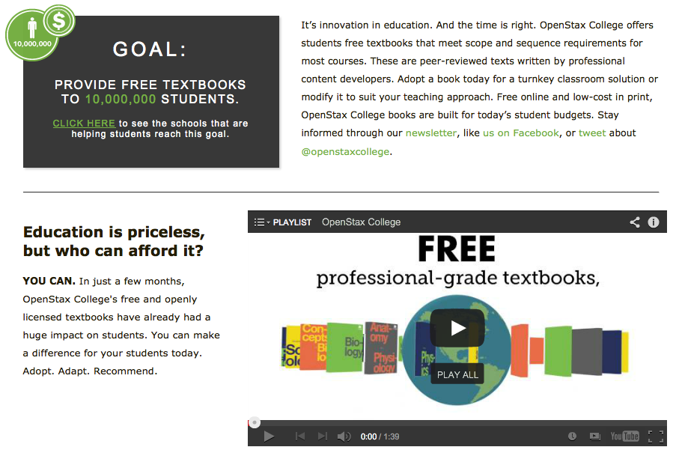
OER Example: OpenStax College
openstaxcollege.org
Notes:
Prof G: Textbooks are great, but what about faculty resources, exam banks, and online assessments?

Slide 10
OER Example: MyOpenMath
myopenmath.com
Notes:
Prof G: This looks similar to MyMathLab and WebAssign. Is anyone use this MyOpenMath program?

Slide 11
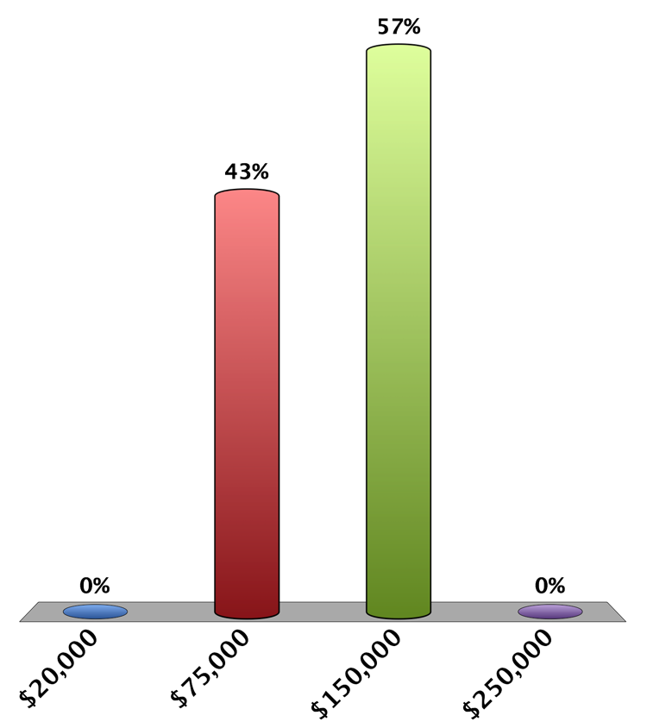
How much $ did SCC math students save in one year due to OER usage?
$20,000
$75,000
$150,000
$250,000
Notes:
Prof G: I don’t think publishers are going to like this. They probably are lobbying their politicians to stop it.

Slide 12
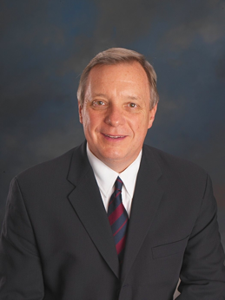
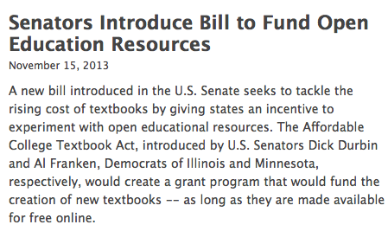
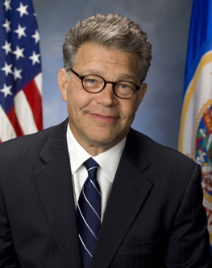
Affordable College Textbook Act
You can go to http://www.sparc.arl.org to help support it
http://www.insidehighered.com/quicktakes/2013/11/15/senators-introduce-bill-fund-open-education-resources
Notes:
Prof G: All of this is nice, but how does it apply to me. I don’t want to teach with some turnkey course from some grant funded professor I don’t even know. What about Academic Freedom?

Slide 13
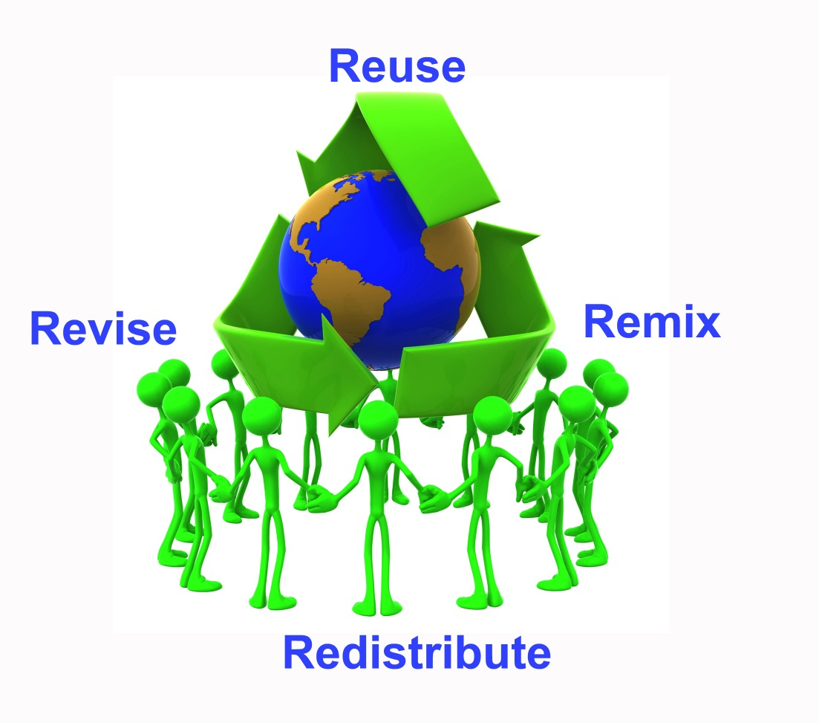
The 4 Rs of OER
Notes:
Prof G: Sounds like a lot of work. Is anyone in our district (besides Scottsdale’s math department) actually doing this?

Slide 14
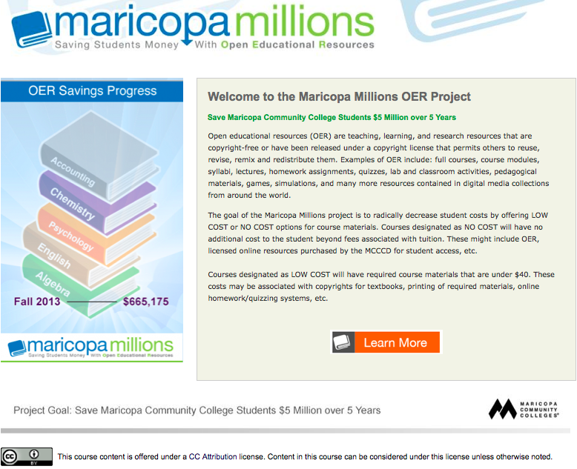
www.maricopa.edu/oer
Notes:
Prof G: Over 600K in one semester. That $5 million dollar goal looks achievable. How are you calculating these savings?

Slide 15
Fall 2013:
Surveyed faculty
Ran SIS reports
Future:
Filter in SIS
“OER” in SIS notes
20 students per class
$100 per student
Notes:
Prof G: SO, tell me more about this project you are working on?

Slide 16
Library Faculty
Notes:
Prof G: A committee and a strategic plan (yawn). How is this plan being put into action?

Slide 17
Creating OER Awareness and Increasing Adoption
Presentations
Call for OER Grants
Dialogue Days
Department Meetings
“Water Cooler” Discussions
Promotional Items
CTLs
College Libraries
http://www.skmurphy.com/startup-stages/scaling-up-stage/
Notes:
Prof G: Is that a stylus on the end of that pen? Did you bring anything for these nice people that got up early … in New Orleans to attend this session? <pause> What about outside of Maricopa??

Slide 18
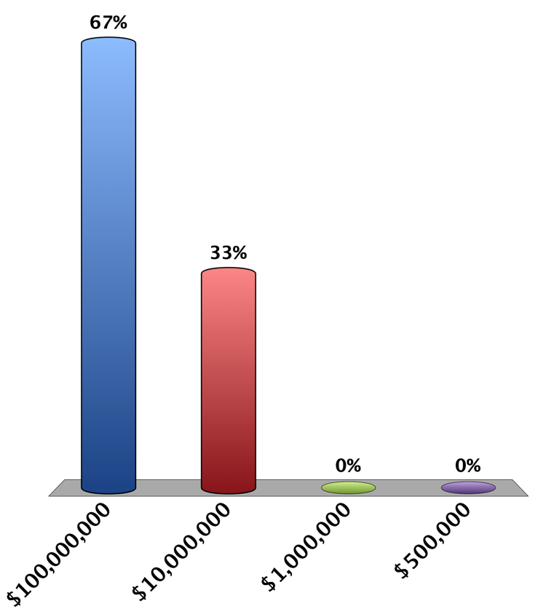
How much money has been saved worldwide through the adoption of OER in higher education?
$100,000,000
$10,000,000
$1,000,000
$500,000
Notes:
Prof G: Very impressive. Sounds like the OER community really is making an impact. Do we have time to hear a little more from the students?

Slide 19
Interviews with
Maricopa Community College Students
can be found at this site:
https://maricopa.instructure.com/courses/811971/wiki/student-video-interviews

