Slide 1
Assessing an Instructor’s Prior Online Experience
Thomas Cavanagh, Ph.D.
Associate Vice President, Distributed Learning
University of Central Florida
Notes:
Required – Title Slide

Slide 2
Dynamic Environment
High growth
High demand for online courses
Required faculty development
1990’s: online education was new and no one had experience
Existing models designed for faculty new to online instruction

Slide 3
The Challenges
New faculty being hired with prior online teaching experience
Deans’ comments
Various models for online teaching
Templates, web-enhanced, document posting, synchronous, asynchronous, SL, etc.
Limited use of online adjuncts who are not geographically proximate
UCF-specific technologies, processes, and expectations

Slide 4
Poll
Generally, how experienced are faculty at your institution regarding online instruction?
Novice
Intermediate
Experienced
Mixed

Slide 5
IDL6543 Overview
Flagship faculty development program for online instruction
Award winning (e.g., Sloan-C Excellence in Faculty Development)
Three key strategies
Online
F2F
Consultations

Slide 7
Proposed Solution/Plan
Online Faculty Readiness Assessment (OFRA)
Web-based Evidence-based instrument
Artifacts demonstrating experience
Descriptions of strategies (e.g. assessment, accessibility, interaction)
Legitimate time commitment
Initial project steps:
Determine evaluation criteria
Develop online submission form prototype
Create assessment rubric
Run a pilot test to validate instrument and establish inter-rater reliability
Revise as necessary and implement

Slide 8
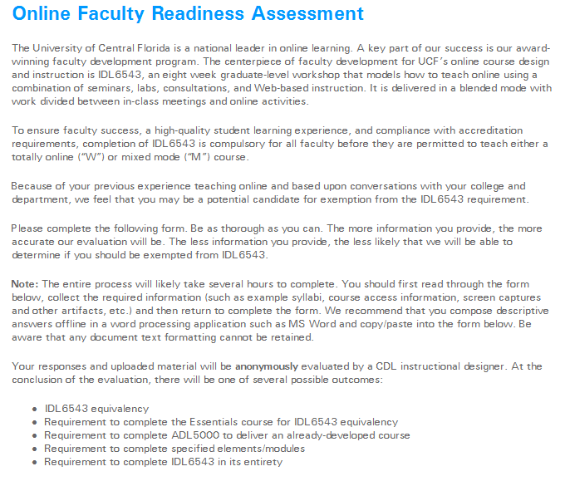
Intro Screen

Slide 9
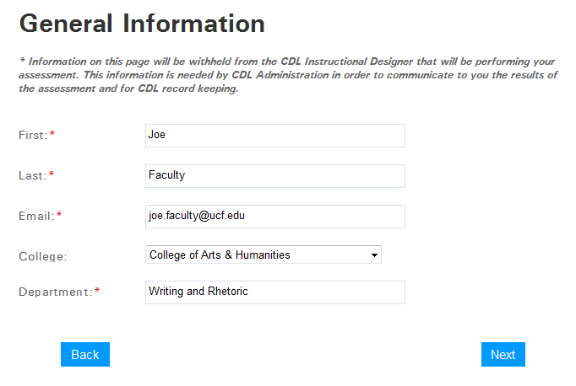
General Information

Slide 10
Criteria
Online Teaching Record
Previously taught online for a college or university?
For which institutions?
How many different courses?
How many sections of those courses have you taught online and how many students were in each section?

Slide 11
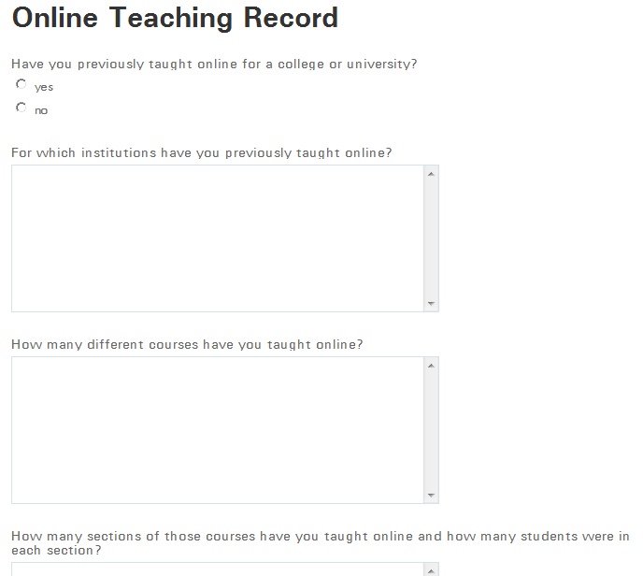
Criteria

Slide 12
Criteria
Online Teaching Record
What was the delivery mode of the majority of the courses?
Have you won any awards for your online teaching?
How did you address accessibility issues for students with disabilities in your online course(s)?
Have you ever been through an external assessment of your online course(s), such as the Quality Matters peer-review process?

Slide 13
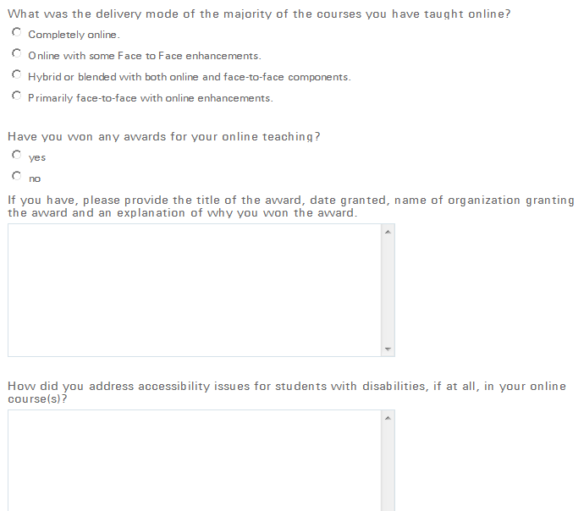
Criteria

Slide 14
Criteria
Learning Management System
Have you developed original online courses from scratch or have you taught primarily from existing course templates or content from a publisher?
What course management programs have you used to teach online?
Which of the following technologies have you used in your online courses?
Animation/Simulation, Audio/Podcasts, Blogs, Course Statistics, Calendars, Chat, Discussions, E-mail, External Media (e.g., DVD, CD-ROM), Glossary, Gradebook, Graphics/images, Performance Dashboard, Quizzes, RSS Feeds, Self Test, Student Presentations, Survey, Video, Whiteboard, Wikis, Other

Slide 15
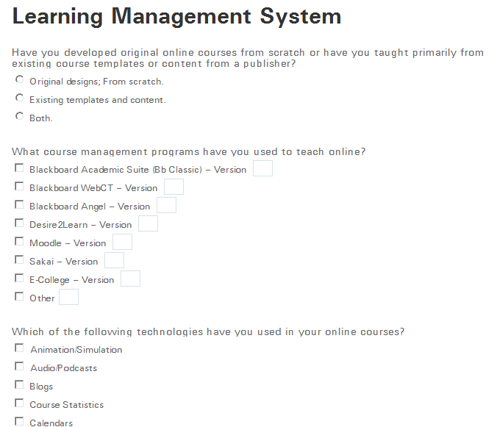
Criteria

Slide 16
Criteria
Professional Development
Have you completed any training or professional development related to online design and/or teaching? Please describe the professional development and provide certificates/transcripts, if available.
Have you ever worked with an instructional designer to develop an online course? Please describe how that relationship worked.

Slide 17
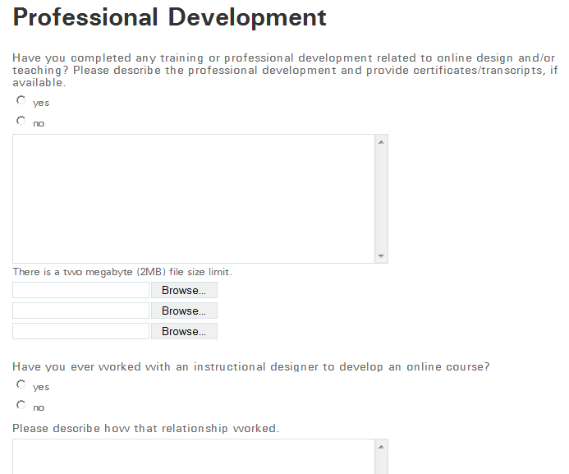
Criteria

Slide 18
Criteria
Strategies
Please provide detailed descriptions related to what you feel is (are) your best online course(s). Areas you should consider include:
Organization and navigation
Learner support strategies
Course learning objectives
Types of interactions and associated activities
Assessments
How you integrated technology
Important or creative design features

Slide 19
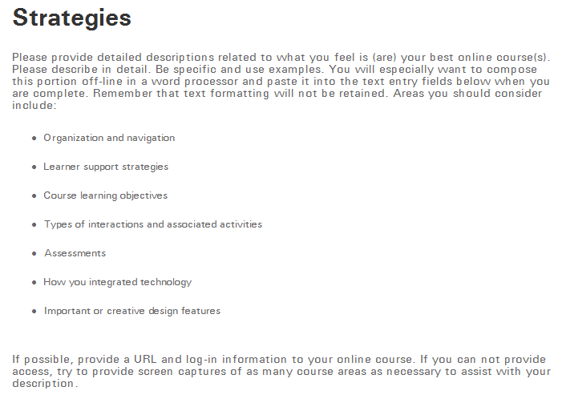
Criteria

Slide 20
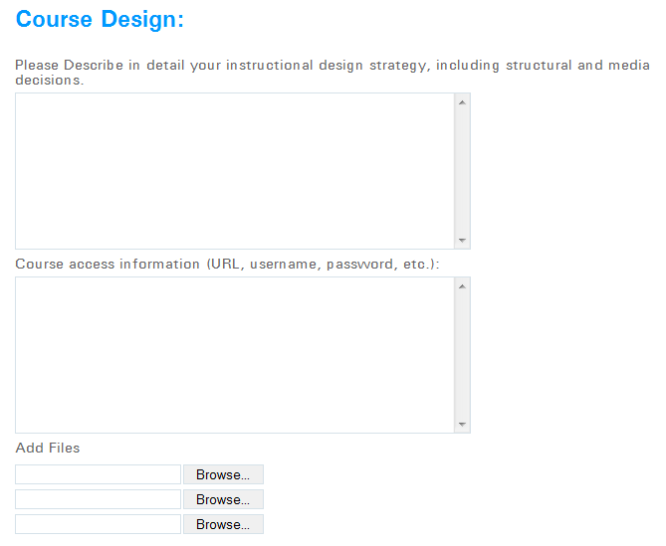
Criteria
Course Design: Please describe in detail your instructional design strategy, including structural and media decisions.

Slide 21
Criteria
Interaction and Collaboration:
Describe course interaction and collaboration strategies. Include use of synchronous tools (such as whiteboards, chat, webcasting) and asynchronous tools (such as email, discussions)
Also include how you addressed the different types of interaction: student-to-student, student-to-instructor, and student-to-content/technology.
Did you use online group projects?
Did you have netiquette expectations?
How did all of these strategies enhance student learning?

Slide 22
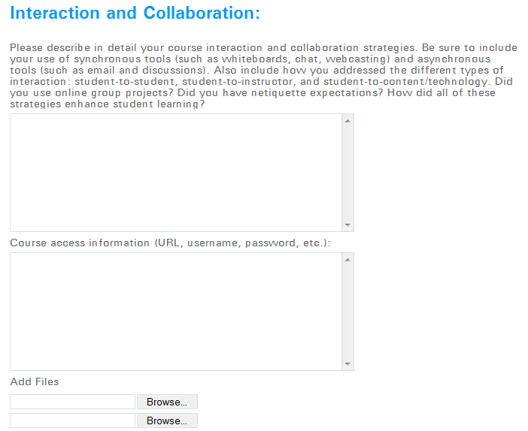
Criteria

Slide 23
Criteria
Assessment:
Describe course assessment strategies. How did you ensure that assignments aligned with course objectives? Did you use rubrics? Did you use authentic assessment strategies such as projects, portfolios or papers?
Did you use scaffolding strategies?
How did you try to ensure academic integrity in multiple choice or other auto-graded tests? Did you use testing centers or proctored exams?
How did you provide performance feedback to students?
Provide example assessments, if possible.

Slide 24
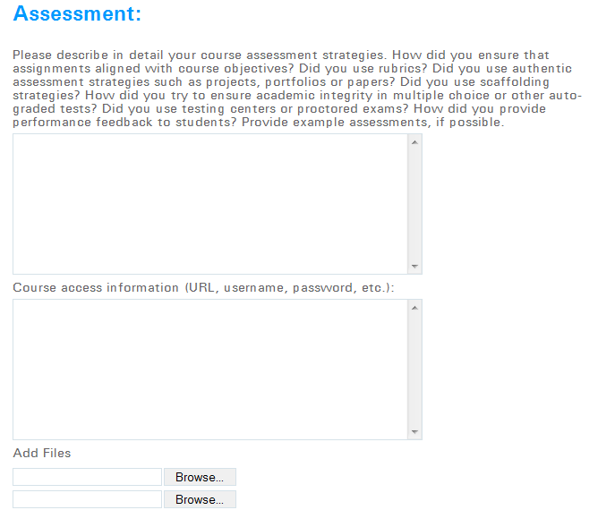
Criteria

Slide 25
Criteria
Wrap-Up
Please provide a syllabus from one or more of your online courses.
Is there any other information that you would like to share that you feel would be helpful in evaluating your readiness to teach online at UCF?

Slide 26
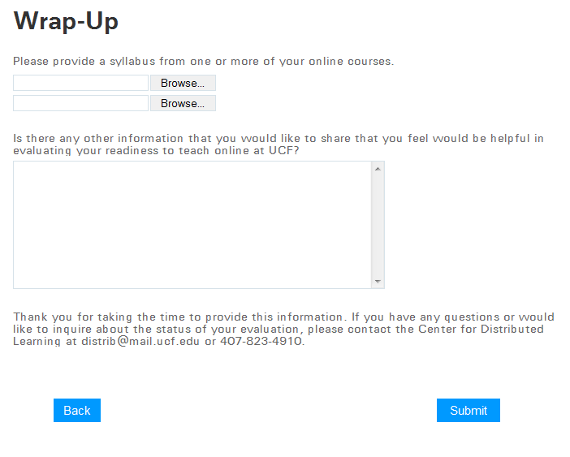
Criteria

Slide 27
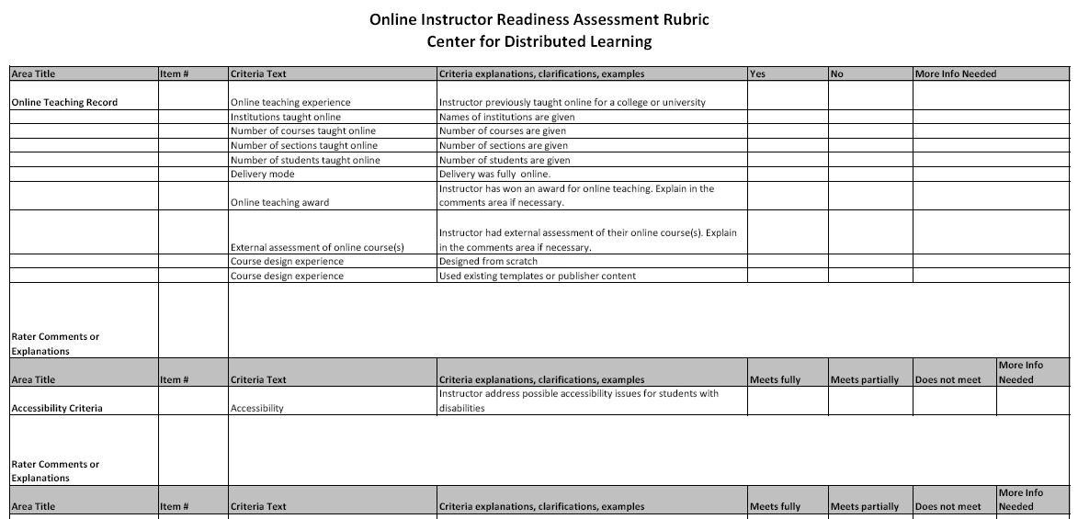
Evaluation Rubric

Slide 28
Potential Outcomes
IDL6543 equivalency
Requirement to complete the Essentials course for IDL6543 equivalency
Requirement to complete ADL5000 to deliver an already-developed course
Requirement to complete specified remedial elements/modules (e.g., Accessibility)
Requirement to complete IDL6543 in its entirety
Provide additional materials (e.g., syllabus)
Meet to learn “UCF specific” policies and procedures

Slide 29
Special Thanks
Contributors to Project:
Linda Futch, Ed.D., Dept. Head: Instructional Design
Baiyun Chen, Ph.D., Instructional Designer
Nancy Swenson, Instructional Designer
George Bradford, Ph.D., Instructional Designer
Andre Watts, IT Manager

Slide 30
Assessing an Instructor’s Prior Online Experience
Thomas Cavanagh, Ph.D.
Associate Vice President, Distributed Learning
University of Central Florida
Notes:
Required – End Slide

