Slide 1

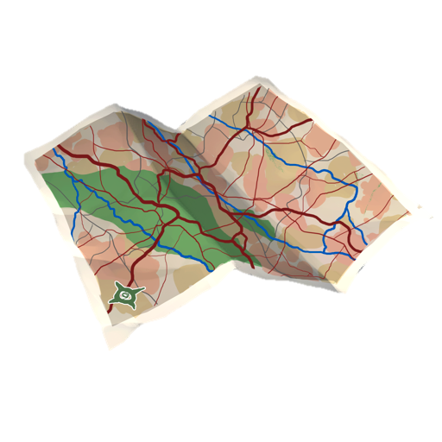
A Student Geography Persona and A Learner Persona Walk Into a Bar… Now What?
Researchers (in alphabetical order)
Chuck Dziuban, University of Central Florida, charles.dziuban@ucf.edu
Flora McMartin, Broad-based Knowledge, flora.mcmartin@gmail.com
Glenda Morgan, University of Illinois Urbana, gmorgan@illinois.edu
Josh Morrill, Morrill Solutions Research, joshua@morrillsolutions.com
Patsy Moskal, University of Central Florida, patsy.moskal@ucf.edu
Alan Wolf, University of Wisconsin at Madison, alanwolf@wisc.edu

Slide 2

Background of the Study

Slide 3
Our survey – A brief history
Post-Faculty Study
Marketing vendor for student sample
Total Sample
3 useful groups to compare:
Current students (full time part time, etc.)
2) Past students / Alumni
3) Never students/ Never went to college.
N = 1,749
$

Slide 4
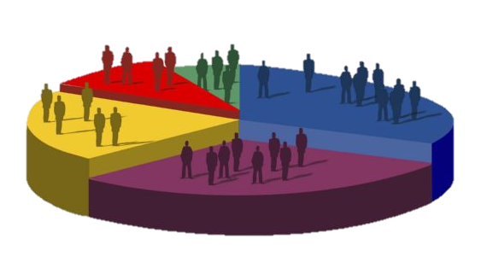
Some Findings…

Slide 5
Student status (n = 1,740)

Slide 6
Type of institution most recently attended
(n = 1,555)

Slide 7

The Personas

Slide 8

How were personas derived?
Started with the questions on learning / studying preferences (same questions used for factor development)
Conducted a Latent Class Analysis on these items
Found different, internally consistent subgroups. Developed personas to help explain these subgroups.

Slide 9
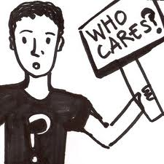

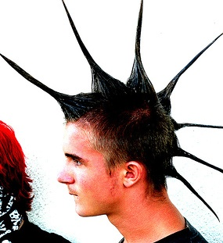
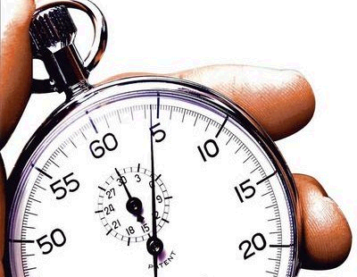
Student personas
Went from these…
…To these…
I solve problems using a plan
I am systematic in my learning
I prefer to set my own learning goals
I enjoy studying
I have a need to learn
I set specific times for studying
I alter my practices when presented with new information
When presented with problems I cannot solve, I ask for assistance
I am confident in my ability to search for information
Ambivalent Learners
Adaptive Learners
Free Form Learners
Time Sensitive Learners

Slide 10
Student personas
Important Considerations of These Personas
- Limited to U.S. sample
- We focused on current / active students (and limited age range for collection)
- We are not yet sure about state vs. trait

Slide 11
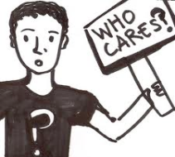
Student persona 1: Ambivalent learners
48%
of Sample
Largest Segment
Do not feel strongly about learning
Confident in ability to find information
Do not enjoy studying
Do not have a need to learn

Slide 12

Student persona 2: Adaptive learners
26%
of Sample
Solve problems with a plan
Set learning goals
Ask for help if they experience a problem
Enjoy studying
Do NOT set specific times to study

Slide 13

Student persona 3: Free form learners
13%
of Sample
Least likely to set specific times to study
Do NOT solve problems with plans
DO have a need to learn
ARE willing to change what they do when presented with new information
NOT systematic in learning

Slide 14
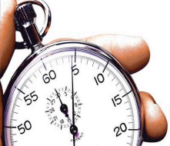
Student persona 4: Time sensitive learners
11%
of Sample
Similar to Adaptive (“Ideal”) Learners in many ways…just not as strong/extreme on the dimensions
MOST likely to set aside specific times to study
Do NOT solve problems with plans
LEAST likely to ask for assistance if they encounter a problem

Slide 15
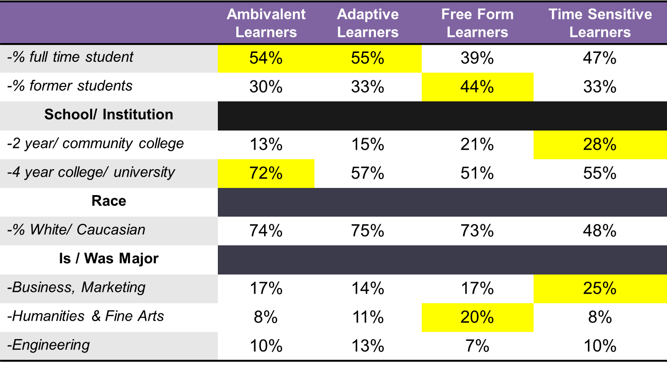
Persona demographics

Slide 16
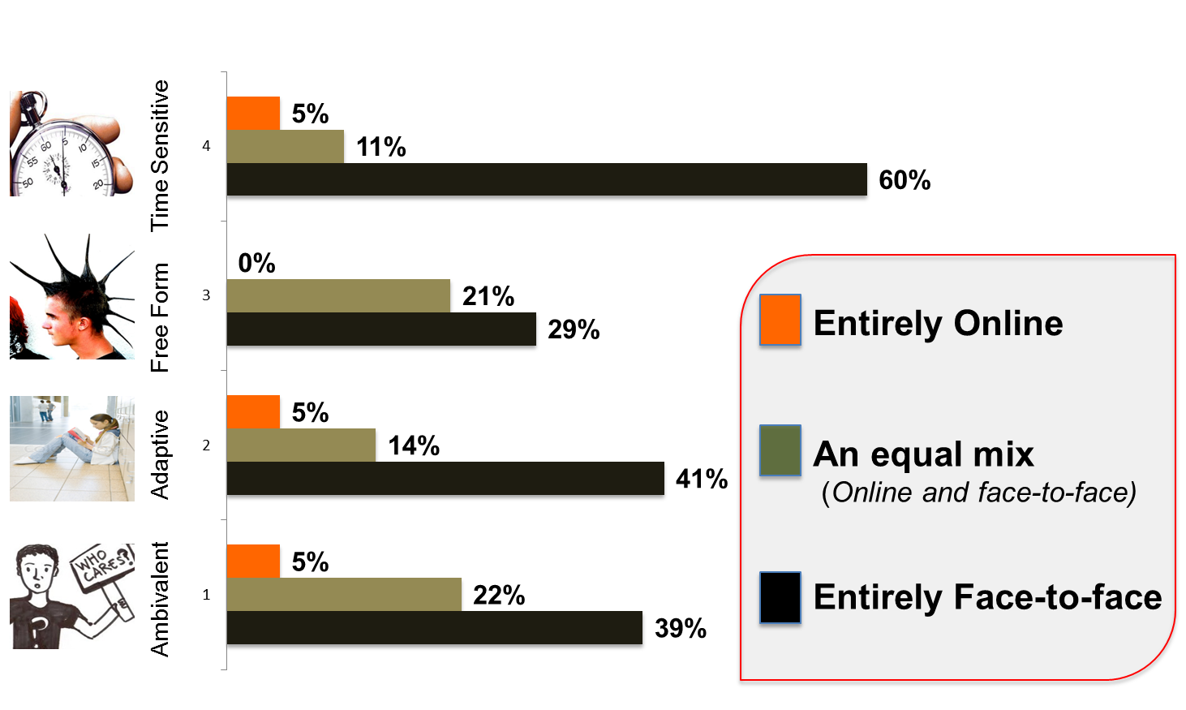
Personas and blended learning
% desiring…All face-to-face, half-and-half, or all online courses

Slide 17
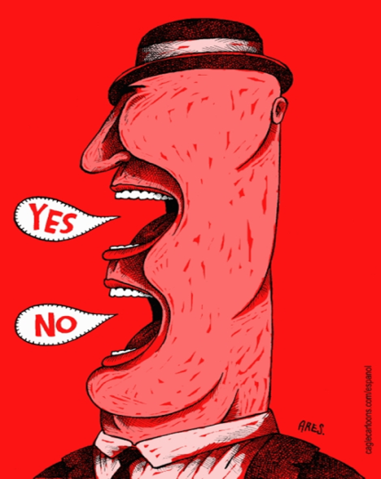
Ambivalence at Work
Were you satisfied with your online course?
Well...

Slide 18
Ambivalence
“In retrospect, it seems rather simplistic to think of attitudes as always being unidimensional. After all, who hasn’t experienced ‘mixed feelings’ about people, places, and things.”
Craig & Martinez (2005)

Slide 19
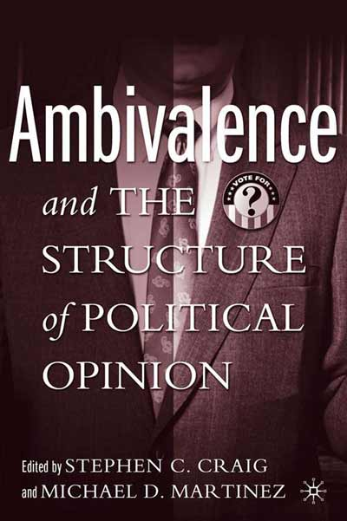
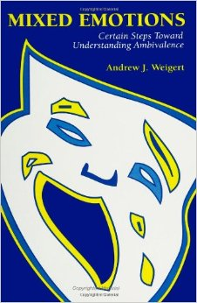

Three good books about ambivalence

Slide 20

Overall rating of the instructor
5
4
3
2
1
Positive Non-ambivalent
Ambivalent
Negative Non-ambivalent
Positive Ambivalent
Negative Ambivalent

Slide 21
Student satisfaction dimensions
Positive Non-Ambivalent | Positive Ambivalent | Ambivalent | Negative Ambivalent | Negative Non-Ambivalent
Course Landscape
Instructor Engagement
Benchmark Progress
Course Rhythm
Expectation Rules
Instructor Engagement
Benchmark Progress
Course Rhythm
Expectation Rules
Instructor Engagement
Benchmark Progress
Instructor Responsiveness
Course Rhythm
Expectation Rules
Instructor Engagement
Benchmark Progress
Course Landscape
Instructor Engagement
Benchmark Progress
r = .61
r = .58
r = .41
r = .43
r = .38

Slide 22
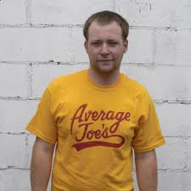
Prototype 1
Course Rhythm
Expectation Rules
Benchmark Progress
Instructor Engagement
Instructor Responsiveness
5
4
3
2
1
Average Joe = 3

Slide 23
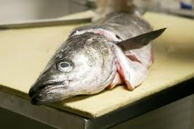
Prototype 2
Course Rhythm
Expectation Rules
Benchmark Progress
Instructor Engagement
Instructor Responsiveness
5
4
3
2
1
Cold Fish = 3

Slide 24
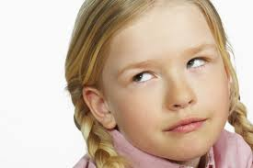
Prototype 3
Course Rhythm
Expectation Rules
Benchmark Progress
Instructor Engagement
Instructor Responsiveness
5
4
3
2
1
What do you want? = 3

Slide 25
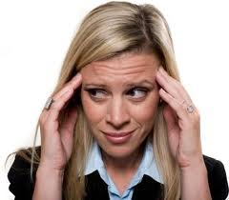
Prototype 4
Course Rhythm
Expectation Rules
Benchmark Progress
Instructor Engagement
Instructor Responsiveness
5
4
3
2
1
Where am I? = 3

Slide 26

Now what?

Slide 27
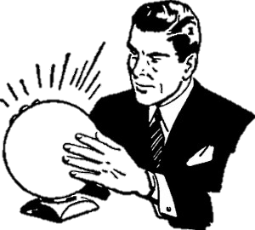
Mass customization
The students of today will be there parents of students tomorrow
2030
I M P L I C A T I O N S

Slide 28
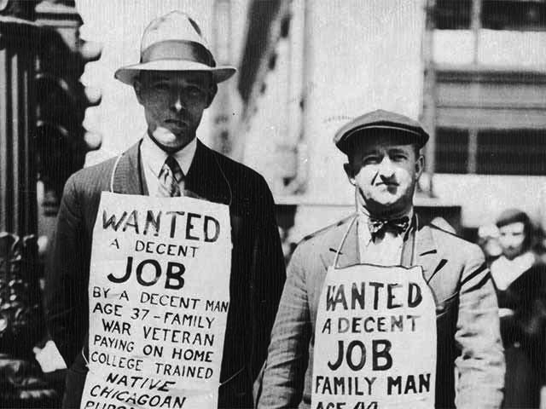
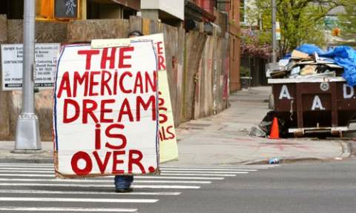
The learners of today – will be the parents of learners tomorrow
Great Depression
The Personas?
Possibly more Time-Sensitive learners?
A new type / breed of ambivalent learners?
Great Recession

Slide 29
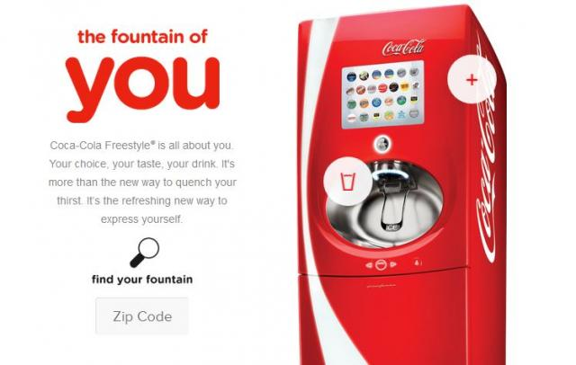


Mass customization!
(Have it your way…)
The Personas?
STUDENTS ARE NOT THE SAME
Time-sensitive and Free-form learners do not want the same thing
which way?

Slide 30
What should we do NOW?
Deep dive into ambivalence?
Look at contexts?
Look at contexts / stability of personas?
Something else….?
What would be MOST useful to see as the next step of this research?

Slide 31

Questions and comments
Glenda Morgan glenda.morgan@gmail.com
@morganmundum
Or one of the other researchers on the project
Chuck Dziuban, University of Central Florida, charles.dziuban@ucf.edu
Flora McMartin, Broad-based Knowledge, Flora.McMartin@gmail.com
Josh Morrill, Morrill Solutions Research, Joshua@morrillsolutions.com
Patsy Moskal, University of Central Florida, patsy.moskal@ucf.edu
Alan Wolf, University of Wisconsin at Madison, alanwolf@wisc.edu
Support for this project was provided by the National Science Foundation DUE award no. 1049537 Any opinions, findings, and conclusions or recommendations expressed are those of the authors and do not necessarily reflect the views of the National Science Foundation

