Slide 1
Faculty Learning Communities
An Effective Tool for Engaging Faculty in the
Innovation, Implementation, and Institutionalization of Technology in Teaching and Learning
Wayne Tikkanen, Director of General Education, Professor of Chemistry California State University Los Angeles
Lynn Tashiro, Director for the Center for Teaching and Learning, Professor of Physics, California State University Sacramento
Marco Martinez, Information Technology Consultant, Center for Teaching and Learning, California State University Sacramento
Notes:
Logistics, introductions,

Slide 2
Who We Are (Fall 2013)
The CSU has
446,000 students
25,000 faculty (tenure line & lecturers)
23 campuses ranging from 1500-38,000 students
Sac State has
29,000 students
700 Tenure line faculty
700 lecturers
Notes:
The class of 3 million as of June 2015 –23 campuses - 450,000 students system wide 25,000 faculty (ft and lecturers)
1 in 20 Americans with a college degree received it from the CSU
Our alumni family is larger than the population of 20 U.S. states
About 50/50% in terms of full and part –time (FTEF)
38% TTT
41% of full time faculty are full professor; 24% associate; 16% assistant and 19% FT lecturer
ITL –
Sac State
CTL

Slide 3
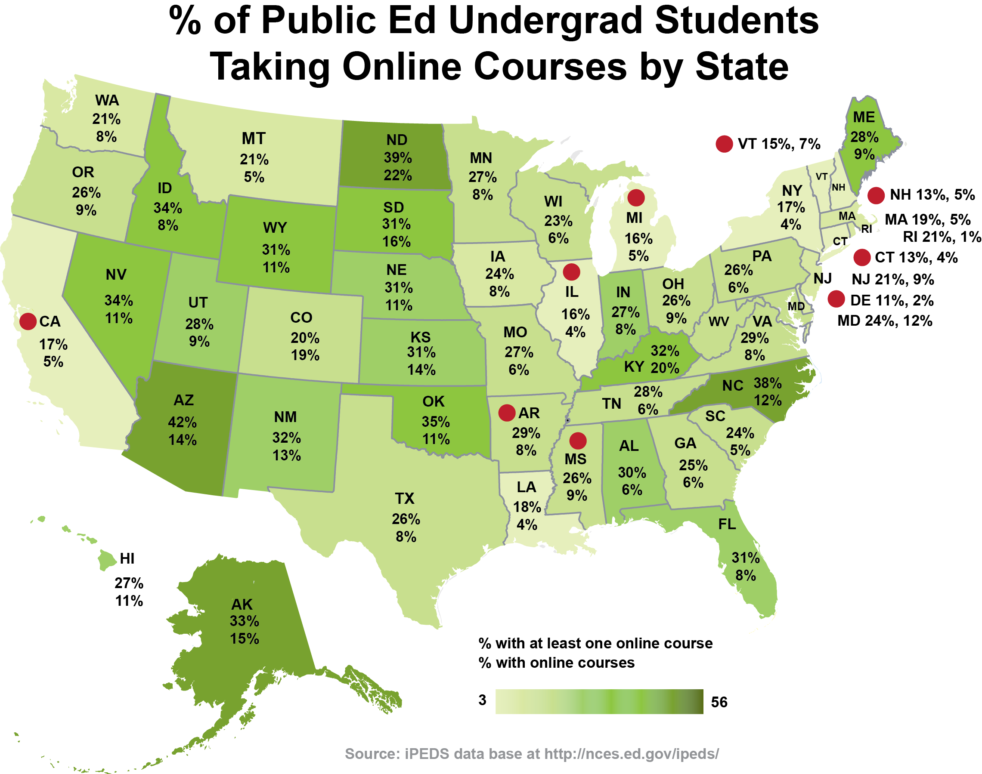
What is the problem we are trying to solve? • CA lags in educational technology implementation • Faculty anxiety
Notes:
1. What is the problem we are trying to solve?
A. Why faculty professional development?
B. Why Faculty Learning Communities
A. Why do we need faculty professional development?
Not just the CSU but CA in general is lagging in the use of technology for teaching and learning
Ex.1 iPEDs data on % of students taking online courses
• Darker green - higher percentage/ lighter green - lower percentage
• Take a minute to locate your state (in chat box, tell us where your from?)
• CA has one of the lowest percentages of students taking online courses
CA and the large system of the CSU needs to “catch up”
IPED = IPEDs Integrated Postsecondary Education Data Systems supported by NCES
NCES National Center for Education Statistics)
B. Why might we be lagging?
• Faculty are the primary creators of academic courses
• And how do they feel about technology?
Ex. Thoughts on the Growth of Online Education
• Red indicates the % that feel anxiety/fear
• 20% of Administrators feel more fear than excitement
• nearly 60% of Faculty feel more fear than excitement
So we have a problem- a majority of the group that is positioned to most effectively utilize technology in education has more fear than anxiety
• The root of the problem is faculty are trained as experts in their discipline!
- not teaching
- not curricular design
- not technology
- not assessment
So faculty need to develop these skills! Continuing education, time, and practice

Slide 4
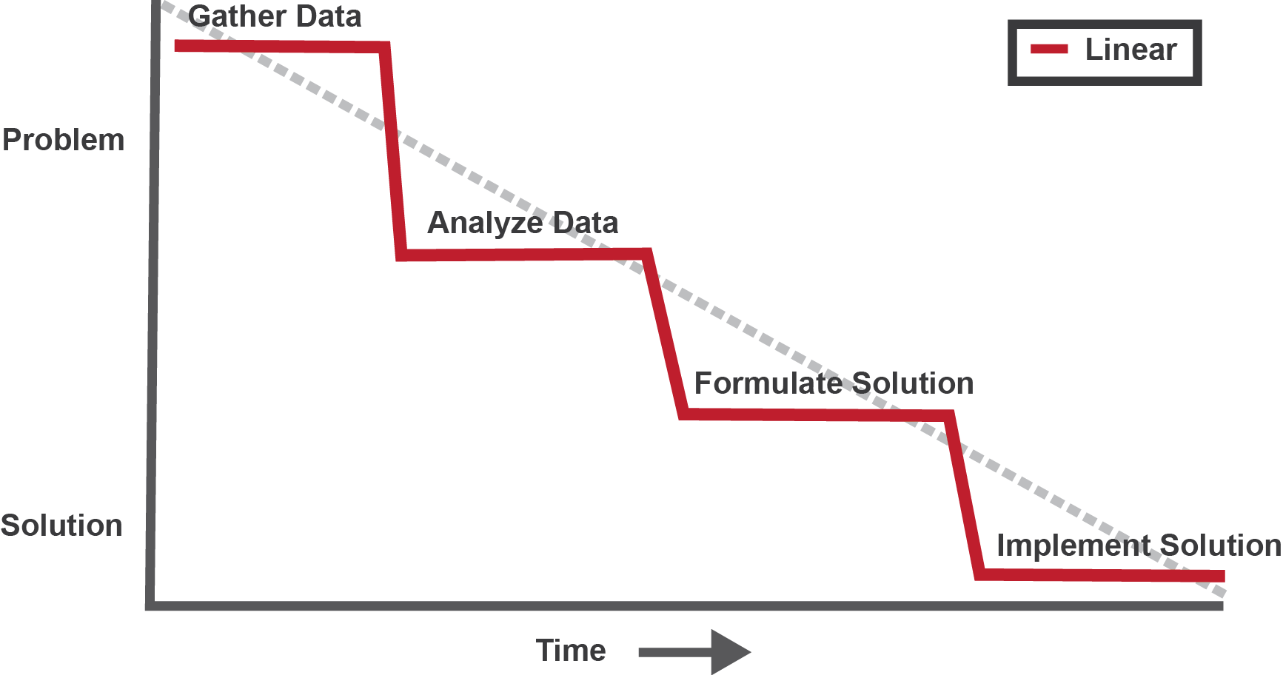
Problem solving: The usual approach
• Faculty
• Technology
• Faculty needs
• Technology potential
• Workshops
• Institutes
• Training
• Busy faculty
• moderate interest
• slow adoption
Notes:
On the surface, the problem seems easy to solve: We approach it in the usual reasonable linear
Gather Data:
About faculty: CVs, Surveys
About technology: emerging technology reports and studies, research based best practice, etc.
Analyze Data:
Faculty have little formal training if any in pedagogy or technology, but they are smart people, they can learn!
There are lots of “cool”, “innovative”, “engaging”, technology apps and tools just waiting to be adopted!
Formulate a Solution: Let’s build workshops, institutes, and hire experts to “train” faculty on pedagogy and technology
Implement Solution:
You look for “experts”… they tend to be “too general” or “too discipline specific”… Your faculty say… “this X doesn’t work in my field”
Faculty are busy (with research), moderately interested, and adoption of technology is slow
Ummm so why isn’t this working better?

Slide 5
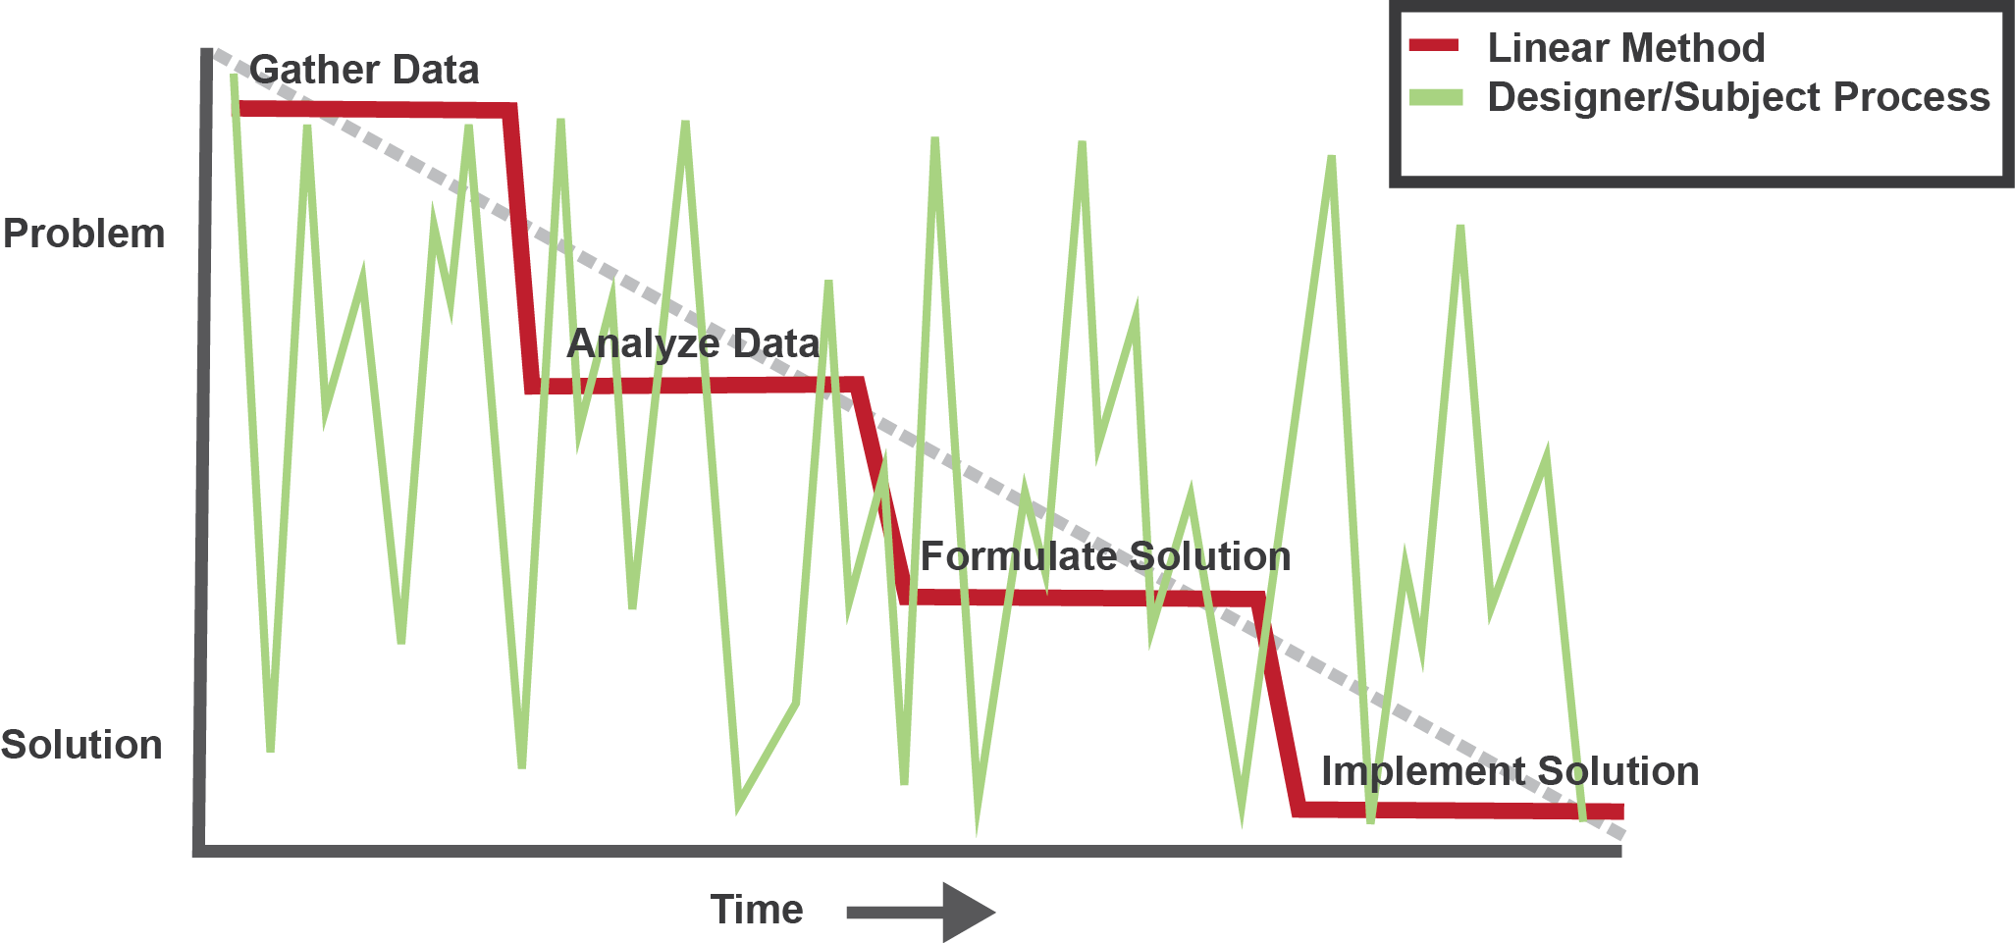
What happens when you have a “wicked problem”
Cognitive process
Multiple perspectives change and redefine the problem of using technology for learning
Notes:
What went wrong is the framing of the problem:
The problem of using technology for teaching and learning in higher education is not a simple one that can be solved by a linear process.
It is a “wicked problem” !
• The term “wicked problem was first coined by public policy/social planning …used by communications, business, and marketing
Note on characteristics of a wicked problem:
• cannot be defined – many people (administrators, faculty, and students) view and frame the “problem” in unique and different ways (there are social, political, and economic variables)
• solutions change the very nature of the problem (when you deliver a course online, student engagement, learning modalities, assessment, and classroom culture all change!)
• For example, the green line might represent multiple attempts over time to implement innovative technology - workshops, institutes, boot camps, e-academies,
Characteristics of WPs
Progress towards a solution for a “wicked problem” one that ahs many solutions, not just a technical issue, but involves social issues and interacting variables etc.
Important to experiment in low stakes ways to find the better solution for your social setting (pilots via FLC – find the better solutions (the minima) more broadly

Slide 6
Participant Polling question:
Which of the following have you participated in:
(select all that apply)
A. Technology workshops (1-2 hours in duration)
B. Technology retreats or boot camps (1 day or more)
C. Technology institutes or academies (1 week – month)
D. Learning Communities (1 year or more)
E. Other: please describe
Notes:
While participants enter in their polling votes:
Give examples of each of these at our institutions?
Let’s not process this in real time – come back to this later since on the spot we don’t know what range and distribution of responses we will get.
Hopeful – people have tried them all, with only a few if any familiar with the FLC model
I think we are done with the poll,

Slide 7
Faculty Learning Communities (FLCs)
Documented, effective professional development (Milton Cox, http://www.units.miamioh.edu/flc/ )
Structured, multi-meeting community of practice with curriculum, deliverables and timeline
When well structured, utilizes the “wisdom of crowds” to effectively address problems
Well designed deliverables are implemented in the short term to demonstrate utility of development topic(s)
Develops core of advocates and experts
Notes:
FLC – community of practice with a difference -
backwards design
flipped classroom
hybrid/on-line courses –
assessing student learning
critical thinking dinner panel
affective components **
program assessment
Learner analytics
Metacognition – regulation of learning
ITL has sponsored 33 FLC over 15 campuses in the past 4 years,
1/3 of them being tech related (flipping the class, moocs ,etc ) impacting about 100 faculty developing new materials implemented in courses (more later)
how much to say about presentations, course changes, etc.
oi_____________
Golden four instructors – how to infuse items across the curriculum, rather than single course “input”

Slide 8
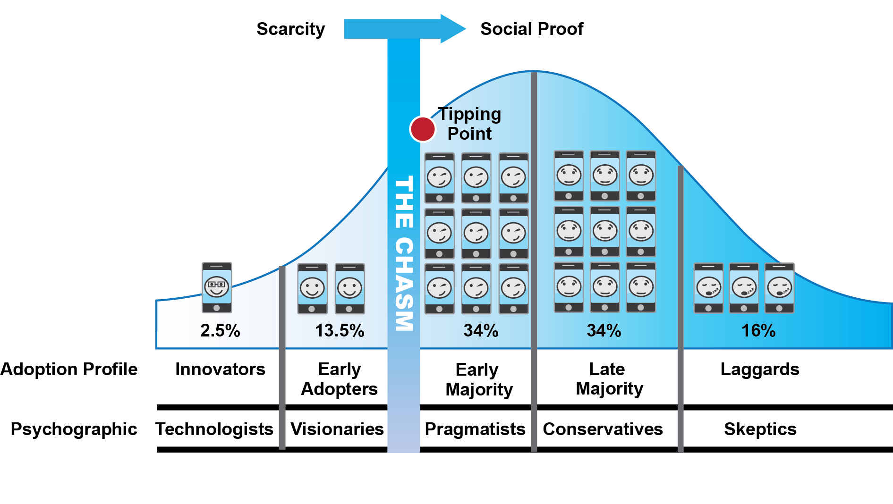
Why FLCs work
Notes:
To see why FLC’s seem to work with technology:
Look at the “Diffusion of Innovation” curve
Note: originally from the discipline anthropology, sociology, popularized by Everett Rodgers of Communication Studies, now widely cited and used by business and technology marketers)
1. Most campuses have innovators and early adopters
- no need to motivate them
- they are your “ stars”, “ trail blazers”
- also likely to be “lone rangers”, not your team leader
- not usually the catalyst for spreading adoption
- they are motivated by the “scarcity, novelty and potential” of new technology
- they only represent 16%
2. To move the needle on using technology in teaching and learning you need to enlist the early and late majority
- they are pragmatists and conservative by nature
- they require social and disciplinary proof that new technology is worth investing in
- this social proof can be fostered by a faculty learning community
3. As for the skeptics?
- when invited in… they may bend a bit, but you won’t get 100% of the faculty for any initiative – don’t waste too much time fighting them
4. What do you need to “jump the chasm / cross the tipping point”?
(move from innovation – institutionalization of technology)
- you need a cohort of faculty leaders – the FLC is a place you can grow them!
- your leaders might be hard to recognize since they are not the “shiny” ones out there with the latest tech gadget or software!

Slide 9
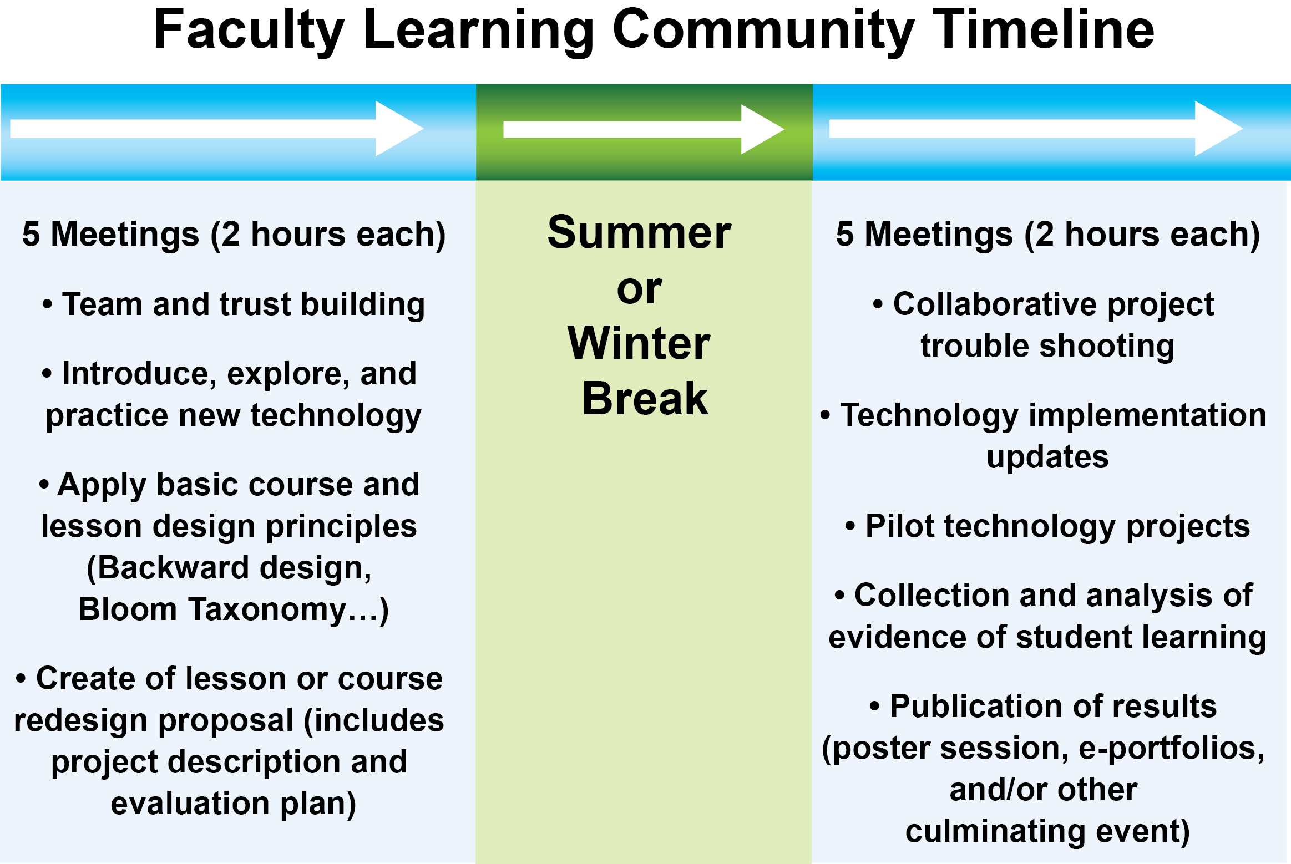
Notes:
Ok so that’s the theory… how does this actually work?
Notes from the trenches:
FLCs are both highly structured and flexible
The structure:
• set meeting days/times/content/attendance
• clear expectations of the content and format of deliverables
• tied to the strategic goals of the university and funding stakeholders
• focus on the scholarship of teaching and learning – dissemination and publication
The flexibility:
• The topics can be quite varied (next slide)

Slide 10
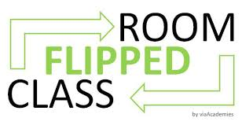
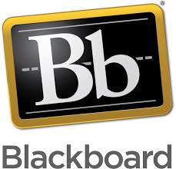
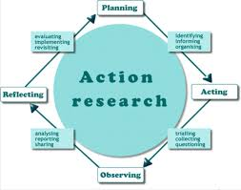
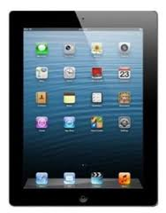
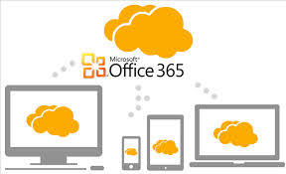
Example technology FLCs
Using MOOCs to Flip Your Classroom
Learning Management System and Action Research
iPads in the Classroom
Instructional Materials for the 21st Century Student
Notes:
Some examples of technology FLCs:
Briefly describe each FLC w/use of the graphics
Common elements for all:
• experiential learning – you try out the technology with the FLC and deploy in in a lesson
• assessment of student learning – each faculty implements a technology tool and collects student learning data
• a culminating event and products that are disseminated publically
– poster session, e portfolio, seminar
- with administrators, colleagues, and funders

Slide 11
FLC Outcomes
Course Redesigns presented at national conference
External Grants: $40,000 from CSU Chancellors Office
Prioritization of classroom wireless infrastructure
Faculty Leadership
Notes:
Why we think FLCs are powerful change agents and help us jump the “chasm” between innovation and implementation/institutionalization:
In addition to the intended outcome of course or lesson redesign, FLCs have resulted in:
• Grants: Which bring recognition, resources, and build infrastructure for pilot projects
• Changes in campus IT infrastructure: a “community of faculty” has a louder voice than your best “lone rangers”
• Faculty leadership: we are working on this… at lest the cats are in the same room!
Similar approach being adopted in a larger PLC to address bottleneck courses in the CSU by the ATS division ??

Slide 12
Funding and Partnerships
$10,000 per FLC (10-15 faculty)
$700 stipends or professional development funds
FLCs are funded and facilitated in partnerships:
• Center for Teaching and Learning
• National Science Foundation
• CSU Chancellors Office
• Student Success
• Office of Assessment
• Sacramento Alumni Association
• College of Natural Sciences
• Center for Community Engagement
• First Year Experience Programs
Notes:
A few important nitty gritty details
FLCs are not an inexpensive solution- they require a significant investment in human resource (and money)
Also… a skilled facilitator (expert herder of cats) is key

Slide 13
Questions?
Contact us:
Wayne Tikkanen, CSU Los Angeles
wtikkanen@calstate.edu
Lynn Tashiro, Sacramento State
tashirol@csus.edu
Marco Martinez, Sacramento State
marco@csus.edu

