Slide 1
Evidence of Impact through the Scholarship of Teaching and Learning
Charles D. Dziuban
Patsy D. Moskal
University of Central Florida

Slide 2
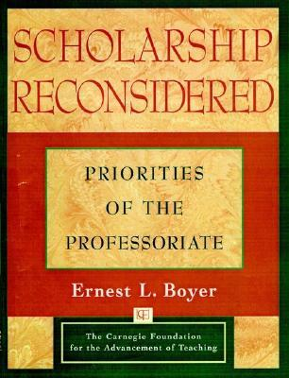
Scholarship Reconsidered: Priorities of the Professoriate (Boyar,1990)
Four forms of scholarship for scholar-educators
Discovery
Integration
Teaching
Application

Slide 3
Scholarship Reconsidered: Priorities of the Professoriate (Boyar,1990)
Discovery – original research advancing knowledge
Integration – synthesis of information across disciplines or time
Teaching – scholarly activities that are directly related to pedagogy
Application – relate knowledge in one’s field to society

Slide 4
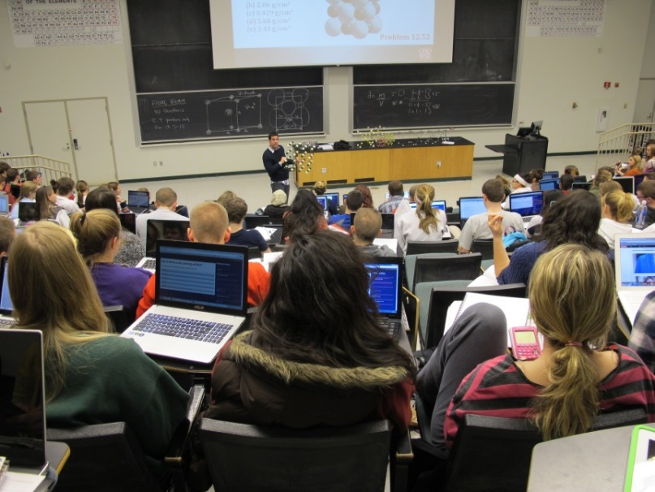
So…what is SoTL?
Involves…
Systematic reflection of the teaching process
Research
Dissemination of the teaching process and its impact on student learning

Slide 5
Organizations Devoted to SoTL
International Society for the Scholarship of Teaching and Learning
The Carnegie Foundation for the Advancement of Teaching
Carnegie Academy for the Scholarship of Teaching and Learning
American Association for Higher Education & Accreditation

Slide 6
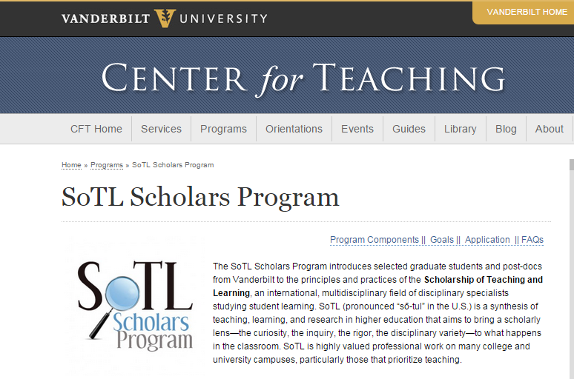
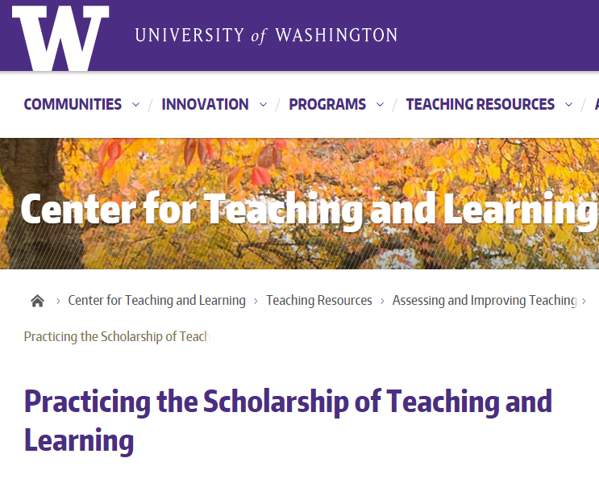
Universities Focused on SoTL

Slide 7
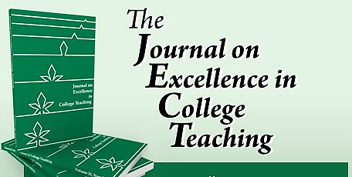
General Journals focused on SoTL

Slide 8
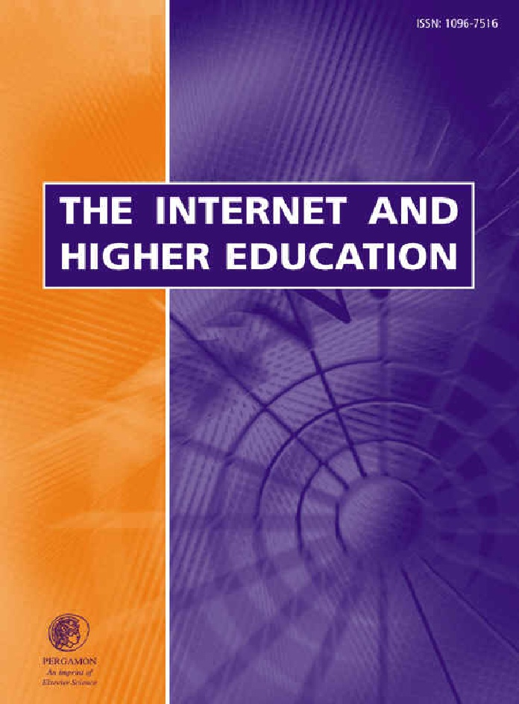
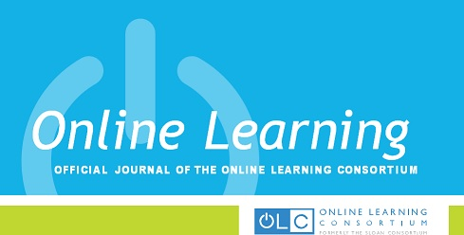
Technology-Enhanced Education Journals

Slide 9
A research context for SoTL

Slide 10
UCF’s Distributed Learning Impact Evaluation
Students
Faculty
Success
Chuck & Patsy, this has nothing to do with me…
Engagement
Retention
Demographic
profiles
Reactive behavior
patterns
Strategies for
success
Generational
comparisons
Information
fluency
SoTL projects

Slide 11
Research Initiative for Teaching Effectiveness
What services do we provide?
Research design
Survey construction & administration
Data analysis & interpretation
Results provided in “charts and graphs” format
Publication and presentation assistance

Slide 12
Faculty SoTL projects
Flipped Chemistry
Civility
Essay Comments
Online programs
Higher order evaluation models
Art in education
Student evaluation of instruction
Word Clouds
Theater
Virtual world

Slide 13
Some SoTL studies

Slide 14
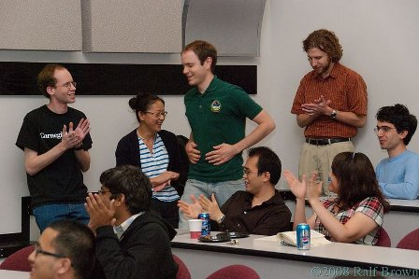
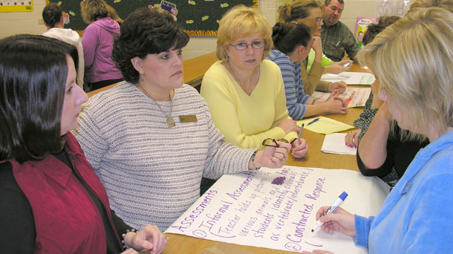
Incivility in online and F2F courses
Alisha Janowsky – Psychology
Kristin Davis – Communication
Students viewing students
Students viewing faculty
Faculty viewing students
Faculty viewing faculty
Davis & Janowsky (2012)

Slide 15
Incivility: Students viewing students
Disrespect
Disrespect
Inappropriate behavior
Cheating
Indifference
Online
Face-to-face

Slide 16
Incivility: Faculty viewing students
Disengagement
Inappropriate behavior
Disrespect
Inappropriate behavior
Indifference
Cheating
Class avoidance
Online
Face-to-face

Slide 17
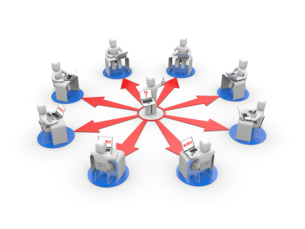
Higher order evaluation models in online learning: Constructive engagement
Aaron Liberman – Health and Public Affairs
Assessment as part of the learning process
Fairer evaluation
Improved student interaction
Improved instructor interaction
Liberman, Scharoun, Rotarious, Fottler, Dziuban, & Moskal (2005)

Slide 18
Virtual online worlds: Second Life accounting
Steven Hornik – College of Business Admin.
Aimee deNoyelles – Center for Distributed Learning
Virtual world self efficacy
Virtual accounting self efficacy
Accounting self efficacy
deNoyelles, Hornik, & Johnson (2014)

Slide 19
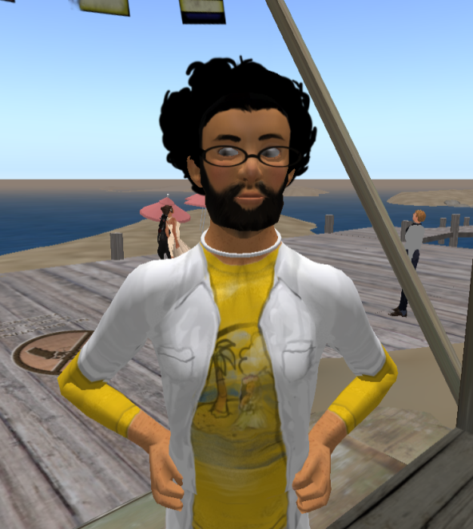
Second Life Model

Slide 20
Word clouds online
Beatriz Reyes-Foster – Anthropology
Can word clouds help with concept formation?
deNoyelles & Reyes-Foster (2014)

Slide 21
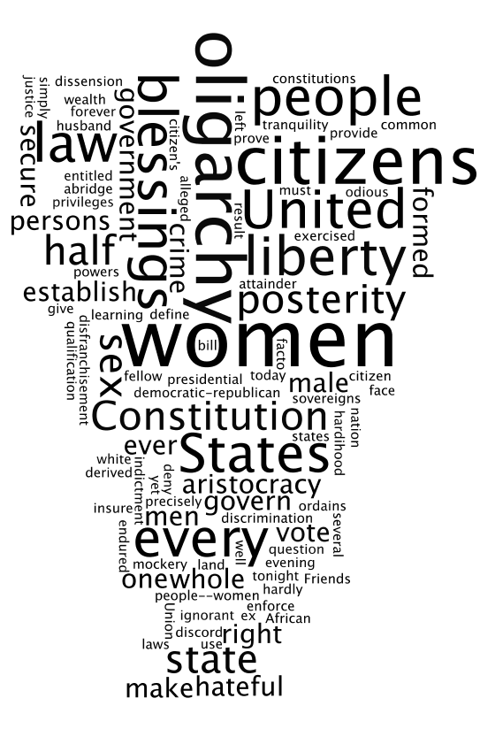
Susan B. Anthony

Slide 22
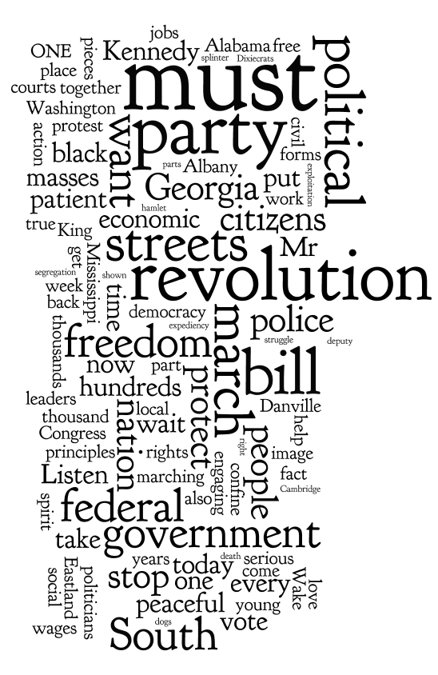
John Lewis

Slide 23
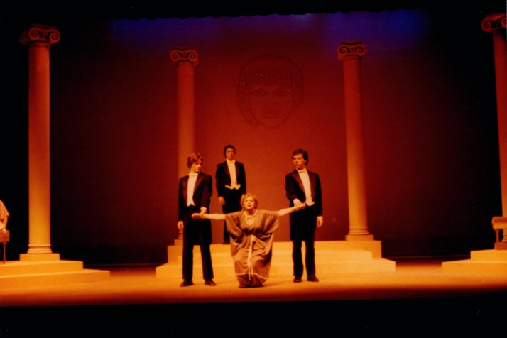
Online theater
Antigone
John Shafer - Theater
Actors at Bradley
Actors at UCF
Audience at Bradley
Audience at UCF
Internet
Shafer, Brown, Boyd, Marino, & Merritt (2005)

Slide 24
“But do they want us in their world”
Tim Brown – Communications
Amanda Groff – Anthropology
Not really
Are students interested in class tweets?
Prefer official channel, e-mails, CMS
Brown & Groff (2011)

Slide 25
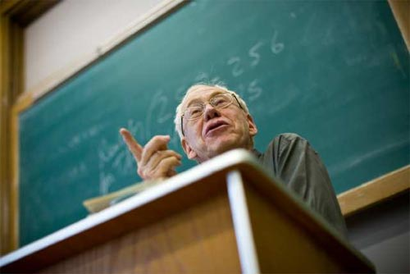
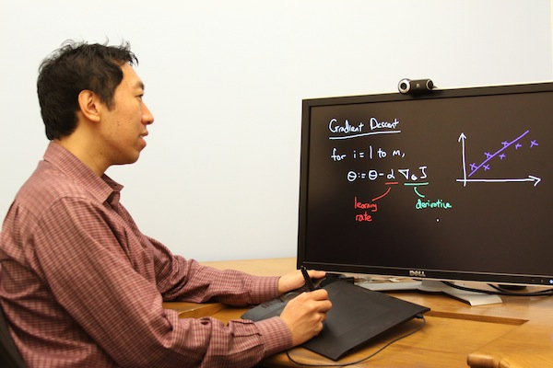
How do you maintain your teaching persona online?
Bill Phillips – Center for Distributed Learning
Who are you?
Who are you?
F2F
Online
Phillips (2008)

Slide 26
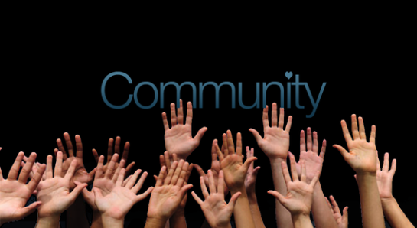
Reconsidering Scholarship Reconsidered (Boyer, 1990)
Scholarship over Time
A New Generation of Scholars
The Campuses: Diversity with Dignity
Enlarging the Perspective
Scholarship and Community
The Faculty:
A Mosaic of Talent
The Creativity Contract

Slide 27
Research Initiative for Teaching Effectiveness
For more information contact:
Dr. Chuck Dziuban
(407) 823-5478
Charles.Dziuban@ucf.edu
http://rite.ucf.edu
http://www.if.ucf.edu/

Slide 28
References
Boyer, E. L. (1990). Scholarship reconsidered: Priorities of the professoriate. Princeton, HJ: Carnegie Foundation for the Advancement of Teaching
Boyer, E. L. (1996). From scholarship reconsidered to scholarship assessed. Quest, 48(2), 129-139.
Brown, T., & Groff, A. (2011). But Do They Want Us in “Their” World? Evaluating the Types of Academic Information Students Want through Mobile and Social Media. In A. Kitchenham (Ed.), Models for Interdisciplinary Mobile Learning: Delivering Information to Students (pp. 49-65). Hershey, PA: Information Science Reference. doi:10.4018/978-1-60960-511-7.ch003
Davis, K., & Janowsky, A. (2012). Perceived differences about incivility between faculty and students in higher education. Presented at 18th Annual Sloan Consortium International Conference on Online Learning.

Slide 29
References
deNoyelles, A., Hornik, S., & Johnson, R. (2014). Exploring the dimensions of self- efficacy in virtual world learning: Environment, task, and content. MERLOT Journal of Online Learning and Teaching, 10(2), 255-271.
deNoyelles, A., & Reyes-Foster, B. (2014, October). Using word clouds in online discussions to support critical thinking and engagement. Presented at 20th Annual Online Learning Consortium International Conference 2014, October 29-31.
Liberman, A., Scharoun, K., Rotarious, T., Fottler, M., Dziuban, C., Moskal, P. (2005). Teaching, learning, and the development of leadership skills through constructive engagement, The Journal of Faculty Development, 20(3), 177- 186.
Phillips, W. (2011). A study of instructor persona in the online environment. (Doctoral dissertation, University of Central Florida).
Shafer, J., Brown, G., Boyd, B., Marino, D., & Merritt, D. (2005). Arts go the distance: Creating a low-budget, long-distance collaboration. Educause Quarterly, 2, 42-49.

