Slide 1
What Makes New Learning Spaces Work? New Research on the Importance of Social Context
Paul Baepler, Ph.D.
J.D. Walker, Ph.D.
Center for Educational Innovation, University of Minnesota
ELI Annual Meeting
10 February 2015

Slide 2
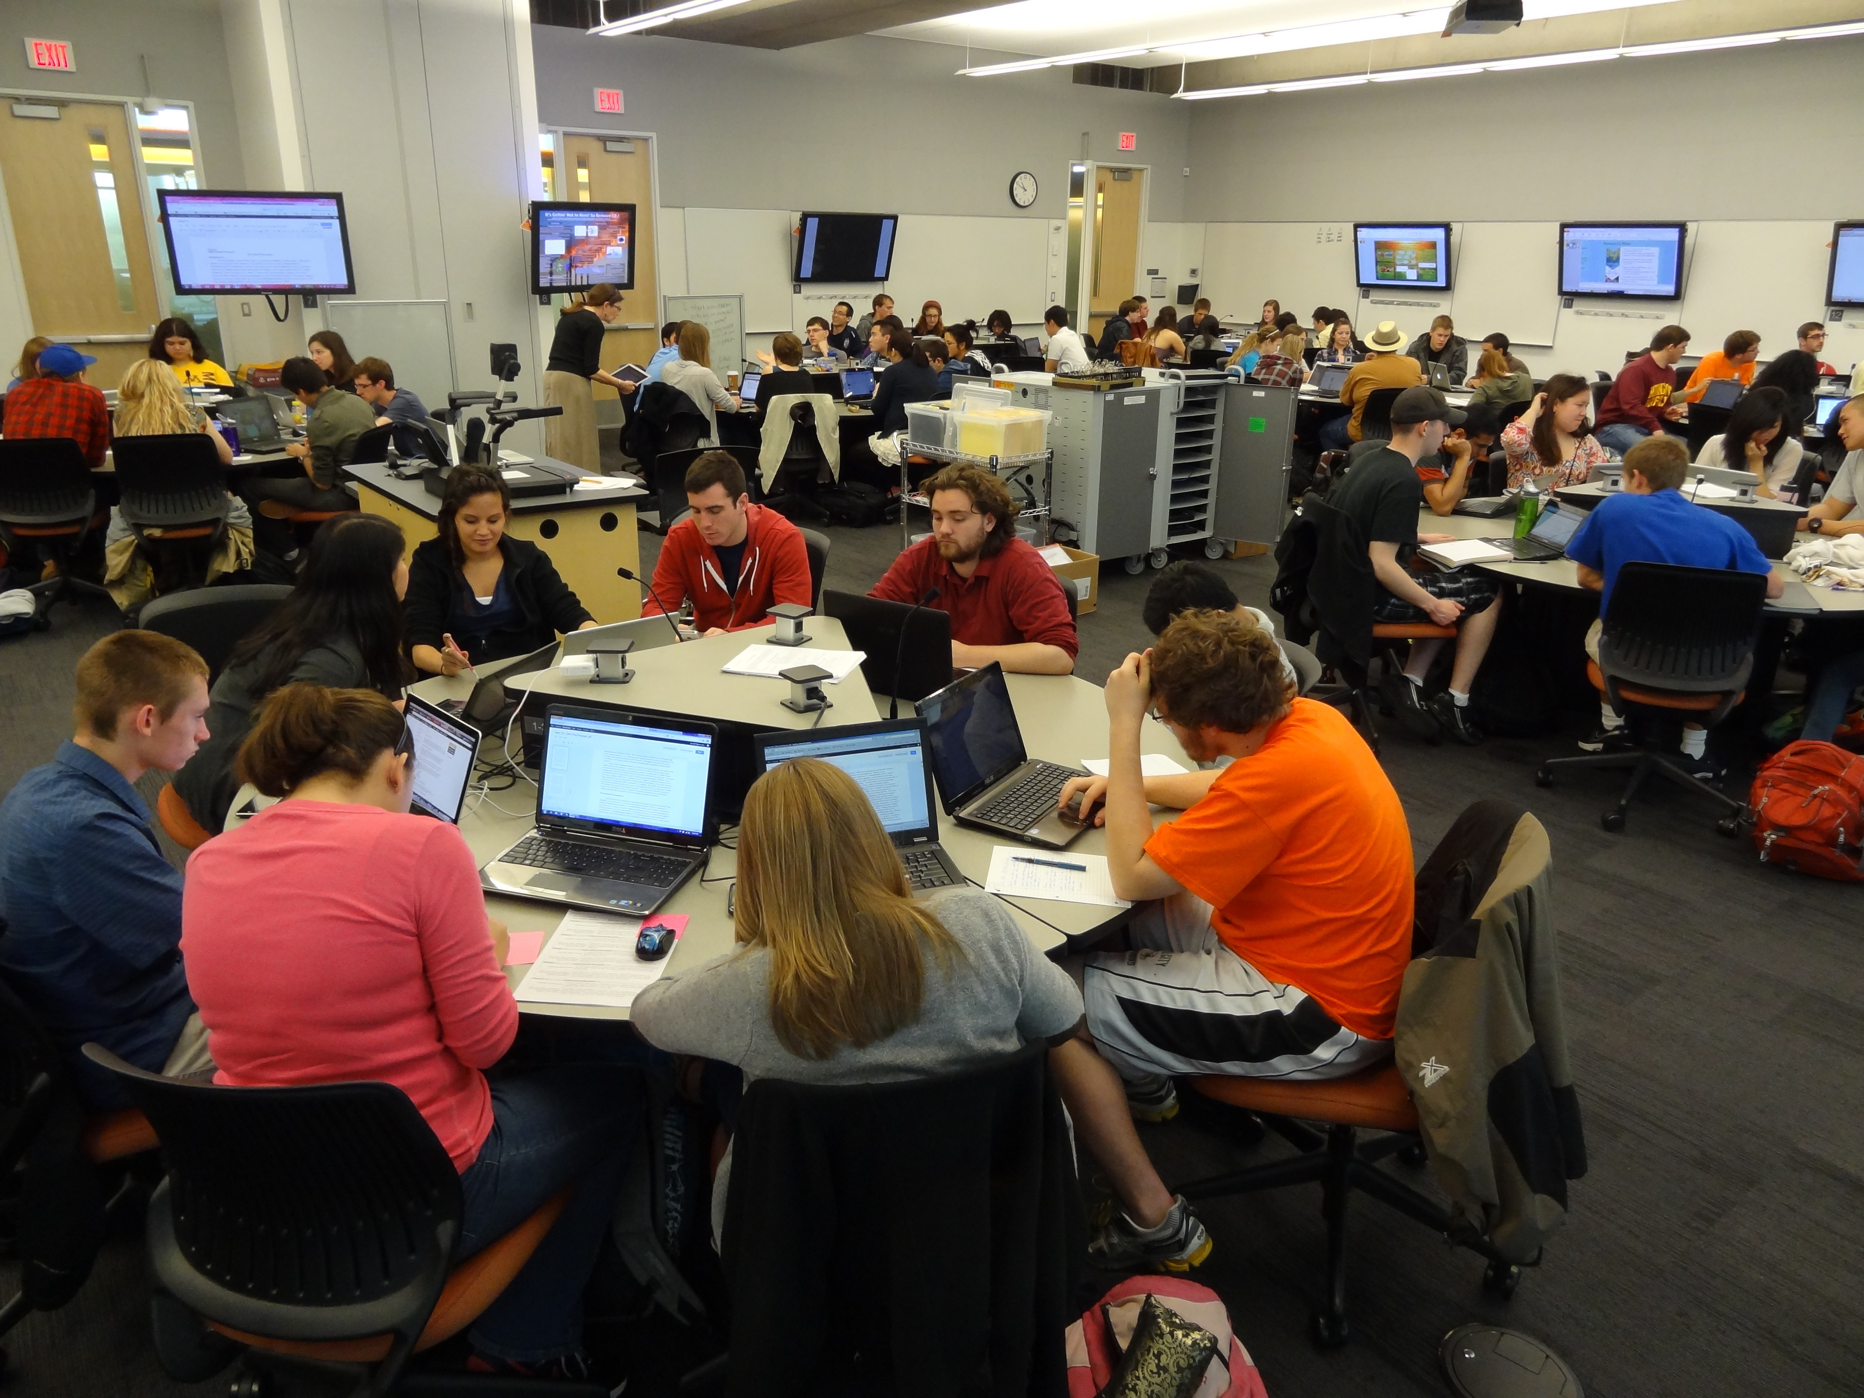
New Research on the Importance of Social Context University of Minnesota Center for Educational Innovation | Paul Baepler, Ph.D. & J.D. Walker, Ph.D.

Slide 3
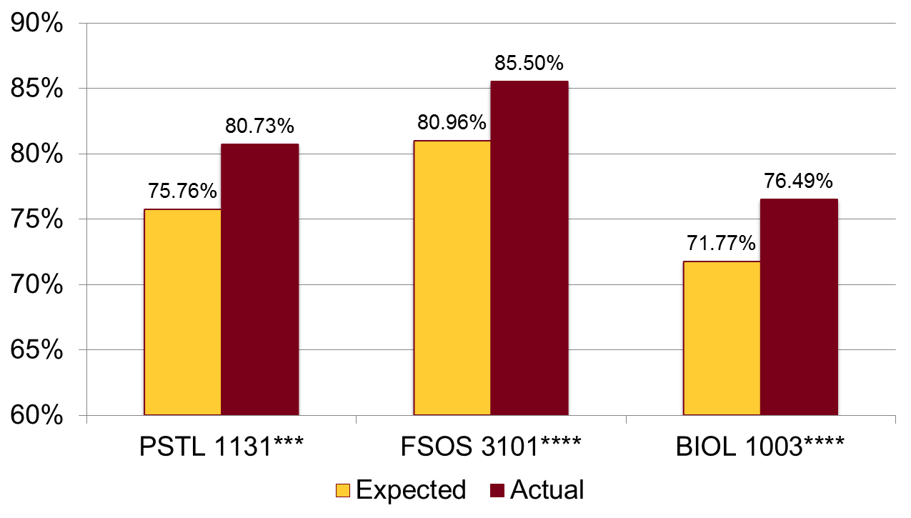
New Research on the Importance of Social Context University of Minnesota Center for Educational Innovation | Paul Baepler, Ph.D. & J.D. Walker, Ph.D.
Initial findings: ALCs affect student learning…. But how?
(See http://z.umn.edu/lsr)

Slide 4
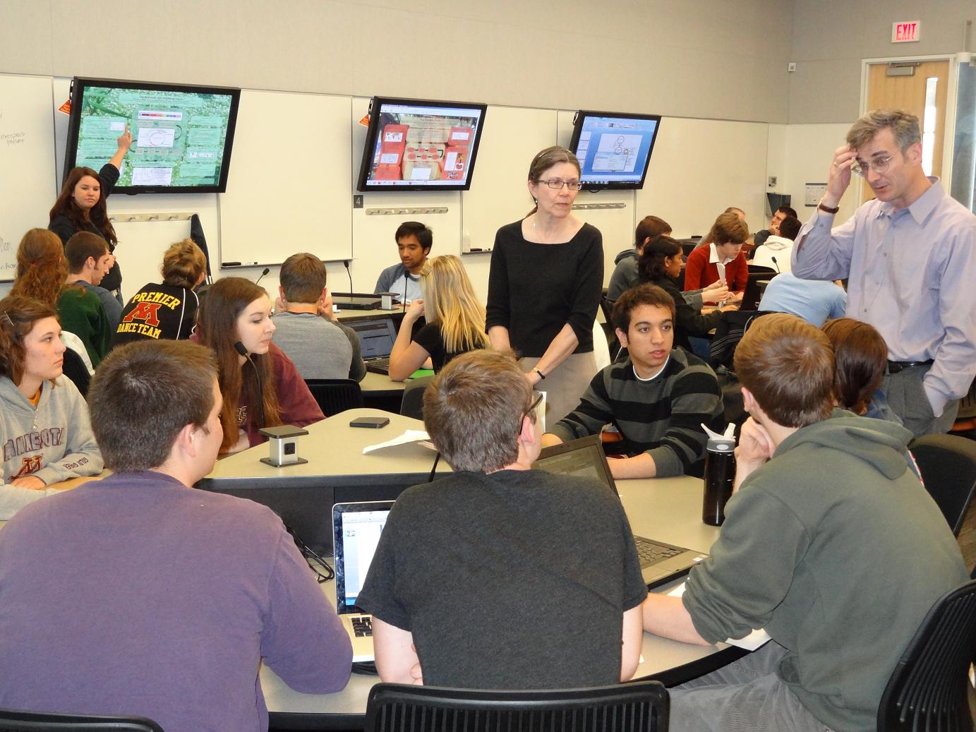
New Research on the Importance of Social Context University of Minnesota Center for Educational Innovation | Paul Baepler, Ph.D. & J.D. Walker, Ph.D.
Social context as mechanism:
Social context – the pattern of relationships in a classroom – matters to learning (Pascarella & Terenzini, 2005; Tiberius, 1994)

Slide 5
New Research on the Importance of Social Context University of Minnesota Center for Educational Innovation | Paul Baepler, Ph.D. & J.D. Walker, Ph.D.
Social context as mechanism:
"The main thing the room does -- it changes the relationship that faculty have with students, and the relationship that students have with one another.“
- an ALC faculty member, 2007

Slide 6
New Research on the Importance of Social Context University of Minnesota Center for Educational Innovation | Paul Baepler, Ph.D. & J.D. Walker, Ph.D.
Mobile Instructor,
Social Student Video

Slide 7
New Research on the Importance of Social Context University of Minnesota Center for Educational Innovation | Paul Baepler, Ph.D. & J.D. Walker, Ph.D.
Measurement: Four dimensions of social context
(N = 1010)
Social Context
Student-student relations
Student-instructor relations
Student as instructor
Student self-efficacy

Slide 8
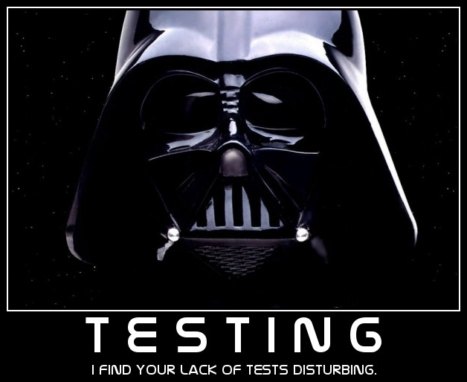
New Research on the Importance of Social Context University of Minnesota Center for Educational Innovation | Paul Baepler, Ph.D. & J.D. Walker, Ph.D.
Testing: Is social context…
Associated with desired student outcomes?
Stronger/better in ALCs than in traditional rooms?

Slide 9
New Research on the Importance of Social Context University of Minnesota Center for Educational Innovation | Paul Baepler, Ph.D. & J.D. Walker, Ph.D.
Testing social context:
Fall 2014 study of three large introductory science classes (N = 324)
Collected data on social context, student background and demographics, standardized learning outcomes
Multivariate predictive analysis to answer question #2

Slide 10
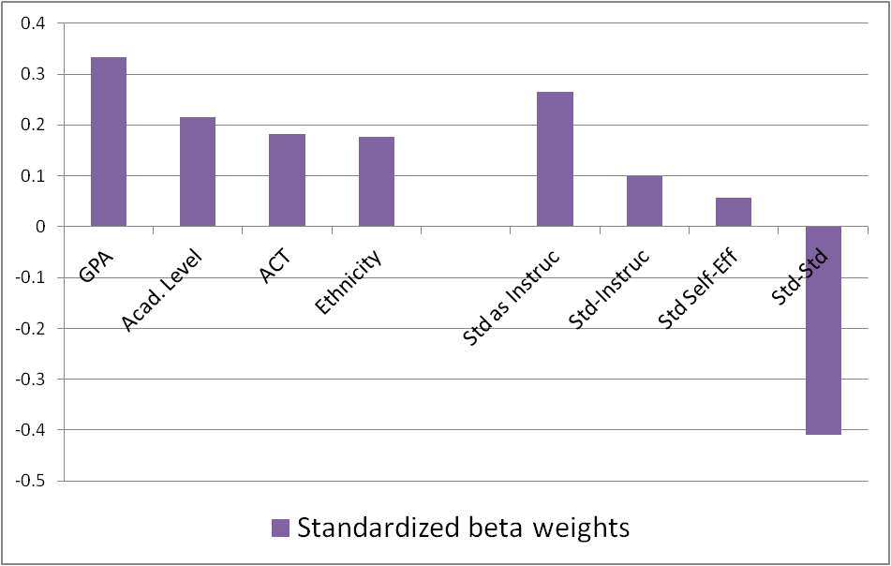
New Research on the Importance of Social Context University of Minnesota Center for Educational Innovation | Paul Baepler, Ph.D. & J.D. Walker, Ph.D.
Linear regression coefficients: Predicting learning
(N = 160; adj. R² = .469)

Slide 11
New Research on the Importance of Social Context University of Minnesota Center for Educational Innovation | Paul Baepler, Ph.D. & J.D. Walker, Ph.D.
Testing social context: Subgroup analysis
Subgroup Correlations with Learning Outcomes
 | Correlation coefficients: R | P-value | N
Female | SAI:.335 SE: .226 SI: .192 | .000 .012 .046 | 106 109 109
Non-white | SAI:.327 | .025 | 47
Freshmen | SAI: .286 | .007 | 88
ACT lowest quartile | SAI: .336 | .000 | 104

Slide 12
New Research on the Importance of Social Context University of Minnesota Center for Educational Innovation | Paul Baepler, Ph.D. & J.D. Walker, Ph.D.
Next steps:
Path analysis to examine nested causal relationships
Large scale data collection in traditional classrooms, fall 2015
Comparative design studies
More on this study forthcoming in:
Baepler, Walker, Saichaie, Petersen & Brooks. (2016.) A guide to teaching in active learning classrooms: History, research, and practice. Stylus Publishing.
Social context
Demogs
Perform- ance
Class size, subject, etc.
Aptitude
Engagement, enrichment, etc

Slide 13
New Research on the Importance of Social Context University of Minnesota Center for Educational Innovation | Paul Baepler, Ph.D. & J.D. Walker, Ph.D.
Thanks!
http://z.umn.edu/lsr
Paul Baepler, Ph.D. (baepl001@umn.edu)
J.D. Walker, Ph.D. (jdwalker@umn.edu)
13

