Slide 1
Identification of new tech
Identification of new tech
Pat Reid

Slide 2
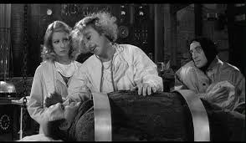
Identification of new tech
Identification of new tech
Faculty request for specific tool
Faculty request for solution to problem
Executive request for review of tool
IT identification of potential tool

Slide 3
IT identification
IT identification of potential tool
Features
Limitations
Uniqueness
Overview of comparison
Project plan
Project plan
Pilot
Assessment/ evaluation
Dissemination
Support team
Business Case
Proposed Tool Review
Rationale for adding to supported products
Considerations
Implementation Plan

Slide 4
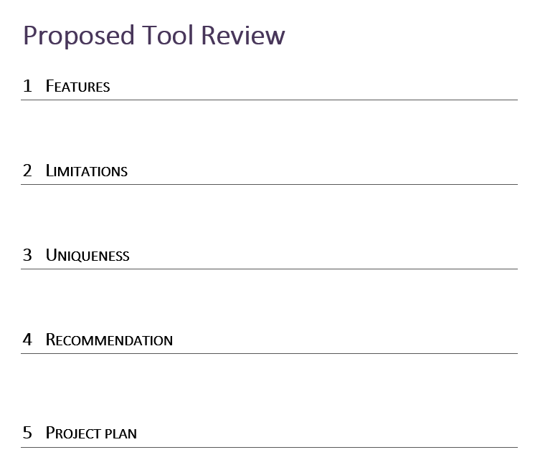
Proposed Tool Review
Quick
No Go
Go/

Slide 5
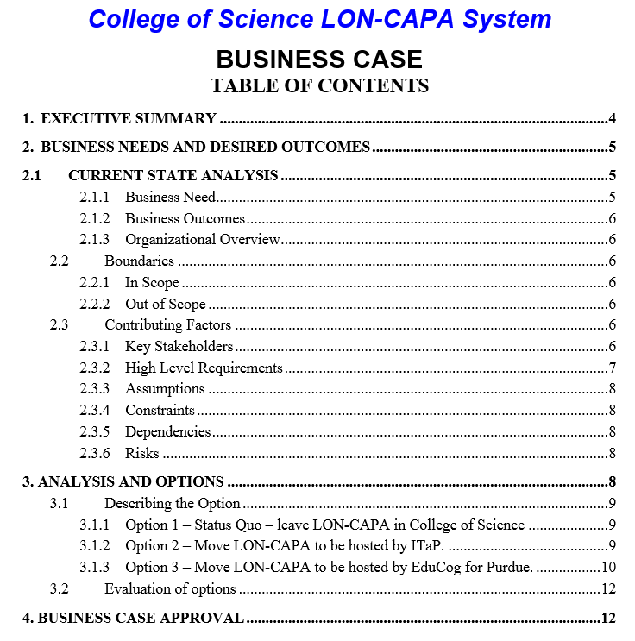
Business case
Detailed
Go/
No Go

Slide 6
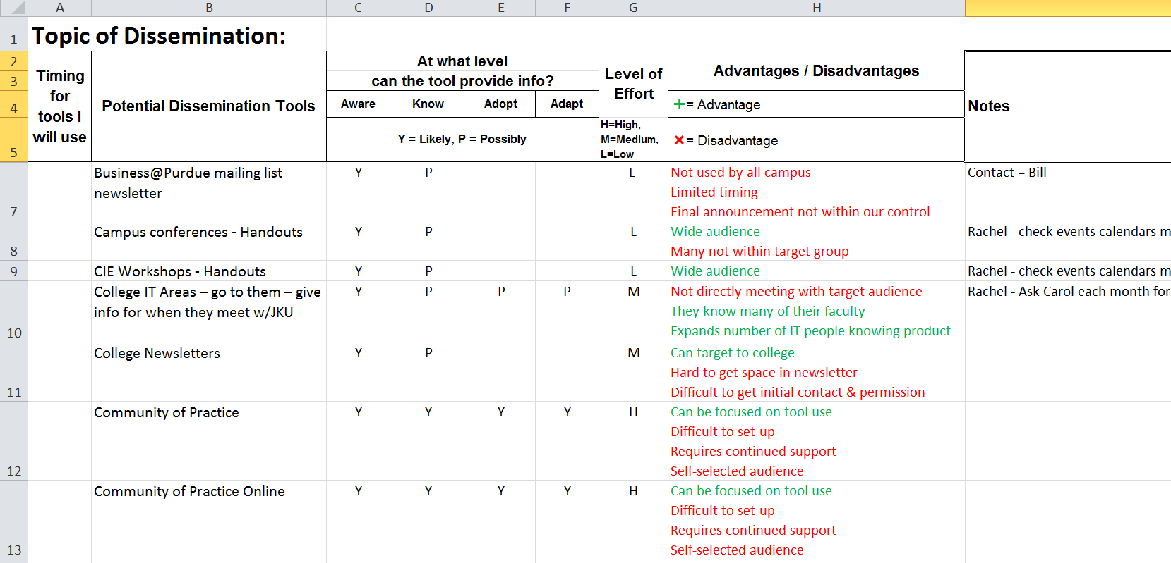
Marketing
Building
Interest
& Use

Slide 7
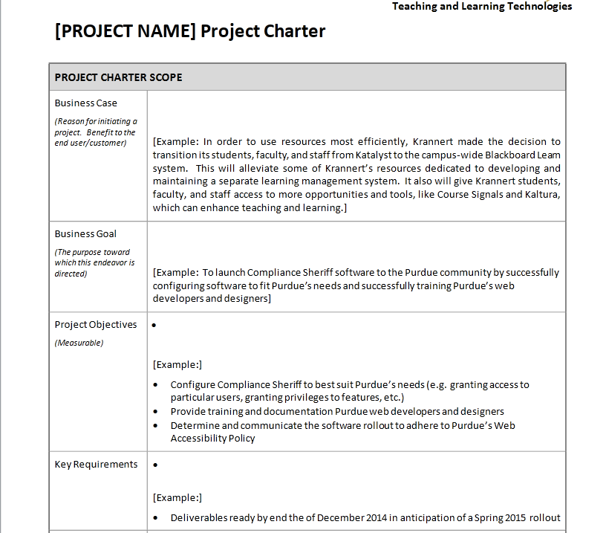
Project charter
Major
Projects

Slide 8
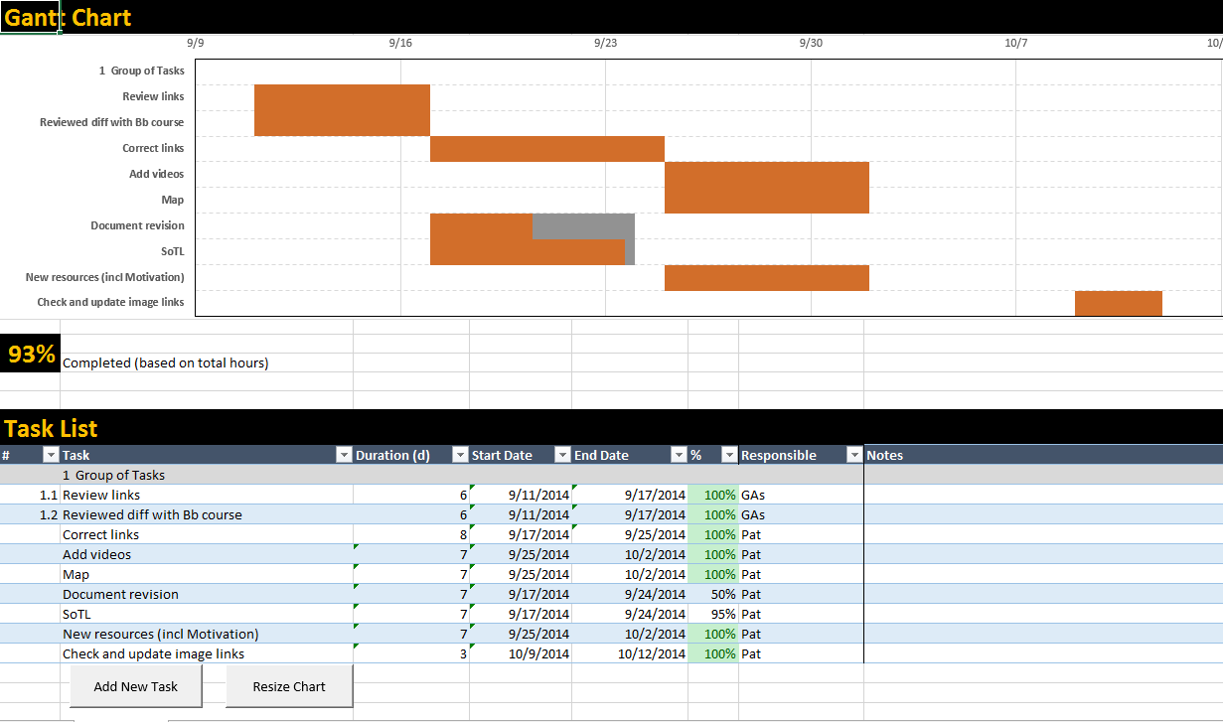
Task list
Task
Management

Slide 9
Specific tool
Faculty request for specific tool
Executive request for review of tool
Current Tools Review
Business Case
Rationale for adding to supported products
Considerations
Similar tool available
Significant differences
Project plan
Implementation Plan
Proposed Tool Review
Features
Limitations
Uniqueness
Overview of comparison
Project plan
Pilot
Assessment/ evaluation
Dissemination
Support team

Slide 10
Current Tools Review
Quick
Review

Slide 11
Proposed Tool Review
Quick
No Go
Go/

Slide 12
Business case
Detailed
Go/
No Go

Slide 13
Marketing
Building
Interest
& Use

Slide 14
Project charter
Major
Projects

Slide 15
Task list
Task
Management

Slide 16
Solution
Current Tools Review
Similar tool available
Significant differences
Project plan
Id required, desired features
Rate comparable products
Faculty request for solution to problem
Software Comparison
Rationale for adding to supported products
Considerations
Implementation Plan
Project plan
Pilot
Assessment/ evaluation
Dissemination
Support team
Business Case

Slide 17
Current Tools Review
Quick
Review

Slide 18
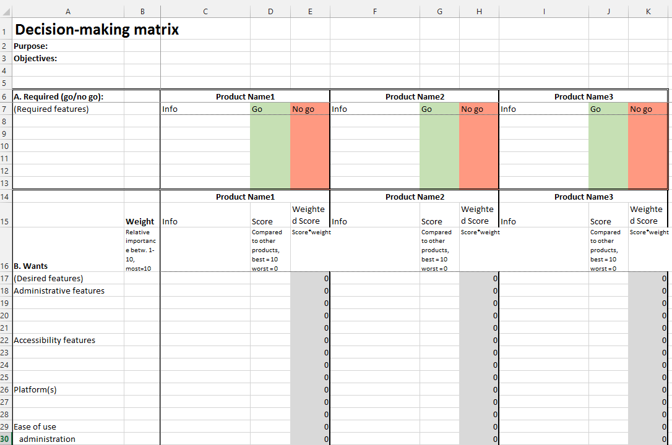
Software comparison
Comparing
Options

Slide 19
Business case
Detailed
Go/
No Go

Slide 20
Marketing
Building
Interest
& Use

Slide 21
Project charter
Major
Projects

Slide 22
Task list
Task
Management

Slide 23
Marketing
Building
Interest
& Use

Slide 24
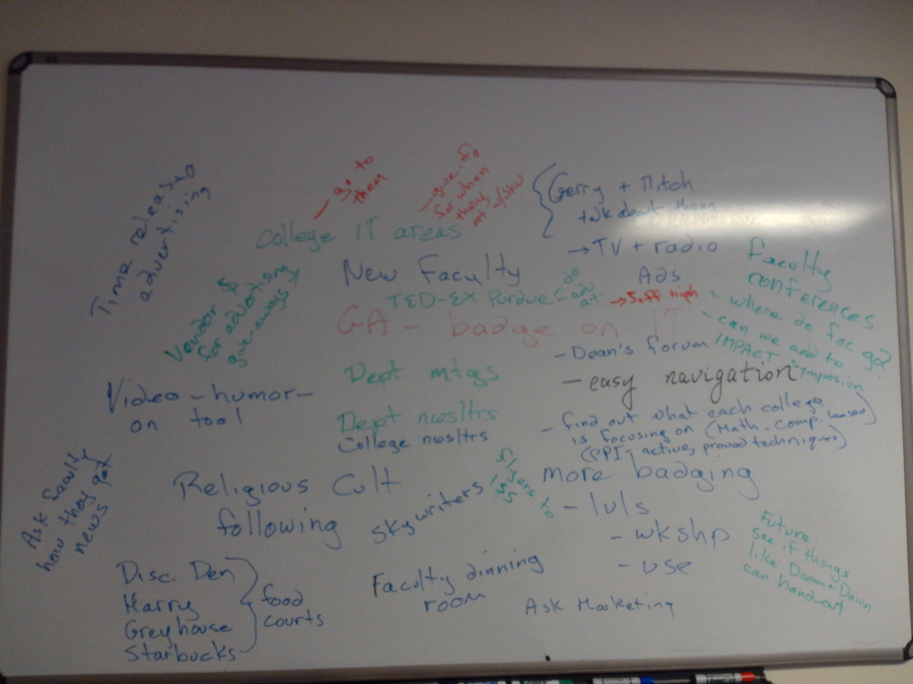
Brainstorm marketing approaches

Slide 25
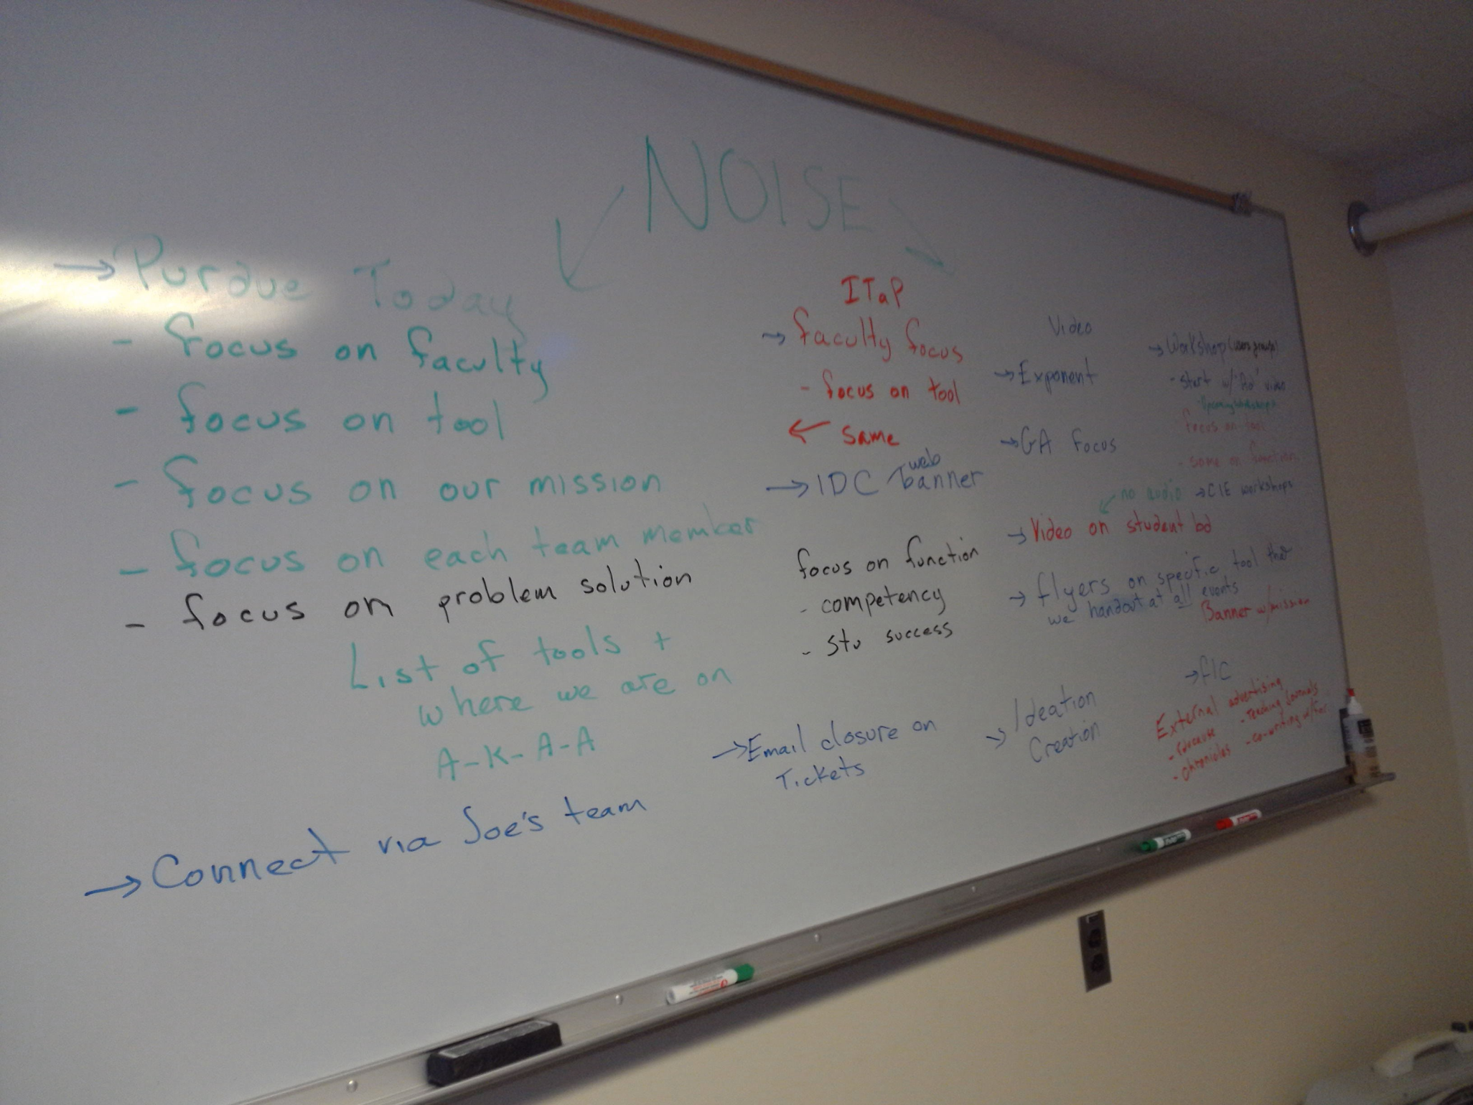
Brainstorm marketing approaches

Slide 26
How can we get faculty attention?
Business@Purdue mailing list newsletter
Campus conferences - Handouts
CIE Workshops - Handouts
College IT Areas
College Newsletters
Community of Practice
Community of Practice Online
Dean’s Forum
Deans’ Offices - handouts
Demonstrations
Dept. Meetings
Dept. Newsletters
Dept. websites
Discount Den, Harry, Food Courts
Email closure on tickets
Email to all faculty
Email to IMPACT fellows
Email to past workshop attendees
Email to user group attendees
Exponent advertisement
External advertising
Faculty Conferences - Handouts
Faculty Conferences - Presentations
Faculty Dining Room
Faculty Senate
FLCs
Flyers to ISS
GA Focus
GA training
Gerry & Mitch – talk about them
HR website
IDC – web banner
Interactive computer presentation
Internal Conference
Internet/Web site
ITaP’s Faculty Focus newsletter
Lunchtime Presentations
New Faculty workshops
New instructor orientation packet
New instructor orientation presentation
Pilot in key area
Posters
President’s Office
Provost’s website
Purdue Facebook feeds
Purdue News Service
Purdue Today
Purdue Twitter feeds
Special Events handouts
Student organizational groups and leadership councils
Ted-Ex Purdue -
TV & Radio Ads
Users groups - Handouts
Users groups - Presentations
Video on tool
Video on Student boards
Web banner
Websites for faculty
Workshops (Tech Tues, Ideation Creation, Wired Wed)

Slide 27
Marketing

Slide 28
Software comparison
Comparing
Options

Slide 29
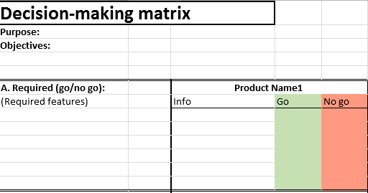
Decision making matrix

Slide 30
Decision making matrix

Slide 31
Decision making matrix

Slide 32
Happiness

Slide 33
