Slide 1
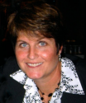
Math Class Flips over Blended Team-Based Learning
Abby Grace Drake
Biology Department
Skidmore College
Saratoga Springs, NY
Kelly Dempsey
Lead Instructional Technologist
Skidmore College
Saratoga Springs, NY

Slide 2
Quotes from students in my MATH 100 class:
“Math has always been my Worst subject.”
“Math is very difficult for me…”
“I have hated every math class I’ve ever taken…”
Notes:
This is how they felt about the class walking in the door!
Bring business cards

Slide 3
An even bigger problem…. Teaching those who
really, really don’t want to learn.
Who are in fact AFRAID of learning!!
$$SD= \sqrt{\frac{\sum{\left(X− \overline{x}\right)2}}{n−1}}$$
$$\frac{1}{13} x \frac{5}{6}=$$
$$A=P {(1+\frac{APR}{n} )}^{ny}$$
Notes:
So I was faced with an even bigger problem!
How many of you feel a little (or a lot) of anxiety when looking at those problems?
Why? Why did the students feel this way? They are bright, they made it into one of the best
small liberal arts schools in the country… They are certainly capable!
Maybe they were never taught in the right environment.

Slide 4
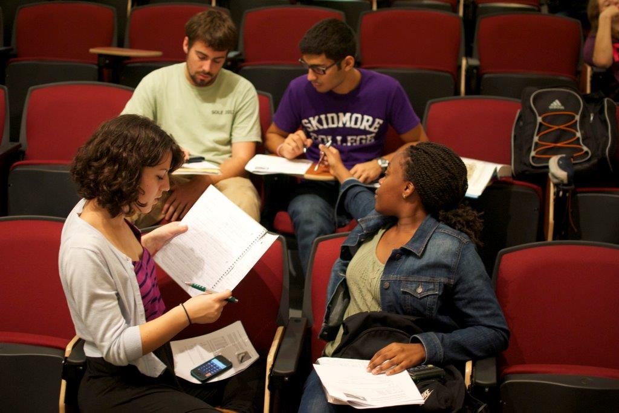
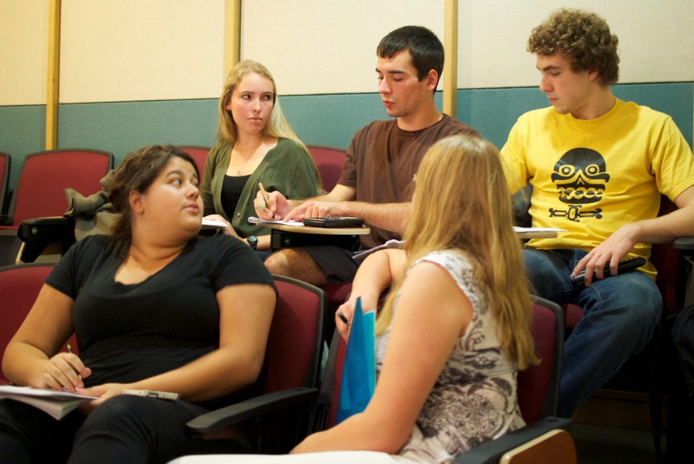
Flip the classroom and use Team Based Learning to
engage your students in class!
Notes:
TBL is trademarked… do I need to put the little TM symbol on there?

Slide 5
Flipped Classroom & Team-Based Learning (TBL) Approach
Phase 1: Study
Read & Study: Devote 3 hours before class.
Watch & Take Notes: 1 hour online lecture before class.
Phase 2: Assess and Refine
Readiness Assurance: RATs (Readiness Assurance Tests)
RATS: MCQs on bolded words and figures in your reading,
concepts from lecture
Lecture: Respond to RATS, illustrate concepts with examples
Phase 3: Apply
Team Applications: Practice and Apply

Slide 6
How does this help me study for the exam?
First Part:
Multiple Choice, True/False
Second Part:
Problem Solving, Analytical and Conceptual Thinking

Slide 7
First Day, First Step: Team Formation
Be transparent
3 - 4 people per team
Create teams with a mix of abilities
Ask students a series of questions and have them line up as they respond
5. Lastly have them count off by the number of teams
Team Formation Survey Questions
Stand up if you completed the assigned reading.
Stand up if you have been in a course that used TBL.
Stand up if you grew up using the metric system.
Stand up if you play on team sport.
5. Stand up if you think this class is going to be hard.
Notes:
This is n’t about putting all of the A students at the front of the line

Slide 8
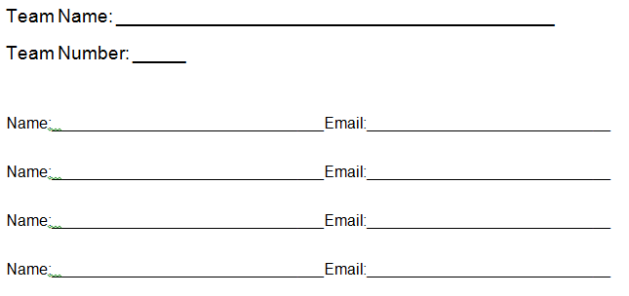
Get to know your team mates! (8 minutes)
Exchange: Names, Emails
What is your TEAM NAME?

Slide 9
Pre-recorded video lecture that the students watch before class. (e.g. https://skidmore.box.com/s/myp8wr8urzvcv955nnfd)
Why?
Students can only focus for short periods of time. Watching lectures on their own time
allows them to set the pace and take breaks.
Students learn at different speeds!
Pause
Rewind
Fast forward
Watch Again and Again!
Most importantly: leaves valuable in-class time for
evaluation, clarification, practice, and guidance!

Slide 10
Kelly Dempsey
Lead Instructional Technologist
Skidmore College
Software: Powerpoint & Ink2Go
http://ink2go.org/
15 day free trial, license: $19.90
Hardware: Surface Pro
Notes:
KELLY this and the next slide
Ink2go captures a video of your screen while you display your powerpoint slides and draw on the screen to annotate your lecture all while also recording your voice so that you can upload the whole lecture as a single video.
See us in person or email if you want a demo

Slide 11
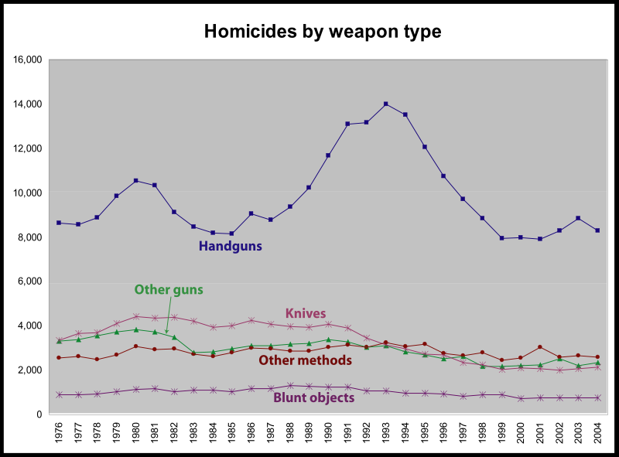
Notes:
An example of a screenshot from one of my math lectures. You can draw on the slide and also highlight the text.

Slide 12
If we use online lectures then
our students won’t come to class!
Notes:
My talk today is going give you techniques that will ensure not only that students watch the online lectures, but that they do the reading before they come to class, that they also STUDY before they come to class and that when they get to class you can immediately evaluate their understanding of the material, provide them instantaneous feedback on their progress, and then you can spend class time clarifying the material and providing exciting examples and follow all of this up with an exciting activity where students engage with and learn each other. This social learning environment is decentralized so that the students are the ones that spend the most time articulating and interpreting the material they are learning. All that in 15 minutes! Here we go!
There are many challenges in this appreoach not only for the students but also for me as a teacher. I need to see things from their perspective, emphatise with students, I’m always asking myself – why do they need to learn this. With my math students this was especially true. Students that are actually capable and interested can soar higher and those who are struggling will feel supported bytheirpeers. One thing about teenagers – they like to rebel -

Slide 13
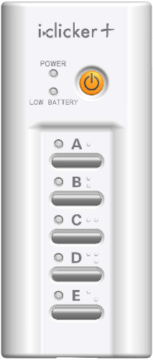
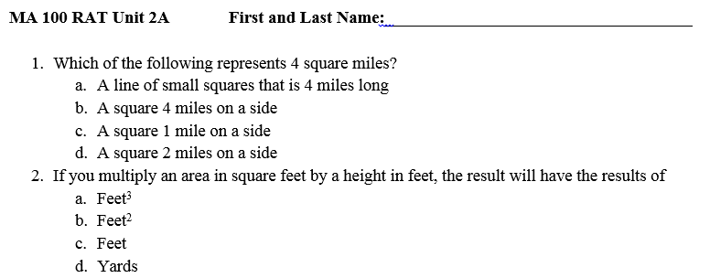
When students get to class…
I-RAT: Individual Readiness Assurance Test (5 minutes)
MCQ on the reading and lecture (keep it basic!!).
Students may not use notes, books or other outside resources.
I allow only 30 seconds per question.
**In large lecture classes I use Iclickers, in smaller classes I use paper tests.
Notes:
, it is helpful to give students a study guide
**REMEMBER you are NOT testing students, you are assuring
that they are ready!

Slide 14
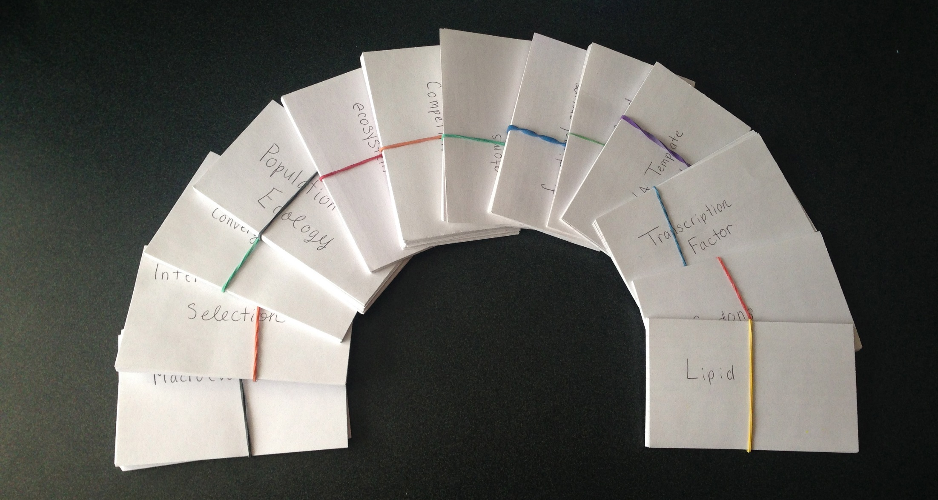
Why RATs?
Photo by Cheyanne Slocum, student in my TBL Intro Bio class
Students not only come to class prepared to learn, they also develop good study skills that will benefit them in other classes!
Notes:
Students are required to come to class
Students must study before they come to class
Teaches them good study habits and they are prepared for more learning and applying.

Slide 15
Next…
T-RATs: Team Readiness Assurance Test (10 minutes, SAME test!)
T-RATs are TEAM tests – Students MUST have consensus on all
answers.
May not use any notes or other materials – only each other!
They may also write appeals at this time to any of the T-RAT questions.
Each class, a new teammate is in charge of the scratch card.
I use team folders which contain a paper copy of the test for each
student on the team and an IF-AT scratch card for scoring.

Slide 16
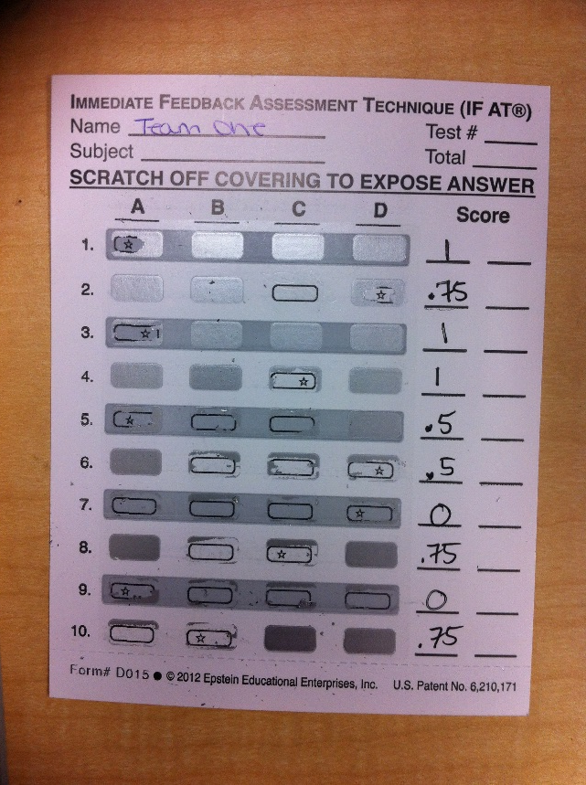
IF-AT (Immediate Feedback Assesment Test) Scratch Cards:
One of the most powerful techniques in my pedagogical toolbox!
http://www.epsteineducation.com/
T-RAT:
Same multiple choice questions.
Taken as a team with scratch cards.
They get 3 chances to find the correct answer.
My scoring system:
Correct the first time = 1pt
Correct the second time = .75 pt
Correct the third time = .50 pt
The best assignments don’t just assess they also teach!

Slide 17
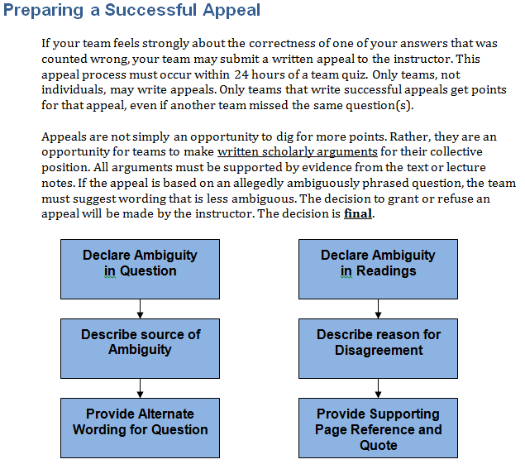
Student RAT Appeals: A method for students to formally appeal a question and/or
answer.
Why in the world would you allow that?!
In writing appeals students must re-engage with the material
and develop well reasoned and referenced arguments.
Notes:
Students must provide a reference justifying their appeal (this makes them go back
to their reading and look it over again!)
*Write a well-reasoned argument for their appeal!
*Appeals may only be submitted by teams for TRAT points!
*Other teams do not benefit from Appeal points – they must write their own.

Slide 18
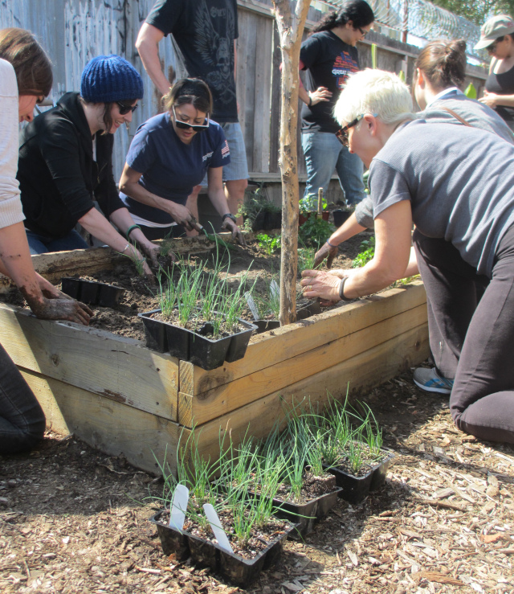
In-class Lecture??
In class after the RAT – Ask if they want any RAT question explained (chalk talk). Then provide an Interactive lecture that is meaningful to them.
Inspiration: http://www.ted.com/talks/dan_meyer_math_curriculum_makeover
Ron Finley: A guerilla gardener in South Central LA
How much soil is needed to fill a raised bed planter?
Notes:
Biostatistics and Intro Bio – 40-60 minute lecture after the RATs with a focus
on clearing up any RAT questions and providing further examples of skills and
concepts. Students need to be invested in the interactive lecture. More time drawing out concepts into the real world.
Show photo ron finley and the link.

Slide 19
Flipped Classroom & Team-Based Learning (TBL) Approach
Phase 3:
Team Applications: Practice and Apply

Slide 20
Team Applications: MA 100
RATs and Interactive lecture one class, Applications next class.
Same students who said:
“I have hated every math class I’ve ever taken…”
This is week 3
Notes:
Students appreciate the flow and rhythm of the two day format – they know that every other class they will get to work with their teams (btw – some of them become great friends!) and they don’t get tested every class.

Slide 21
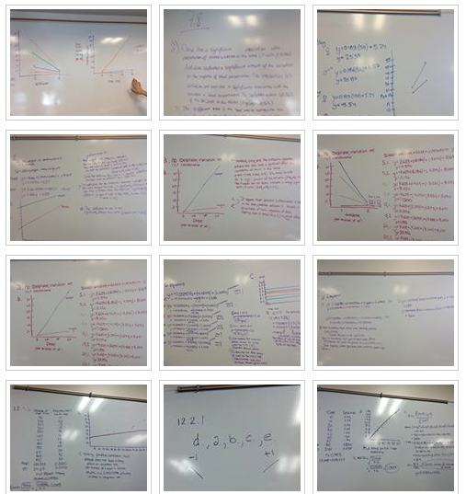
Team Applications: Teams Post Answers to class Facebook Group.
By dividing all of the exercises amongst the teams, a bank of all of the worked-out answers
is created and can be used to study for the tests.

Slide 22
TBL
Point Distribution
You Will Decide!
Vote on 02.19.14
Empower them!
Option A:
I-RAT 25
T-RAT 10
Team Application 10
Peer Evaluation 5
Option C:
I-RAT 5
T-RAT 35
Team Application 5
Peer Evaluation 5
Option B:
I-RAT 12.5
T-RAT 12.5
Team Application 12.5
Peer Evaluation 12.5
Option D:
I-RAT 5
T-RAT 13
Team Application 25
Peer Evaluation 7
Notes:
I set aside some of the points for the course to TBL and I let them decide how to distribute those points. This makes them more comfortable accepting this new format and establishes a sense of trust with me as their teacher.
They get up and campaign and give speeches

Slide 23
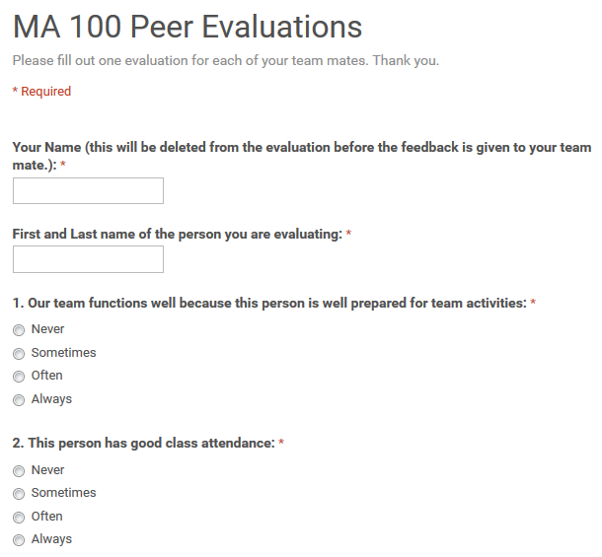
Peer Evaluations: Accountability
In small group work often one or two students will do all of the work. Peer evaluations
keep all members accountable.
Google Drive > Create > Form

Slide 24
Peer Evaluations: Accountability
Students respond better to comments about their behavior
from their peers than they would respond to a teacher.
Notes:
I read all of the evaluations to make sure there is nothing untoward in them and then remove the name of the evaluator and hand them back to the students. Students that are doing well really appreciated the great things that their team mates say about them. Students that are not prepared are have other issues such as dominating the group will very often change their behavior for the better.

Slide 25
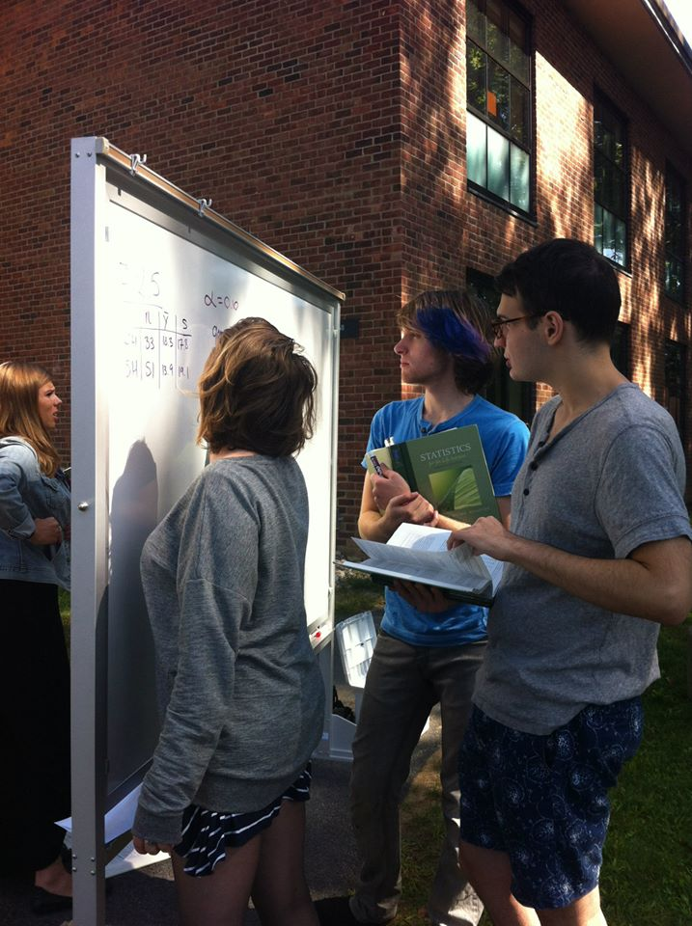
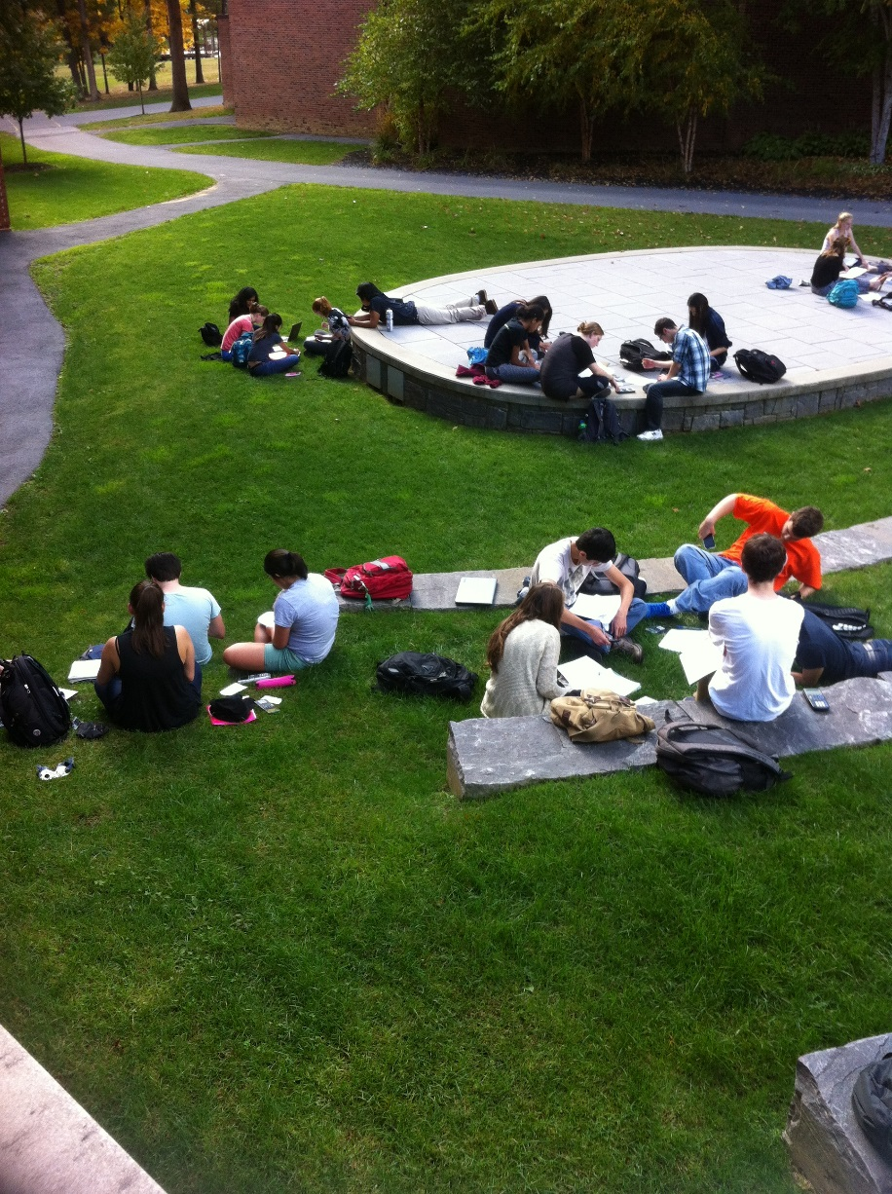
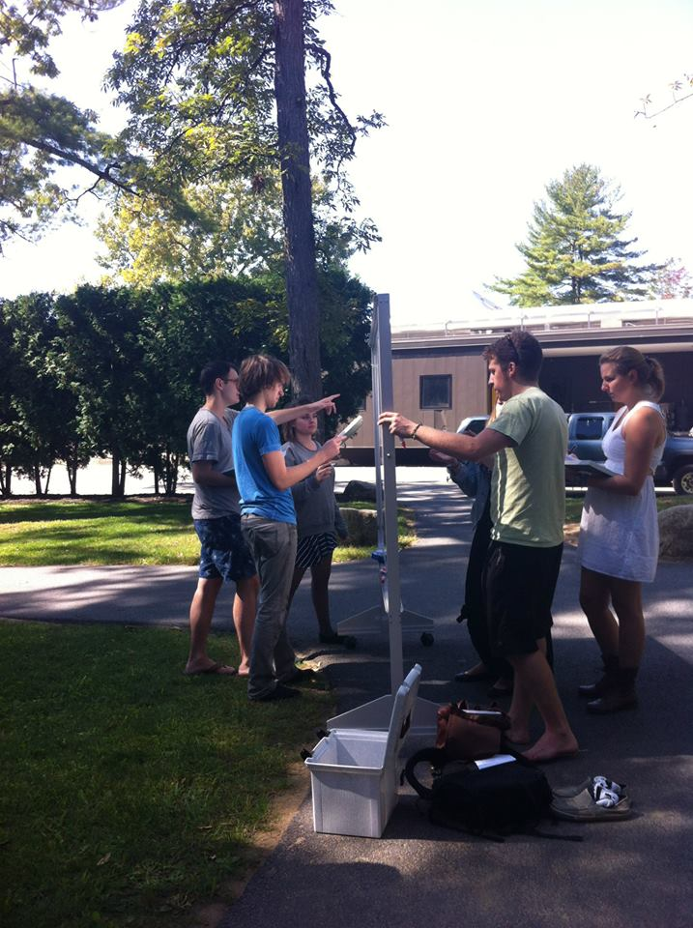
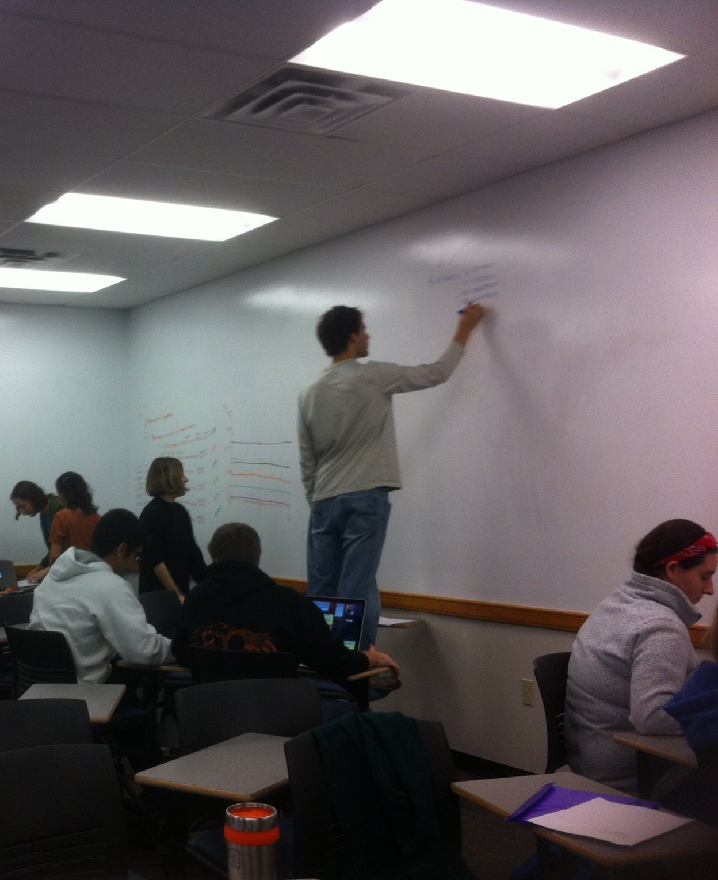
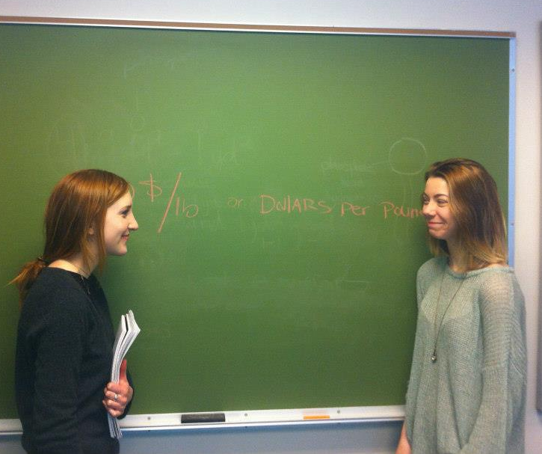
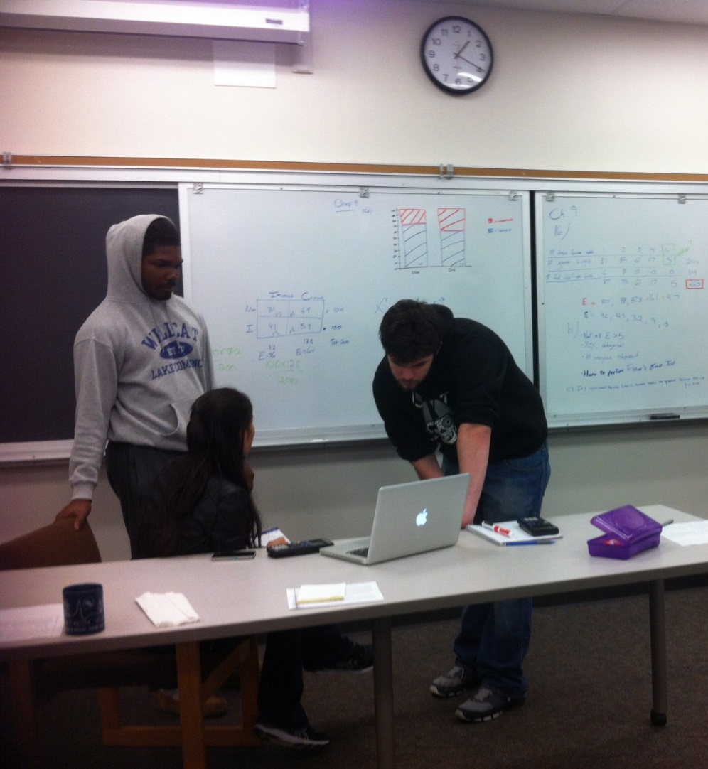
Why do I love TBL and the Flipped Classroom?
Engaged, happy, social students.
Students learn from the online lectures at their own pace.
Not covering basic material – able to cover higher-order concepts and skills.
Students actually do the reading and come to class prepared.
Students study throughout the semester – this lessens the need to “cram” the night before the exam.
Students must articulate concepts and reasoning to their peers. To learn something well… teach it!
Notes:
Computer picture – note that students watch the lecture videos before they come to class – here they are just reviewing a lecture.

Slide 26
How did MA 100 students respond at the end of the semester?
“The team based learning is great! I finally understand concepts that never clicked in the past.”
“It’s Fun. The prerecorded lectures are great and the team applications can be incredibly helpful.”
“More Team Apps.”
“I really enjoy the format… I feel like I am being setup to succeed rather than fail.”
“We are able to watch the unit we are reviewing and then go over some problems
In class which helps us understand the material.”
“I think that the Team Apps are very helpful.”
“At first I was I was apprehensive about taking this class because math has always been my
Worst subject. But this class has been really accessible to me … I LOVE Team-Based Learning.”
Notes:
I feel like this pedagogy allows me to reach more students in a deeper and more meaningful way. A number of students told me that this class transformed them as students, they had shown they could succeed at something that before they had always failed at, now… what couldn’t they do?

Slide 27
Math Class Flips over Blended Team-Based Learning
Feel free to email us:
abbygracedrake@gmail.com
kdempsey@skidmore.edu

