Slide 1
Beyond the Flipped Classroom
Using Problem Based Learning to Teach Millennials at the UC Berkeley – UCSF Joint Medical Program (JMP)
Jessie Heminway, JMP Instructional Technologist

Slide 2
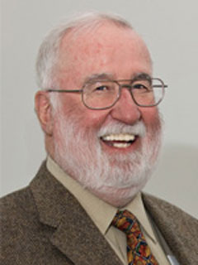
“Half of what you’ll learn in medical school will be shown to be either dead wrong or out of date within five years of your graduation; the trouble is that nobody can tell you which half. So the most important thing to learn is how to learn on your own.”
Dr. David Sackett: “Father of Evidence Based Medicine”

Slide 3
Reality #1 Explosion of Data

Slide 4
Reality #2 Information Instantly Available
Notes:
Information instantly available
In addition to Google and wikipedia kinds of instant searching, there are applications.
World Lens or Google Translate: For example, my daughter showed me an app the other day that, using the camera, instantly translates a sign into another language. Using the camera, this app instantly reads, Estrada Desmoronada as Road Collapsed. No getting out the dictionary or even typing in the word.
Shazam: Identifies Music and TV by just listening through the microphone
Keeps the information: Now has
phone identity,
Song/TV searched
Whether it was purchased and where
Now aggregating information on songs searched and bought etc.
Some have said that the behaviors of the Millennial generation are not necessarily because they are more tech–saavy, but rather they are technology dependent.
Expectations of technology changing behaviors
By this I mean, it is second nature for them to use technology to find answers to everyday questions and to casually consume technology as a way of life. Technology and instant information is a given, it’s habit.

Slide 5
Why come to school?

Slide 6
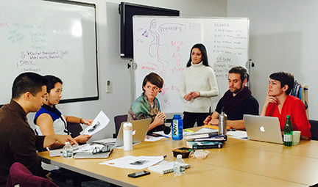
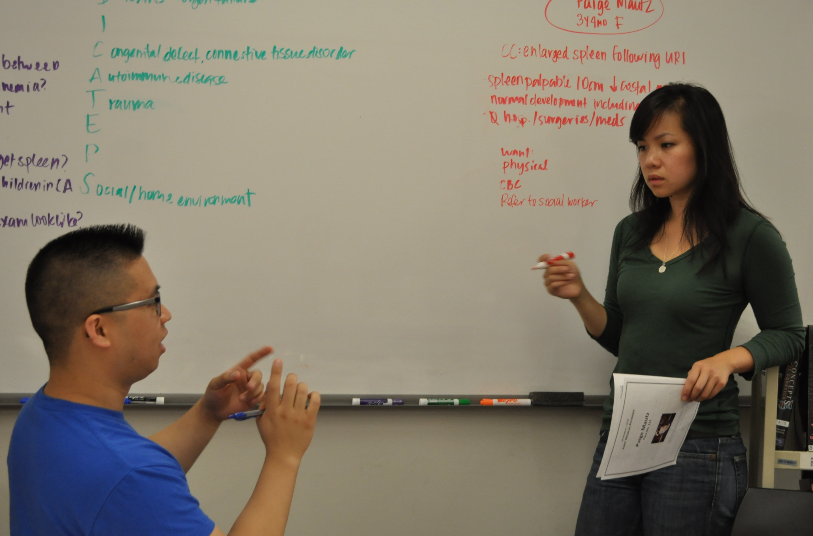
Teaching Each Other at the JMP
Students from the UC Berkeley – UCSF Joint Medical Program

Slide 7
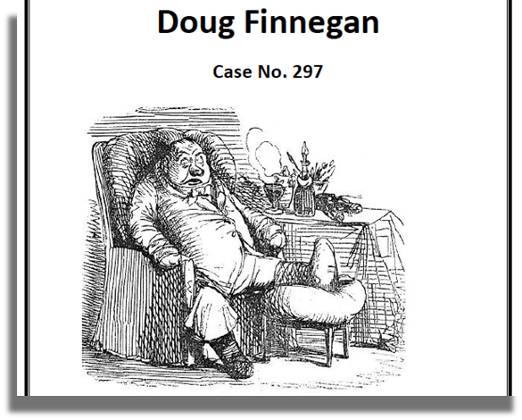
JMP First Year Students Day 1 - Page 1
Doug Finnegan is a 55 year-old man who comes into your clinic complaining of pain in his right toe.

Slide 8
JMP First Year Students Day 1 - Page 2
Mr. Finnegan reports that two weeks prior to this visit, he noticed a "slight pain" in his right great toe. It progressed over the next few days, and became red, warm, swollen, and tender. At that time, he treated himself by soaking his foot in warm salt water, and the symptoms resolved within three days. After a few more days, he again began to notice "a slight aching" in his toe, which, over the following 24 hours, became "significantly worse," which prevented him from walking.
There is no history of recent foot trauma, injuries, or skin abrasions. He has not had fever, chills, sore throat, dysuria, frequency, urgency, or urethral discharge.
One and one-half years ago, Mr. Finnegan had right ankle swelling, which was not treated at that time. Eight months ago, he had pain and inflammation in his right knee, which was treated with NSAIDs as an outpatient, with much relief. Three years ago, he was diagnosed with gonorrhea, which was treated successfully with ceftriaxone.
He has no known allergies, and is not currently taking any medications. There have been no other hospitalizations. He does not smoke, and drinks only one or two beers each week. He says he generally has oatmeal for breakfast, otherwise ‘doesn’t think much about’ what he eats.
Mr. Finnegan is married and has one 25 year old child in good health. He describes himself as Irish American and works as a quality control technician. His parents are both living. His father has hypertension, and has suffered one heart attack; his mother has asthma.

Slide 9
JMP First Year Students Day 1 - Page 2
Mr. Finnegan reports that two weeks prior to this visit, he noticed a "slight pain" in his right great toe. It progressed over the next few days, and became red, warm, swollen, and tender. At that time, he treated himself by soaking his foot in warm salt water, and the symptoms resolved within three days. After a few more days, he again began to notice "a slight aching" in his toe, which, over the following 24 hours, became "significantly worse," which prevented him from walking.
There is no history of recent foot trauma, injuries, or skin abrasions. He has not had fever, chills, sore throat, dysuria, frequency, urgency, or urethral discharge.
One and a half years ago, Mr. Finnegan had right ankle swelling, which was not treated at that time. Eight months ago, he had pain and inflammation in his right knee, which was treated with NSAIDs as an outpatient, with much relief. Three years ago, he was diagnosed with gonorrhea, which was treated successfully with ceftriaxone.
He has no known allergies, and is not currently taking any medications. There have been no other hospitalizations. He does not smoke, and drinks only one or two beers each week. He says he generally has oatmeal for breakfast, otherwise ‘doesn’t think much about’ what he eats.
Mr. Finnegan is married and has one 25 year old child in good health. He describes himself as Irish American and works as a quality control technician. His parents are both living. His father has hypertension, and has suffered one heart attack; his mother has asthma.

Slide 10
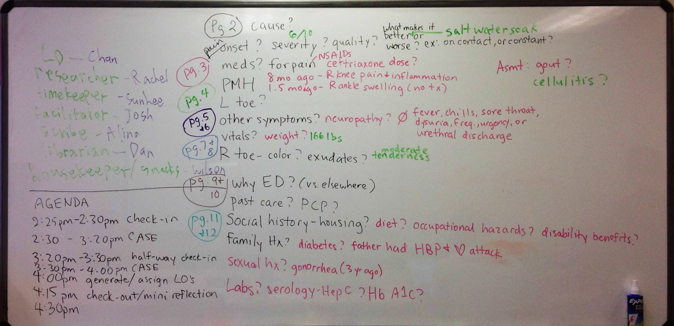
Whiteboard on 1st Day of Medical School

Slide 11
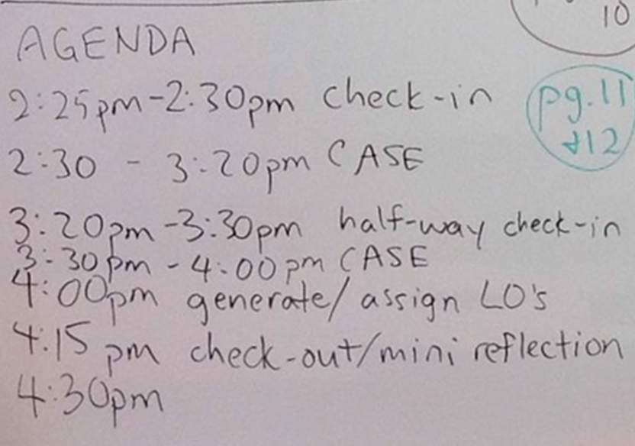
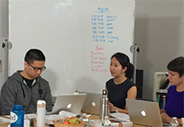
Whiteboard on 1st Day of Medical School

Slide 12
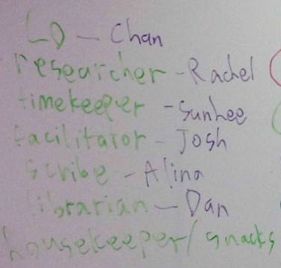
Whiteboard on 1st Day of Medical School

Slide 13
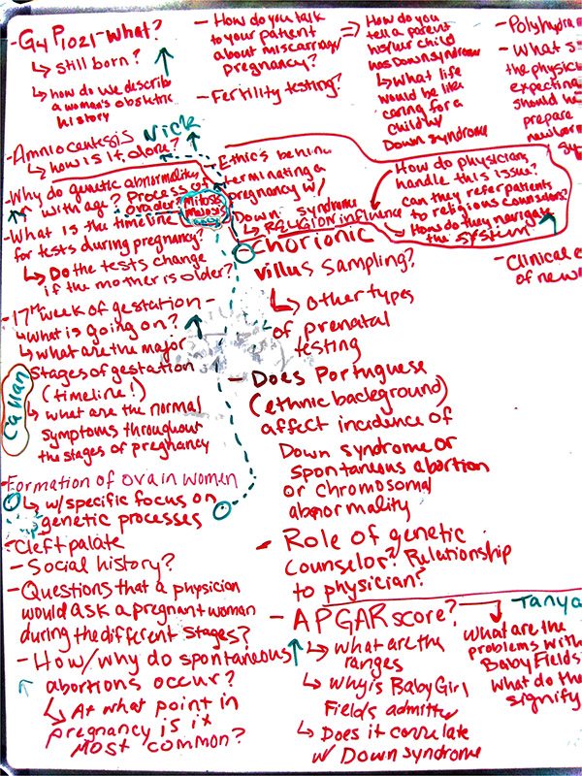
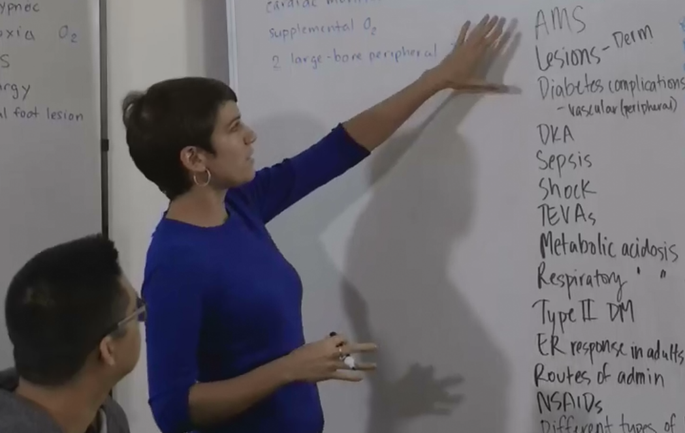
Learning Issues & Learning Objects

Slide 14
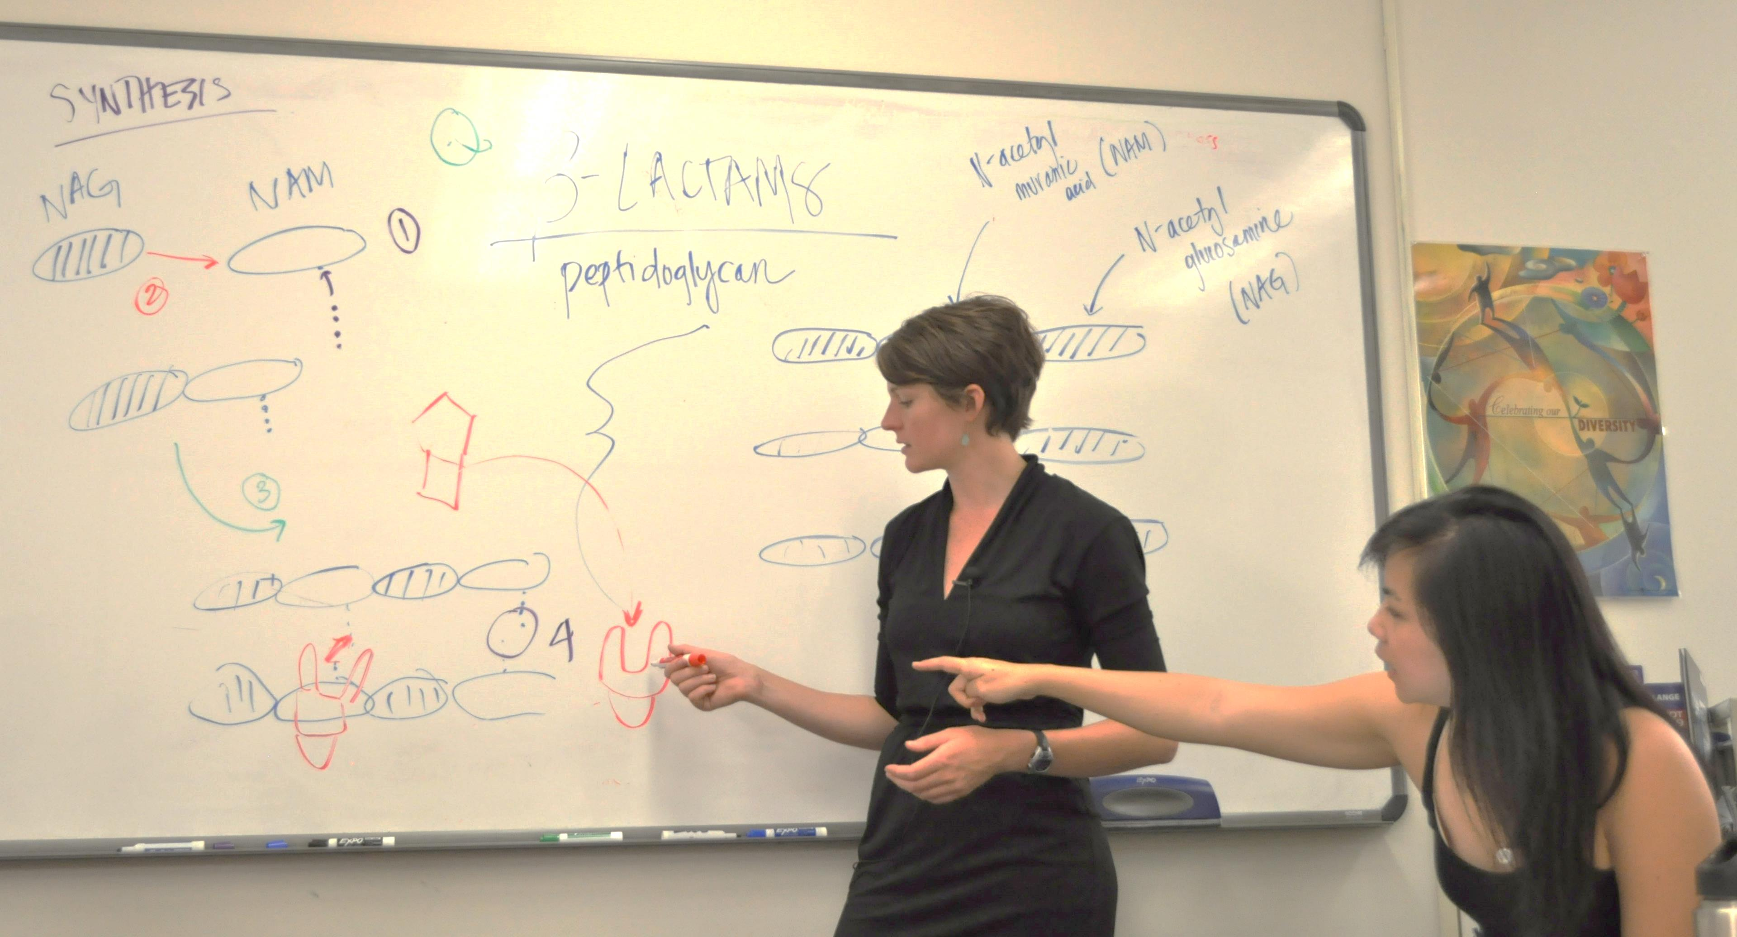
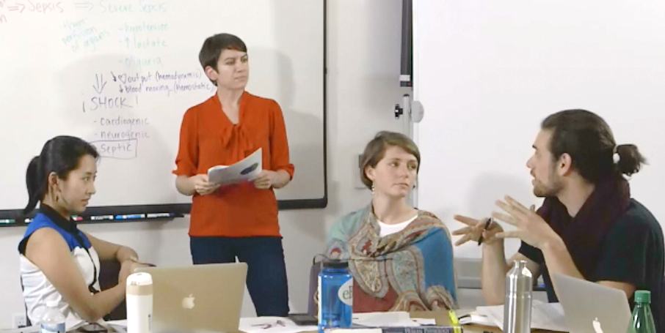
Teaching & Learning

Slide 15
The PBL Journey
Session I
Case Pages Reveals
Generate learning issues (LIs)
Assign learning objects (LOs)
Discussion, collaboration, lists, drawing
Wrap up
Diagnosis, outcome
Final pages
Session III
Assign more learning objects
More learning issues
More case pages
Teach difficult concepts
Session II
Outside class - research & write LO for teaching at the next session-read LOs of others
Outside class - research & write LO for teaching at the next session-read LOs of others

Slide 16
“Half of what you’ll learn in medical school will be shown to be either dead wrong or out of date within five years of your graduation; the trouble is that nobody can tell you which half. So the most important thing to learn is how to learn on your own.”
Dr. David Sackett: “Father of Evidence Based Medicine”

