Slide 1
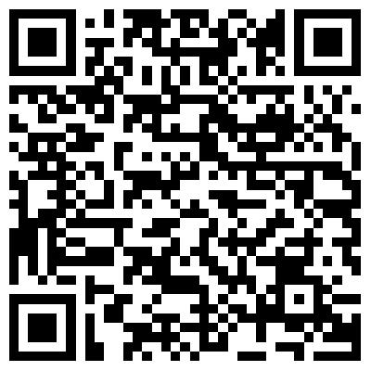
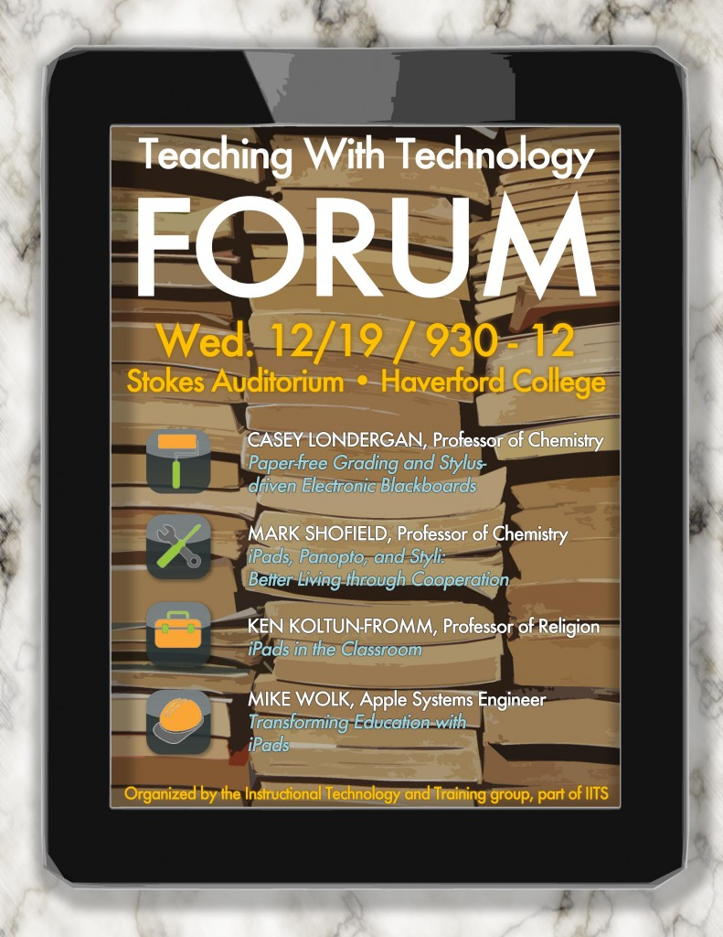
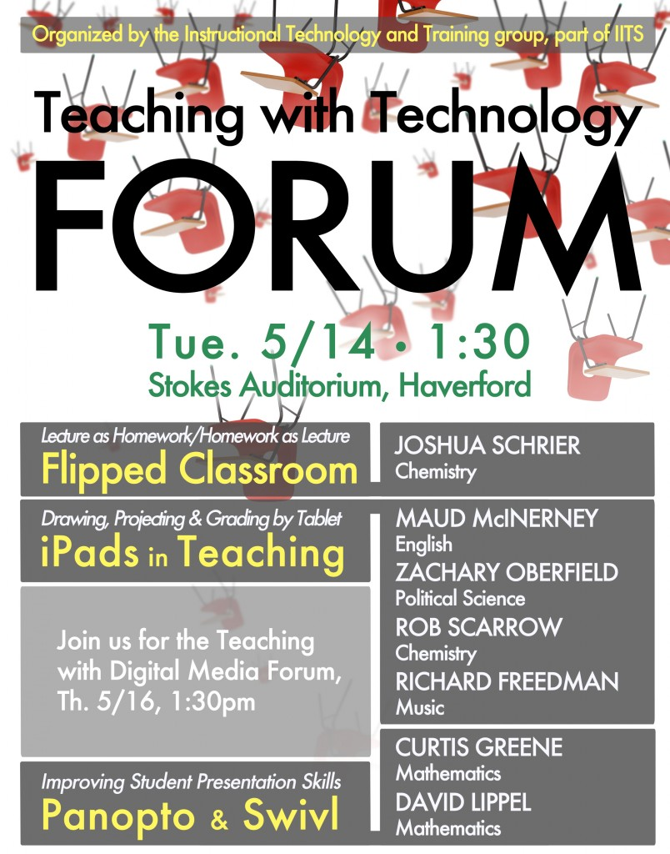
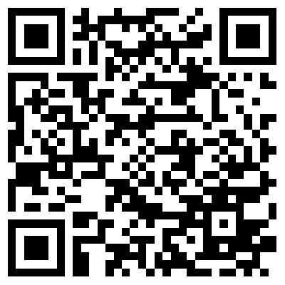
Best Practices for Faculty Development in Liberal Arts:
Engaging Faculty to Explore Instructional Technology
- Partnering with faculty and using their voices -
STRATEGIES
TEACHING WITH TECHNOLOGY FORUM
T.I.P. (TECHNOLOGY, INNOVATION, PEDAGOGY) VIDEO SERIES
Instructional Technology Staff: Faculty partners, not just tech support.
Champions: Find and cultivate faculty champions and use their voices to promote instructional technologies.
Administrators: Make sure the Administrators are aware of faculty’s work through events, videos, and newsletters.
Haverford and Beyond: Make the events and videos available to your own institution and a wider audience.
Frequency: Twice a year, during the finals week.
History: Started in Fall 2005.
Format: Several faculty presentations.
Topics: Instructional technologies that faculty implemented during the semester & Teaching with Technology grant projects.
Themes: Tools to increase student engagement, digital media in the classroom, etc.
Length: 1.5 ~ 2 hours.
Length: Approximately 5 minutes.
Format: Interview.
Interviewees: Mostly faculty & some students.
Topics: Flipped classrooms and labs, active learning using clickers, lecture capture system, embedding digital media into curriculum, etc.
Delivery Method: Bi-weekly newsletter to individual community members.
Accessibility: Closed captioning.
PURPOSE
Showcase creative ways that Haverford faculty members use technology to enable and enhance liberal arts education.
Inspire faculty.
Promote new pedagogy and instructional technology.
Inform the instructional technology services we offer.
Provide faculty with opportunities to get feedback and new ideas from their colleagues.
Hiroyo Saito
Director of Instructional Technology Services
hsaito@haverford.edu
Charles Woodard
Digital Media Specialist
cwoodard@haverford.edu

