Slide 1



Presented By
Florence Gilzene-Cheese, PhD
This presentation leaves copyright of the content to the presenter. Unless otherwise noted in the materials, uploaded content carries the Creative Commons Attribution-NonCommercial-ShareAlike license, which grants usage to the general public with the stipulated criteria.

Slide 2
Presentation Overview
  A Quick Look at:
The skills that support faculty preparation for the virtual environment
The concept of online facilitator readiness
Characteristics for successful online preparation and engagement

Slide 3
Institutional Context
Dual mode institution
Online programmes in 2008
Reach - 17 Anglophone Caribbean countries

Slide 4
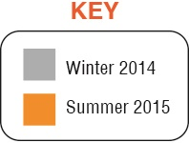
Cohort Comparison
Demographic data
New to Online – 76, prior training 14
74 Females (82%)
83 trainees from the Caribbean

Slide 5
Winter 2014 and Summer 2015 Cohort Count by Country

Slide 6
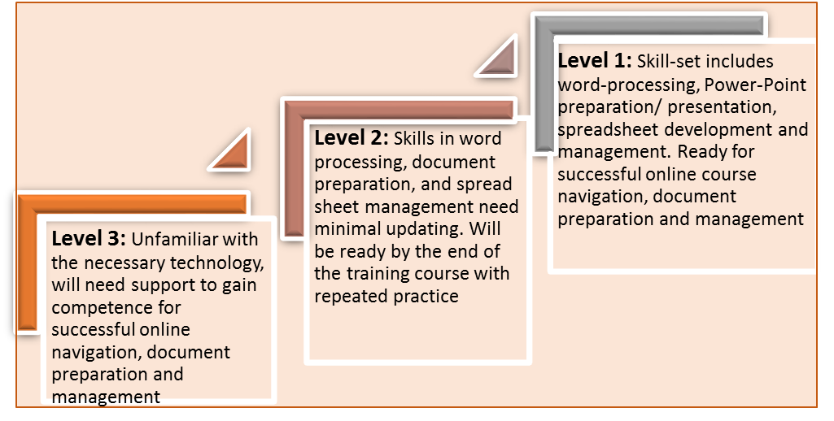
Pre-Training Skill-Set

Slide 7
Training Overview & Implementation
Implementation
Delivery Model
Web based course
Synchronous and asynchronous elements
5-Week delivery
Support online presence and participation
Faculty Readiness
Experience and Performance

Slide 8
Lessons From The Training

Slide 9
Online Success Factors

Slide 10
Sustainability Criteria
Communities of Practice (CoP)
Quality Checking (Coaching and Monitoring)
Ongoing Faculty Engagement – one on one and small group training and optional engagement

Slide 11
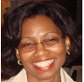
Acknowledgements…
Special thanks to Dr Glenda Gay, Senior Lecturer at the UWI, Cave Hill campus, who collaborated with me on the research.
I truly appreciate the time, attention, valuable insights and the research materials shared as we worked through the process.
Unwavering gratitude to the 90 trainee faculty members who participated
Thank you, for making this research engagement valuable!

