Slide 1
Getting started with accessibility
closed captioning at Brown University
Notes:
In the spring of 2014, Brown University began investigating ways to caption video content used for teaching, learning and/or documenting university events. Our goal: to lead a unified, campus-wide effort ensuring that we will meet the needs of all members of the Brown community. We will talk about our process, what we learned, and what we’ll need to do to improve the service.

Slide 2
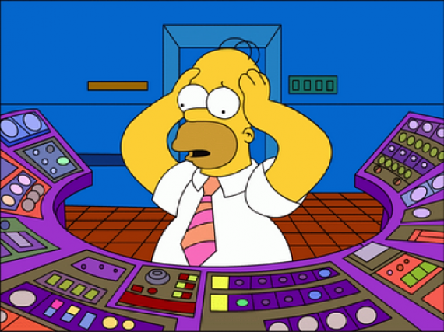
I DON’T KNOW WHERE TO START!

Slide 3
What needs to be more accessible?
Web design/online tools
Online video
Visual/text materials
Test taking
What’s most important to your university?

Slide 4
Captions matter
Let’s see some examples!

Slide 6
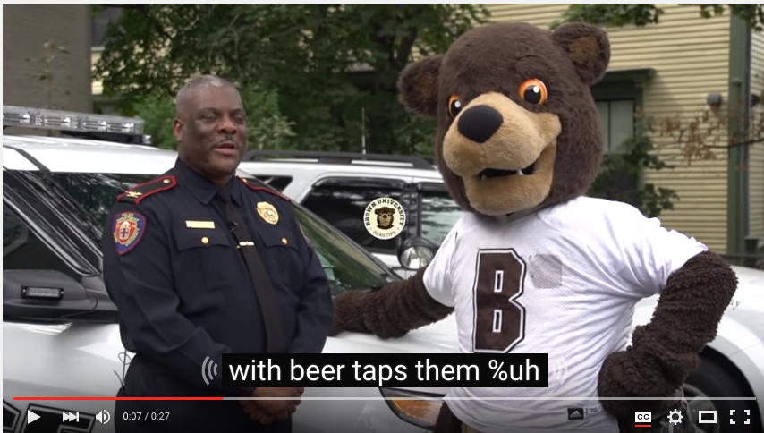
Captions matter!

Slide 8
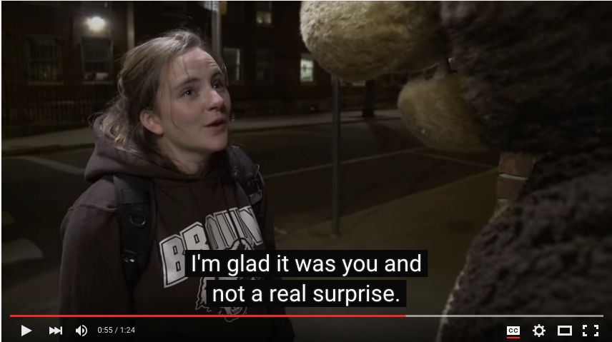
Notes:
Human captions are great because they use punctuation and are well-timed.
The context of your message isn’t lost.

Slide 9
Why did Brown start with captioning?
Use of video for teaching and learning is exploding!
Flipped classrooms and online courses
We needed to start somewhere! Captioning was an obvious area of need and making a difference seemed achievable.

Slide 10
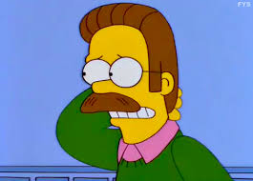
Lawsuits against universities made looking at technology accessibility a priority

Slide 11
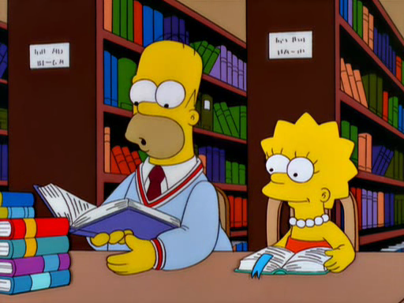
Working with experts is important

Slide 12
Poll: do you have accessibility experts on your campus?
1. We have an accessibility services office and I’ve worked with them.
2. We have an accessibility services office but I’ve never worked with them.
3. We don’t have this kind of resource on my campus.

Slide 13
Project participants
Brown had accessibility working groups in the past, but we created a specific group to focus on getting a University-wide process and policy in place

Slide 14
Why we chose who we chose:
Accurate captions
Standard time frame for caption delivery
Cost
Process/usability
Ability to integrate with video platforms/tools used at Brown
Flexibility, willingness to add features based on our needs
References, prior experience with the vendor

Slide 15
Benefits
Ensure compliance with the ADA and reduce risk of lawsuit
Reflect the University’s core values-visibility of doing the right thing
Attract applicants who are underrepresented at Brown

Slide 16
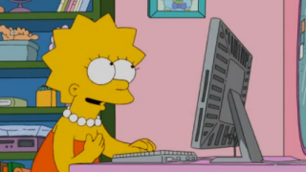
What do we caption?

Slide 17
How’s it going?
Estimating hours of content was difficult
We used a formula/strategy
We overestimated!
Caution- “should we caption this?”
What about videos that we don’t own (YouTube, etc?)
Other uses of captioning (unrelated to accessibility)

Slide 18
What did we learn?
Work with others on campus
Spread the word about the importance of accessibility
Consider accessibility whenever taking on a new project/solving a new problem
Ask for help from experts

Slide 19
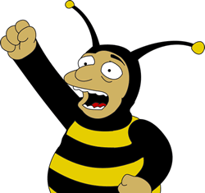
Where can YOU start?
What’s the current priority/buzz on your campus? Can you use that excitement to your advantage?

Slide 20
Resources
Brown’s Closed Captioning guidelines
National Association of the Deaf: ADA requirements and education
The Chronicle of Higher Education: April 22, 2010 “Compliance Is a ‘Major Vulnerability’ for Online Programs”
New York Times: February 12, 2015
“Harvard and MIT Are Sued Over Lack of Closed Captions”

Slide 21
Questions?
Get in touch!
catherine_zabriskie@brown.edu
gillian_bell@brown.edu

