Slide 1
Assessing Impact and Difficulty
Laurie Cochenour
Pitt Online
Notes:
How do decision makers prioritize making instructional materials and university websites accessible? At Pitt we collaborated with the Office of Disability Services to determine what the most commonly requested accommodations are for students with disabilities. Then we looked at the impact and the effort/affordability of making instructional materials accessible. The result is what we refer to as the Accessibility Matrix which has helped us prioritize the actions we need to take to make our courses and instructional materials accessible to all students.

Slide 2
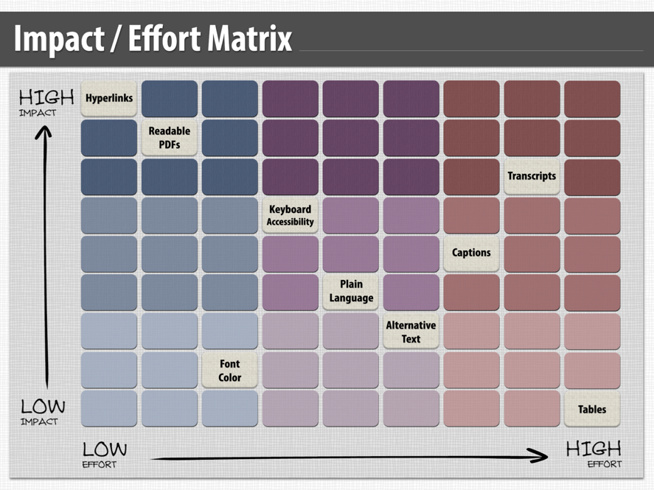
Notes:
I don’t suggest that this is the final word on how this chart should look. In fact, I think if we revisited it today we would prioritize items differently. For example, during the process of reviewing Pitt websites using the WAVE tool, we discovered that the gold used on Pitt’s webpages doesn’t meet the contrast specifications for accessibility. That would seem a fairly easy fix. However, for Pitt it would mean completely redoing all webpages associated with the university. So, if you want to create your own matrix, you need to take into consideration your university’s goals, specific web design themes, and resources available for this endeavor.
Creating new materials or websites that meet accessibility standards is much easier than retrofitting existing ones.

Slide 3
Impact/Effort Matrix
Task
Hyperlinks
Readable PDFs
Font Color
Keyboard Accessibility
Plain Language
Alternative Text
Captions
Transcripts
Tables
Notes:
If you visit the Center for Instructional Development and Distance Education website at: -------, you will see this chart that describes the task, explains how it effects accessibility and provides examples.

