Slide 1
Condensing the Cloud
Developing a Coordinated Organizational Approach Towards Service Sourcing
Bruce Maas, Chief Information Officer
Melissa Woo, Acting Chief Operating Officer
Copyright Bruce Maas and Melissa Woo 2011. This work is the intellectual property of the authors. Permission is granted for this material to be shared for non-commercial, educational purposes, provided that this copyright statement appears on the reproduced materials and notice is given that the copying is by permission of the author. To disseminate otherwise or to republish requires written permission from the author.
Notes:
Condensing the Cloud: Developing a Coordinated Organizational Approach Towards Service Sourcing
Bruce Maas
Melissa Woo
University of Wisconsin-Milwaukee
We are frequently bombarded with information on how to tackle the "cloud" in specific contexts—service sourcing alternatives, legal concerns, its effects on jobs—but we're given little guidance on how to develop an approach that integrates these different contexts strategically. In this session, we will describe how our organization is creating a shared vision that combines service sourcing, staff professional development, IT service management, strategic communications, and campus partnerships into a coordinated approach to the cloud.

Slide 2
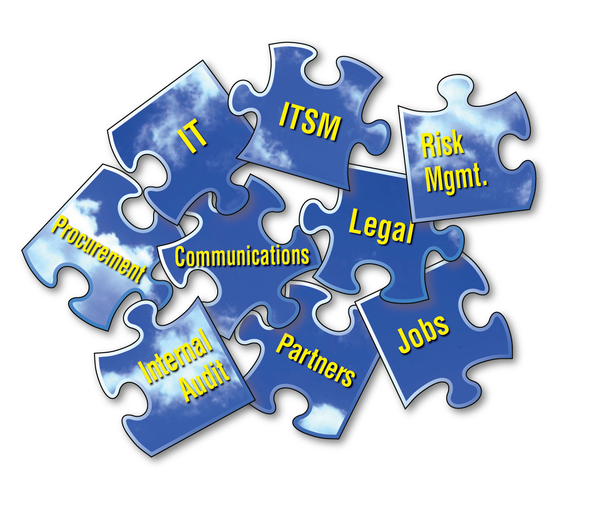
Notes:
Lately we have been bombarded by information related to the effect of cloud services on the future of IT.
There are so many separate pieces of information about the cloud. How can we assemble these pieces into a consistent and coherent approach to the cloud in our organizations?

Slide 3
Shift happens…
Provider
Sole source
Facilitator
Multi-sourced services
Notes:
The increasing adoption of cloud services requires a shift in our thinking in a number of areas.
Given the increasing consumerization and democratization of IT, IT needs to stop thinking of itself as the sole service provider to the campus community. Instead, IT will need to shift towards a role in aggregating and maintaining a portfolio of multi-sourced services. IT will be counted upon to work with faculty, staff and students to facilitate the best use of technology to achieve their goals.
The shift from being a provider to a service facilitator and aggregator will necessitate a change in many, if not most, IT professional's jobs. IT professionals will increasingly need to shift from a purely technical focus to one that is more fully client-facing. Skills in business analysis, risk management, vendor management and service integration will become more important than specific technology knowledge.
IT service management is also changing. When all services were maintained on-premise, IT had "control" over each process, such as change management and incident management. In cases that a service is sourced above-campus, some aspects of such processes are no longer under our control, and are often opaque to us. IT needs to change its approach to IT service management to compensate for these differences.

Slide 4
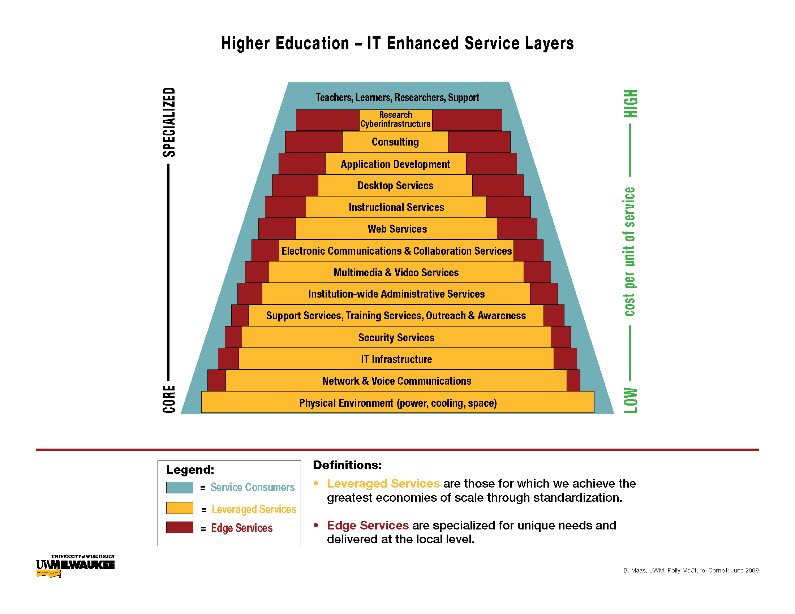
Notes:
Our vision for the future includes a "service layers" model in which personnel resources and service sourcing options are leveraged as appropriate based on the level of standardization or specialization required.
Each service layer combines services that are best leveraged via outsourcing or central IT and those that are best provided by "edge," i.e., distributed IT.
Services that benefit from standardization tend to be best served via a provider (outsourced or on-premise) that operates at a larger scale. As services become more specialized in nature, the contribution of large-scale providers tends to be reduced, and such services are often best provided from the edge.
There can exist multiple, different versions of this service layer model on one campus. Often different schools/colleges on campus will have very different needs because of factors such as level of resources available, the nature of the scholarship in different disciplines, and cultural acceptance. For example, natural sciences may have a very different balance and source of leverage vs. edge than the arts.
A PDF of the Service Layers diagram can be downloaded from the EDUCAUSE site at: http://www.educause.edu/sites/default/files/library/presentations/E10/SEM03A/Service%2BLayer%2BDiagram-High%2BLevel.pdf

Slide 5
Partnerships
Notes:
We have formed a new, stronger partnership between information security, procurement, internal audit, legal affairs and IT operations.
This team tackles cloud-related issues so that multiple viewpoints and concerns of adopting cloud services are addressed.
This partnership has resulted in better collaboration and dialog between the areas, including joint campus presentations on the topic of cloud services.
One of the upcoming tasks for this group will be to work with campus to identify requirements for campus-wide cloud contracts. For example, a cloud-based storage service might become the "preferred" service towards which faculty, staff and students would be referred. Although it would not preclude the use of other cloud storage services, the service on campus contract would be the best supported.
The most important lesson that we have learned from this partnership is that attention needs to be paid to staffing levels in each of the partner groups. Understaffing leads results in lengthy evaluation processes of contracts, and prevents the processes from being nimble, leading to frustration for those waiting to use the services they want.

Slide 6
Realigning strengths and skills
Business analysis
Strategic communications
Risk management
Vendor management
“Cloud" architecture
Notes:
As our organization shifts from a "techie" focus towards a client- and business-oriented focus, our staff will need to develop skills to remain relevant in the cloudy future. As such skills are also currently relevant, the additional professional development investment provides both short- and long-term benefits.
In order to provide our staff with skills they need today and in the future, we continue to provide the technical training needed to stay current but are also providing training in business-related skills.
Business analysis skills, such as project management and requirements management, will become even more important. Other skills needed include risk management and vendor management.
For those who wish to retain more of a technical focus, there are likely to be opportunities in the areas of high-level architecture, design and service integration.
We offer the following training to all staff to develop business-related skills:
strategic communications
project management
requirements elicitation
ITIL
Currently we are assessing individual and group strengths using the StrengthsFinder assessment. We plan to utilize the information to help align staff, groups and leaders with appropriate roles and functions for the future.
Our conversations with our staff have had mixed results. Our younger staff seem pleased that we wish to help them address their futures actively. However, some of our more established staff are expressing concerns about the changes to their roles. Therefore we are continuing to refine our approach and communications regarding professional development.

Slide 7
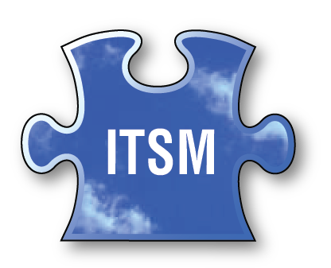
ITSM Changes
Change management
Incident management
Notes:
Another area in which service multi-sourcing has a significant effect is IT service management.
Our organization is currently adopting ITIL processes for IT service management. Unfortunately, the greater incorporation of externally provided services from multiple vendors adds complexity to ITIL processes.
External vendors have control over aspects of some ITIL processes, including change management and incident management. Often the aspects controlled by vendors are opaque to our organizations.

Slide 8
Strategic Communications
Central IT staff
Distributed IT staff
Campus community
Notes:
As we move towards greater adoption of services that are not locally sourced, change leadership has become increasingly important.
Strategic communication is a key component of change leadership. Aspects of our strategic communications regarding service multi-sourcing have included:
Central IT staff
nature of IT jobs is likely to shift
we are offering professional development assistance to enhance skills in areas of projected growth
individuals are responsible for their own futures and need to engage actively in their professional development
Distributed IT staff
their roles in direct support of faculty/staff become increasingly important
will likely have to be knowledgeable in cloud-based services in order to support clients
will likely see greater centralization of services that can be leveraged at scale
Campus community
support levels differ for cloud-based services - increased amount of self-support may be needed
customizations tend to be minimized in cloud-based services

Slide 9
Notes:
How did we go about putting the pieces of the puzzle together? (Of course, this is still a work-in-progress!)
Seven years ago, the CIO established a number of core service initiatives. Essentially, he invited “non-typical” participants into the IT “party.” Areas such as audit, legal and procurement were invited to participate in training activities, governance groups, and on project teams. Working together led to the realization that it was very useful to have input from each of the specialties in order to make the best decisions.
Four years ago, we adopted the IIBA (http://www.theiiba.org) requirements management practices internally and also offered requirements management services to other areas on campus. This was foundational and necessary, as it provided for a shared vocabulary and shared processes.
Next, our organization incorporated an improved strategic communications framework to aid in conveying information effectively both internally and to the campus. As part of this effort, all central IT staff attended a multi-day strategic communications course.
(Bruce)
Two years ago, we first introduced the idea of IT Service Management (ITSM) utilizing the ITILv3 framework to central IT staff. However, our ITSM efforts really began in earnest about a year ago, when we kicked off our ITSM program by providing a ITILv3 Foundation training and certification course for 25 individuals representing central and distributed IT units.
The groundwork laid by the development of the core service initiatives seven years ago helped in establishing the trust and sense of teamwork needed to create a cloud service contract review team. As previously described, the review team consists of individuals from Internal Audit, Legal Affairs, Procurement, Information Security and IT.
The final piece that rounds out the puzzle is that we are addressing staff professional development and training for a future where services will be sourced from multiple places, not just central IT.
We utilize what we have learned in strategic communications to convey to the campus community the potential, opportunities, risks and changes that adoption of the cloud brings. Similarly, we are utilizing strategic communications as part of socializing our staff to the need to consider their own professional development to prepare for their futures. Our partnership with the other areas of the review team demonstrate to our staff potential areas they might want to explore as part of their professional development to future-proof their careers. Similarly, our staff are also recognizing the important role of ITSM processes in managing multiply-sourced services.

Slide 10
Sharing
your
ideas…
▪ Staff professional development
▪ IT service management
▪ Strategic communications
▪ Change leadership
▪ Campus partnerships
▪ Other ideas?
Notes:
Group exercise:
Split into small groups.
In your group, spend 5 minutes identifying and recording your top problems and/or barriers in your organization’s adoption of cloud services.
Now, pass your list to the next group.
Each group then brainstorms solutions to the problems given to them by the other group for 5 minutes.
Report back the best solutions your group has suggested to the other group’s problems.

Slide 11
Condensing the Cloud
Developing a Coordinated Organizational Approach Towards Service Sourcing
Bruce Maas bmaas@uwm.edu
Melissa Woo mzwoo@uwm.edu
Notes:
Condensing the Cloud: Developing a Coordinated Organizational Approach Towards Service Sourcing
Bruce Maas
Melissa Woo
University of Wisconsin-Milwaukee
Cloud-related publications:
Shaping the Higher Education Cloud: An EDUCAUSE and NACUBO White Paper, May 2010, http://net.educause.edu/ir/library/pdf/PUB9009.pdf
Brukbacher, Steve. “Practical Strategies for Managing Risk in Cloud Computing” (Research Bulletin 3, 2011). Boulder, CO: EDUCAUSE Center for Applied Research, 2011, available from http://www.educause.edu/ecar
Schaefer, Beth, and Melissa Woo. “Structuring the IT Organization for Cloud Services” (Research Bulletin 12, 2010). Boulder, CO: EDUCAUSE Center for Applied Research, 2010, available from http://www.educause.edu/ecar.
Woo, Melissa and Michael Dieckmann. “The Multiple Personalities of Cloud Computing” EDUCAUSE Review, Vol. 45, No. 3, May/June 2010.
Cloud-related presentations:
Cloud Computing Policy and Legal Issues, 2010 Midwest Regional EDUCAUSE Conference, http://net.educause.edu/MWRC10/Program/1022708?PRODUCT_CODE=MWRC10/DISC02
Evaluating the Cloud: Making a Decision for Your Campus, 2010 EDUCAUSE Annual Conference, http://www.educause.edu/E2010/Program/CORP12
Cloud Computing Security: An Oxymoron?, 2010 EDUCAUSE Annual Conference, http://www.educause.edu/E2010/Program/DISC14
Cloud Computing: Hype or Hope?, 2009 EDUCAUSE Conference, http://www.educause.edu/E09+Hybrid/EDUCAUSE2009FacetoFaceConferen/CloudComputingHypeorHope/175837
Cloud Computing: Three Views of the Cloud, 2009 EDUCAUSE Enterprise Information & Technology Conference, http://net.educause.edu/ENT09/Program/1020525?PRODUCT_CODE=ENT09/SESS10

