Slide 1
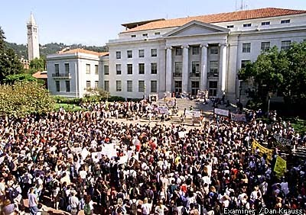
Breaking Through the Barriers to Enterprise Standardization, Without All the Pain
Bill Allison
Director, Campus Technology Services / IST
Chair, IT Architecture Committee
UC Berkeley

Slide 2

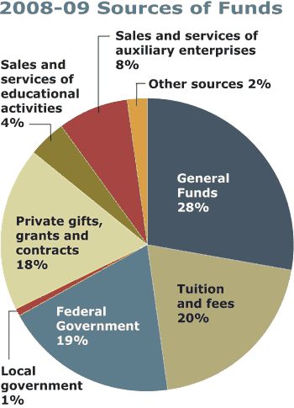
Context: UC Berkeley
Year Chartered: 1868
Carnegie Classification: RU/VH (R1)
Fulltime Faculty: 1,582
Part-time Faculty: 500
Undergraduate Students: 25,500
Graduate Students: 10,298
Staff: 10,000
Academic Departments: 130
Annual Revenue: $1.78B
State (gen funds): $498M
Research: $650M
Tuition: $330M
Central IT Budget: $ 60M
Total campus IT spending: $160M
Total campus IT Staff (FTE): ~800
Reference: http://berkeley.edu/about/fact.shtml

Slide 3
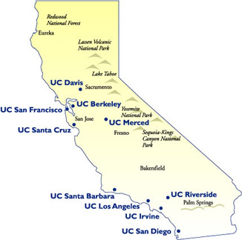
UC Berkeley’s “Enterprise”
UC Berkeley
And one campus in the larger “UC Enterprise”:
Sample Administrative
Departments:
Finance
HR Center
Student Affairs
IST (IT)
Sample (of the 130) Academic
Departments:
Letters & Sciences
Business School
Law School
Public Health
Optometry
Public Policy
EECS
Forestry

Slide 4
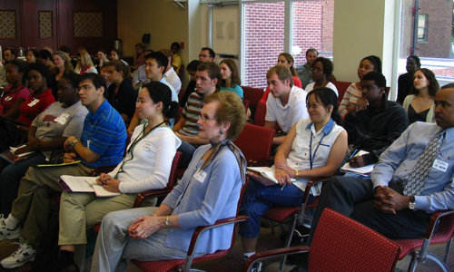
Questions for You

Slide 5
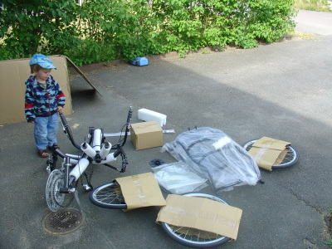
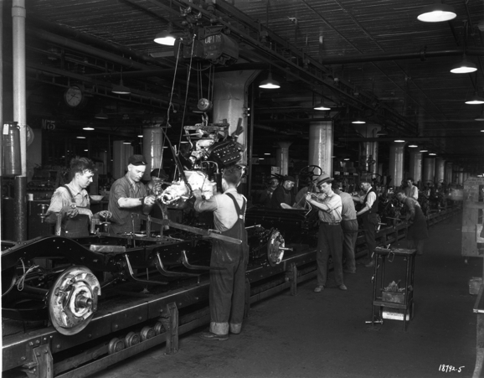
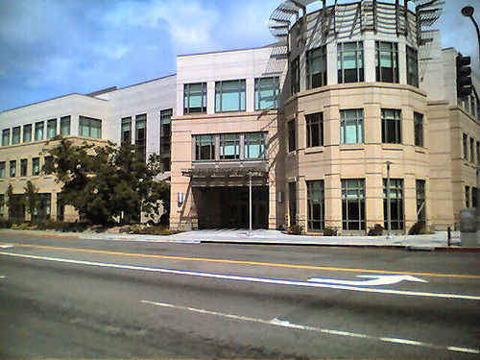
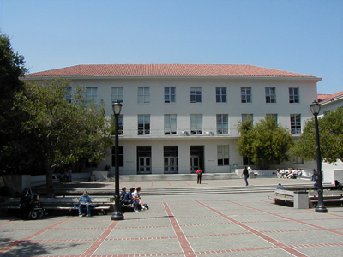
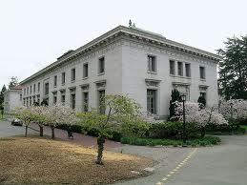
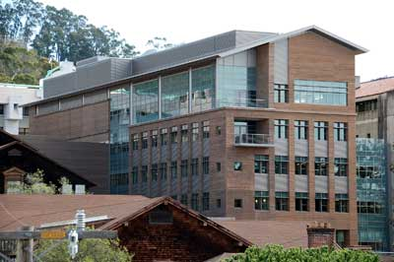
Enterprise Standardization
Enterprise = whole organization
Standardization = agreement on common approach
Optimizing the greater good
Local sub-optimization implied
GOAL: Different divisions with common processes and Shared Service Centers

Slide 6
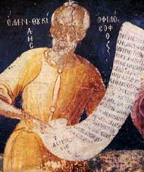
Enterprise Systems History
Patterns recur, but in different form
Pattern of Evolution/Maturity
At first People were the Process
Scope of Process expands
Economic, consumer drivers

Slide 7
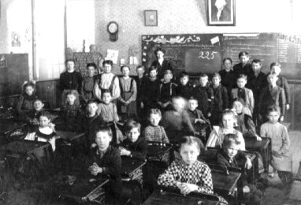
Approach for Today
Enterprise Systems at Berkeley
Growth of Complexity and Cost
The Dream of Standardization
Barriers to Standardization
Case Studies – overcoming the barriers

Slide 8
The UC Payroll/Personnel System
(1970’s)
1976: UC needs a payroll system
The Integral contract and design
Attempts to standardize pay rules
Maintenance
Mainframe systems through PC era, selling point is customization: “no change required”

Slide 9
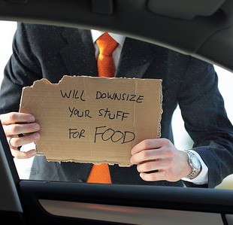
Meanwhile, in the business world…
(Late 1980’s-1990’s)
Ratio of managers to workers increased from 19% in 1950 to 32% in 1987
Since 1988 1/3 - 1/2 of all med/large U.S. businesses downsized every year
“Compact” Broken in 1990’s

Slide 10
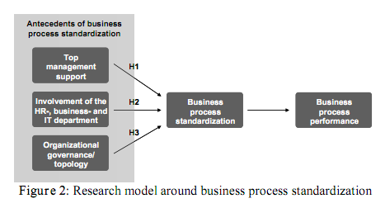
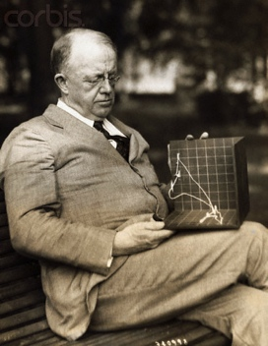




Business Process Standardization:
(1990’s)
1920’s – Frank Gilbreth
and his “therblig” units
July 1990 HBR: Michael Hammer “Don’t automate, obliterate”
Rethink business when bringing technology in
Influence on ERP

Slide 11
ERP Comes to UC Berkeley
(1994-2005)
ERP Immaturity
Encoding existing practices
Customization & deferred maintenance
Local control versus standardization
HR and Financial Systems
Reporting
Automation without coordination

Slide 12
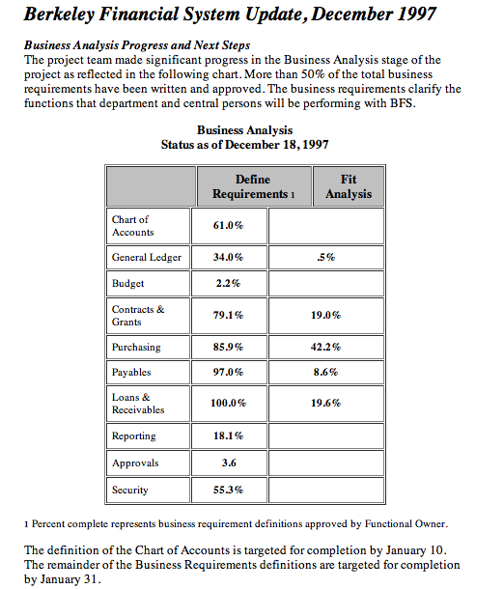
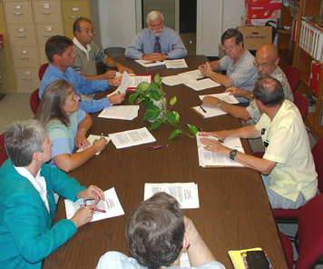
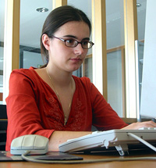
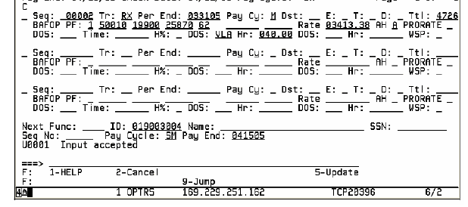
Functional Owners & the
Departmental User
Fit/Gap
Two Constituencies
The Role of IT

Slide 13
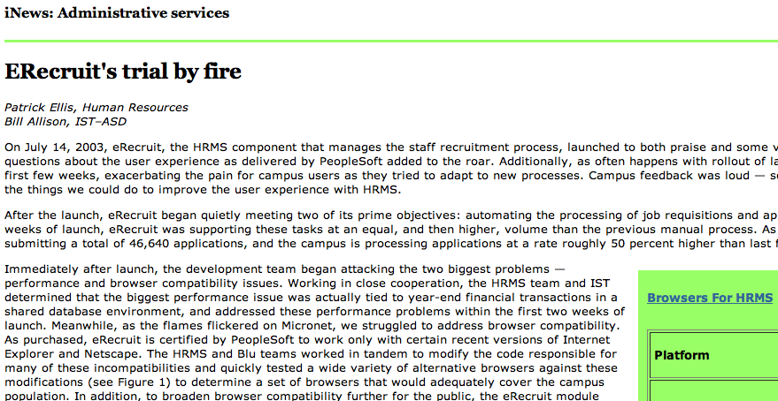
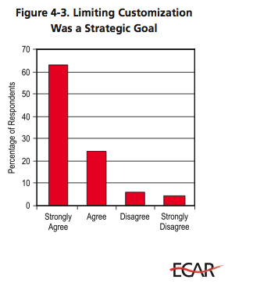
Customization & Satisfaction
(2003)
CHALLENGES:
User satisfaction correlates with customization
Cost also correlates with degree of customization
Complexity / Maintainability

Slide 14
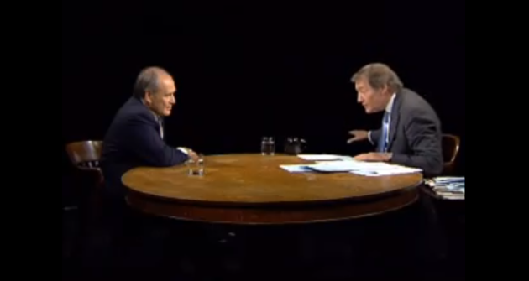
The Dream
(2008)
“Charlie, we rolled out Peoplesoft HR in 6 months and full SAP in 3 months at Home Depot”
Notes:
Robert Nardelli on Charlie Rose, 2008

Slide 15
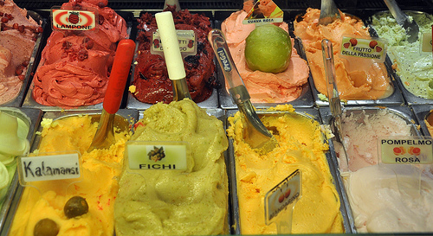

Standardization: the push for vanilla
(2008)

Slide 16
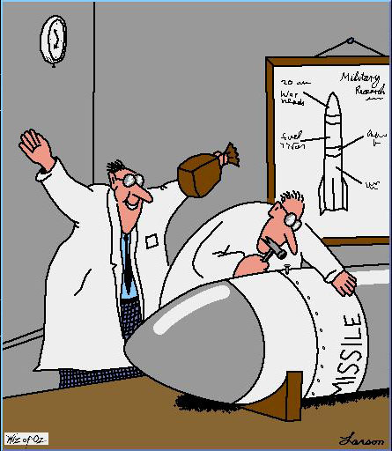
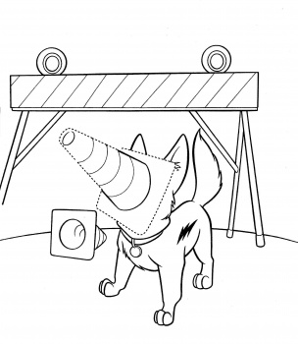
Barriers to Standardization
Truly Unique Processes
Cultural Resistance (Administration, IT & Departments)
Lack of exception process

Slide 17
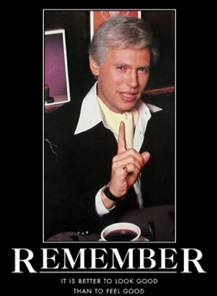
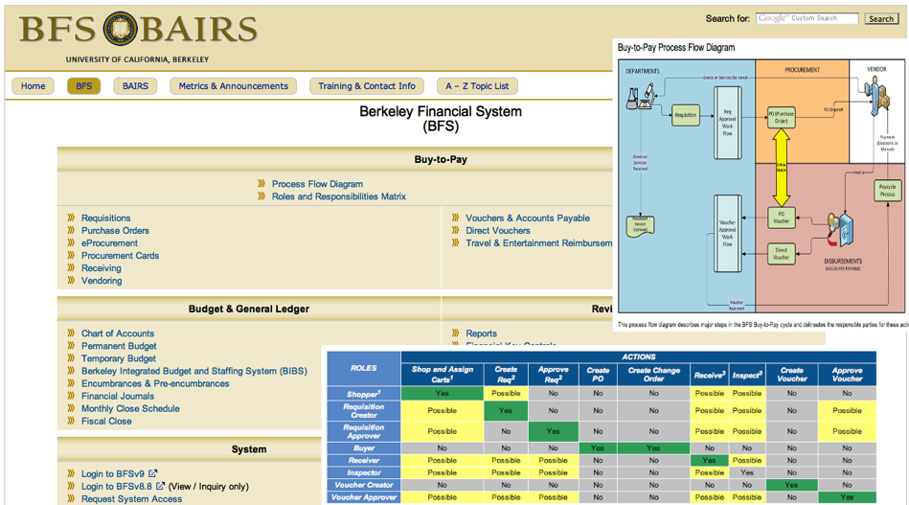

We *Look* Great! But…
(2008-2010)
Everyone gets 1,500 to 40 (vanilla)
Functional owners didn’t get departmental needs
Process automation didn’t get reengineering
Business rules didn’t get understood
Everybody got pain: administration & departments
Pain got exacerbated by aggressive schedule

Slide 18
Lessons of Vanilla
(2010)
Notes:
Just kidding

Slide 19

Lessons of Vanilla
(2010)
Move to “vanilla” brought stealth reengineering in the form of delivered processes
Need for broad, multi-channel outreach & engagement
Broader representation needed (both constituencies)
Temptation of leadership to over-sell benefits
Change management and communications
“We need less consensus and more participation”
Delays from fear of being wrong – paralysis and then snap decisions

Slide 20
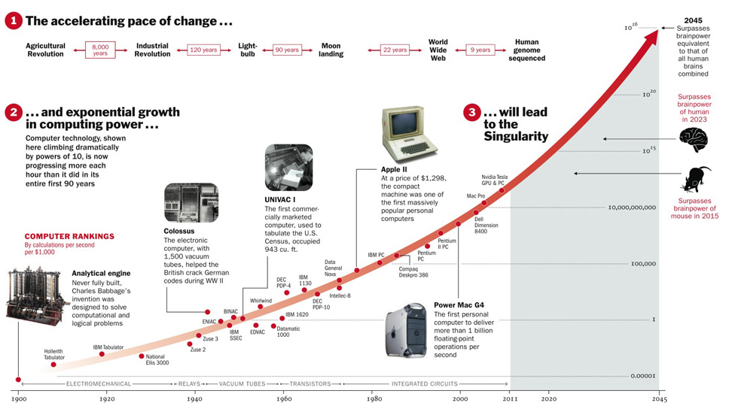

Change Is Coming
Notes:
Graphic from Time Magazine, 2010

Slide 21
Change Is Coming to Cal
Leadership must make more nimble, effective decisions
Campus must define governance: input vs. decision rights; who makes decisions and how
The institution must simplify its processes
The institution must reengineer the way it selects, configures and deploys technology
The campuses must standardize where we can across the UC system
This requires re-thinking the organization’s staffing models

Slide 22
The IT Organization Today
784 Berkeley staff classified in IT jobs today
  ($81M annually)
    42 work in demand to identify and document all aspects of the problem to be solved
    46 work in design and business analysis of projects
    696 work in delivery of services (the fire-fighters)

Slide 23

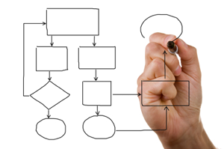

Need to balance:
Demand, Design, Delivery
Demand Planning: 25%
Identify and document all aspects of the problem to be solved
Detailed Design: 30%
Analyze process, data and technology options and map the solution at the right layer
Delivery: 45%
Borrow, buy, or build the right solution to achieve the design

Slide 24
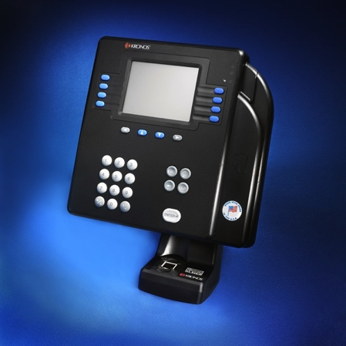
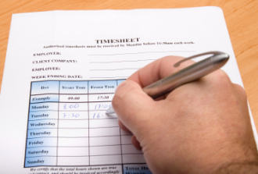
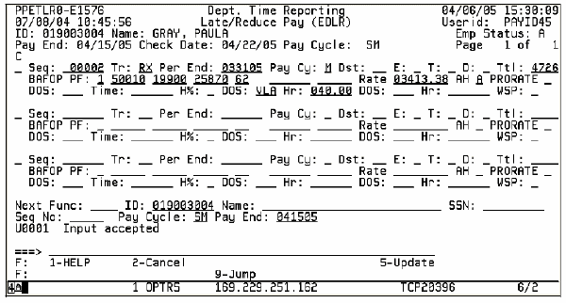
Managing Demand
24 Timekeeping systems at UC Berkeley
2 that integrate with PPS electronically
Standardizing on solution
Standard rules : Nonstandard interpretation
The importance of stupid questions
Incentives matter

Slide 25
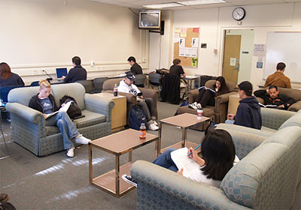

Aligning Design with Vision
Strategy: “Become more student-centric”
Team’s Interpretation:
Registrar’s Vision:
Student-service focus:
Comfortable Wait
Student-service focus:
No Wait
Initiative team designed new comfortable waiting area with couches, TV etc.
What he meant: Design the registration process to run “like a hotel check-in”

Slide 26
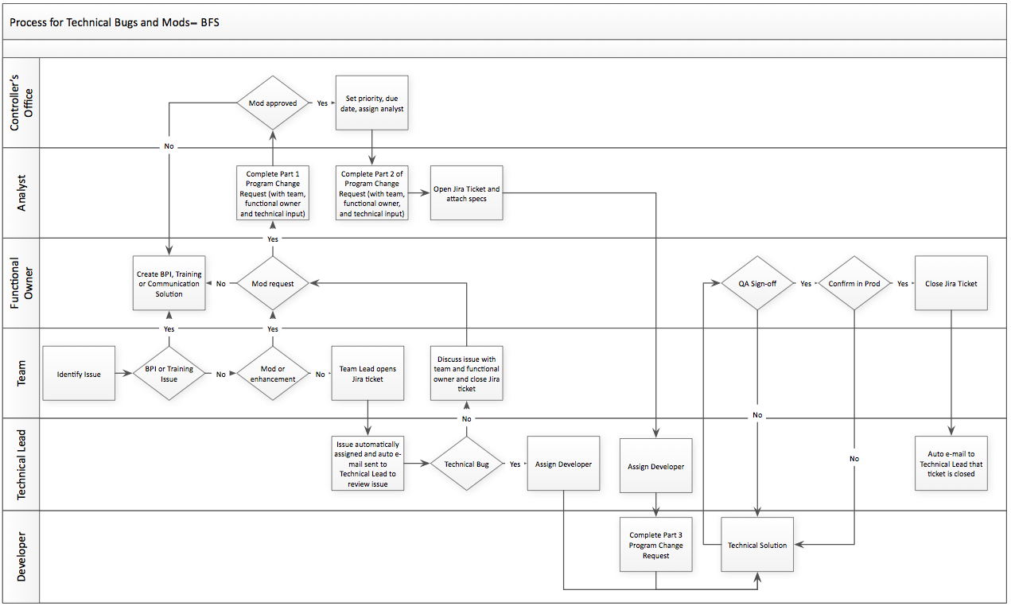
Sustaining Standards through Change Management
Notes:
Swimlanes are: developer, tech lead, team, functional owner, analyst, controller (exec) --- need change governance.

Slide 27
Multi-campus eProcurement
Using Lessons from Vanilla
New model in play: Saas
A New Role for IT
Business in the Driver’s Seat
Managing Risk and Expectations

Slide 28
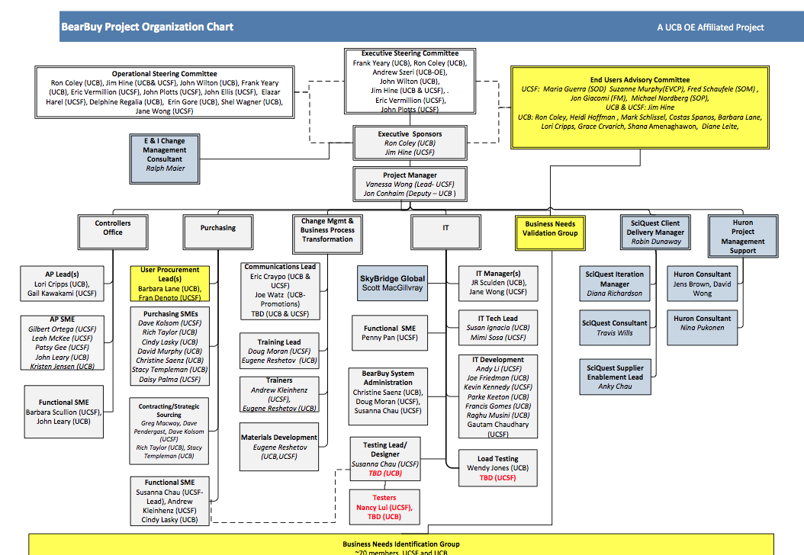
Staffing A Project for Standardization

Slide 29
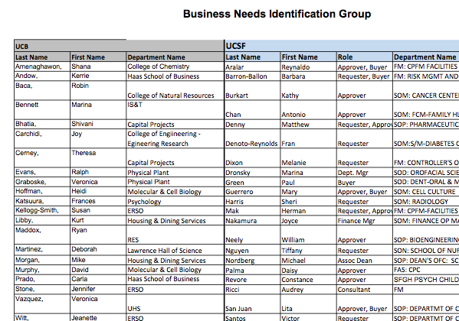
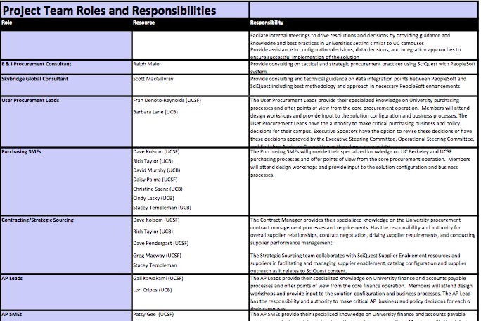
Clearly Defining Roles

Slide 30
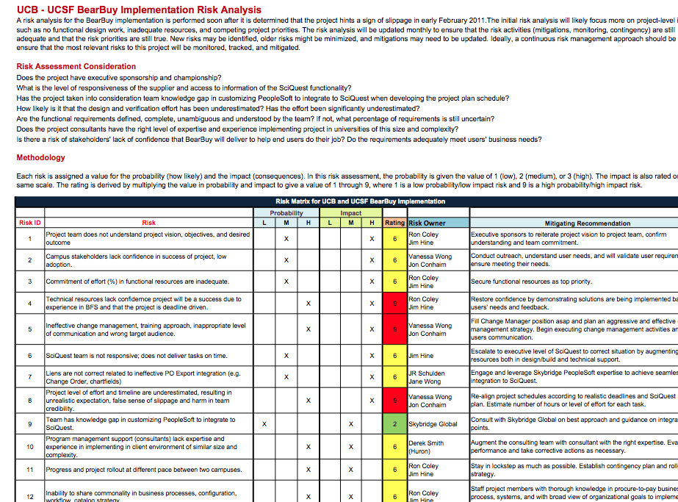
Managing Risk

Slide 31
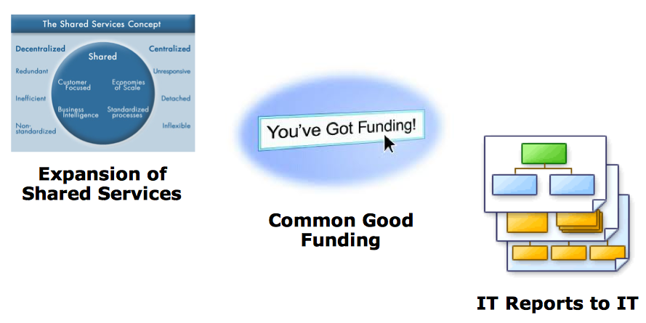
Where do we go from here?
Shared Service Centers
Re-engineered organization (demand, design, deliver)
IT shifts more focus to a consultative role to the business
Defining governance and funding for common good
Robust program management function

Slide 32
Discussion & Questions

