Slide 1
On-Demand SaaS
Guy D. Falsetti
Sr. Systems Architect
University of Iowa

Slide 2
University of Iowa
Founded in 1847
Over 30,000 students
Over 12,000 FTE Faculty and Staff
Large healthcare enterprise

Slide 3
MS Blaster Worm
Hit the Iowa campus August 2004
Generally unprepared for the event
One long-term goal: “Secure Computing” initiative
Notes:
Don’t know if I like the graphic

Slide 4
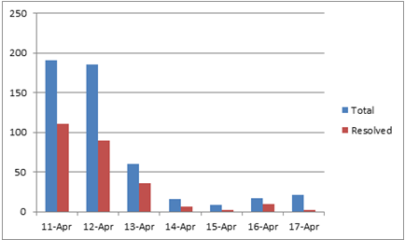
FlashBack Trojan Cases

Slide 5
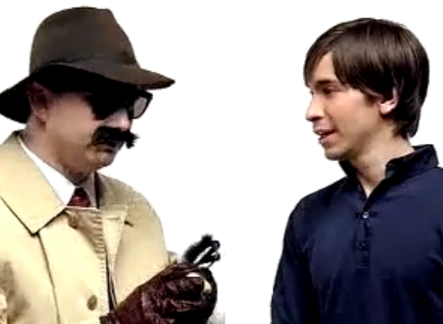
Wake-up Call to Mac Users

Slide 6
Client Management Definition
OS Management: Configuration changes, security patching, power management, Wake-On-LAN
OS Deployment: Operating system deployment for out-of-box, refresh, and replace scenarios
Asset Management: Inventory, reporting, license management
Application Management: Application deployment, patching, software inventory

Slide 7
Areas of Success
Central infrastructure
Departmental IT support
Software as a service
OS deployment
Building a community for support

Slide 8
Central Infrastructure
Notes:
This accounts for about 80% of the workstation in our Active Directory

Slide 9
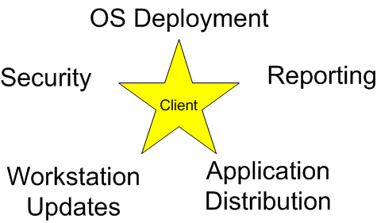
Features of Infrastructure

Slide 10
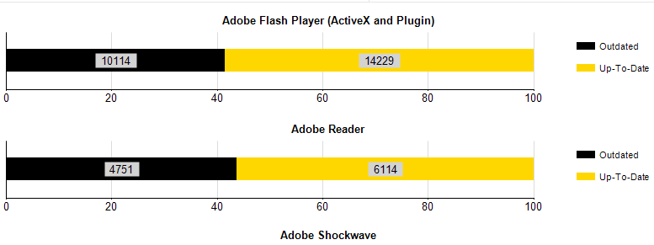
Reporting
Building a common set of metrics for campus
Example: Adobe Report
Notes:
We have a lot of reports we can generate. This is just an example.

Slide 11
Partnerships On Campus
56 departments participate
Types of IT groups
Small departments – Internal Audit
Large departments – College Liberal Arts and Sciences

Slide 12
Small Departments
Central ITS manages workstation
Service Offering
File space
Workstation set up
Print server
Application delivery
Security updates

Slide 13
Large Departments
Meet with the central group to build a root collection
Central ITS basic training
Full control to manage their workstations
File space
Workstation set up
Print server
Applications delivery
Security updates

Slide 14
Application Deployment
Shared set of deployment packages
Central IT provides applications to campus
200+
Total departmental deployments
22,000+

Slide 15
Virtual Desktop
Over 156 applications

Slide 16
Building a Community
Allowed central and individual departments to come together on projects
Both sides benefited from project
Central got a more secure campus environment
Departments saved time and dollars

Slide 17
Reciprocal Sharing
Best practices on how to do deployments
Help other departments solve problems
Reporting templates for better management
Experience with hardware drivers

Slide 18
ITADmin Community
Monthly meetings
Over 70 people attend every meeting
Over 200 people on an e-mail list
Iowa serves as benchmark for campus IT communities

Slide 19
Questions ?

