Slide 1

Project, Portfolio and Service Management Software Built for Higher Education
More colleges and universities depend on TeamDynamixHE PPSM than any other solution
Coordinating Project, Portfolio, and Service Management: Overcoming Obstacles to Operational Excellence
Notes:
The goal of this presentation is to leave you with a few take aways to help your institution improve. We are going to cover a lot of ground here but this is meant to be an overview of our experiences with IT leader across higher ed. This will also be recorded.

Slide 2

Agenda
Review of common obstacles
Approaches for consideration
Q&A

Slide 3
TeamDynamixHE Mission
“To enable college and university IT organizations to achieve their business objectives through products and services that foster operational excellence and exceed expectations”
Notes:
Focused on the betterment of higher education operations and helping teams increase the value they add
Analsysts are constantly engaged in assessing HE challenges and monitoring trends Gartner, EDUCAUSE, Campus Tech, etc..

Slide 4




















Client Sample

Slide 5
TeamDynamixHE Advisory Council
  The TAC is self governing steering committee comprised entirely of higher education leadership
      Maintains its own bylaws and leadership
      Meets quarterly with one annual face-to-face meeting
      Responsibilities
        HE alignment
        Prioritize enhancements
        Product partnering
        Use case development
        Review
        Beta testing

Slide 6
Project, Portfolio and Service Management Software Built for Higher Education
More colleges and universities depend on TeamDynamixHE PPSM than any other solution
Trends in Building Operational Excellence

Slide 7
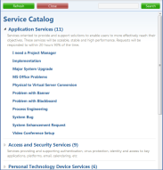










Project, Portfolio and Service Management
Work Requests
Work Request Fulfillment Streams
Service Catalog
Governance & Projects
Productivity
MyWork®
Email
Routing Logic
Service Desk & Assets
TDMobile
Web Forms
TDCommunity
Web Services
Operations & Change Management
Tickets
Reporting
Web Services: Service-Oriented Architecture
Notes:
We are seeing a transition from silo’d solutions to cross silo solutions focusing on coordinating project portfolio, change and service mgmt solution. Think of this as a conceptual diagram for solutions, whatever they may be to these problems. This is a depiction of our product road map which is essentially designed to support the moving parts of IT. This will also guide a walk through of process and tool concepts.
You may only be concerned with a limited list.

Slide 8
Common Roadblocks
Challenging budget and capacity environments
Negative perception of IT’s value
Difficulty making confident decisions/commitments due to unclear understanding of activities, capacity, status, priorities
Difficulty adjusting to rapidly changing priorities
Staff’s resistance to change
Determining where to begin
Notes:
We are going to walk through these challenges will and present approaches that we have seen to be successful within other institutions. I should also say that I am
not suggesting that
1. this list is comprehensive
2. that we know the challenges of your individual institution
3. I’m not suggesting that you face any of these challenges
I will say that the content in this presentation has been built and tested for over a decade through observation, interview and hands on work with excellent colleges and universities addressing these challenges.
The goal is to give you ideas around how to improve. And by the way I’m not going to suggest any concepts that absolutely require TeamDynamix software or services. You may have the tools and skills you need in house. I will use our product from time to time as an example but you may have existing tools or the lack of need for tools given the complexity of the organization.

Slide 9
Project, Portfolio and Service Management Software Built for Higher Education
More colleges and universities depend on TeamDynamixHE PPSM than any other solution
Common Challenge:
Budget and Resource Constraints

Slide 10
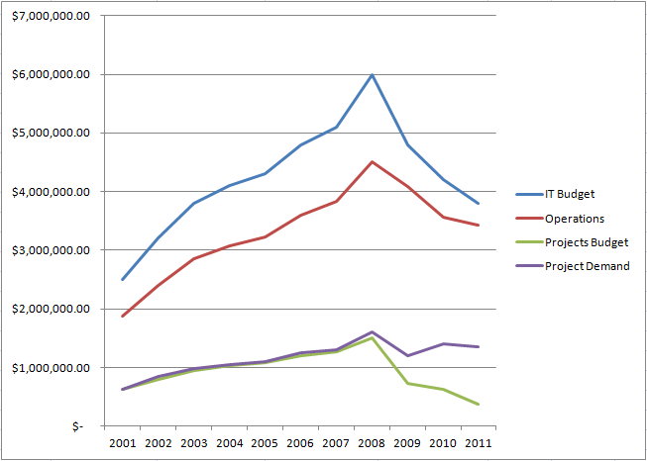


The CIO’s Environment: 1999-2012
Innovation Budget (Projects)
CIO
Project Demand

Slide 11
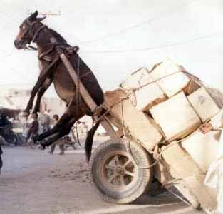


Business Overview
<
Budget
Budget needed to meet demands

Slide 12




Business Overview
President
“I don’t have the resources to complete all of the work being asked of me between projects, support and required operations work to keep the lights on.”
Deans
Deans
CIO
Faculty
Researchers

Slide 13
Business Overview
President
“We gave you $10M this year. What do you mean you can’t get the work done? Just do your job and figure out how to make it work.”
Deans
CIO
Faculty
Researchers
Notes:
It’s very difficult to affect change when the organization is constantly understaffed, fighting fires and jumping from priority to priority.

Slide 14
Project, Portfolio and Service Management Software Built for Higher Education
More colleges and universities depend on TeamDynamixHE PPSM than any other solution
Common Challenge:
Perceived Value Challenges

Slide 15
Problem 1: Stakeholders Have Limited Visibility
Stakeholders often have a limited frame of reference and don’t understand the full scope of IT work
“I just don’t know what they do with $10M per year”
Application Management
Learning Management System (LMS)
Student Information System (SIS)
Infrastructure Management
Servers
Content Management System (CMS)
Facilities Management System
Custom Development
Networks
Security
Support Services
Student Help desk
Faculty Help Desk
PC/Phone Mgmt.
Telephony
Admin Services
Application Hosting
Compliance
Project Services (PMO)
Email
A/V Equipment
Security
Limited Understanding
Limited Understanding
Notes:
Managing expectations

Slide 16



Problem 2: Stakeholders Find IT Difficult to Engage
“I don’t know how to request a new report. I guess I’ll email my friend Ken. He’ll handle it.”
Web forms
President
“I email requests to IT but never know what happens to them. It’s frustrating.”
Docs
Deans
“I need a new laptop. Who do I talk to? It’s hard to deal with IT. It will probably take forever to get it anyway.”
Conversations
Faculty
Email
“For an applications project I email a word doc request. For a hosting request I go to a web site, and for an AV need I submit a ticket. What happens to all of my requests, and how do I check on their status?
Researchers
Service Desk

Slide 17
Project, Portfolio and Service Management Software Built for Higher Education
More colleges and universities depend on TeamDynamixHE PPSM than any other solution
Common Challenge:
Difficulty Making Confident Decisions/Commitments
&
Adjusting to Rapidly Changing Priorities
Notes:
Many institutions do not have a solid foundation to do so.

Slide 18




How work is typically requested and tracked
Word
Word
Web forms
Support Services
Ticketing Software
Web forms
Admin Services
Ticketing Software
Excel
PPT
Excel
PPT
Email
MS Project
Email
Custom DB
Custom DB
Web forms
Word
Ticketing Software
Web forms
Word
Ticketing Software
Infrastructure Management
Application Management
Excel
PPT
Excel
PPT
MS Project
Email
MS Project
Email
Custom DB
Custom DB

Slide 19

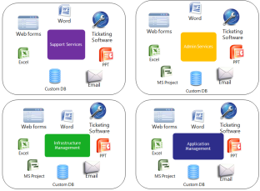
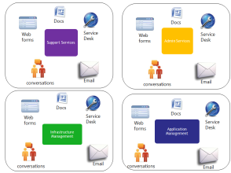
Making confident management decisions is difficult
Multiple work tracking tools, multiple departments, with data that changes minute by minute
Reports require massive amounts of manual effort and are instantaneously obsolete and untrustworthy
IT
Multiple request channels, multiple departments, with data that changes minute by minute

Slide 20
Old Work Management Paradigm
Support Services
Admin Systems
Infrastructure Management
Academic Systems

Slide 21
Changing Work Management Paradigms
Support Services
Admin Systems
Infrastructure Management
Academic Systems
Notes:
It’s very difficult to manage outcomes for customers when multiple departments with varying goals need to contribute.

Slide 22
Project, Portfolio and Service Management Software Built for Higher Education
More colleges and universities depend on TeamDynamixHE PPSM than any other solution
Common Challenge:
Staff Resistance to Change

Slide 23



Different Resources = Different Work Streams
Operations
Projects
Incidents
Incidents
Projects
Operations
Projects
Incidents
Operations
.

Slide 24

Individual Administrative Burden
Word
Excel
Custom DB
PPT
MS Project
Ticketing Software
Personal To-Do Lists

Slide 25
Individual Administrative Burden
“Why do they want me to track what I’m doing? Do they not think I get enough done?”
“What are they going to do with this information? Is it going to be used in my annual review?”
“How in the world is this going to help me? I have work to get done. What a pain?”

Slide 26
Project, Portfolio and Service Management Software Built for Higher Education
More colleges and universities depend on TeamDynamixHE PPSM than any other solution
Common Challenge:
Determining Where To Begin

Slide 27
Why is it so difficult?
The problems are many
Resources are few
Budget is tight
The “fires are always burning!” and need to be put out
No one seems to be motivated to take action
Processes don’t currently exist
Tools don’t currently exist
Being overwhelmed

Slide 28
Project, Portfolio and Service Management Software Built for Higher Education
More colleges and universities depend on TeamDynamixHE PPSM than any other solution
Addressing the Challenge:
Determining Where To Begin
Notes:
We are now going to shift gears and look at approaches that we have consistently seen work. Not that there aren’t other approaches. Additionally, most organizations don’t approach everything at once. We will go through the information in that fashion but, for example, when we engage with a client we pick the approaches and solutions that will address the biggest pains. We build an evolution path.

Slide 29
Where to Begin?
Force order rank the challenges/Pains that are crippling IT in order of severity.
Determine the minimum amount of information, process and tool you would need to address the challenge.
Build “bare bones” organizational change plans to introduce the minimum amount of change to address the challenges.
Address the most problematic challenges first. Think about the amount of change that the organization can assimilate.
KEEP IT SIMPLE AS POSSIBLE !
Notes:
This is a mindset.

Slide 30
Project, Portfolio and Service Management Software Built for Higher Education
More colleges and universities depend on TeamDynamixHE PPSM than any other solution
Addressing the Challenge:
Foundations for Decision Making and Adaptation

Slide 31
Project, Portfolio and Service Management
Work Requests
Work Request Fulfillment Streams
Service Catalog
Governance & Projects
Productivity
MyWork®
Email
Routing Logic
Service Desk & Assets
TDMobile
Web Forms
TDCommunity
Web Services
Operations & Change Management
Tickets
Reporting
Web Services: Service-Oriented Architecture
Notes:
Making confident decisions relies on understanding the activities and constraints within the organization. Involves both process and tools.

Slide 32
Confidence through understanding
Track and measure the basic activities within the organization
  Projects
  Changes/Operations
  Incidents
Questions to answer about basic activities
  Who is responsible?
  How will it be addressed?
  When will it be done?
  How much time will it take those working on it (high level allocations)
  How does the work support our mission/objectives
  Who are we doing the work for?
Notes:
Training on how to collect and maintain data, reporting can be very valuable with this basic information.

Slide 33
Project, Portfolio and Service Management
Work Requests
Work Request Fulfillment Streams
Service Catalog
Governance & Projects
Productivity
MyWork®
Email
Routing Logic
Service Desk & Assets
TDMobile
Web Forms
TDCommunity
Web Services
Operations & Change Management
Tickets
Reporting
Web Services: Service-Oriented Architecture

Slide 34

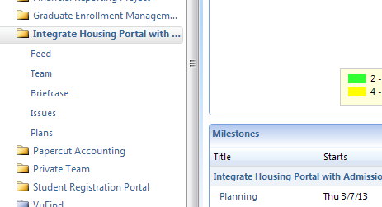
Project Work Spaces
Notes:
Minimum information:
Name
Start end
Type of work
Who’s working on it for about how much time
Basic status
How the work support objectives

Slide 35
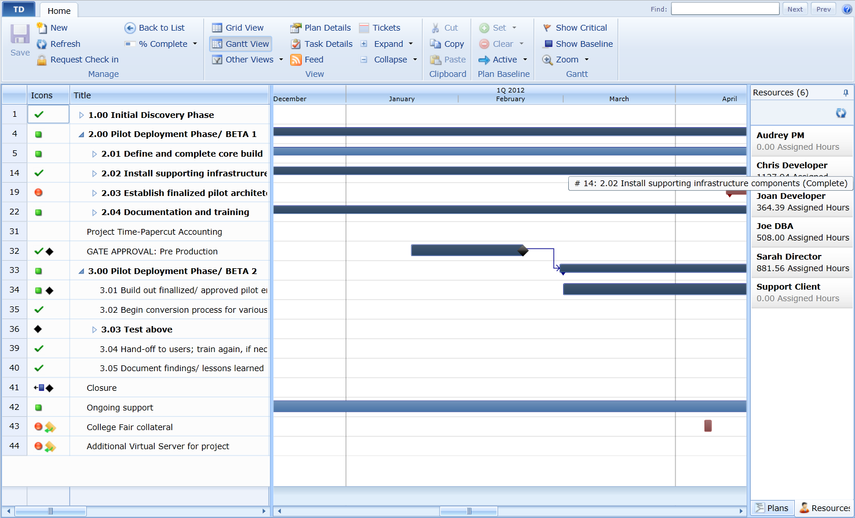
Management Tools
Notes:
Minimum:
Name
Start end
Type of work
Who’s working on it for about how much time
Basic status
How the work support objectives

Slide 36
Project, Portfolio and Service Management
Work Requests
Work Request Fulfillment Streams
Service Catalog
Governance & Projects
Productivity
MyWork®
Email
Routing Logic
Service Desk & Assets
TDMobile
Web Forms
TDCommunity
Web Services
Operations & Change Management
Tickets
Reporting
Web Services: Service-Oriented Architecture

Slide 37
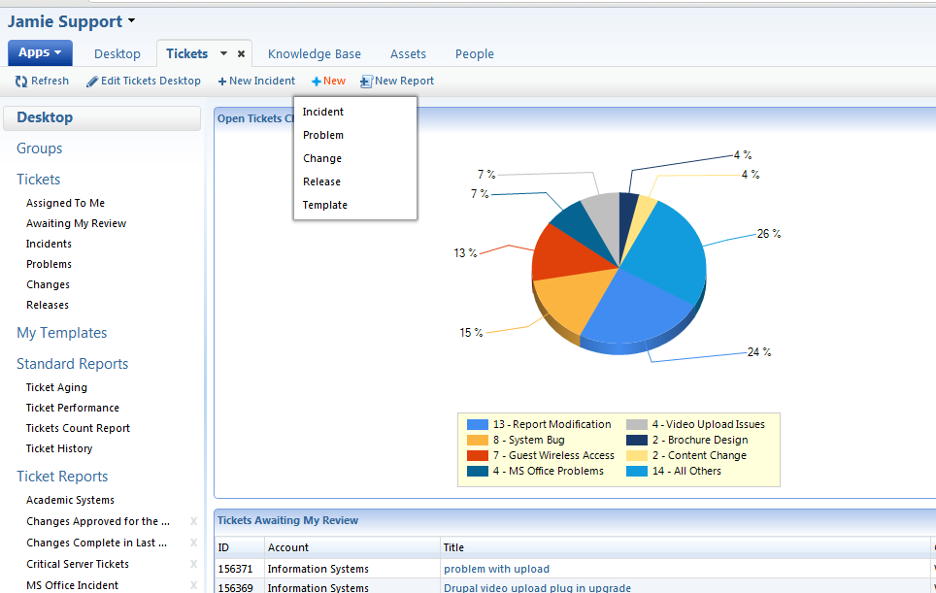
Notes:
You have the basics that drive what people work on. ITIL aligned processes.
-Institutions that do well in this area think about how much time their resources spend in these areas.
-how much time does it consume for resources? Estimate as a retainer. Gather some basics for analytics.

Slide 38
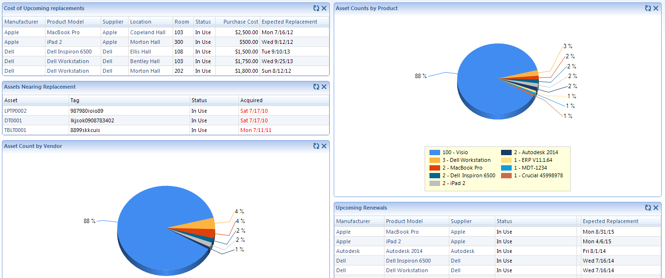
Asset/CI Management
Notes:
We have found an understanding of Assets and CIs to be valuable for planning and the management of support and change.

Slide 39
Project, Portfolio and Service Management
Work Requests
Work Request Fulfillment Streams
Service Catalog
Governance & Projects
Productivity
MyWork®
Email
Routing Logic
Service Desk & Assets
TDMobile
Web Forms
TDCommunity
Web Services
Operations & Change Management
Tickets
Reporting
Web Services: Service-Oriented Architecture
Notes:
Definition: work that isn’t break/fix but isn’t big enough to be a project. Consumes huge amounts of time and energy but is seldom recorded well enough to help make improvements to the organizations ability to operate. This is were a lot of IT’s work is done.
-how much time does it consume for resources? Estimate it.

Slide 40
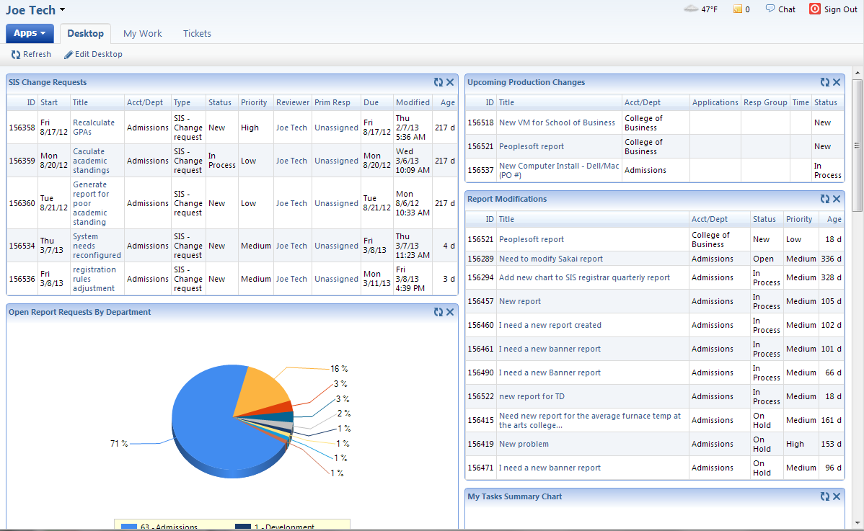
Project, Portfolio and Service Management

Slide 41
Project, Portfolio and Service Management Software Built for Higher Education
More colleges and universities depend on TeamDynamixHE PPSM than any other solution
Addressing the Challenge:
Negative Perception of IT’s Value
& Making Confident Decisions
Notes:
Institutions that get this far have built a basic foundation for improving communication, ability to manage the department and navigate.

Slide 42
Project, Portfolio and Service Management
Work Requests
Work Request Fulfillment Streams
Service Catalog
Governance & Projects
Productivity
MyWork®
Email
Routing Logic
Service Desk & Assets
TDMobile
Web Forms
TDCommunity
Web Services
Operations & Change Management
Tickets
Reporting
Web Services: Service-Oriented Architecture
Notes:
Make it easier to work with IT and visibility and communication

Slide 43
Changing Perceptions
Make IT easier to work with: simplify the request process
Educate stakeholders and leadership about priorities, current commitments, future commitments, value added, and constraints.

Slide 44
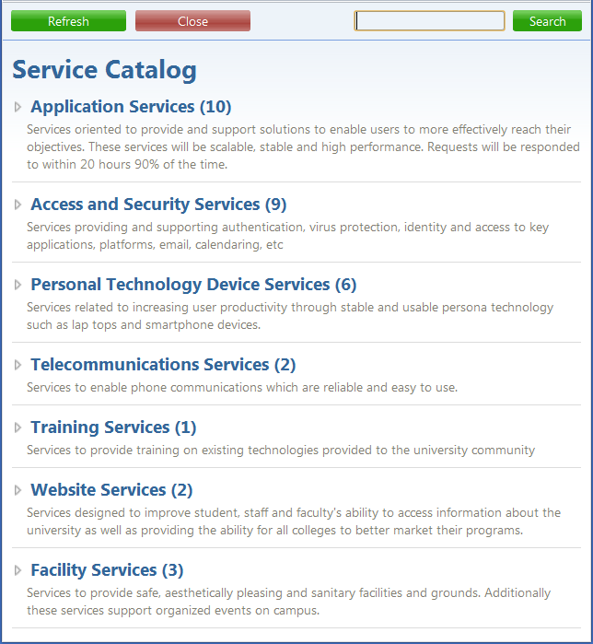

Example Service Catalog
Notes:
Ties to the frustration of how to better work with IT. How to make it easier.
One place.
Clearly articulate what is available
Envision how you could manage any institutional requests.
Specific information gathered.
ITSM/ITIL
Expectations

Slide 45

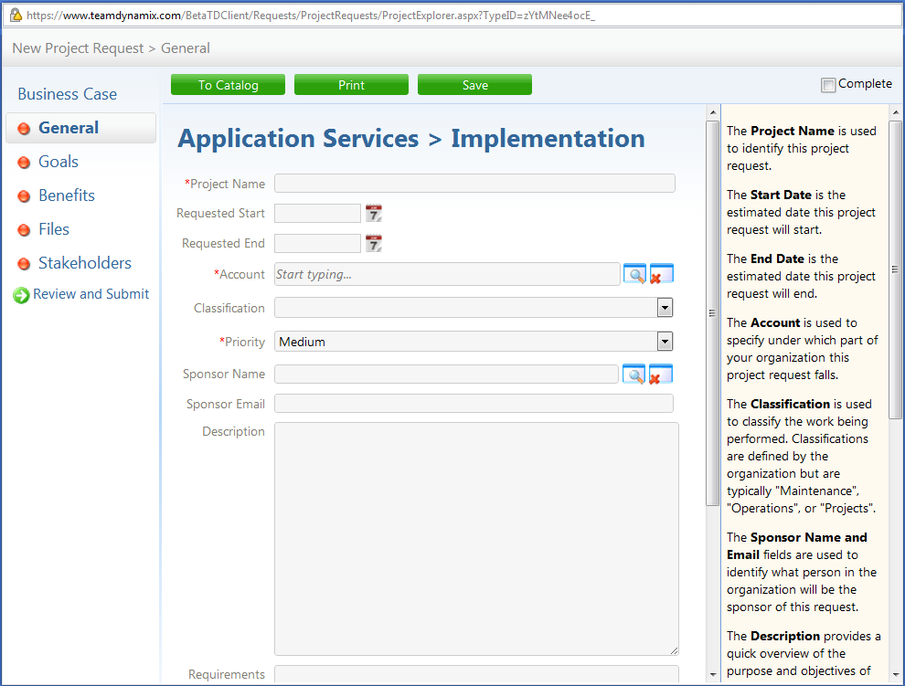
Catalog Item Request Example

Slide 46
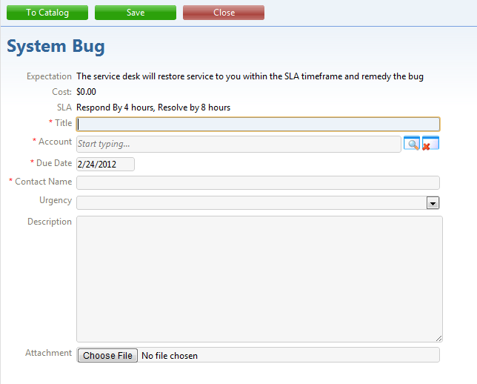
Catalog Item Request Example
Notes:
Communicate expectations

Slide 47
Changing Perceptions & Making Confident Decisions
Educate stakeholders & IT Leadership
  Current commitments, status and how many resources they consume
    Projects
    Ops
    Incidents
  Backlog of work yet to be started
  Priorities
  Current and future constraints (remind them that IT is a scarce resource!)
Notes:
The best regularly communicate the basics and over time understanding builds. This is an example.

Slide 48
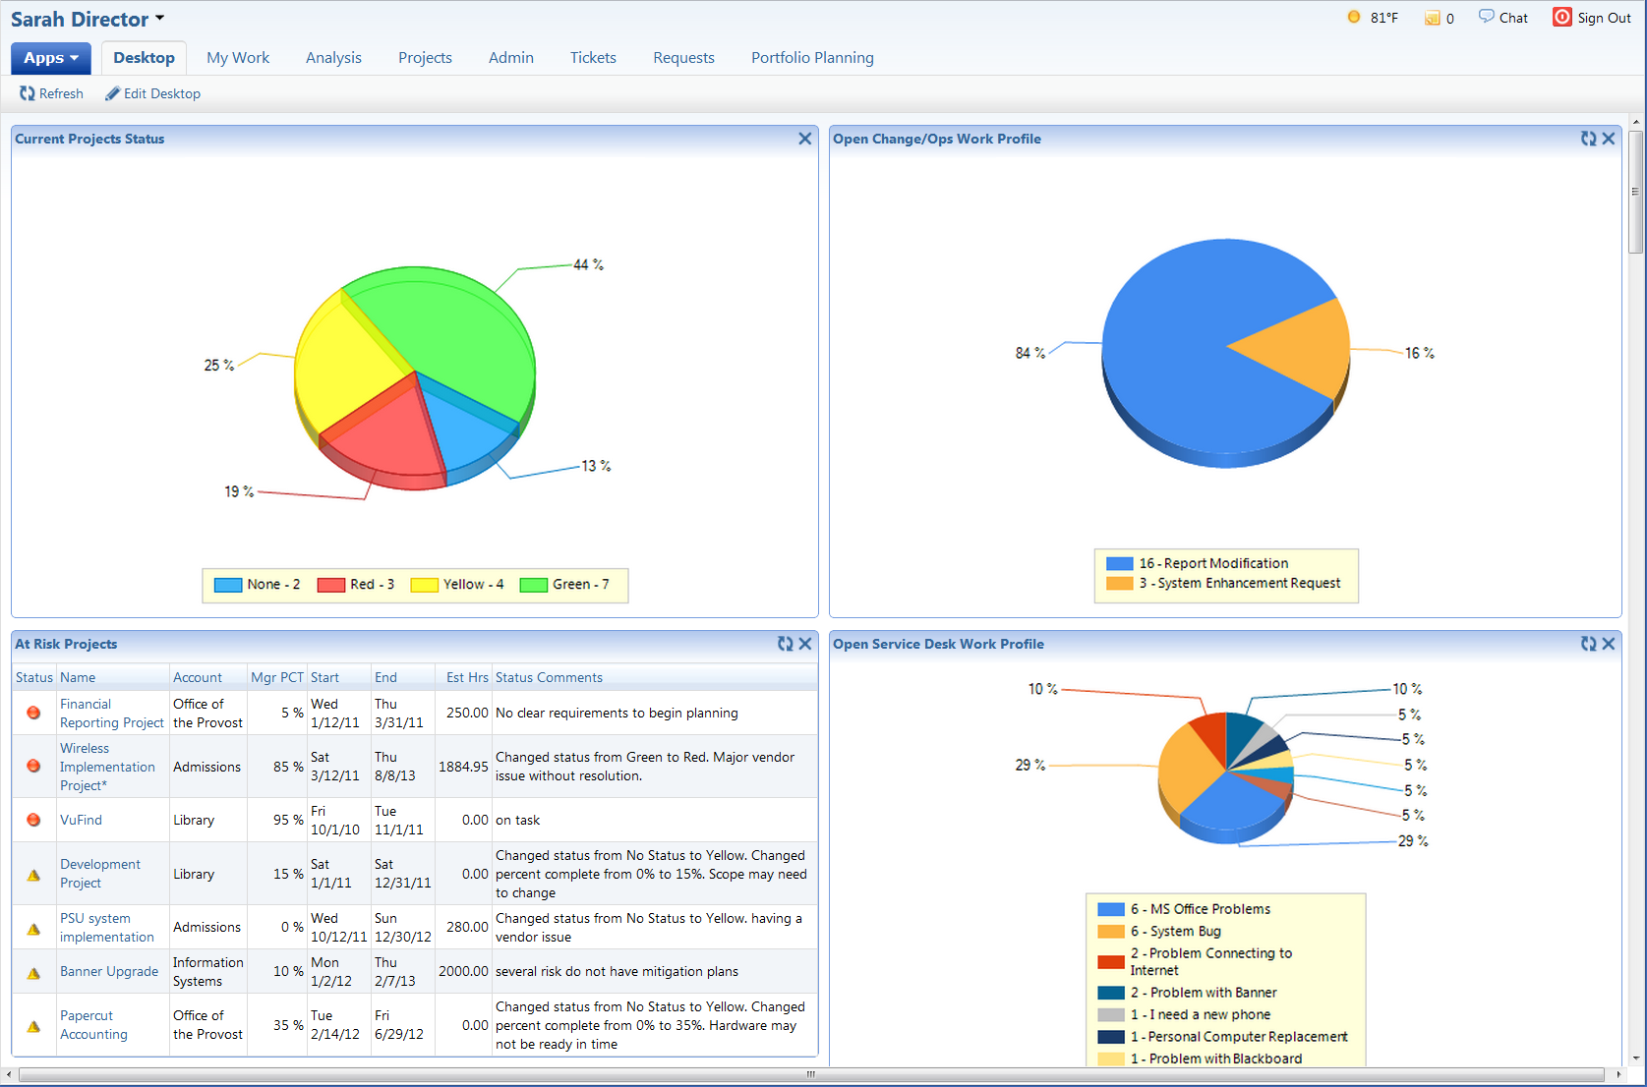
Notes:
Enable action to be taken quickly and show the whole picture
-CONFIDENTLY MAKE Decisions
-See resources across all work streams (full disclosure)

Slide 51
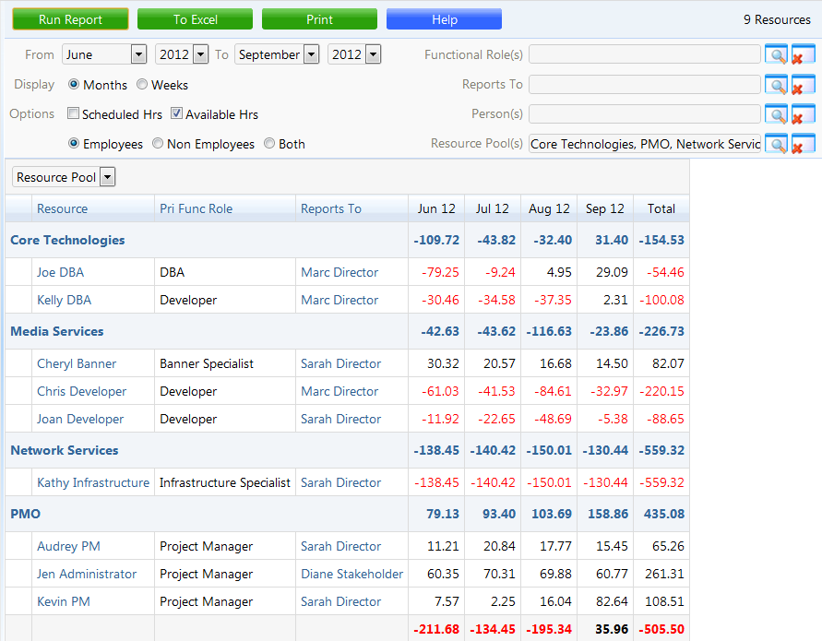
Notes:
Allows us to truly understand our capacity

Slide 52
Project, Portfolio and Service Management Software Built for Higher Education
More colleges and universities depend on TeamDynamixHE PPSM than any other solution
Addressing the Challenge:
Adjusting to Rapidly Changing Priorities

Slide 53
Adjusting to Changing Priorities (inputs and drivers)
Understand priorities to guide decisions
Understand capacity
  What are my resources’ availability to do work
  How is people’s time being allocated
Understand the moving parts to assess the options for and impacts of making changes
Notes:
This can be done at a high level additionally this approach is especially appropriate for tools if your environment is complex.

Slide 54
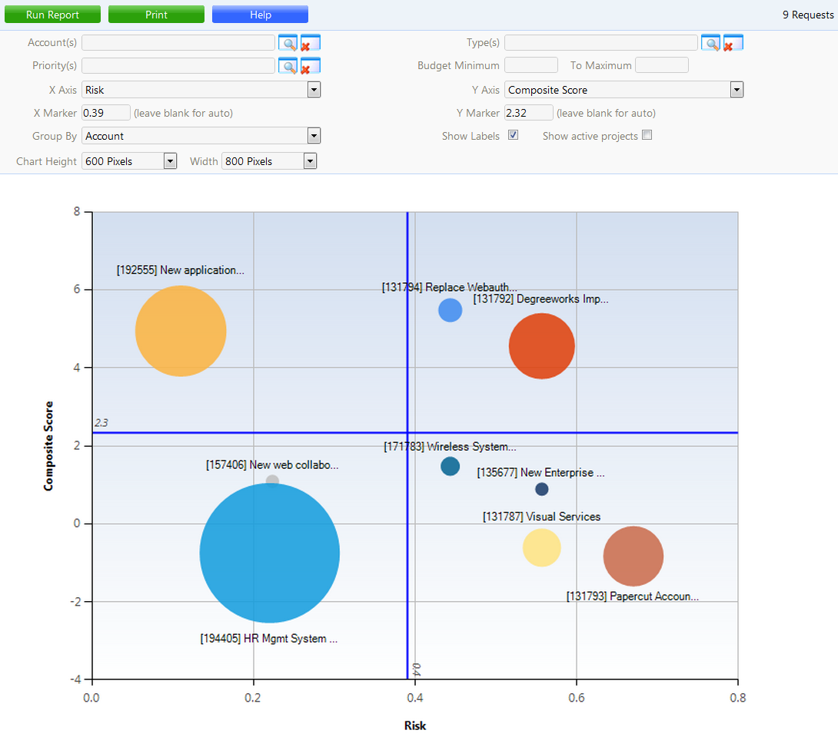
Prioritization Tools
Notes:
Simple indicators to compare value to drive decisions
Combat pet projects
When can we fit the work in. Anything you eval should have this capability.

Slide 55
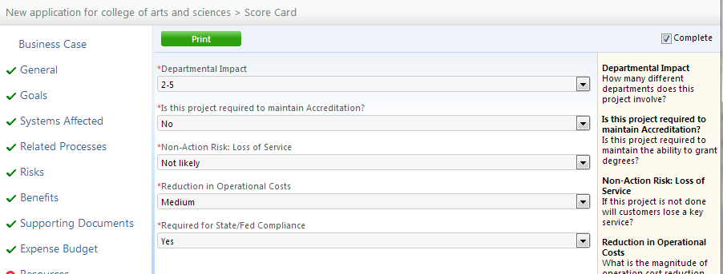
Simple Scoring Model

Slide 56
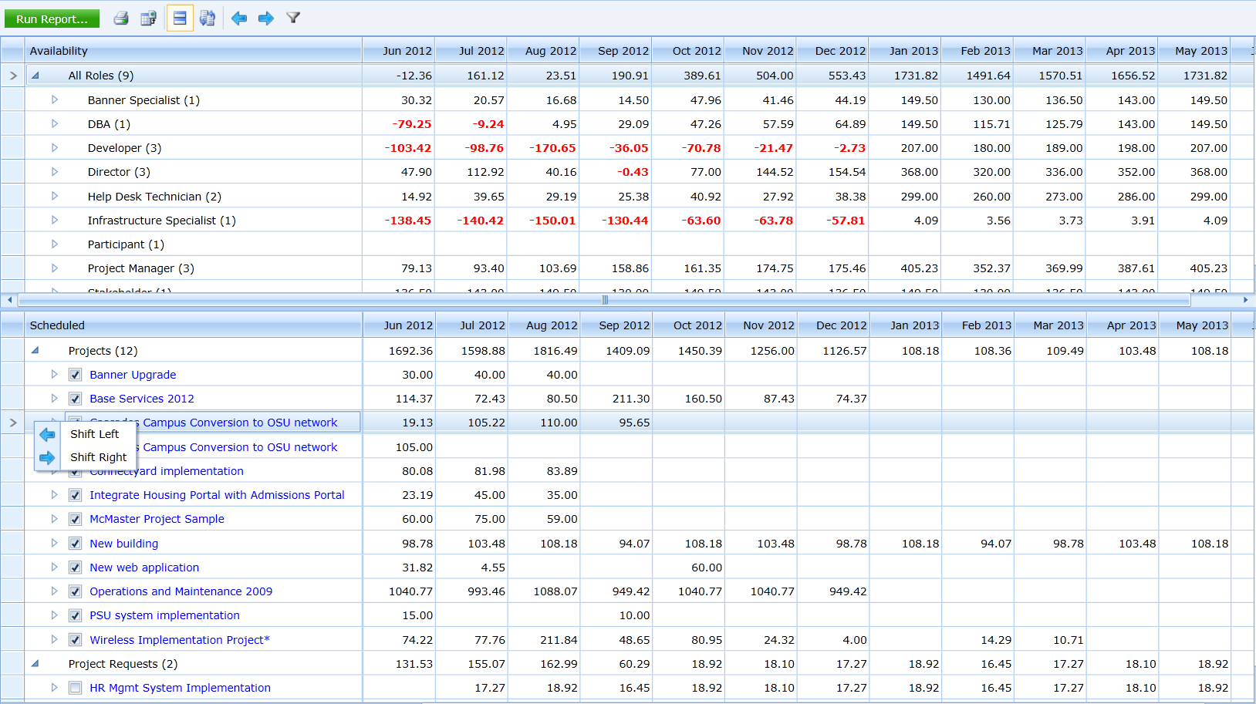
Scheduling Tools
Notes:
Should support simple models

Slide 57
Project, Portfolio and Service Management Software Built for Higher Education
More colleges and universities depend on TeamDynamixHE PPSM than any other solution
Addressing the Challenge:
Staff Resistance to Change

Slide 58
Project, Portfolio and Service Management
Work Requests
Work Request Fulfillment Streams
Service Catalog
Governance & Projects
Productivity
MyWork®
Email
Routing Logic
Service Desk & Assets
TDMobile
Web Forms
TDCommunity
Web Services
Operations & Change Management
Tickets
Reporting
Web Services: Service-Oriented Architecture
Notes:
How do we pull this all together to simplify the team members life?

Slide 59
Reducing Resistance
Focus on their pains. Tie change back to beneficial results for those required to change.
“Right-fit” processes and tools to the pain. Avoid overkill.
Give resources a “one page” view of their responsibilities and make it very easy for them to accomplish what they need to in order to achieve the results you are looking for.
Tools should streamline and simplify hand off points to reduce administration work and “dropped balls”.
Notes:
Resources What does it do to me and for me?

Slide 60
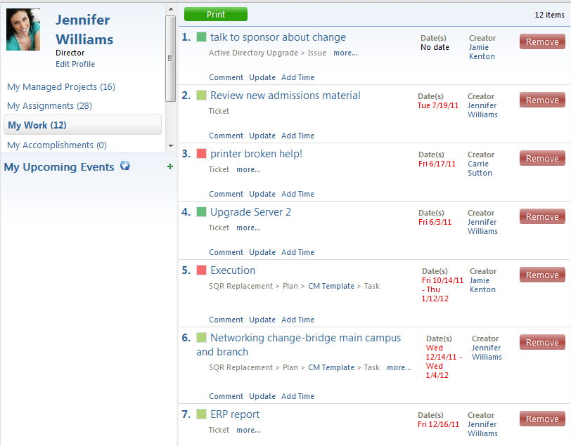
Productivity: Work Consolidation
Notes:
Key for success going forward
Makes it easier for resources adding value
Increases adoption

Slide 61
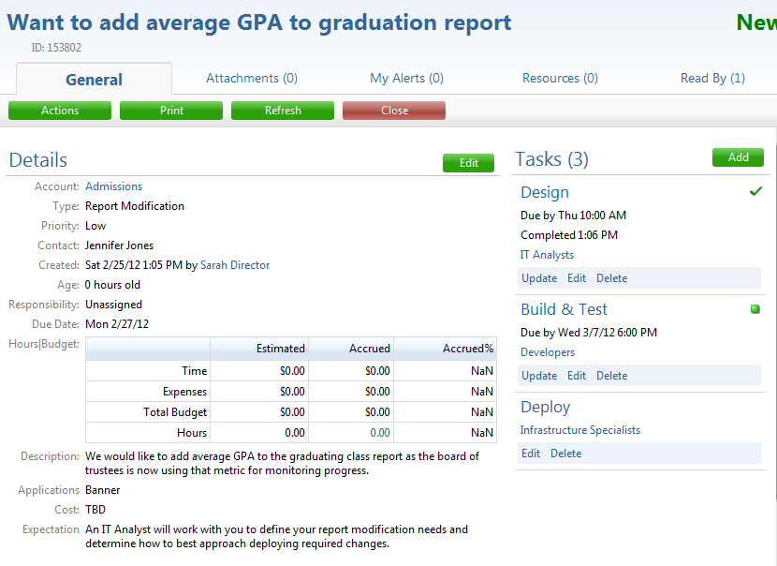
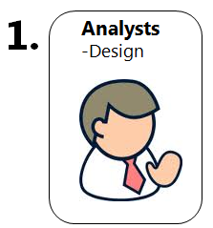
1. Design: IT Analysts
Notes:
Notice the OLAs. Key for investigating issues
An example of a report modification.
Shepherd the process automatically

Slide 62
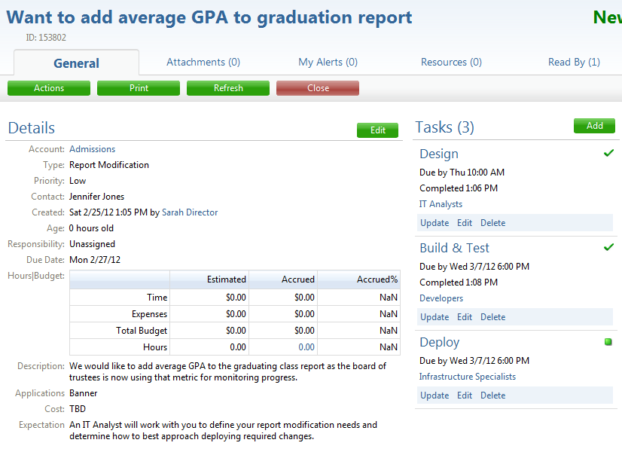
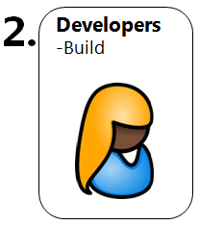
2. Build & Test: Developers

Slide 63
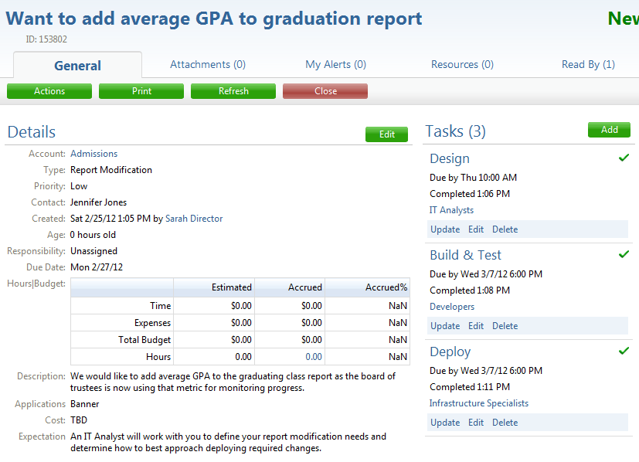
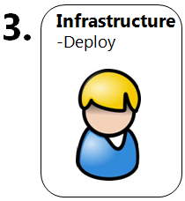
3. Build/Deploy: Infrastructure Specialists

Slide 64
Project, Portfolio and Service Management Software Built for Higher Education
More colleges and universities depend on TeamDynamixHE PPSM than any other solution
Questions?
Andrew Graf
agraf@teamdynamix.com
614-340-3341
Notes:
Remember that most institutions don’t attempt to tackle all of what we talked about at once. We work with clients to help them prioritize their pains and apply the appropriate solution and then build a phased road map to help leadership continually improve results, efficiency and reputation.
HAPPY HOUR

