Slide 1
A Practitioner’s Approach for Implementing Information Security Policy
Ask questions at any time.
David Wilhite
IT Security Office
primary author of IS procedures
at University of South Carolina
Notes:
Introduction.
I’ll be sharing with you the method we are using to establish IS processes at the Univ of SC.
---
Please ask questions at any time.

Slide 2
About Our Environment
35,000 students
8,000 faculty & staff
8 campuses
centralized / decentralized IT
Notes:
To give you an idea of the complexity of our environment (explain)

Slide 3
Establishing Governance
Authority + Requirements
Notes:
The core issue we’re tackling in establishing policy is “governance.”
Governance of anything involves establishing authority and requirements.
And that’s the process I’ll be describing here.
At our university, this governance is established and codified using a policy framework.
What do I mean by policy framework ... ?
--

Slide 4
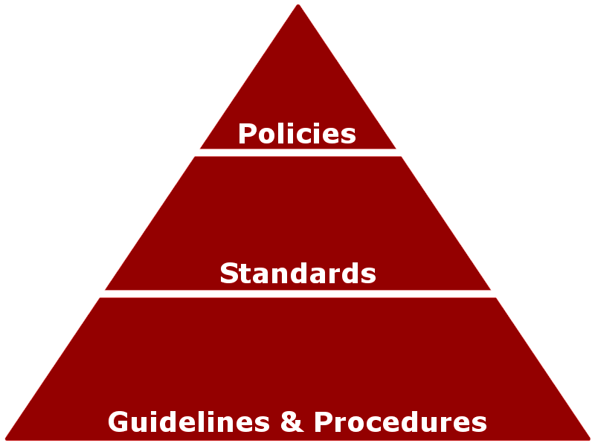
Policy Framework
built from the top, downward
Policy – overall intent and direction
originates at trustee/executive level
avoids specifics which may be subject to change
Standard – basis by which to measure policy
originates at data steward level
high level detail, without implementation guidance
Guideline – implementation guidance
authored/endorsed by subject matter experts
more details, but not specific to org. units
Procedure – implementation steps & provisions
authored/endorsed by organizational unit
more details, specific to organizational unit
Notes:
Our policy framework looks like this:
It’s built from the top, downward, starting with policy documents, then standards documents, and finally guidelines and procedure documents.
--
Policy documents (describe)
--
Standards documents (describe)
--
Guideline documents (describe)
--
Procedure documents (describe)
You might be saying to yourself, that’s too abstract, give me an example.
Lucky for you ...

Slide 5
That’s too abstract! Give me an example!
public safety
Policy – overall intent and direction
originates at trustee/executive level
avoids specifics which may be subject to change
State Constitution: “The legislature shall establish laws to protect the safety of the people.”
Standard – basis by which to measure policy
originates at data steward level
high level detail, without implementation guidance
State Law: “No one shall operate a vehicle at an unsafe speed. The Dept of Transportation shall determine and post maximum safe speed.”
Guideline – implementation guidance
authored/endorsed by subject matter experts
more details, but not specific to org. units
Experts document criteria for determining maximum safe driving speed.
Procedure – implementation steps & provisions
authored/endorsed by organizational unit
more details, specific to organizational unit
DOT consults guidelines and prescribes speed limits.
Notes:
I’ve got you covered.
Let’s look at an example you’re probably already familiar with.
--
In the area of state laws and public safety.
--
We can compare Policy documents to a state constitution. One provision of your state constitution might say something to the effect that the legislature shall establish laws to protect the safety of the people. (compare bullets)
--
We can compare Standards documents to a state law. One law in your state might say something to the effect that no one shall operate a vehicle at an unsafe speed, and that the Department of Transportation shall determine and post maximum safe speed. (compare bullets)
--
In this case, Guidelines might be where experts document the criteria determining maximum safe speed. (compare bullets)
--
And Procedures might be the compared to the speed limits that are posted.
Take note that as we progress down the hierarchy we increase the specificity and make the requirements easier to follow, and easier to enforce.

Slide 6
Dual Authority and Enforcement
Board
and Executives
Policies
Data Trustees & Stewards
University Info Security Office
Standards
Procedures
Notes:
At our university, authority for information security starts at the top.
--
The board and top level executives have endorsed Policies.
--
These Policies place part of the governance in the hands of designated Data Trustees and Stewards.
--
The Data Stewards create or endorse standards; and these standards become requirements to be met in order to have access to university data.
--
Policy also designates the University Information Security Office as authoritative on the subject of information security ...
--
... and charges it with the responsibility to create the guidelines and procedures – at the university level – for secure handling of information. And since our Data Stewards are generally not experts on information security ...
--
The Information Security Office has authored the security aspects of the standards required by the Data Stewards.
--
And these standards refer to the same Guidelines and Procedures.
So the same set of security standards and procedures are enforced by the Data Stewards, with the penalty of noncompliance being loss of access to university data.
And also enforced by the Information Security Office, with the penalty of noncompliance being loss of access to the university network.

Slide 7
Checks & Balances
Board
and Executives
Auditor
Executive
Advisory Comm.
Policies
Data Trustees & Stewards
University Info Security Office
Standards
Functional
Advisory Comm.
Procedures
Notes:
Checks on authority are established through ...
--
... the creation of an executive level advisory committee to advise on the creation of policies, standards, and procedures ...
--
... and a functional level advisory committee to advise on the creation of guidelines and procedures.
--
In addition, the university auditor – who reports directly to the board – has authority to review the whole thing.

Slide 8
Strategy to Complete Policy Framework
Policies
Establish Policy.
Requires executive backing.
Create Data Access Requirements documents.
Identify protected data elements (per Data Steward).
Standards
Create Data Security Requirements document.
Based on industry standards (ISO 27002, PCI DSS)
Guidelines
Procedures
Create Information Security Program documents.
High level guidelines and procedures.
Notes:
Here’s the strategy we are using at the University of South Carolina to develop are framework.
Note that I said “are using” – it’s an ongoing process that is not yet fully implemented, but has been working well for us so far.
--
In establishing policy, we’ve found there is simply no substitute for executive level backing.
Part of this is designating data stewards who are high enough level in the organization to enforce the policy.
--
The data access requirements (standards) will probably have to wait until you have data stewards designated.
--
Concurrently, you can begin creating security standards based on industry standards. (discuss)
--
You can also begin creating security guidelines and procedures. You will probably find that some of your departmental IT staff want to do the right thing, but don’t necessarily know what the right thing is. The procedures can help these people.

Slide 9
Policies
http://www.sc.edu/policies/univ150.pdf – Data Access / Stewards
http://www.sc.edu/policies/it300.pdf – Information Security
Browse other institutions’ policy documents, and plagiarize shamelessly.
Adapt to your environment.
See who will endorse it.
Never waste a good crisis. But if you do, just keep looking; they’re not hard to find.
Notes:
In creating or revising policy, our approach has been this:
--
First step is to shamelessly plagiarize policy documents from other institutions.
--
And here are links to our relevant policy documents, in case you want to see.
--
Of course you have to adapt these policy documents to your institutional environment.
--
This is the Field of Dreams approach – “if you build it, they will come” – if you have a good solid policy document ready for executives to examine and tweak to their liking, it might improve your odds of getting it done. And if you still have trouble getting traction, remember ...
--
Never waste a good crisis. (explain)
(Detection tools help)

Slide 10
Data Access Requirements (Standards)
Data Access Requirements – Registrar
Authoritative Datasets
“General Student” table
“Grades” table
Sensitive Data Types
Social Security Number (Restricted) – whether full or partial, must be treated as Restricted Data.
Academic Scores (Restricted)
Disciplinary Information (Restricted) – All information related to academic probation or other disciplinary actions must be treated as Restricted.
Directory Data (Limited/General Access) – Several data types are classified below as Directory Data. For students who have requested this data to be unlisted, it must be treated as Limited Access. For other students, this data is General Access. Where unlisted status is not known, treat as Limited Access.
Phone Number (Limited/General Access) – see Directory Data above.
Email Address (Limited/General Access) – see Directory Data above.
Authoritative Datasets listed above may only be accessed under the terms and conditions outlined in the Data Security Requirements document, posted here: [URL]
All Sensitive Data Types listed above, regardless of source, must be used only as specified in the Data Security Requirements document, posted here: [URL]
Data Stewards create Data Access Requirements documents.
Data Stewards endorse Data Security Requirements document (drafted by IS Office).
Notes:
Here’s our approach to the data access standards.
The data stewards use this document to essentially stake out their turf.
This is a greatly abbreviated version of our registrar’s document. (step through a few)
--
An important component of this document is having the steward endorse the security standards.
--
And we also include an important reminder statement that the steward is authoritative over these data elements regardless of where they exist, or where they came from.

Slide 11
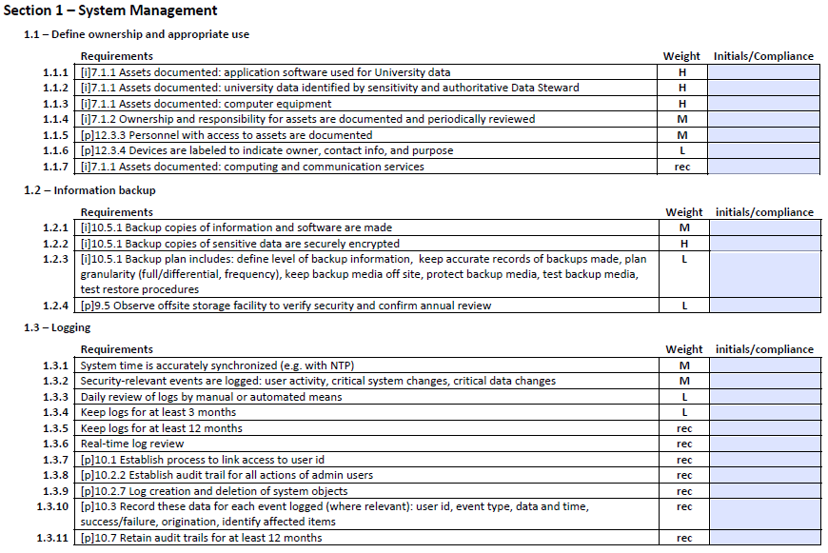
Data Security Requirements (Standards)
http://uts.sc.edu/itsecurity/docs/USC-DSR-Checklist-Restricted.pdf
Notes:
Now let’s look at the data security standards.
They are cherry-picked from ISO 27002 and PCI DSS, as indicated by the letter “i” or “p” in square brackets.
Other local requirements are also included, without any letter designated.
To see the full list, you can download the PDF from the link at the bottom.
And as with all of the information I’m presenting, feel free to use anything you want.

Slide 12
Guidelines and Procedures
UISO 901.3.1 Media Security Procedure
Purging/Destruction Process
Rewritable media, whether fixed or removable, must be sanitized by using software or be physically destroyed in such a way that data is irretrievable. The software that is chosen should overwrite the entire contents of the media at least one time, which is sufficient for most data being stored. However, for data from some sources, those sources may require more stringent processes (e.g. Department of Defense research data). In such cases, follow their more restrictive guidelines. See Appendix A for suggested erasure software to use.
OU Procedure 901.3.1-A may establish
greater detail for this process.
Security Office creates a University-level Procedure, as part of the Information Security Program, calling on OUs to fill in details.
One department may specify the details one way.
UTS 901.3.1-A Rewritable Media Purging
Purging Process
PC Intel platforms: Use “DBAN” software configured to write a single pass of random data.
Mac Intel platforms: Use method described in Apple support article https://support.apple.com/kb/HT1820
Other departments may choose other details.
CSE 901.3.1-A Rewritable Media Purging
Purging Process
Use “DBAN” software configured to use “DoD Short” method.
Information Security Program
http://uts.sc.edu/itsecurity/program
Notes:
Now let’s look at guidelines and procedures.
Here’s a snippet from one of our procedures.
(read)
--
The Security Office creates a university-level procedure, and allows the organizational units – the departments – to fill in details.
--
So one department might specify one set of specifics ...
--
While another department does things a bit differently.
--
To see all of our guidelines and procedures, as well as training materials, you can browse this link.

Slide 13
Eating the Elephant – All at Once?
Risk: Frustrating staff.
Risk: Clandestine noncompliance.
Risk: Additional legal liability.
Notes:
Now let’s fast forward to implementation.
Let’s say you have your policy framework complete: your policies, standards, and procedures.
Do you think you can not just throw it all in front of your university community and say “go do it”?
Here are some of the risks if you take that approach:
--
First off you will probably overwhelm and frustrate your staff to the point that they simply refuse.
--
Or perhaps they will find ways to rebel in secret.
--
You could even end up making things worse for your university. (discuss legal liability)

Slide 14
Eating the Elephant – In Byte-Sized Pieces
Assess your current achievable level of compliance.
Set the bar there (with deadline).
Bring into compliance.
Raise the bar (with deadline).
Notes:
So here’s the approach we’re taking at the University of South Carolina.
--
We started out by informally assessing our current level of compliance with the security standards that we drew up, by talking to our various departmental IT managers. From that we guesstimated a level of compliance that we thought would be achievable in the short or medium term.
--
And that’s where we set the bar, along with a deadline for compliance.
--
To enforce compliance, we created a kind of score card or grading rubric. Those with unacceptable levels of risk will lose their access to university data.
--
Eventually we will be raising the bar.
--
and this part of the process repeats.

Slide 15
Data Security Requirements (Standards)
Notes:
Now look again at the security requirements.
You can see our scoring rubric on the right side.
This is the tool we’re using to ease our IT managers into these requirements.
(discuss – weighting)
(discuss – data sensitivity classification)

Slide 16
Updates and Protests
Board
and Executives
Executive
Advisory Comm.
Policies
Data Trustees & Stewards
University Info Security Office
Standards
Functional
Advisory Comm.
Procedures
Notes:
There is an elegant beauty to this structure, which we believe should hold up over time.
(example: new requirement – DLP)
(example: protest – physical access controls)

Slide 17
Establishing a Policy Framework for Information Security
Questions?
Notes:
End of presentation
---
Questions?

