Slide 1
Yin and Yang Leadership:
Making the Impossible Possible
Linda Cureton – NASA CIO
2011 EDUCAUSE Mid-Atlantic Regional Conference
January 12, 2011

Slide 2
Busting Myths
Leading change is easy.
There’s nothing new under the sun.
You have to have 100% agreement to implement any change.
Why bother?

Slide 3

Discussion Topics
The Second Law of Thermodynamics
Why People Resist Change
Yin and Yang
What YOU Can Do
Don’t Leave Here Unchanged

Slide 4
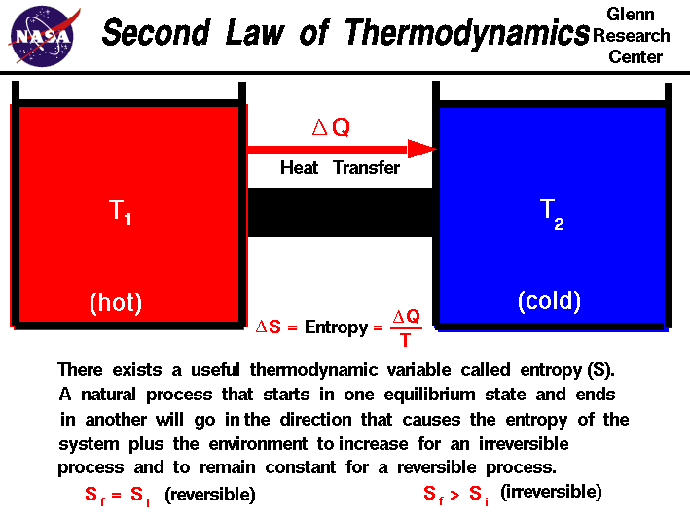
The Second Law of Thermodynamics
From a state of order to disorder
From structured to chaotic
From new to old
… unless
You do something!
Source: NASA Glenn Research Center

Slide 5
The Second Law of Thermodynamics
Extinction
  ORDOVICIAN-SILURIAN EXTINCTION:
  Small marine organisms died out. (440 mya)
  DEVONIAN EXTINCTION:
  Many tropical marine species went extinct. (365 mya)
  PERMIAN-TRIASSIC EXTINCTION:
  Largest mass extinction event in Earth's history affected a range of species (250 mya)
  TRIASSIC-JURASSIC EXTINCTION:
  The extinction of other vertebrate species on land allowed dinosaurs to flourish. (210 mya)
  CRETACEOUS-TERTIARY EXTINCTION: (65.5 mya)
Organizational demise
  Firestone
  Immigration and Naturalization Service
  TWA
Fall of Nations
  USSR
  Nazi Germany
  Roman Empire
Notes:
Extinction: http://www.amnh.org/exhibitions/dinosaurs/extinction/mass.php
Man:
2006 – 77.85
2050 – mid 80s
2100 - > 100
2300 – 100-106
Organizational demise:
http://ezinearticles.com/?Why-Great-Companies-Go-Out-of-Business&id=1700042 (Firestone)
INS (DHS)
TWA (http://en.wikipedia.org/wiki/Air_Mail_Scandal )

Slide 6

Why People Resist Organizational Change
We just don’t have time for that.
We don’t have enough resources to do that.
Do we really need it?
It’s much too risky.
We have already discussed something similar a long time ago. Forget it.
Talk to Mary about it. It’s not my area.
I am quite sure, it wouldn’t work.
We are not ready.
It sounds good theoretically, but it would never work in practice.
We are too big / too small.
It’s too early / too late for that.
Prove that it will work, and I am behind you.

Slide 7
Yin and Yang
Two aspects of the same reality
Yin
  slow, soft, yielding, diffuse, cold, wet, and passive
  associated with water, earth, the moon, femininity and nighttime.
Yang
  fast, hard, solid, focused, hot, dry, and aggressive
  associated with fire, sky, the sun, masculinity and daytime
Organizational examples:
  Innovate versus meet expectations
  Mission obsessed versus mission aligned
  Being the best versus being acceptable

Slide 8
Force Field Analysis
Kurt Lewin
  Social scientist
  Used to diagnose situations
Bring together extremes to solve problems
Weighing pros and cons
Analysis
  Clarifying and strengthening the “driving forces” for situation
  Identifying obstacles or “restraining forces” to a situation
  Encouraging agreement on relative priority of factors on each side of the balance sheet

Slide 9

Force Field Analysis
Driving forces
  Pushing in a particular direction
  Initiate change
  Keep momentum going
  Examples:
    Business need
    Executive support
    Able and willing people to execute

Slide 10
Force Field Analysis
Restraining forces
  Acting in opposition
  Restricting action
Examples:
  Time pressure
  Lack of enthusiasm
  Competing demands

Slide 11

The Tao of Pooh
Pooh and Rabbit struggle to find their way home.
Every time they embark on their journey, they end up in a sand pit.
They decide that they need to do something unconventional.
Source: Benjamin Hoff – The Tao of Pooh

Slide 12
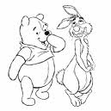
The Tao of Pooh
“Well … we keep looking for Home and not finding it, so I thought that if we looked for this Pit, we’d be sure not to find it, which would be a Good Thing, because then we might find something that we weren’t looking for, which might be just what we were looking for, really.”

Slide 13


The Tao of Pooh
Finding a solution by looking for the thing you don’t want to find.
Driving forces don’t always find the thing we seek.
Restraining don’t always move you away from what we seek.

Slide 14
Yin and Yang
Lewin’s equilibrium is achieved when the driving forces equal the restraining forces
Impossible problems get solved
The restraining forces actually help achieve the desired outcome.

Slide 15
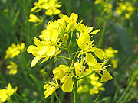
Moving Mountains with Innovation
The Mustard Seed
  Very small
  Grows into a sprawling plant that has many uses
  Mustard, mustard plaster used for medicinal applications tasty mustard greens.
Be customer focused and relevant
  Consumerism
  Tempo, timbre, tone
Be willing to take risks
  Manage risks
  Be brave
Have a plan
Notes:
Innovation takes courage. There is no need for courage if there is no risk. And there is no innovation without risk of failure . In a survey of two hundred projects in Research &Development labs, findings showed that only 57% of the projects achieved technical objectives; only 31% were marketable or commercially viable; and only 12% achieved market success. By these numbers, only about one project in eight would be of benefit to the organization.
Well said! I would put this as number 1 and move customers to number 2. But that might mean failure for me if the customer doesn’t come first!
We can footnote this.
Great breakdown!

Slide 16
What Can You Do?
Change starts with you!
You don’t need 100% of the people on board
Communicate and reinforce new ideas
From Nothing is Impossible:
“Those who’d formerly hidden behind the chaos in the school and used it as an excuse for not producing had their major justification taken away.”
“Doing nothing, running scared, and second-guessing kills initiative, blights creativity, and ultimately sabotages the organization and the good work it should be accomplishing”
– Lorraine Monroe

Slide 17
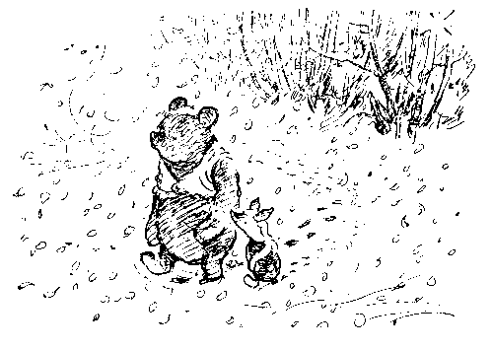
What Can You Do?
People won’t do it for YOU. What are your motivations?
Can you stay in the ring? Can you take a punch?
Are you prepared? Are you ready for < 100%?
Do you have enough courage?
Do you have balance?
Notes:
Staying in the ring – Buster Douglas

Slide 18
Questions

