Slide 1
Getting Started with Digital Dashboards
Jill Forrester, Director
Steve Brandt, Associate Director
Enterprise Systems
Library and Information Services
Dickinson College

Slide 2
Copyright Dickinson College 2010. This work is the intellectual property of the author. Permission is granted for this material to be shared for non-commercial, educational purposes, provided that this copyright statement appears on the reproduced materials and notice is given that the copying is by permission of the author. To disseminate otherwise or to republish requires written permission from the author.

Slide 3
About Dickinson College
4-year, private liberal arts college
Students: 2,376
Faculty: 237
Employees: 549 full-time, 84 part-time

Slide 4
About Enterprise Systems
Charted to support technology solutions with “enterprise” scope and to provide primary interface to LIS for administrative computing.
Environment
Dickinson Gateway – our portal solution
Banner – our ERP solution
Cognos – our enterprise reporting solution
Staff
Application Support Team (2 DBAs, 5 Application Support Analysts)
Decision Support Team (3 Analysts)
Application Development Team (2 Programmers, 1 Portal Administrator)

Slide 5
The Reporting Pyramid: Information Need
Strategic
Tactical
Transactional
Digital Dashboards!
Drill Through
Reporting Breadth

Slide 6
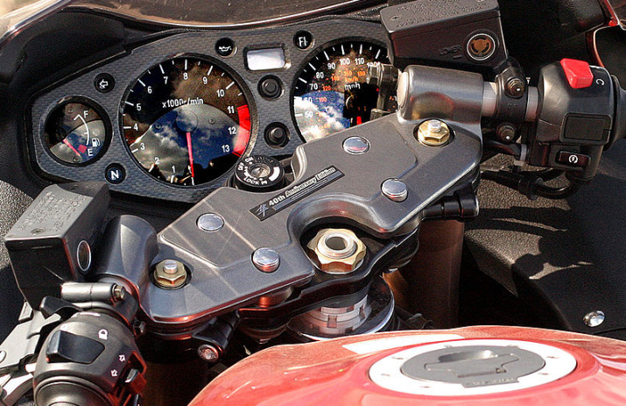
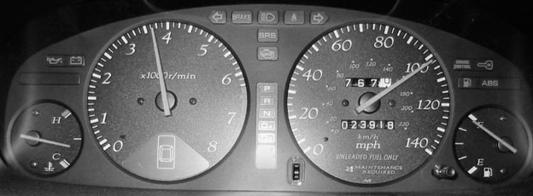
What is a digital dashboard?
A dashboard ...
is a control panel located under the windshield of an automobile
contains the instrumentation and controls pertaining to the operation of the vehicle
Source: “dashboard.” wikipedia.org, 2010

Slide 7
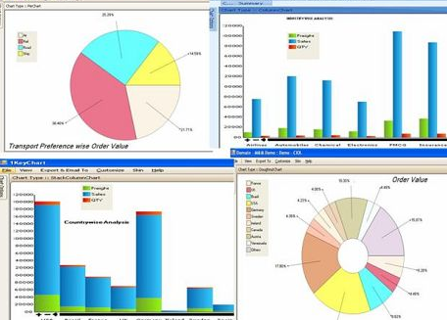
What is a digital dashboard?
A digital dashboard …
is a visual display of the most important information needed to achieve one or more objectives
provides high-level summaries
uses concise, clear, and intuitive display mechanisms
is customized to the consumers requirements
Source: Intelligent Enterprise, Stephen Few, 2004

Slide 8
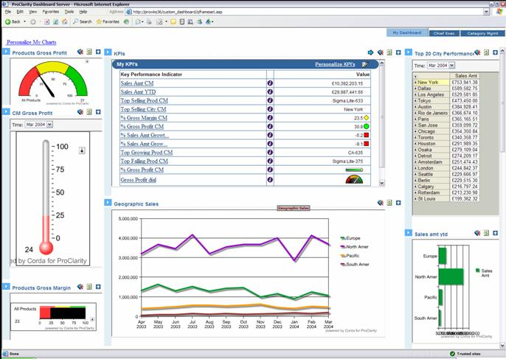
Examples

Slide 9
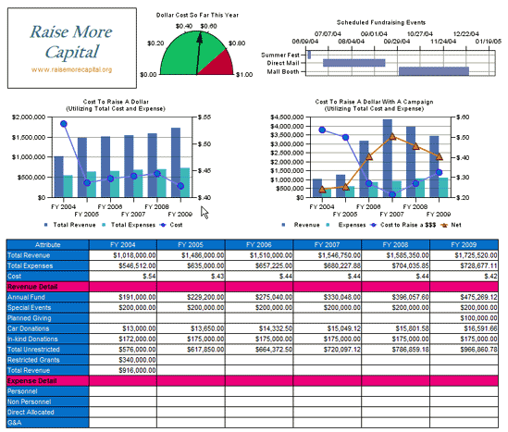
Examples

Slide 10
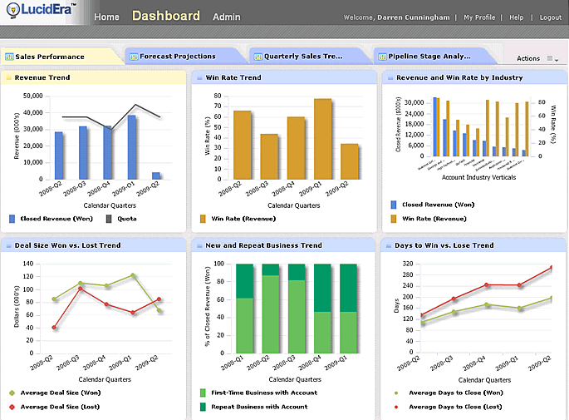
Examples

Slide 11
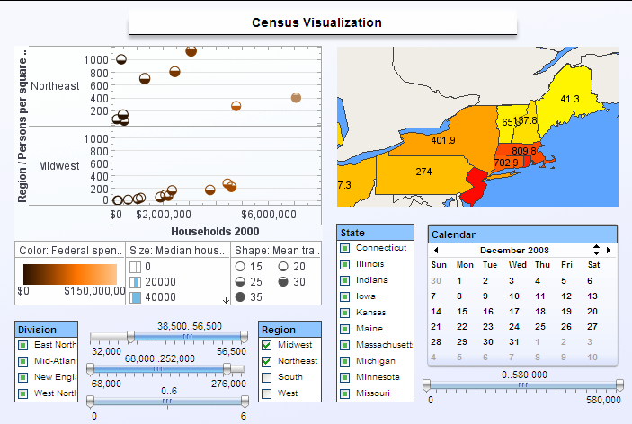
Examples

Slide 12
Why use digital dashboards?
Benefits include:
Visual presentation of performance measures
Align strategies and organizational goals
Ability to make more informed decisions based on collected business intelligence
Keep everyone focused on organizational goals
Save time over running multiple reports
Source: “Dashboards (management information systems).” wikipedia.org, 2010

Slide 13
Dashboards at Dickinson
Strategic
Tactical
Transactional
Digital Dashboards!
Fourth Year & Beyond
Starting Point
Drill Through
Third Year
First 2 Years
Reporting Breadth

Slide 14
Dashboards at Dickinson: Starting Point (cont.)
Clamor for “dashboards”
Real desire was transaction reporting.
Conclusion: education was needed.

Slide 15
Dashboards at Dickinson: Second Iteration
Lots of education.
Very little desire.
Significant thought & work – not a subscription service
Relatively small operation
Long & irregular business patterns – harder to apply standard concepts

Slide 16
Dashboards at Dickinson: Third Iteration
Focus on data-driven groups
Admissions
Advancement
Build “best-guess” prototypes to use as sales tools / engagement points
Enrollment
Key giving metrics
Result: gradual integration

Slide 17
Dashboards at Dickinson: Mechanical Framework
Use the tools you already have
Premium reporting tool: Cognos
Learning curve
License cost
Generate basic HTML & PDF output and store to external file location
Existing portal: Luminis
Wrap HTML and place in channel
Secure
No cost
No training

Slide 18
Dashboards at Dickinson
Demonstration

Slide 19
Dashboards at Dickinson: Next Steps
Not yet pervasive across the college
Expand & refine existing dashboards
More actual-to-target comparisons
Better graphics/visuals
Take advantage of existing generic framework
Expand to other functional areas—Library Services

Slide 20
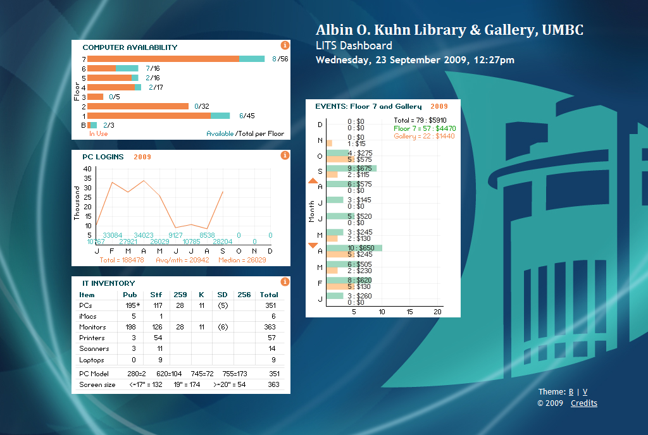
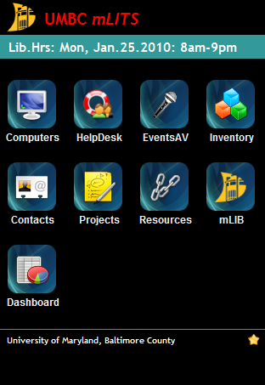
A Digital Dashboard for Library IT Operations at UMBC
May Chang, Director, AD Library Technology, ECU
Kenner Miner (‘12), Project Assistant, UMBC

Slide 21
UMBC Library IT Services
Staff
1 IT Manager
1 Programmer
6 Students
Operations:
Computers and peripherals
Software and applications
Audio-visual equipment
Digital initiatives:
Innovative technologies

Slide 22
Key Performance Measures
Computer usage and status
HelpDesk call log
Events and equipment rental
Inventory of equipment and software
Strategic information requirement
Streamline operations

Slide 23
Application
Desktop
XHTML, CSS, PHP, Flash
Mobile
XHTML, CSS, PHP, JavaScript
Platform independent (app developer fees on Android Market, Apple, Windows Marketplace)

Slide 24
Digital Dashboard desktop

Slide 25
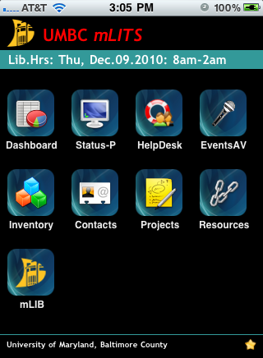
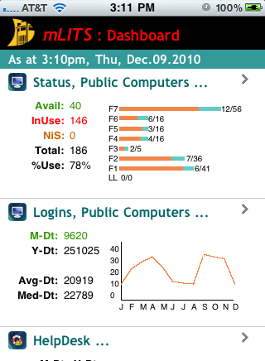
Digital Dashboard mobile

Slide 26
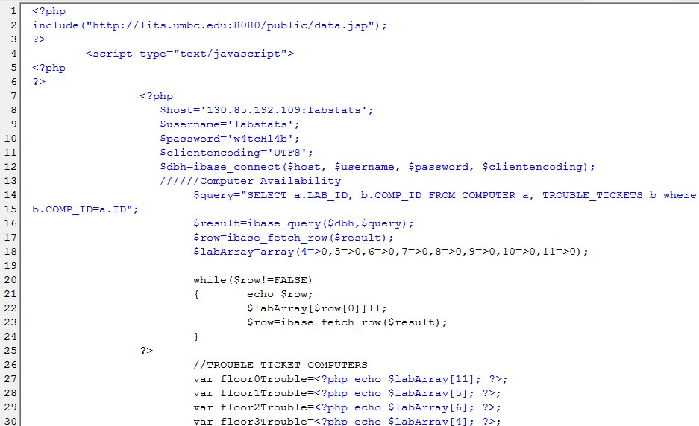
PHP and JSS

Slide 27
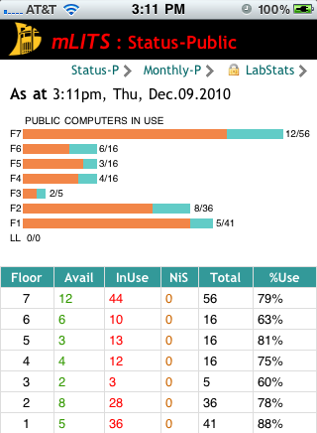
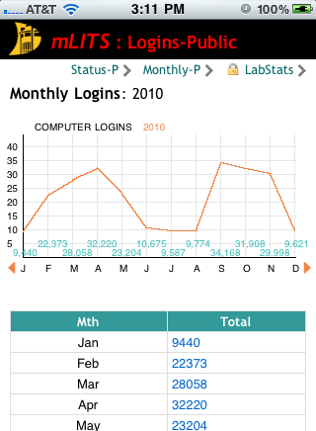
Computer Usage

Slide 28
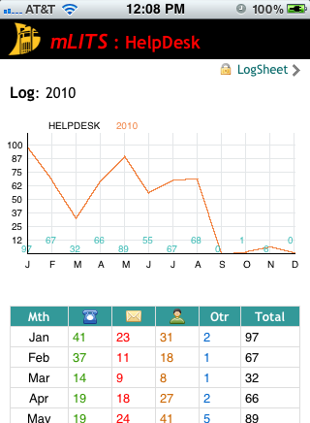
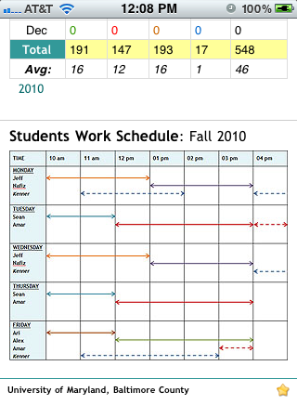
Help Desk

Slide 29
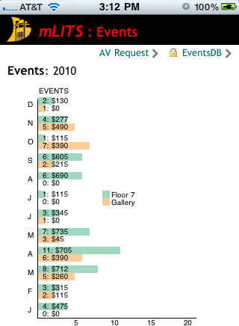
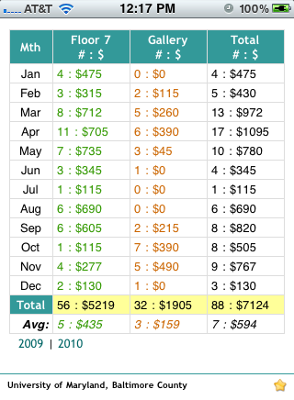
Events and AV Equipment

Slide 30
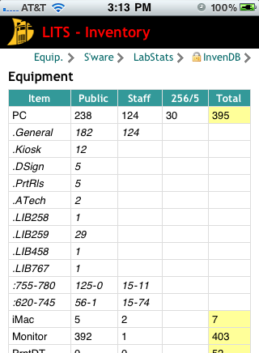
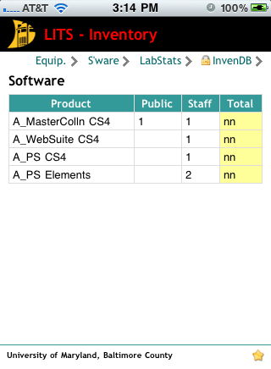
Inventory

Slide 31
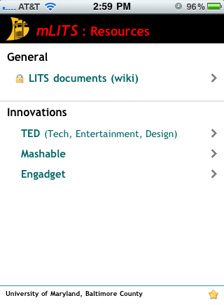
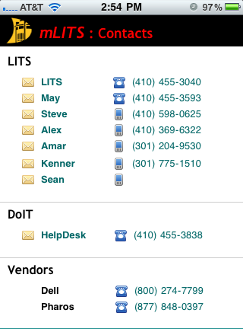
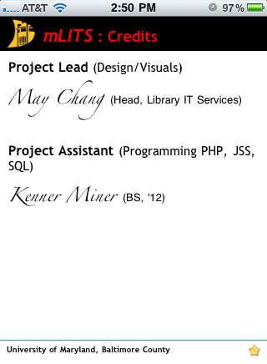
Other Features

Slide 32
Pluses and Minuses
+ KPI/BI at fingertips, on the go
+ Visual (Flash has smoother graphics)
− Disparate sources of data
− Programming

Slide 33
Moving forward . . .
Further automation of data extraction for dashboard display
Identify other areas in Library management and operation that would benefit (eg, the library system, gate count, etc)

Slide 34
Keys to success
Define objectives
What do you want to manage or track?
Keep it strategic!
Define metric/measures
How will you know success?
Point in time comparisons, current targets, predictions, measurement norm or benchmark
Actionable!
Define the audience
Who will benefit?
Provide accessibility!

Slide 35
Keys to success (continued)
Define the distribution mechanism and technical requirements
How will you develop, deliver, and secure it?
Follow best practices for dashboard design (layout and content).
Well-organized
Specific for the task
Use good data
Actionable!

Slide 36
Final Thoughts and Questions
Keep it strategic.
Make it accessible.
Keep it simple.
Try a pilot!
Questions?
For more information, contact
Jill Forrester, forrestj@dickinson.edu
Steve Brandt, brandtst@dickinson.edu
May Chang, changm@ecu.edu
Kenner Miner, kminer1@umbc.edu

