Slide 1
Collaboration Comes First:
A CMS Selection Process

Slide 2
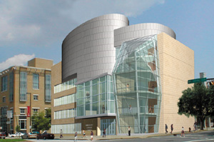
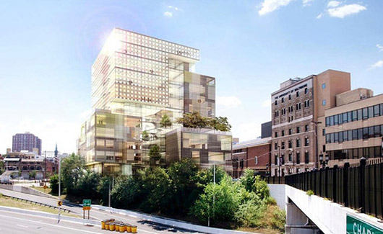
Obligatory “About Us” slide
Founded in 1925; online MBA in 1999
Part of the University System of Maryland
6500+ students
Four Schools
Yale Gordon College of Arts
and Sciences
Merrick School of Business
College of Public Affairs
School of Law

Slide 3
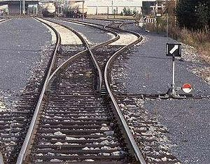
Some UBOnline history…
Prehistory - Web Boards
1999 - RCDDS/Collegis (now SunGuard Higher Education)
2001 - Prometheus
2005 - WebTycho

Slide 4
Prometheus
Cold Fusion-based LMS built by George Washington University, turned into a commercial product, and adopted by 65 postsecondary institutions.
Eventually bought by Blackboard.
LMS selection process
RFP
Faculty Evaluation

Slide 5
Previous Selection Process
In 2005, University of Baltimore faculty were invited to evaluate several leading platforms.
Their choices were ranked and delivered to the Administration.
Contract negotiations with the first choice hit a snag with four months to go.

Slide 6
Enter the Dark Horse
Another USM school had a tool and, somewhat like GW, was looking to commercialize it.
For those running e-Learning this was a god-send; for the faculty it was disingenuous, sneaky, and a betrayal.
This wasn’t a statement about the tool, it was more of an internal trust issue.
*Clearly, in 2010, this wasn’t something we wanted to repeat.

Slide 7
WebTycho
Developed and run by UMUC
UB has been their only outside client
Five years of…
Reliability
Ease of use
Familiarity

Slide 8
Three Options to Consider
Blackboard
Moodle
Sakai
Some great resources out there…
2009 EDUCAUSE webinar highlighting three institutions making three different choices
Georgia Tech - Sakai http://educause.informz.net/z/cjUucD9taT0zODgzMTYmcD0xJnU9MTAwMDAzMjM0MSZsaT0xNDYxMzg3/
SUNY - Moodle http://educause.informz.net/z/cjUucD9taT0zODgzMTYmcD0xJnU9MTAwMDAzMjM0MSZsaT0xNDYxMzg4/
Cornell - Blackboard http://educause.informz.net/z/cjUucD9taT0zODgzMTYmcD0xJnU9MTAwMDAzMjM0MSZsaT0xNDYxMzg2/index.html
Additional resources, including migration plans and budgets at EDUCAUSE Live! http://net.educause.edu/live0914

Slide 9
Purpose of Presentation
Not “Why” we made our choice.
Not about our implementation.
Not about training and support.
It is about “How” we made the choice and what you might learn from our mistakes and successes.

Slide 10
LMS Selection Taskforce
Faculty
Fully-online
Face-to-face
Library
Staff
e-Learning Center
Office of Technology Services
Center for Excellence in Learning and Teaching

Slide 11
Activity 1
What features are most important to you?
Based on Role
A-D e-Learning Administrator
E-H Law Professor
I-M CFO
N-R Biology Professor
S-V Business Professor
W-Z Librarian

Slide 12
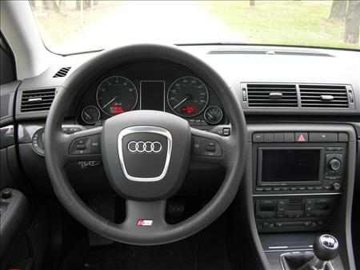
In the Driver Seat
After our previous dilemma in 2005 we want to be sure that Faculty were in the driver seat.

Slide 13
Features first
Faculty would do a feature analysis
Costs wouldn’t be examined until the feature analysis was completed
Cost Ranking would be weighed as 40% of the decision
Administration made a commitment to abide by the faculty recommendation

Slide 14
Gradual Exposure
3 environments
1 sample course used in each platform
Add a little time and gather results

Slide 15
Gradual Exposure
3 environments
1 course belonging to each faculty member
Add a little time and gather results

Slide 16
Gradual Exposure
3 environments
1 course belonging to each faculty member
Add a script for what needs to be tested, a little time and gather results

Slide 17
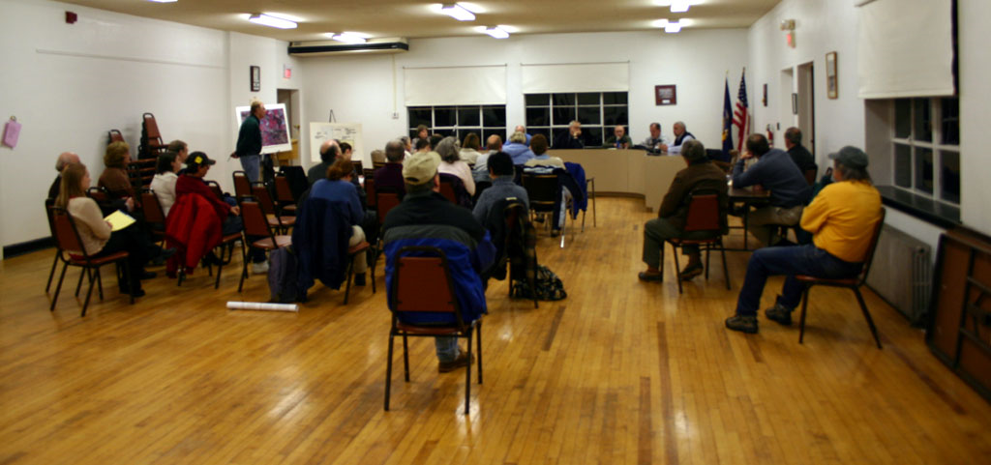
Community engagement
One important part of the plan was continual communication.
Several Town Hall sessions to gather requirements/concerns and showcase different platforms.
Open to faculty, staff, and students.
Follow-up with Peer-to-peer faculty engagement

Slide 18
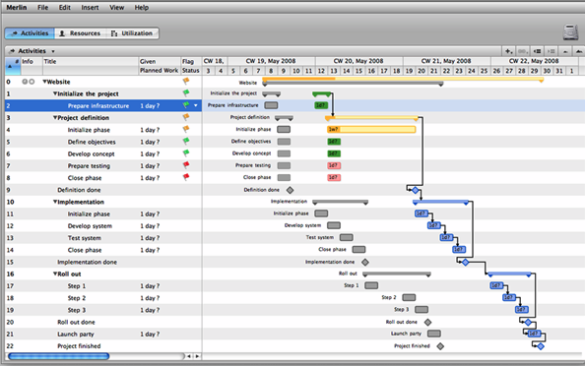
The plan
Sure, there were timelines and deliverables, benchmarks and meetings, gradual exposure to the platforms and regular communication to the community.
There was also risk.

Slide 19
Activity 2
Identify the Risk
Every institution is different
Identify what you think our greatest risk was and share what yours might be.

Slide 20
Project risk
Most of the personnel weren’t entirely accountable to the plan.
The project was being supported by staff, but the execution and ultimate decision was in the hands of the faculty.

Slide 21
Respecting the Faculty
Faculty want to be involved but had some very real limitations.
Collaboration is most successful when paying respect to faculty’s concerns - foremost being time.

Slide 22
Giving Direction
Faculty were getting lost as they examined features.
Creating a script was our first adaptation.
Faculty weren’t sure what to do once they got into the LMS.

Slide 23
Creating an evaluation rubric
How would we rate and compare features (one to another)?
How could we create a baseline that all faculty could relate to?
How could we focus the evaluation to be more than a rating (eliminating indecisiveness).

Slide 24
Rubric Instructions
Online Survey for rubric
Rate: how does each of the proposed replacement platforms compare to WebTycho in each area?
Rank: please rank each LMS in each area.
Comment: add comments for each area.
Recommend: state your overall preference and tell us what made the difference.

Slide 25
Crucial Features (using WebTycho as the median)
Announcements
Syllabus
Course Content
WYSIWYG Editor
Conferences
Study Groups
Class Members
Assignments Folder
Assessments
Student Portfolio
Grade book

Slide 26
Less Critical Features (still utilizing WebTycho terms)
Webliography
Workbook
Chat
Class Awareness

Slide 27
Features NOT in WebTycho
Automatic Notification
Batch downloading/uploading of assignments for grading
File management features
Other features

Slide 28
Host the shootout

Slide 29
Results (for UB)
All were judged “acceptable” although there was a clear preference.
In both ranking and rating Sakai was the favorite, although not in all areas.
Later months would finalize a ranking on cost which also placed Sakai as most preferred.

Slide 30
Summary
Process
Gradual Exposure
Script
Rubric
Shootout
Respected faculty
Time
Decision
Gave us a clear decision that could be justified for our institution’s needs.

