Slide 2
Overview of the Information Security Guide:
How to get a virtual workforce for free
January 14, 2011, 9:30am

Slide 3
Copyright Statement
Copyright Mary Dunker, Ced Bennett, Tammy Clark, Miguel Soldi, John Bruggeman, Theresa Semmens, 2011. This work is the intellectual property of the authors. Permission is granted for this material to be shared for non-commercial, educational purposes, provided that this copyright statement appears on the reproduced materials and notice is given that the copying is by permission of the author. To disseminate otherwise or to republish requires written permission from the authors.

Slide 4
Questions for the audience
What is your role?
Security officer
Other IT/Technical
Administrative
Academic

Slide 5
Questions for the audience
When you are looking for security information/solutions, what is the resource you use most?
Colleagues
Publications/articles/Internet
Classes
EDUCAUSE Security Guide
Other

Slide 6
Agenda
Introduction
Structure of the Guide
Finding information in the Guide
Contributing to the Guide
Questions and Answers
Here’s where you can find the Guide
www.educause.edu/security/guide
Notes:
Ask Q as we go. We will answer some right away and hold others until either answered by presentation or Q&A
We’ve provided a link to the guide so you can open it in another browser window and follow along, if you wish

Slide 7
Higher Education Information Security Council
Established in 2002 by EDUCAUSE and Internet2
HEISC formerly called the Security Task Force
Works to improve information security and privacy programs across the higher education sector
through its community members and focused partnerships with government, industry, and other academic organizations
Actively develops and promotes awareness and understanding, effective practices and policies, and solutions for the protection of critical IT assets and infrastructures
Notes:
Background. A word from our sponsor…

Slide 8
Information Security Guide
A major initiative and key publication of HEISC
A compendium of information providing guidance on effective approaches to the application of information security at institutions of higher education
Content managed by the Editorial Board
Represents a broad cross-section of higher education community
Input comes from
Editorial Board members
Other HEISC working groups
Conference presentations and published articles
Information security practioners from a wide variety of institutions

Slide 9
Another poll…
What security standard approach does your institution use (predominately)?
ISO
NIST
CobiT
PCI DSS
other
don’t know
none
Notes:
What security standard approach does your institution use (predominately):
ISO
NIST
CobiT
PCI DSS
other
don’t know
none

Slide 10
Structure of the Guide
Recently reorganized to follow ISO 27002 topics
But it is NOT an implementation toolkit for ISO 27002
ISO 27002 was selected as the organizing principle of the Guide because it is a widely accepted international standard – and because…
ISO 27002 is concerned with the security of information assets (i.e., the actual information)
ISO 27002 focuses on information security controls within a framework of enterprise security topics

Slide 11
www.educause.edu/security/guide
Notes:
Here’s the home page. The guide is hosted by Internet2 as a wiki.
The home page is the door to a world of information security information! In addition to the navigation pane on the left, this page contains featured resources and publications that are particularly timely.

Slide 12
Navigation pane, ToC, Overview
bread crumb trail
Notes:
Every topic page includes:
Navigation pane
Linked Table of Contents which depends upon the ISO category structure for the topic
Overview description of general intent of the ISO topic
“Bread-crumb” trail at the top of the page

Slide 13
Standards
Notes:
Every topic page includes:
A Cross-reference to other common standards
(optional) Getting Started section
This example is from Risk Management, and you can see where other ISO standards apply as well as NIST, COBIT, and PCI-DSS
The “getting started” section introduces definitions.

Slide 14
Objectives
Notes:
Every topic page includes:
Information Security categories appropriate to that ISO topic
ISO objective for each category of the topic
Explanations, links to articles, links to presentations, links to institutional case studies (identified by the light bulb), and links to other resources

Slide 15
Resources
Notes:
Every topic page includes:
A blue box near the bottom of the page that highlights all resources referenced on the page. Sometimes just looking at the “resources” section is the quickest way to see what other institutions are doing and to avoid reinventing the wheel.

Slide 16
Finding information in the Guide
Two ways find information
Link directly to the desired information via the Navigation Pane
Look for the desired information using the Search tool
Navigation Pane is the quickest and easiest
When the topic name makes the location of the desired information obvious, e.g.,
Risk Management (ISO 4)
Security Policy (ISO 5)
Information Security Incident Management (ISO 13)
Notes:
If needed quickly, use the navigation pane for information in fairly obvious places: Compliance, Business Continuity Management, Physical and Environmental Security, …

Slide 17
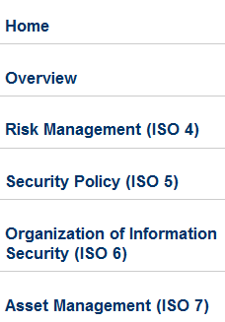
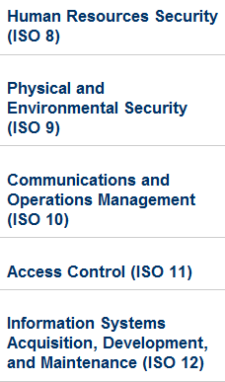
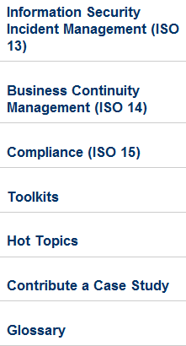
Navigation Pane
Notes:
What’s in the Navigation Pane?
Home – announcements and featured resource links
Overview to the Guide – similar to this presentation
Each of the twelve ISO Topics -- Risk Management (ISO 4) through Compliance (ISO 15)
Toolkits – links to specifically developed resources
Hot Topics – resources related to topics of current interest
Contribute a Case Study – instructions and forms
Glossary – list of terms and phrase definitions

Slide 18
Finding information in the guide
Navigation pane is not as effective if you don’t know where the desired topic is covered in ISO, e.g.,
Data Classification is in Asset Management (ISO 7)
Awareness and Training is in Human Resources Security (ISO 8)
Cryptographic Controls is in Information Systems Acquisition, Development, and Maintenance (ISO 12)
For these sort of topics, use the Search Tool
Or to ensure you find all information relevant to your interest
Notes:
Sometimes it’s less obvious where to look for information. In this case, us the search tool.

Slide 19
Using the search tool
leave empty
Notes:
Searching is easy but not fully intuitive the first time
Using the Search box on the breadcrumb bar will ALWAYS search the entire wiki – all spaces. Not usually the best choice.
Start searching by leaving the search box empty and pressing the search button…
If you don’t see the search button, just place your cursor in the empty search box, and hit “enter.”

Slide 20
Using the search tool
Note: Be sure to avoid the selection called “Old Security Guide”
Notes:
… which brings you to this expanded search box next to the Internet2 logo.
Important note: The Guide is one of several “spaces” in a generalized wiki. To search effectively, we must restrict searching to just the Guide.
Be sure to limit your search to the Information Security Guide using the pull-down menu under, “Where.” This will filter (or limit) the search to just the Guide.
Avoid the selection called, “Old Security Guide,” which no longer contains any content.

Slide 21
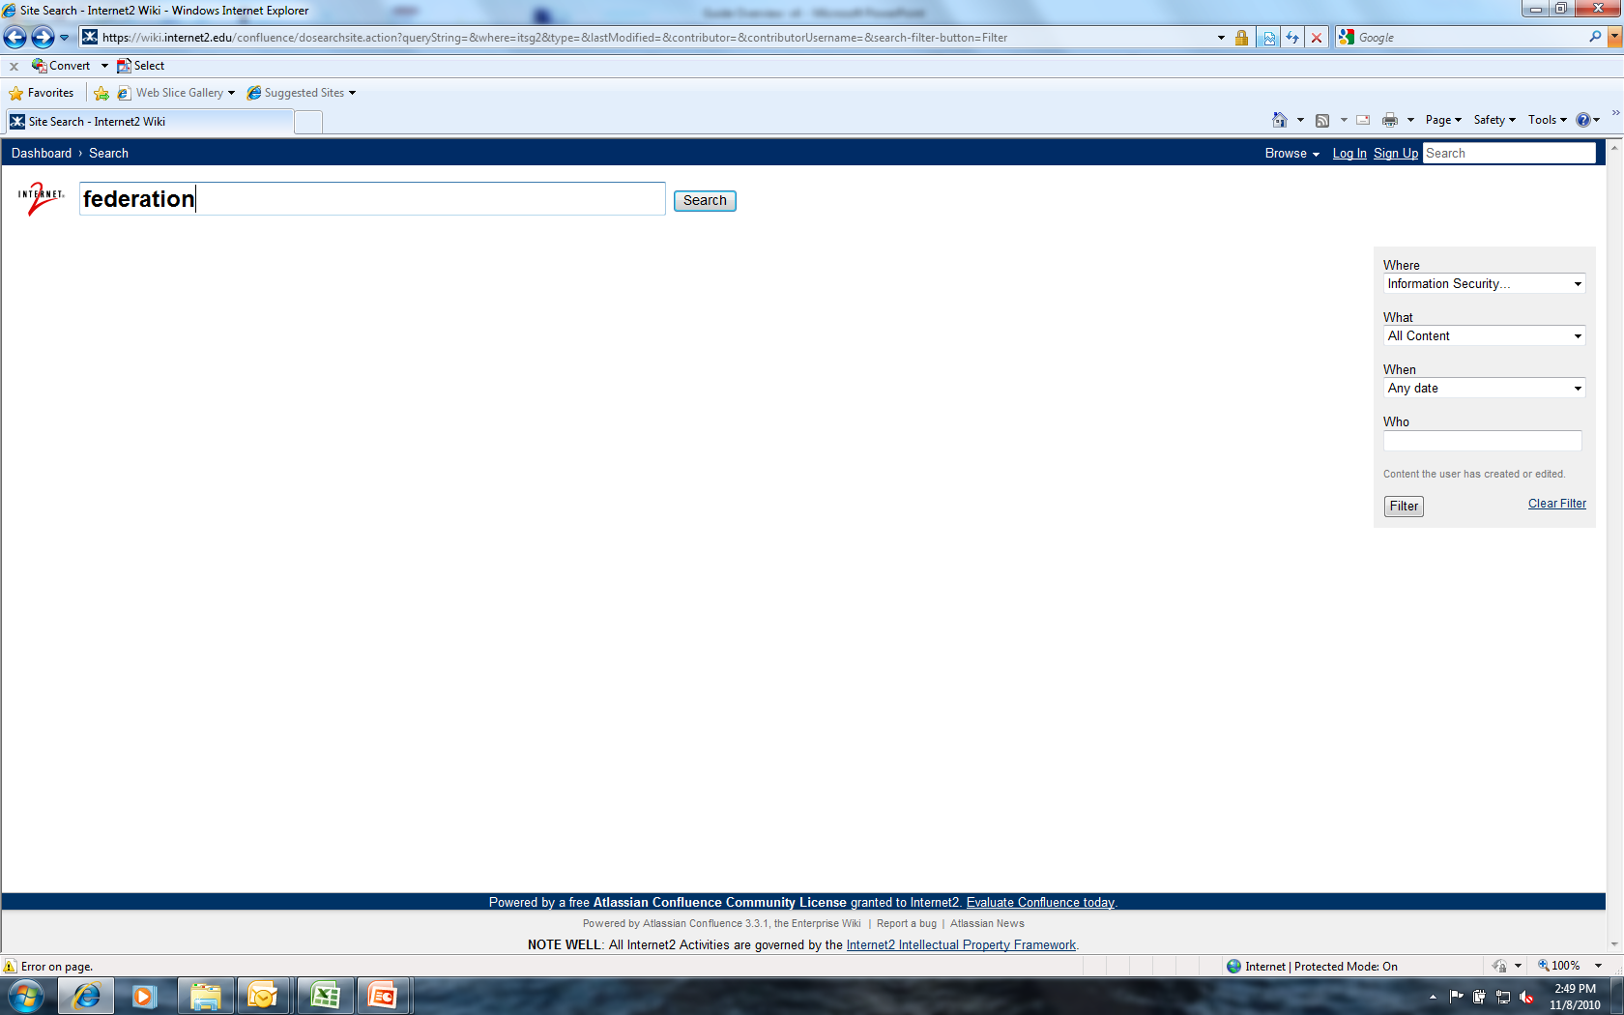
USING THE SEARCH TOOL
Now enter your search term into the search box on the left side of the page (next to the Internet2 logo)

Slide 22
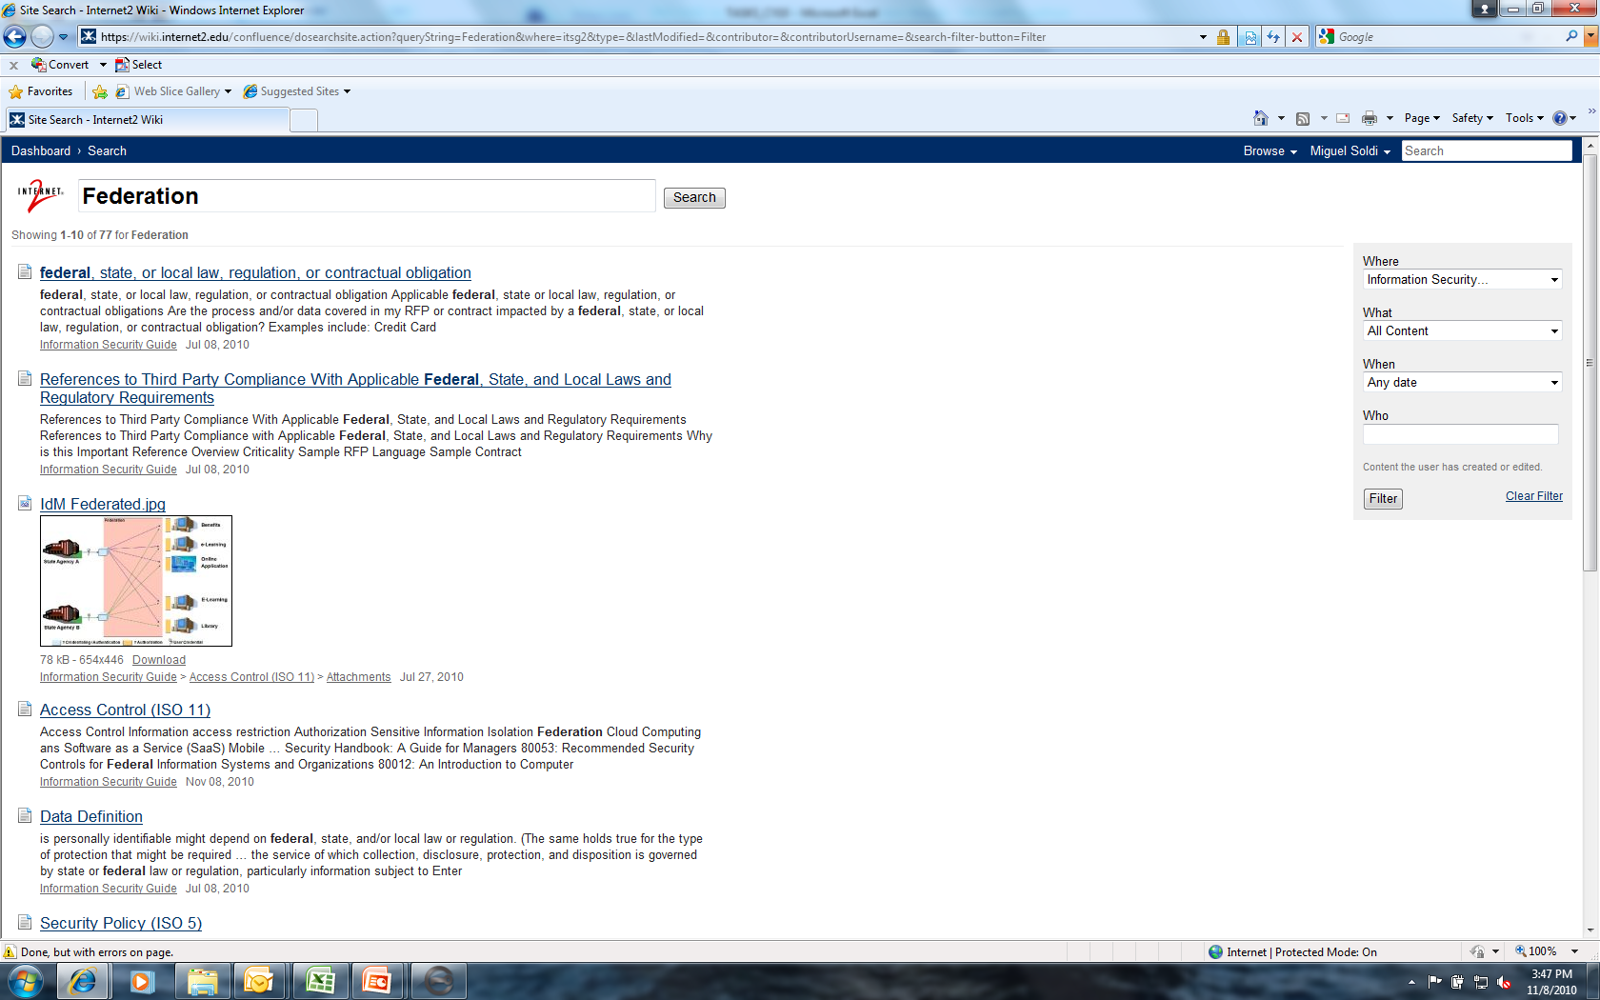
SEARCH RESULTS: FEDERATION

Slide 23
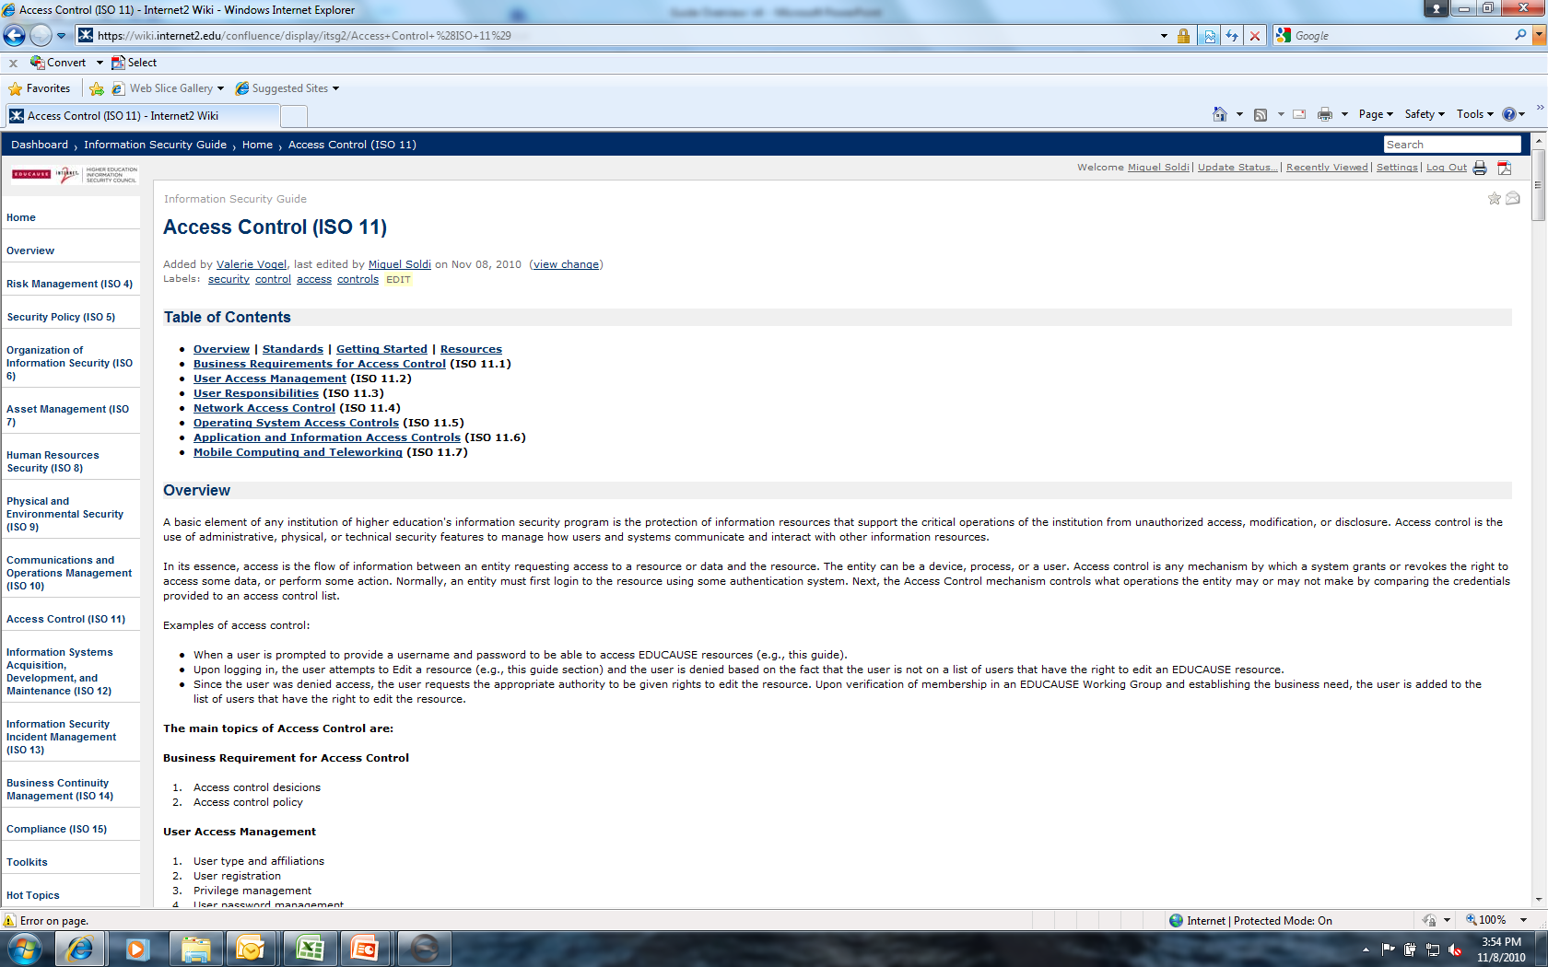
SEARCH RESULTS: FEDERATION
If you scroll down…….

Slide 24
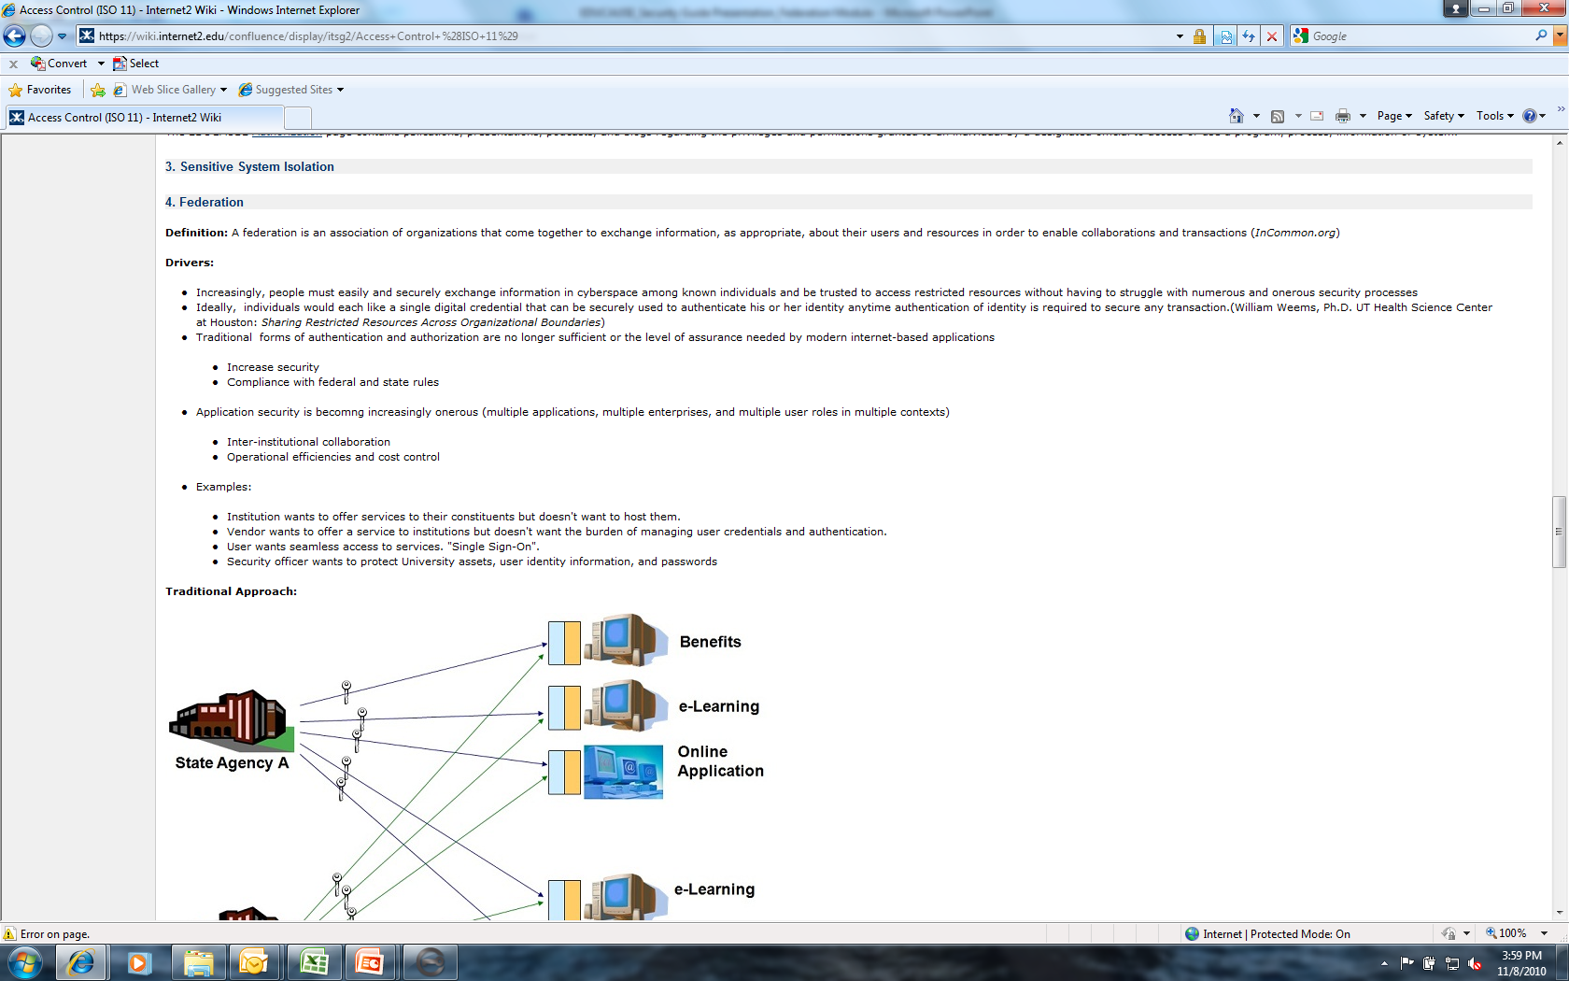
SEARCH RESULTS: FEDERATION
Notes:
… you see the category on federation.

Slide 25
Using the search tool
Now enter your search term into the search box on the left side of the page (next to the Internet2 logo)

Slide 26
Search results: contract language
Notes:
This search will also find references containing the individual words, “contract” and “language.” Two very useful resources are highlighted here.
We could have searched the entire Internet2 wiki, but by limiting the search to the Information Security Guide, we reduced the number of hits from 51 to 36.

Slide 27
Search results: contract language
Notes:
… and here is the guide section on Data Protection Contractual Language. This is actually one of the Toolkits, so we’ll also take a look at toolkits included in the guide.

Slide 28
Using the search tool
Now enter your search term into the search box on the left side of the page (next to the Internet2 logo)

Slide 29
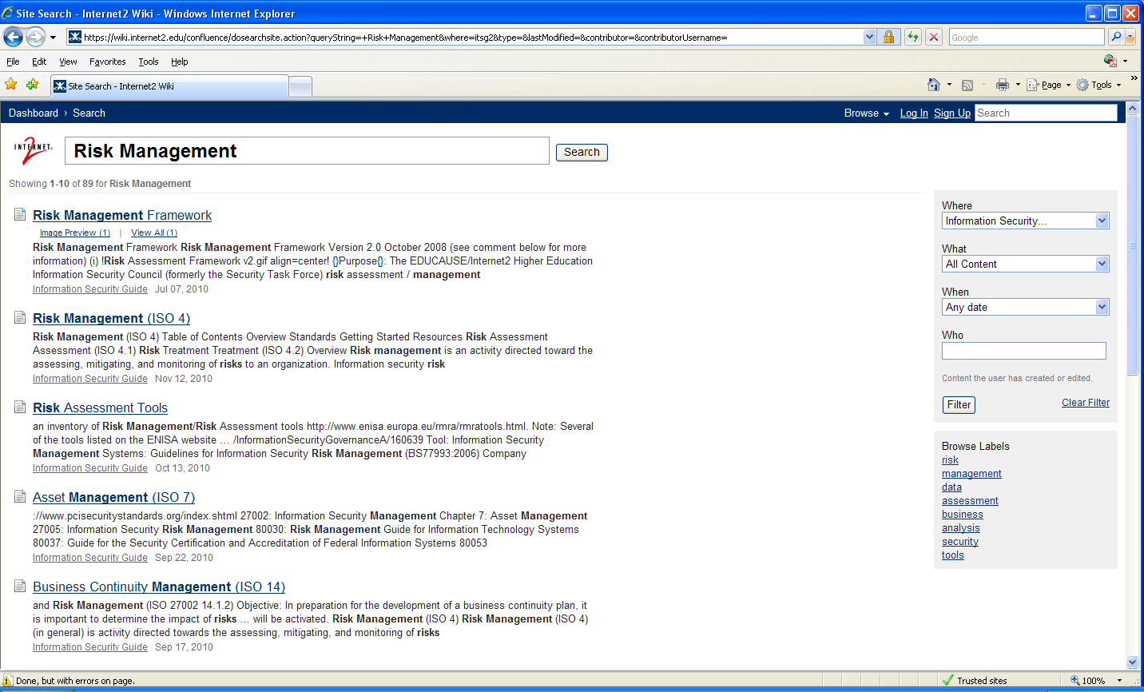
Search results: RISK MANAGEMENT
Notes:
Searching on Risk Management yields 89 results.
Notice that the search tool finds word permutations such as plurals; i.e., “risks.”

Slide 30
Search results: RISK MANAGEMENT
Notes:
… and here is the guide section on Risk Management Framework toolkit. This toolkit is one of the references in the Risk Management (ISO 4) high-level topic. You can see this in the breadcrumb trail.

Slide 31
Toolkits
Notes:
You can find “Toolkits” in the navigation pane. Clicking there takes you to resources that have been developed by EDUCAUSE groups that can save you a lot of time and research!
The newest toolkits are highlighted in the blue box, but older ones are still relevant.
Some popular toolkits:
Business continuity planning
Confidential data handling
Data classification
Incident notification
Data Protection Contractual language
Let’s take a closer look at one of them – Data Incident Notification…

Slide 32
Toolkits: incident Notification
Notes:
None of us needs a data breach, but if it happens, the Data Incident Notification toolkit has templates, examples, and guidance that can save you a lot of time and effort!

Slide 33
Hot Topics
Type “Hot Topics” into the search window and click enter
Notes:
You’ll also want to take a look at the Hot Topics, which can be accessed through the navigation pane or using the search tool. Most of these pages were created in response to questions brought up in the EDUCAUSE Security Discussion Group listserv. Reviewing the hot topics could turn your pain into immediate gain!
For example, are you worried about what’s on all those mobile devices the executives are using?
Take a look at the hot topic page for mobile device security.

Slide 34
Hot Topics
Click on “Hot Topics” Link to open
Notes:
Here are search results for Hot Topics. Note that we’ve still limited the search to the Informtion Security Guide.

Slide 35
Hot Topics
Choose from list of Hot Topics to research
Notes:
… and the resulting page.
Are you worried about the information on all those mobile devices the executives are using?
Take a look at the hot topic page for mobile device security.

Slide 36
Hot Topics: Mobile device security
If you scroll down…….
Notes:
The topic page identifies steps to secure your mobile devices.

Slide 37
Hot Topics: Mobile device security
Notes:
Many resources – policies, guidelinesare available from both Higher Ed and industry.

Slide 38
Contributing to the guide
The Editorial Board depends upon input from many sources
There are two ways to provide input to the Guide
Make a comment on any page
The underlying platform is a wiki. All comments are monitored and suggestions are acted upon
Submit a case study
The chances are good that your institution is doing something that others will want to know about and possibly emulate

Slide 39
Add a comment to any page
Notes:
The “add comment” icon is at the bottom of every page

Slide 40
Add a comment
Notes:
Clicking on “Add comment” opens up a box where you can anonymously add text and post it to the wiki. Note that adding a comment includes a captcha.
Although comments are anonymous by default, it would be helpful to include contact information so we can follow up if necessary.

Slide 41
Contributing to the guide
Notes:
The other, more visible, contribution you can make is a case study.
Case studies are highlighted on a page with a light bulb because these are specially designed for inclusion in the security guide. A case study gives you the opportunity to publish your effective practice and help someone who may be struggling with the same issue.
Clicking on “Contribute a Case Study” in the navigation pane takes you to this page with instructions on how to submit a case study.

Slide 42
Case Study template
Notes:
The Case Study template is available in two formats: A writeable PDF form, and text file. The template guides the submitter through a description of his or her solution, including benefits, challenges, future plans, and return on investment.

Slide 43
Case Study template
Notes:
Text version…
The template allows the submitter to check some information about the study and to help select the ISO category for the solution. The form also includes an Intellectual Property Agreement.
The .pdf version includes a “submit” button that e-mails the form to security-council@educause.edu.

Slide 44
You can also make suggestions or ask questions by sending email to
ced.bennett@stanford.edu
dunker@vt.edu
security-council@educause.edu
Here’s where you can find the Guide
www.educause.edu/security/guide

Slide 45
Questions and answers
Notes:
General questions from the audience?

Slide 46
Questions and answers
Here are some questions from us…
What do institutions and security officers need from the Guide? What other materials would be useful?
Are there Case Studies (i.e., campus effective practices and solutions) that you would like to see included? Does your institution have an effective practice that you would be willing to share as a Case Study?
What, in addition to the Guide, could HEISC do to support institutional information security?

