Slide 1
Teaching Technology Virtually: Beyond the Desktop
Steven Engorn January 13, 2011
Stevenson University
School of Graduate and Professional Studies
sengorn@stevenson.edu
443-352-4220

Slide 2
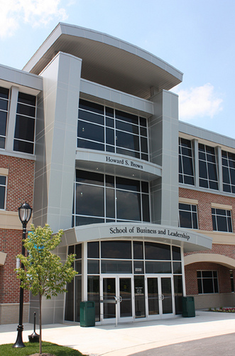
Stevenson University – Who are we
Private Liberal Arts University
Founded – 1947
Located in Stevenson Maryland
Two campuses
Stevenson, Maryland
Owings Mils, Maryland
Enrollment
Total – 4,000
FTE – 3,000
Graduate - 400

Slide 3
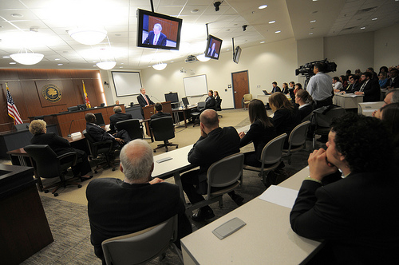
School of Graduate and Professional Studies
Accelerated Bachelor’s degree programs
Accelerated Master’s degree programs
8-week format
Online and onsite

Slide 4
History
Master’s degree in Forensic Studies required use of technologies in online environment not readily available
Online requirements to include:
Configure and test logging utilities to track key events and preserve forensic evidence
Identify the classes of system exploits and the vulnerabilities they attack
Develop an environment to defend the network and system against hacking exploits and evaluate appropriate countermeasure products

Slide 5
History (continued)
Educause Conference in Seattle, Washington
Attended session on N.C. State VCL
VCL was catalyst for developing idea of SU’s Virtual Lab
Received grant from DOJ to enhance Forensic Studies Master’s degree program
Used portion of this grant to build SU Virtual Lab pilot
Requirement to be able to go beyond standard virtual desktop configuration and simulate corporate network infrastructures

Slide 6
Idea becomes reality SU’s Virtual Lab (VLAB)
Built on VMware Virtualization software solution
IBM Blade Center hardware
Ability to easily build very simple or complex corporate network infrastructure environments
All technologies available to students online
Technology must be expandable to include online and onsite courses from other degree programs

Slide 7
Idea becomes reality SU’s Virtual Lab (continued)
Licensing compliance
Maryland Education Enterprise Consortia agreement
Student Option
Microsoft compliance
Software requirements
MSDNAA agreement
OIT Security concerns for Remote Access
Remote access via Citrix software solution

Slide 8
Vlab Requirements
Minimal involvement of OIT once setup completed
Online request for course configuration setup
Faculty responsible for obtaining software requirements
Faculty build their own images and prepare them for students
Expandability

Slide 9
Timeline
June 2008 Hardware ordered and installed
July/Aug 2008 Solution tested
Aug 2008 Faculty training
Sept 2008 Pilot started (2 courses)
Jan 2009 5 courses added to pilot
Aug 2009 Purchased more hardware
Sept 2009 3 more courses added

Slide 10
Timeline (continued)
June 2010 Departmental initiative ($75K) to
increase Vlab hardware
Sept 2010 12 courses using Vlab
Jan 2011 Pilot capstone course using simulated Corporate network infrastructure

Slide 11
Investment
Initial investment of $100,000 (grant funded)
Initial hardware and software infrastructure
Leveraged existing space in current Blade Center environment
Second investment of $75,000 (University funded) with purpose of expanding use of Vlab for undergraduate courses

Slide 12
Current Configuration Hardware
(3) HS21 IBM Blades – Xeon quad core with 32GB ram
(2) HS22 IBM Blades – Xeon quad core with 32GB ram
8TB storage
3TB located on high speed drives
5TB located on lower speed drives

Slide 13
Current Configuration Software
vSphere Enterprise 4 Plus (Vmware)
vCenter (Vmware)
vCenter Lab Manager (Vmware)
vFoglight (Visioncore)

Slide 14
Planned Upgrades
4TB storage for media library
Additional 1.6TB high speed drives (grant funded)
(2) additional HS22 Blades (32MB)

Slide 15
Example of Benefits
Networking course had 20 students
Running 3 sections of this course
Each student was given 4 VM’s
240 unique VM’s were associated with this online course
Students have hands on experience building networking environments
Environment does not interfere with University network

Slide 16
Sample Configurations

Slide 17
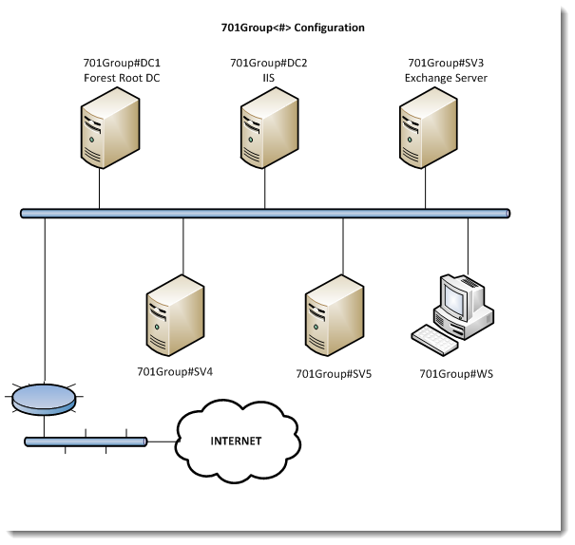

Slide 18
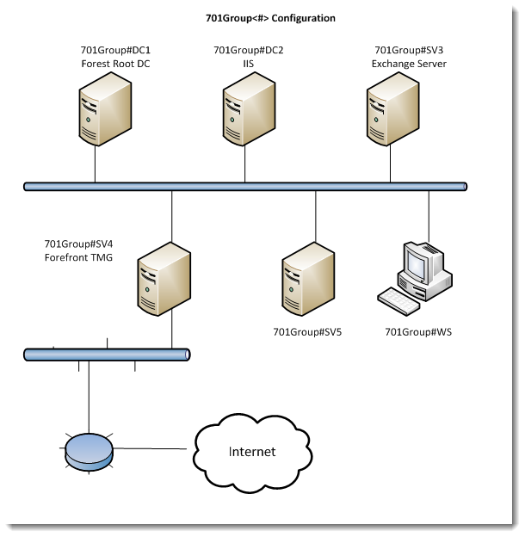

Slide 19
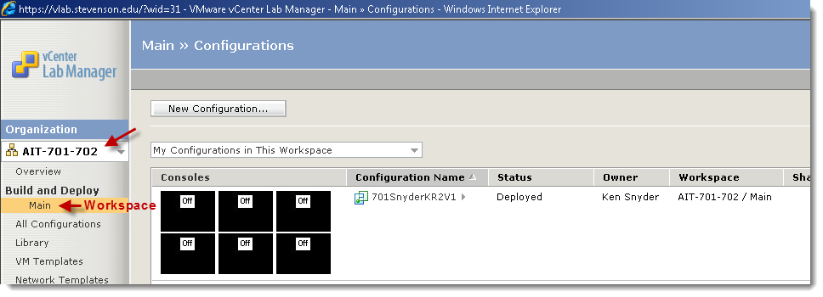

Slide 20
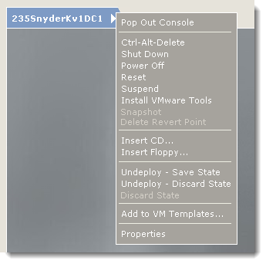

Slide 21
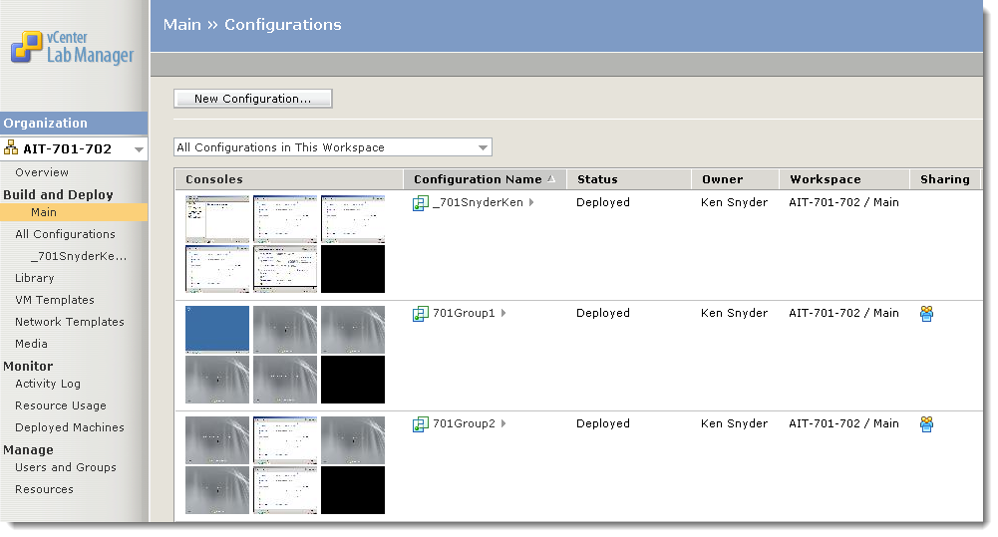

Slide 22
Sample of Media Library
Over 60 ISO’s available for student use
MSDNAA Agreement
Examples
Windows Server 2008 R2 Standard, Enterprise, Datacenter, and Web
Windows 7 Enterprise
Exchange Server 2007 or 2010
Forefront Security for Exchange Server

Slide 23
Lessons Learned
Need Vlab course administrator
vCenter Lab Manager training for faculty
Good relationship with OIT
Consider hardware capacity vs faculty requests
Scripts advantageous (not part of vCenter Lab Manager) to build student workspaces
Hardware decisions are important
Example: 7200 RPM drives vs 15000 RPM drives

Slide 24
Demo

Slide 25
Questions

Slide 26
THANK YOU

