Slide 1
Building a Knowledge Base:
The Key to Collaborative Information
Cynthia Gingrich
Technical Support Assistant
Temple University
Sheri Stahler
Associate Vice President
Temple University
EDUCAUSE Mid-Atlantic 2011
Notes:
Sheri – gather feedback from audience

Slide 2
Objective
Identify Information Gaps on Campus
Provide a Strategy to Build a Knowledge Base to Bridge those Information Gaps
Notes:
My presentation today will look at ways to identify information gaps that may exist on your campus. I will use for an example a project that I’ve been working on at Temple University called the Knowledge Base. By the end of the presentation this morning, you will have the tools some practical know-how should you be interested in creating or refining your own Knowledge Base to address any information gaps on your campus.

Slide 3
Temple University
North Philadelphia
Public
36,000 Students
17 Schools/Colleges
9 Campuses
Notes:
So first things first, Temple University is a large public, urban university in the heart of North Philadelphia. In 1888, it was begun as a commuter school but now has about 12,000 students living on or near campus. One in every eight higher educated Philadelphians is a Temple graduate.
We have nine campuses, including Rome and Japan, seventeen schools and college and 36,000 students.

Slide 4
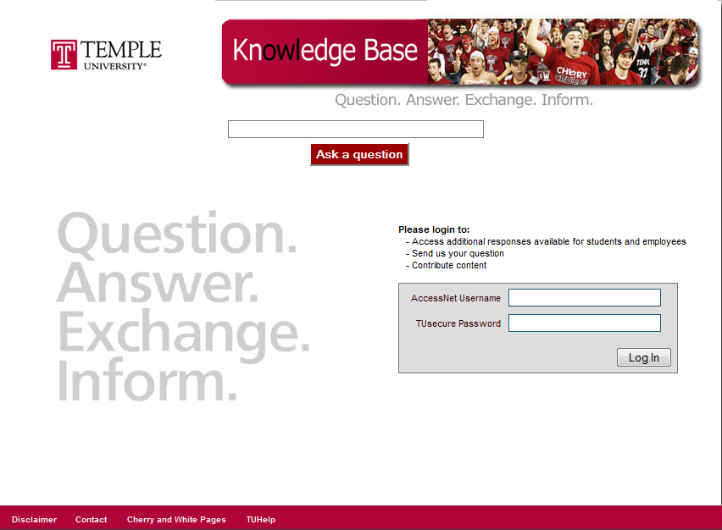
Notes:
The project initially began in 2005 in the School of Communication and Theater as a component of their administrative portal. At that time, it was only available to faculty and staff. In 2008, Computer Services adopted the Knowledge Base. They decided that it should be university-wide and available to students. Since then, not only have we expanded to include students but we now have public search interface that provides information for prospective students and parents.

Slide 5
Data
Information
Knowledge
Notes:
So then let me give a brief overview of how I define data, information and knowledge, especially with relation to the Knowledge Base.
When it comes to that which is most useful to us in performing our jobs, data definitely has its place. We have to track usage through gate counts, the number of times a website is visited or how often a service is used. An academic department might also depend on enrollment data for their funding. Data is very important and drives the decision making at most organizations, including colleges and universities. But most data is only useful when it is interpreted to become information.
Information, simply, is contextualized data. Take for example the question “How do I change my password?” This question gets as many as 12 hits a day our Knowledge Base at Temple. Some might look at that and say “ok, that’s nice.” And then move on. But managers at the Help Desk know how this number compares with the number of actual password resets. Therefore, something that is data to most people becomes information to the Help Desk managers. They see that data in the greater context of all password resets.
Information then, becomes knowledge when it results in action. Let’s continue with our example of password resets. If the managers at the Help Desk notice that password resets are up AND the Knowledge Base is getting a lot of hits, perhaps something needs to be done. Perhaps they could modify their website so that changing your password is easier. In fact, this is exactly what they did last summer. So that initial data was contextualized into information and then the information was acted upon to create knowledge.

Slide 6
Action
Context
Knowledge
Reusability
Notes:
The amount of data available to the world is continuously increasing. But the context required to turn that data into information is still very limited. And the capability and understanding to turn information into knowledge is ever more limited. This limitation creates something called an information gap.
-Empower the university community by providing necessary information/knowledge

Slide 7
Information Gap
Data
Reusable Knowledge
Information
Notes:
Data and information are out there; on a website or in a brochure. But it doesn’t always reach the students, faculty and staff who rely on that information to carry out their day to day responsibilities on campus.

Slide 8
Data
Reusable Knowledge
Information
Notes:
Sheri: The Knowledge Base provides information on our audience so that we can better provide for their information needs. With this information, we can work on closing the information gap and also learn how students translate their available information into Knowledge.
In studying this gap on our campus, we also look at what tools people are using and why and how we can provide information on those preferred tools.
Cynthia: My presentation today will focus on bridging the gap in order to get available information into the hands of those that need it most. I will focus specifically on something that we’ve created at Temple University called the Knowledge Base.
But the Knowledge Base is just one way to bridge the gap, not the only way. Even though this presentation focuses on the Knowledge Base, this is not a situation of either/or, the Knowledge Base is simply one method to communicate and share information on campus. We are constantly taking into consideration the search behavior of our community and tweaking the Knowledge Base accordingly.

Slide 9
Notes:
Since it came online in January of 2009, the Temple University Knowledge Base has received some 40,000 hits. We have 1100 published questions contributed by 80 administrative and academic departments.
-Encourage autonomy of content contributors – they maintain their own set of questions.
Sheri (?): Perhaps you already have a Knowledge Base on your campus. At Temple, several department did already have a Knowledge Base before this Knowledge Base came online. But the difference is that the previous Knowledge Base had separate databases for each department. This new Knowledge Base, however, has one single database that holds information from every department. This means that you can search information from all 80 departments, in the same search and there is no duplication of information or effort.
So, in two years, how do you get 80 contributing departments, 1100 published questions and 40,000 hits?

Slide 10
Step 1:
Obtain senior level buy-in
Notes:
Step 1: get senior level buy-in. Our executive sponsor is the Vice President for Computing and the university’s CIO. He recognized the potential for the Knowledge Base early on and mandated all of his departments to contribute. This beginning group provided a live prototype that helped us get buy-in from other departments. The Provost’s Office was next major senior level office that we had to get on board. If we wanted any information from the academic offices on campus, we had to have full support from the Provost’s Office.
But, when we first presented the Knowledge Base to the Provost’s Office, they were hesitant. They had three main concerns.

Slide 11
How is this different from the search on the university website?
Website Search
Knowledge Base
Notes:
Their first concert: How is the Knowledge Base different from the search on the university website?
You can do a search on the website and it will return an assortment of PDF documents from several years ago or a webpage that may contains one of your search terms hidden at the very bottom of the page. This search will cost the user a significant amount of time as they weed through all of the irrelevant results to find exactly what they’re looking for.
But with the Knowledge Base, each question and answer is chosen and published by the responsible department. For instance, the Knowledge Base contact in the University Registrar’s office might say “we get the question “How do I get a transcript?” over and over again. I think this question important so I am going to put it in the Knowledge Base.”

Slide 12
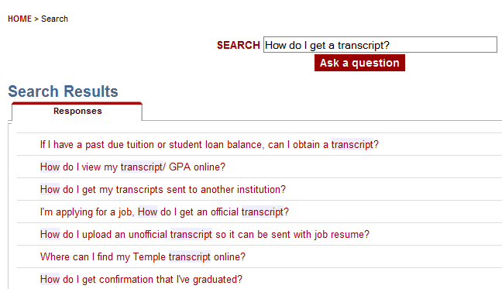
Notes:
So now, when a student types “How do I get a transcript?” into the Knowledge Base, they get the exact information they need without having to dig through other irrelevant information.
Another element about the Knowledge Base that is helpful is the possibility of finding answers to questions you may not have thought about previously. For example, if you ask “How do I get a transcript?” You will get find information about getting an official transcript, but then you will also see a question about getting an unofficial transcript, or getting confirmation that you’ve graduated. These may be questions that you didn’t think of originally but that you will find very useful.

Slide 13
How will we maintain the information so it doesn’t become outdated and irrelevant?
Notes:
The second concern from the Provost’s Office was “How will we maintain the information so that it doesn’t become outdated and irrelevant?”

Slide 14
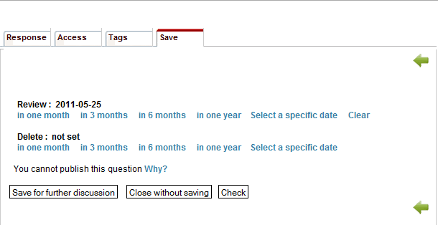
Notes:
Well, each question in the Knowledge Base must have a review date in order to be published. And the review date must be a year or less.
If we go back to our question of “how do I get a transcript?” You can see that this question was last updated on November 4, 2010. So not only does the Knowledge Base require a review date as an internal process, it also communicates that information to the user. The user, then, can know for sure that this information is current and relevant.

Slide 15
Why would we duplicate information that is already available on our website?
Notes:
Finally, the Provost’s Office was concerned about duplicating information on the department website and duplicating the effort of the individuals in that department.
One thing we emphasize is that websites do not have centralized control; each department creates their own website and while they follow general design principles, each website is certainly individual. Whereas the Knowledge Base can provide a collective body of Knowledge from across the university all in a standardized format and design. The department still has control of their content, but they are participating in a greater collaborative effort. The Knowledge Base provides the structure needed to collaborate and share information across departments.
It is true, many websites have a static FAQ page. This all goes back to the concept that there are multiple ways to share information to the university community. But with a static FAQ page, an end user still has to search for the page and then scan the page to find the question they want. But say for example, a student is on a static FAQ page for the Registrar’s office and they read a question about checking their grades online. So then they go to check their grades but they can’t login because their password is expired. Well then, they would have to do another search to find the FAQ page for the Help Desk and information about changing their password.
But if they were in the Knowledge Base, the FAQs and the searching all happens in the same screen, no need to have multiple windows and navigate to multiple webpages – Collective body of knowledge that is managed centrally and allows for cross pollination between departments.
Also, if you think about your receptionist receiving phone calls asking questions for which the answer already resides on your website, is that not also a duplication of effort? There are many ways in an office where efforts are duplicated and not all are necessarily in an online environment.

Slide 16
Notes:
Let’s go back to the example of “how do I get a transcript?” If we take a closer look at the response to this question, you will see that the answer points the user to the Registrar’s website.

Slide 17
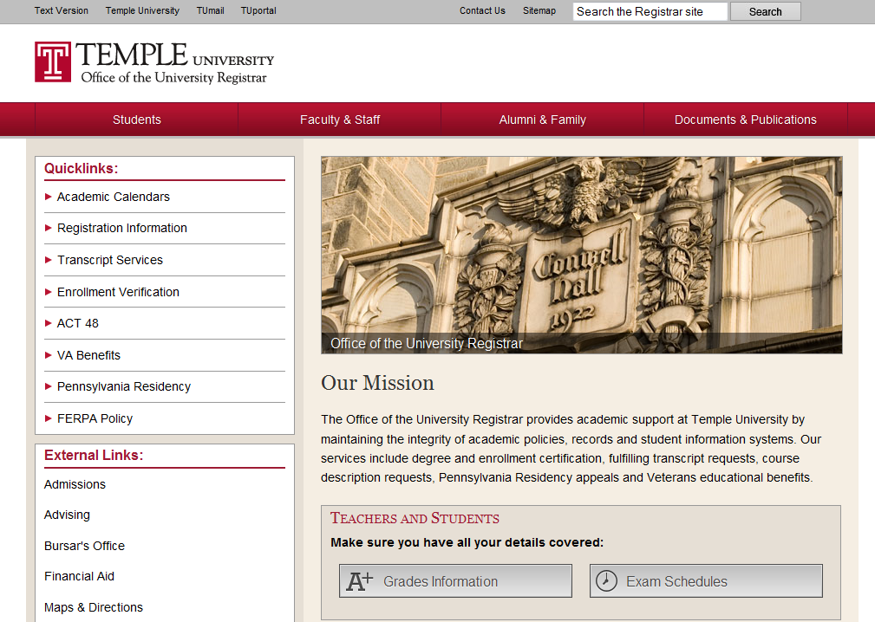
Notes:
Sheri: Web content management
Cynthia: At the Knowledge Base, we are not in the business of duplicating information and creating more work. Instead, we point users to a department website, to a policy or to a form. Temple University has approximately 500,000 individual web pages and the task of finding the exact one that you need can be daunting.

Slide 18
?
Notes:
Think of the Knowledge Base as connecting the student, faculty or staff member to the specific web page that contains the exact piece of information they need at that any given moment.
With that, we were able to address the concerns of the Provost’s Office and gain their support and buy-in for the Knowledge Base.
Handling the concerns of all of our contributing departments is an ongoing process. We communicate with contributing departments about once a quarter to provide any feature updates and answer any questions or concerns they have. Genuinely listening to the needs of our contributors and our end users and addressing those concerns has made all the difference. There is not a department that contributes to the Knowledge Base that I have not met with personally. It certainly takes more time to approach a project in this manner. But the success of this type of knowledge-centric project absolutely depends on it.

Slide 19
Step 2:
Decide which questions to include
Notes:
The second step to building a Knowledge Base is gathering the information. Hundreds of thousands of millions of questions exist out there. So how do you decide which ones should be included in the Knowledge Base? When we first approach a contributing department, we provide a set of criteria to help decide which questions to include.

Slide 20
How many times a day do you get asked this question (in person, on the phone, over email)?
Notes:
Generally speaking, if you get a question say at least 5 times a day, then it is definitely something you want to add to the Knowledge Base. The front office folks are usually the best people to provide information about the most frequently asked questions for a particular office.

Slide 21
Is this question applicable to a relatively wide audience?
Notes:
Next, the Knowledge Base is a good resource for more general questions. Questions that reference an individual situation or require the look-up of a single student’s account are too specific for the Knowledge Base.
Think about these two questions:
I activated my new student account yesterday and I set my password but I still am not able to access my email. What should I do?
How do activate my account? Or How do I change my password?
The first question would require contacting the individual, looking up their account and providing a response based on that information. The end result is a question in the Knowledge Base that is only applicable to one out of some 30,000 students, faculty and staff on main campus.
But if you have the question: How do I activate my account? Or How do I change my password? Then you are publishing information that will be relevant to just about every single person in the Temple community.

Slide 22
Can I back up my response with a policy, procedure or website?
Notes:
In other words, questions and answers in the Knowledge Base should be objective. There is a very fine line between adding knowledge (capability, understanding and information) to a situation and providing your own, unchecked opinion on a topic. Can you back up your response by linking to a website, a policy, or a procedure that is documented publically.

Slide 23
Step 3:
Promote to the community as a resource.
Notes:
So now, you have senior level buy-in, you have a good set of applicable but not too specific questions. The third step is to promote the resource that you’ve created to your community, to your end users. We created a full-scale communication plan for the Knowledge Base including mass emails, and announcements in the daily news bulletin.

Slide 24
Notes:
We also had several posters printed, like the one you see here.

Slide 25
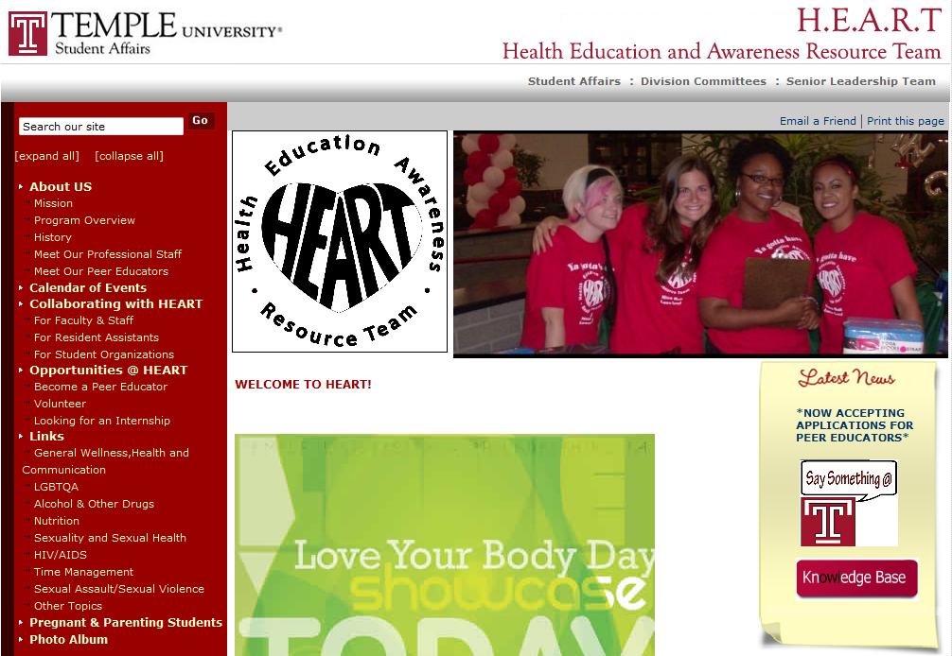
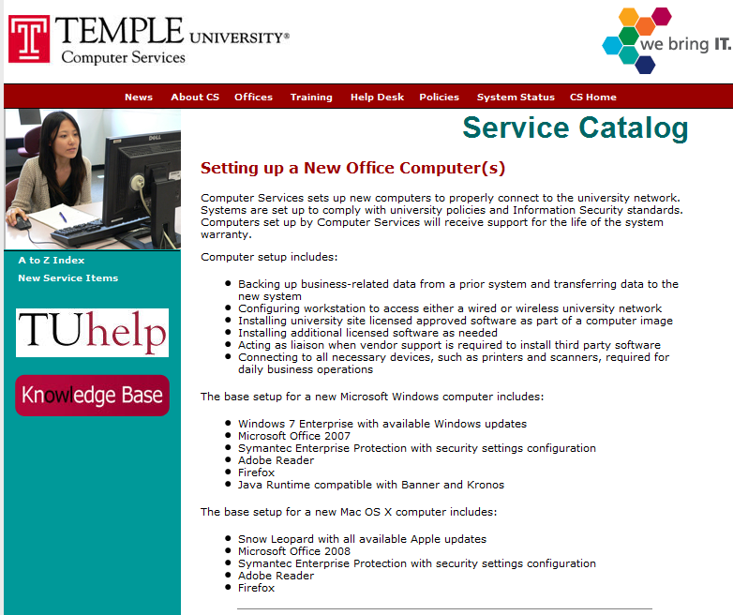
Notes:
Next we went to each contributing department and recommended they put the Knowledge Base logo and a link on their website.

Slide 26
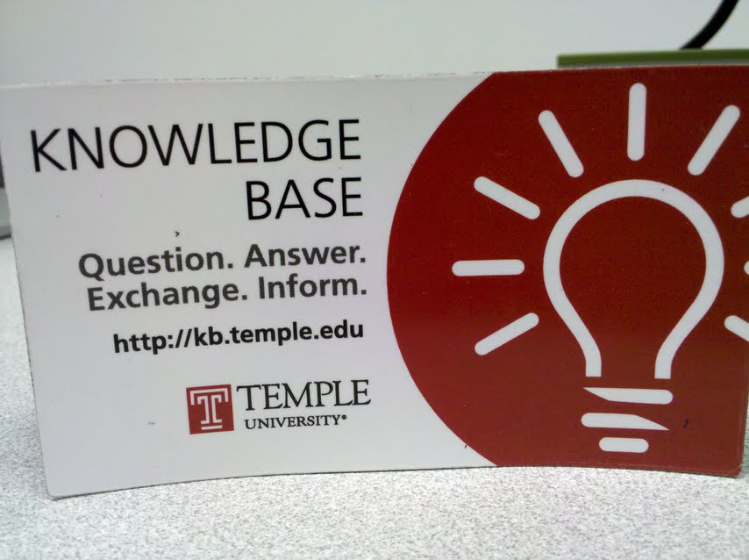
Notes:
We also hand out Knowledge Base magnets at Residence Hall move-in, new employee orientations, and open houses as a way to continuously promote the Knowledge Base to those that are new on campus. I brought a stack of magnets with me today so please feel free to take one on your way out!
The entire Knowledge Base project is basically a grass roots effort to encourage Knowledge Sharing across campus, something that intrinsically goes against the culture of most organizations. So you have to take every opportunity available to talk about, promote, present, or demo the Knowledge Base.

Slide 27
Step 4:
Review, report and refine.
Notes:
The final step of building a Knowledge Base is to continuously review, report and refine the content according to the needs of the user.
As I mentioned earlier, each question is fixed with a review date. On that date, the question and the answer must be reviewed by the owner. Any updates to the content should be made before the question is republished.
The Knowledge Base also has a complete reports module built in that allows all content contributors access to reports for their department and for the entire Knowledge Base. This information can be viewed directly in the browser within the Knowledge Base or it can be downloaded into an Excel spreadsheet for further manipulation.

Slide 28
Notes:
For example, if I wanted to create a chart like this where I can see a comparison of usage between 2009 and 2010. The darker bars are 2009 and the lighter are 2010.

Slide 29
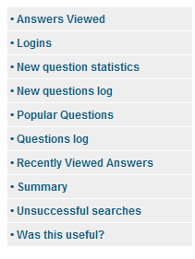
Notes:
But for most content contributors, it will suffice to view the reports within the Knowledge Base.
In the Knowledge Base, content contributors have access to the following reports.
The primary reports used to show success in the Knowledge Base as the Answers Viewed, Popular Questions and Was this Useful?
A report that we use to demonstrate any gaps in the information within the Knowledge Base is the Unsuccessful searches.
These reports are not just to see the top questions, but also to see patterns. These patterns point to any potential gaps in information. I then work with the departments to make recommendations for filling in those gaps.

Slide 30
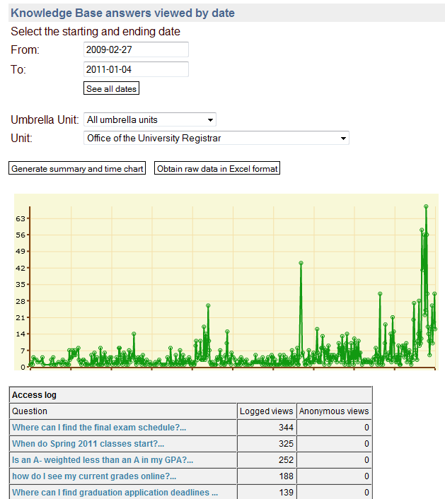
Notes:
The Answers Viewed report looks something like this: you can select the dates at the top, and then select the department that you want to see. I decided to look at the Registrar’s Office here.
Then, the report gives you a visual representation of usage over time and then a list of the number of hits for each question.

Slide 31
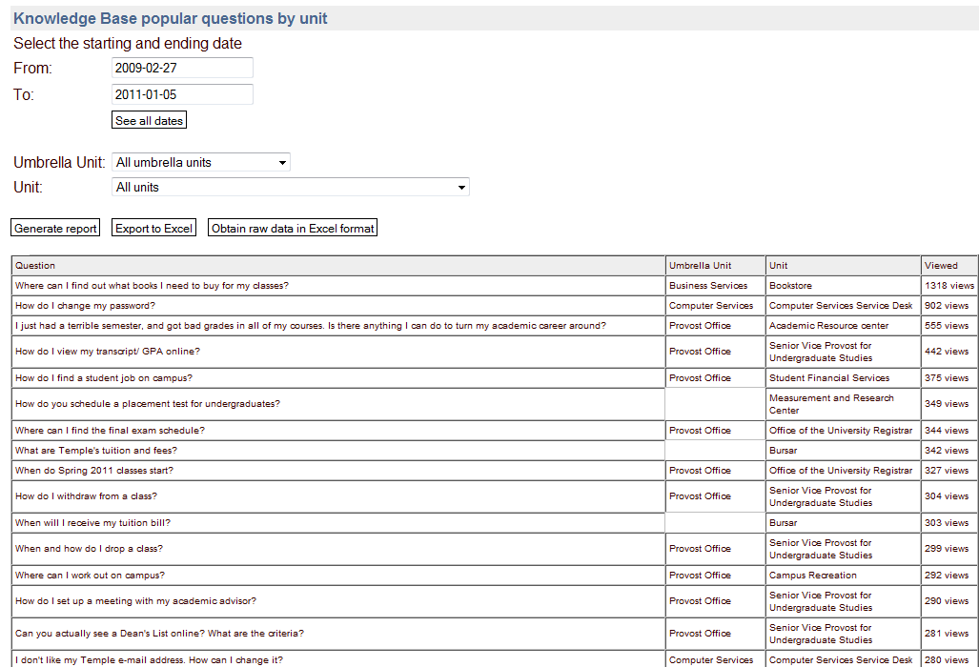
Umbrella Unit
# Hits
Question
Unit
Notes:
Next is the top ten most popular questions. Again, I can select the time frame that I want to look at, and then I could look at the entire Knowledge Base, or a specific unit.

Slide 32
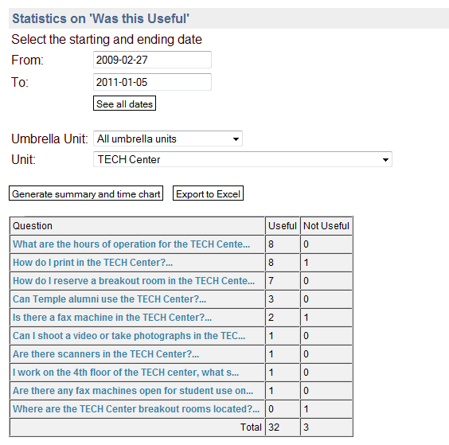
Notes:
Each question in the Knowledge Base has a feedback mechanism that asks “Was this useful? Yes or No.” This information is collected into a report. Here I am looking specifically at questions for the TECH Center. Their questions are doing pretty well in terms of feedback.
This feedback can be very useful for the contributing departments as they write questions and answers in such a way that their audience can understand.
Sheri (?): Right now if someone selects that a question and answer were not useful, there is no way for them to say why something wasn’t useful. But we have a feature update in the works that will allow the community to submit their own version of what they think the question should look like. These suggestions would not be available publically to other members of the community, but would be used by the content contributors and administrators to refine the questions and answers according to the feedback. As a result, we will integrate the idea of crowd sourcing into the Knowledge Base.

Slide 33
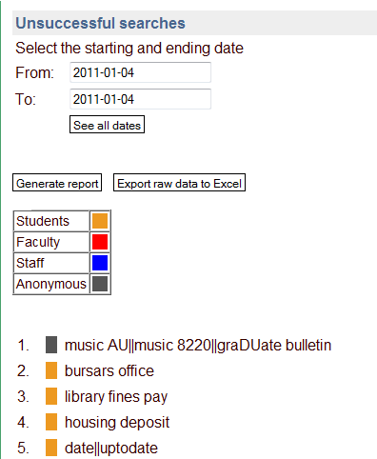
Notes:
Finally, the unsuccessful searches are those that don’t result in a question being looked at. In other words, someone does a search in the Knowledge Base, they’re presented with results, and for whatever reason, they do not click on any of the results to read the answer.
There could be several reasons for this and so the information in this report is more anecdotal evidence of possible information gaps. But it is still very helpful, especially for departments in seeing where they may want to modify their list of questions in the Knowledge Base. (reminder of Step 2: Choose questions to put in the Knowledge Base.)

Slide 34
Where do we go
from here…
Notes:
So now, you have senior level buy-in, you have a core set of questions and dedicated content contributors from several departments. You’ve marketed the Knowledge Base to let people know it’s available and you’re providing reports and periodic status updates to all involved. But where does it go from here? Knowledge, by it’s very nature, does not stay stagnant. It grows into new knowledge. Therefore a Knowledge Base also must grow, and evolve along with the Knowledge it holds.
For the Temple University Knowledge Base, we’re looking at current trends in user behavior such as increasing hand held and mobile device usage. We’re also aware of the Google-inspired search culture that has formed in the last few years. As a result, our next two major initiatives are a mobile web version of the Knowledge Base and a federated search that searches multiple databases at once through a single search interface. This would allow end users to search the Knowledge Base, the Temple Google search, the directory and others all at the same time.
We also have the potential to add content to the Knowledge Base and make it only available for a specific department which creates a sort of intranet.

Slide 35
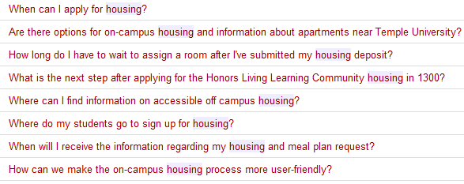
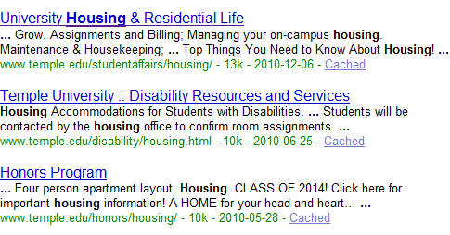
Frequently Asked Questions
Directory
See more Directory results…
Temple Websites
See more Frequently Asked Questions…
See more website results…
Notes:
Another project that is in progress is a federated search between the Knowledge Base, the Temple Google search and the directory search.
This is the result of a suggestion from one of our users. So far the Provost’s Office has seen it and is very impressed.

Slide 36
Successes
Changes
Challenges
Notes:
Challenge: Knowledge Base is only available to those with login credentials but my department primarily works with prospective students and parents.
Change: Added public search interface for selected questions that does not require authentication.
Success: The public search box went live in April of 2010 and has already received 1500 hits.
___
Challenge: Larger umbrella departments, such as the Provost’s Office and HR wanted to have a way to oversee all of their sub-units at one time.
Change: We created an additional layer of governance called the Umbrella unit.
Success: For these larger departments, this has been very helpful to them to keep track of all the content going out from their units and make sure that everything correlates and there’s not duplicated effort.
___
Challenge: Departments wanted to be able to see statistics for their questions without having to ask me for a report.
Change: We introduced a reports module that allows any contributing department to view reports for the entire Knowledge Base to track their progress.
Success: I spend less time preparing reports and departments have easy access to stats.

Slide 37
In Summary…
Identify Information Gaps on Campus
Provide a Strategy to Build a Knowledge Base to Bridge those Information Gaps
Notes:
So this is where we’re at. As I said before, the project is constantly growing and evolving and one of our tasks is to be flexible enough to grow and evolve with the system and the user base that we serve and at the same time stand strong on the principles of information sharing. My goal today was to provide some practical steps to creating a Knowledge Base to increase collaborative information flow on your campuses and in your organizations using the Temple University Knowledge Base as an example.
We have some time now for questions…

Slide 38
Questions?
Sheri Stahler
sstahler@temple.edu
215-204-1030
Cynthia Gingrich
cynthiag@temple.edu
215-204-5929
http://kb.temple.edu

