Slide 1
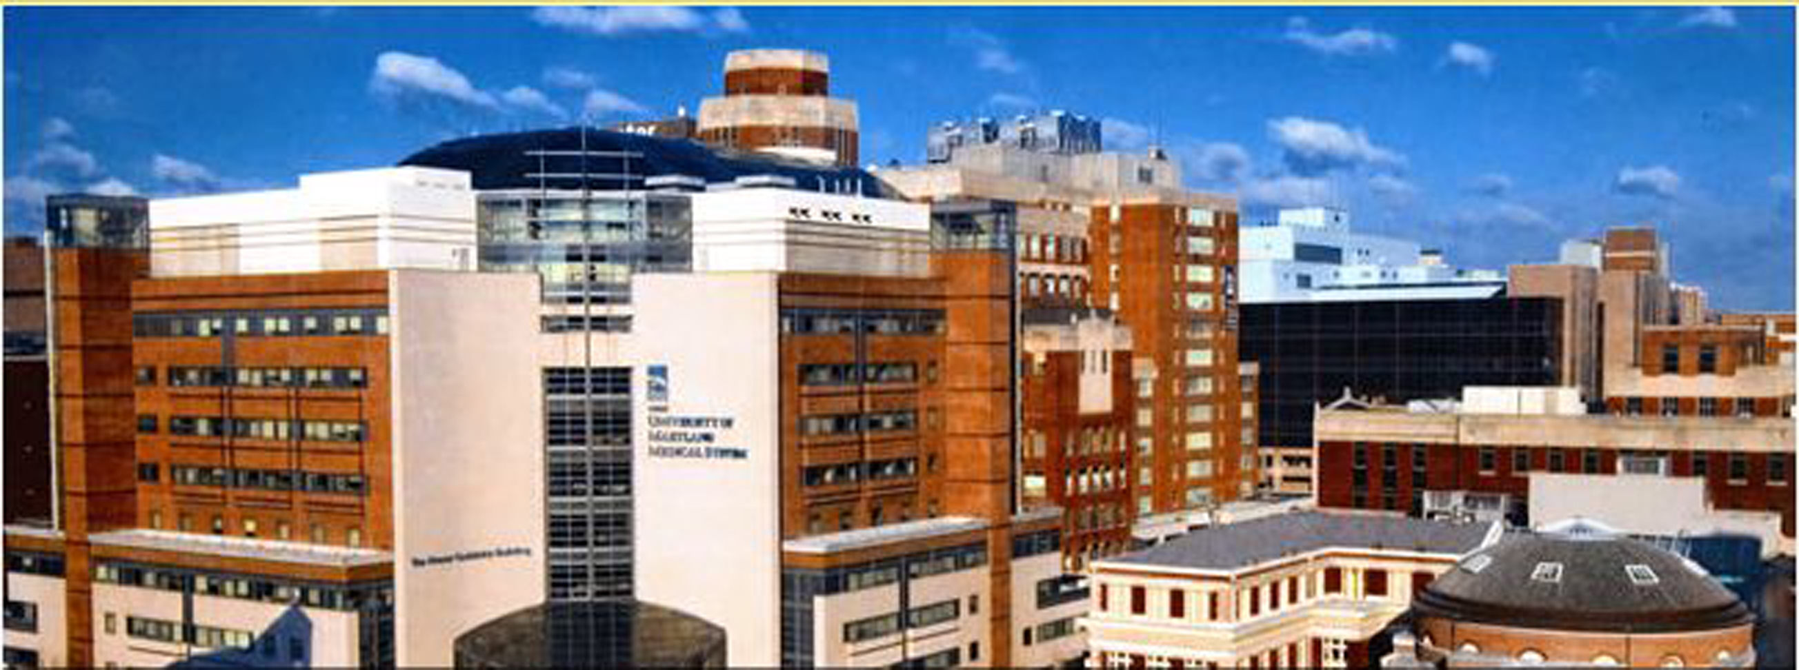
Unifying Disparate Campus Email Systems
Steve Brown
Senior, Systems Administrator
University of Maryland – CITS
sbrown@umaryland.edu
Joe Mancuso
Director Infrastructure Services
University of Maryland - CITS
jmancuso@umaryland.edu

Slide 2
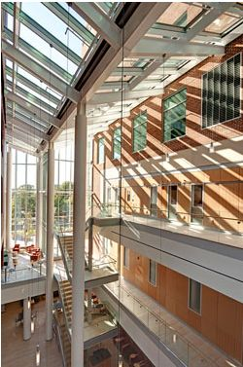
Statement of Problem
University of Maryland is comprised of seven professional and graduate schools
It also has a close relationship with the University of Maryland Medical Center
Self-sufficient entities led to independent email systems
Separateness prohibits standard email functionality
Missing features are: Global Address Lists, distributions lists and calendar sharing

Slide 3
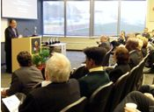
Background
Many different email platforms had evolved
Address lookups across environments was nonexistent
Decision was made to create a unified address book
Initial deployment was
Microsoft’s Active Directory Connector (ADC)
Microsoft’s GroupWise to AD connector
Finally in 2010 a product call UnitySync,
http://www.dirwiz.com, was found
Uses standard LDAP calls
Easy to configure with excellent technical support

Slide 4
How it Works
User’s information is replicated to the different directories throughout the UM campus
Some do not wish to have information “pushed” to their directory
Opened the central repository servers so that LDAP lookups could be achieved from any desktop messaging application
Allows individual users to do Global Address List (GAL) lookups for anyone on campus
Easily send messages throughout the environment
Do not have to be bothered with what an individual’s email address is
All that is needed is to know the person name
Today most users are not aware they are collaborating with users in other disparate messaging environments.

Slide 5
Importance to Your Institution
Projects like this help pull the campus community closer
Having email addresses and demographic information available is vital
When this type of information is not available, user frustration occurs and valuable time is wasted.

Slide 6
Session Outcomes
Make an assessment of what is working for the UM and decide if it will work for you
Identify some of the pitfalls that can occur when implementing a project of this nature
Discuss issues with UM team members that support the day-to-day activities of a large disparate messaging environment.

