Slide 1
Technology Project Selection and Governance at Loyola University Maryland
Richard G. Sigler, Director PMO
Loyola University Maryland

Slide 2
Bringing process: building something great
Loyola recognized the need for process
no more arbitrary “yes & no”
selection process must be repeatable & consistent
must represent the strategic and evolving needs
the University must be involved and “buy in”
projects must be tracked and managed in a portfolio
increase project success

Slide 3
Loyola decided we needed a
PMO

Slide 4
How do we do that?

Slide 6
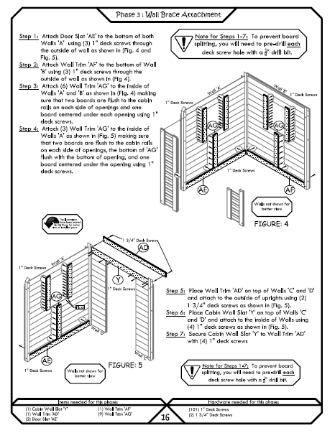
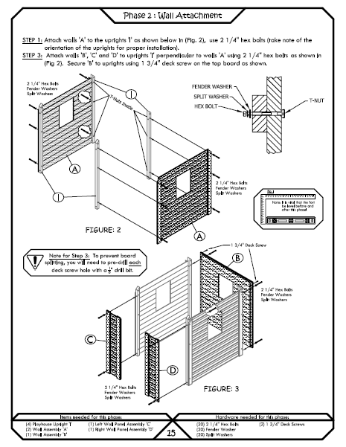
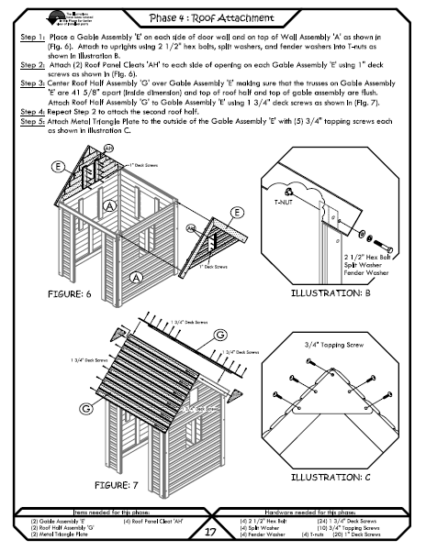

Slide 8
PMO
Invest Well
Increase Success
Lower Risk
Increase Maturity
Show Progress

Slide 9
Project Portfolio
PM Process
Information System (PPM / PM Info Sys)
Support Strategy

Slide 10
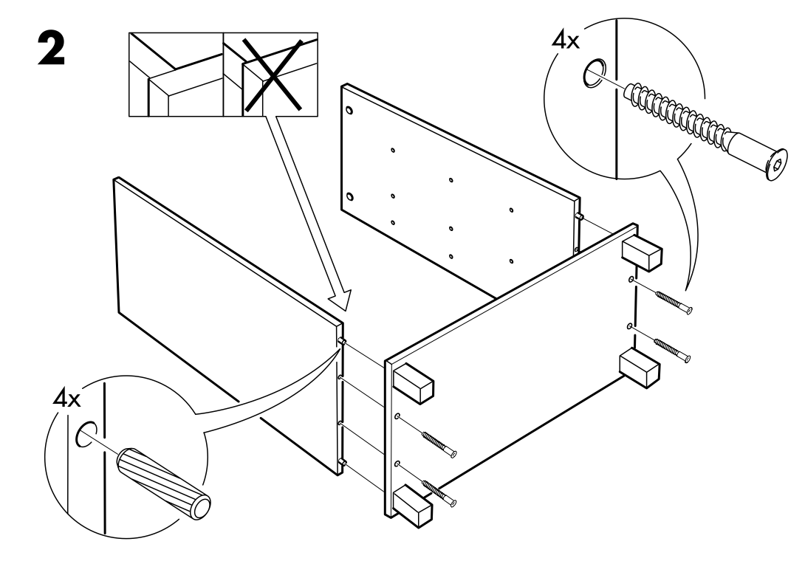
Project Portfolio
Formation
Tracking
Reporting

Slide 11
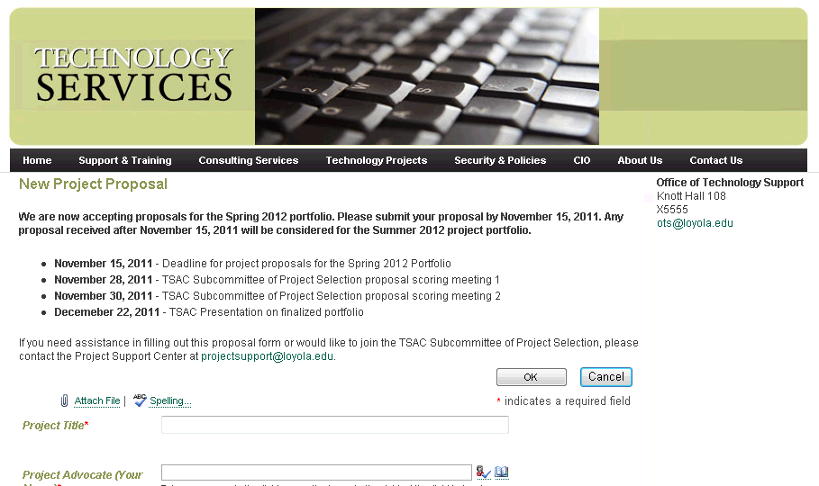
Portfolio Formation – Step 1 Proposal
Actor: Organization Member
Process: Fills out online proposal form
Tool: Online proposal form
Output: Submitted proposal

Slide 12
Portfolio Formation – Step 2 Investigation
Actor: IT Director
Process: Cost Estimation (People / Dollars)
Tool: Evaluation Scorecard
Output: Cost information on Scorecard

Slide 13
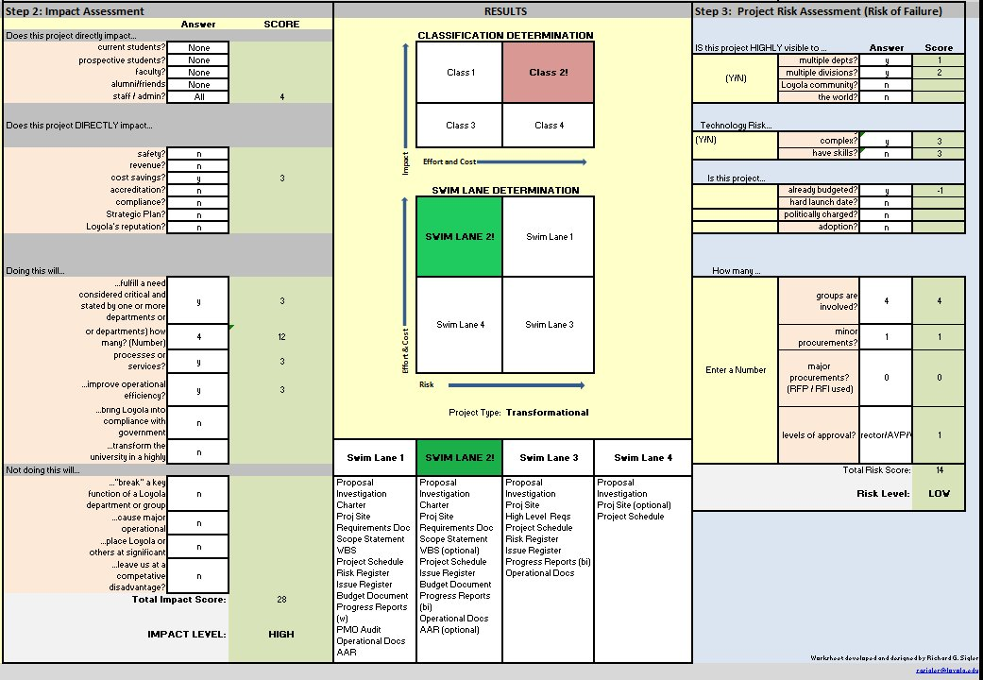
Portfolio Formation – Step 3 Scoring
Actor: Governance
Process: Objective Project Scoring (Impact & Risk)
Tool: Evaluation Scorecard
Output: Project Class & Impact, Project Swim Lane & Risk

Slide 15
Project Classification (Prioritization)
Projects are scheduled
Class X - Regulatory
Class 0 - Underway
Class 1 – High Impact / Low Cost = Quick Win
Class 2 – High Impact / High Cost = Large Strategic
Class 3 – Low Impact / Low Cost = Nice to Have
Class 4 – Low Impact / High Cost = Declined

Slide 16
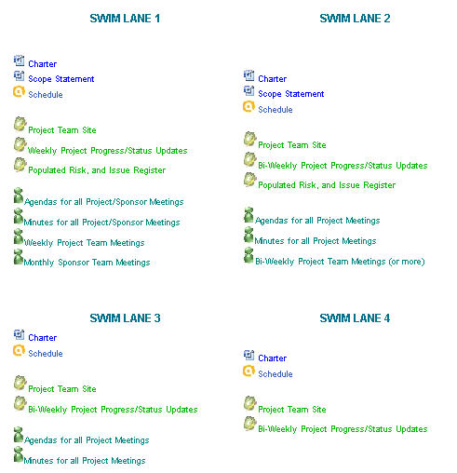
Swim Lane (Required Level of Management)

Slide 17
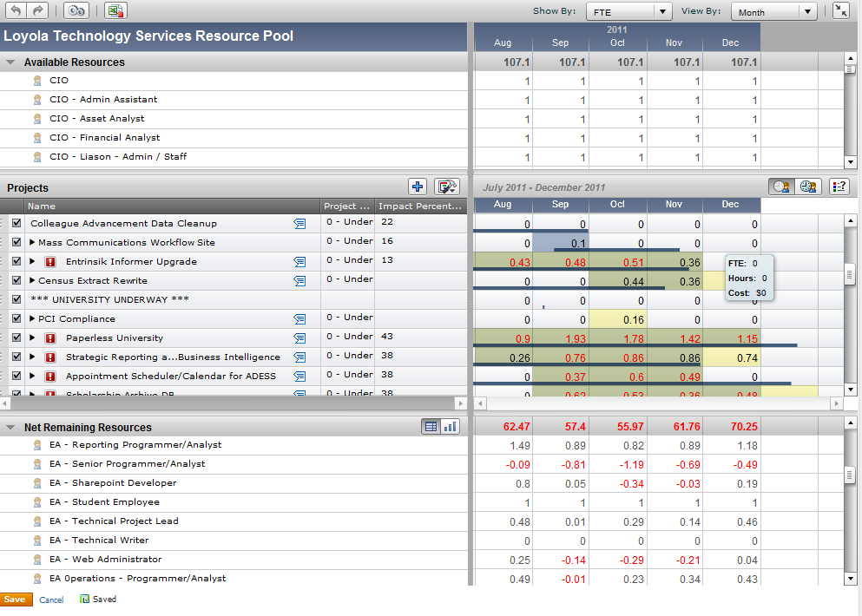
Portfolio Formation - Step 4 HL Scheduling
Actor: IT / PMO
Process: Resource Estimation & Capacity Planning
Tool: PPM
Output: Leveled Portfolio

Slide 18
Portfolio Formation – Step 5 Approval
Actor: Governance / IT Leadership
Process: Portfolio Review and Approval
Tool: PPM
Output: Approved Portfolio

Slide 19
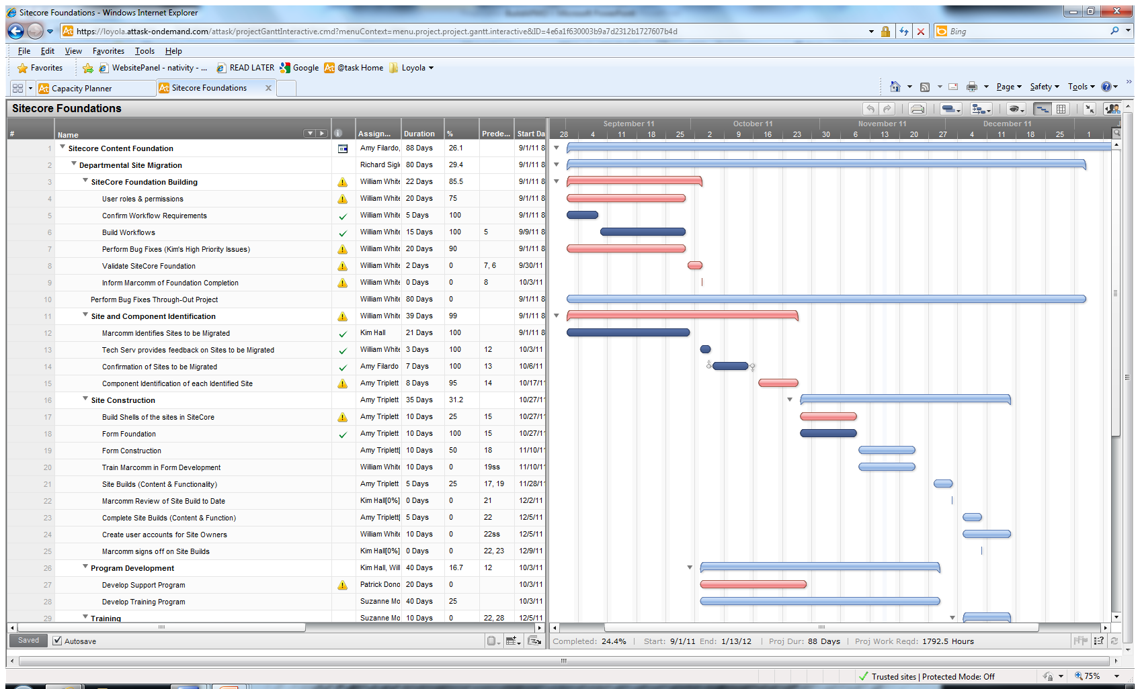
Portfolio Tracking
GANTT
Progress Reports
KPIs
TIME
COST
SCOPE

Slide 20
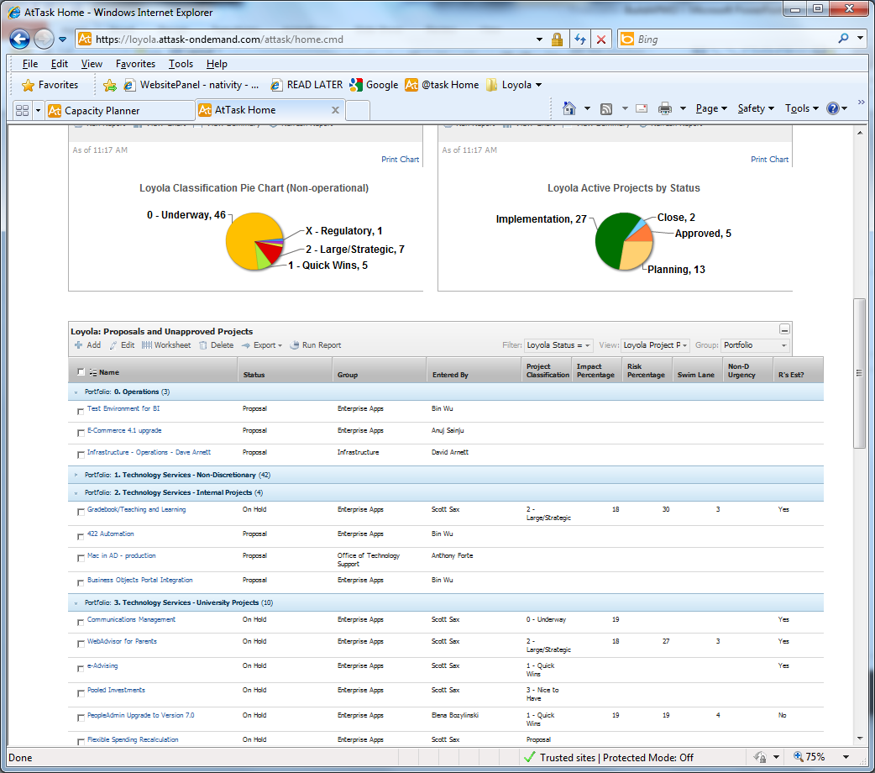
Portfolio Reporting
Dashboards
Review Meetings
Reports
Report Outs

Slide 21
PM PROCESS
Swim Lanes
Stages
Stage Gates

Slide 22
Swim Lane (Required Level of Management)

Slide 23
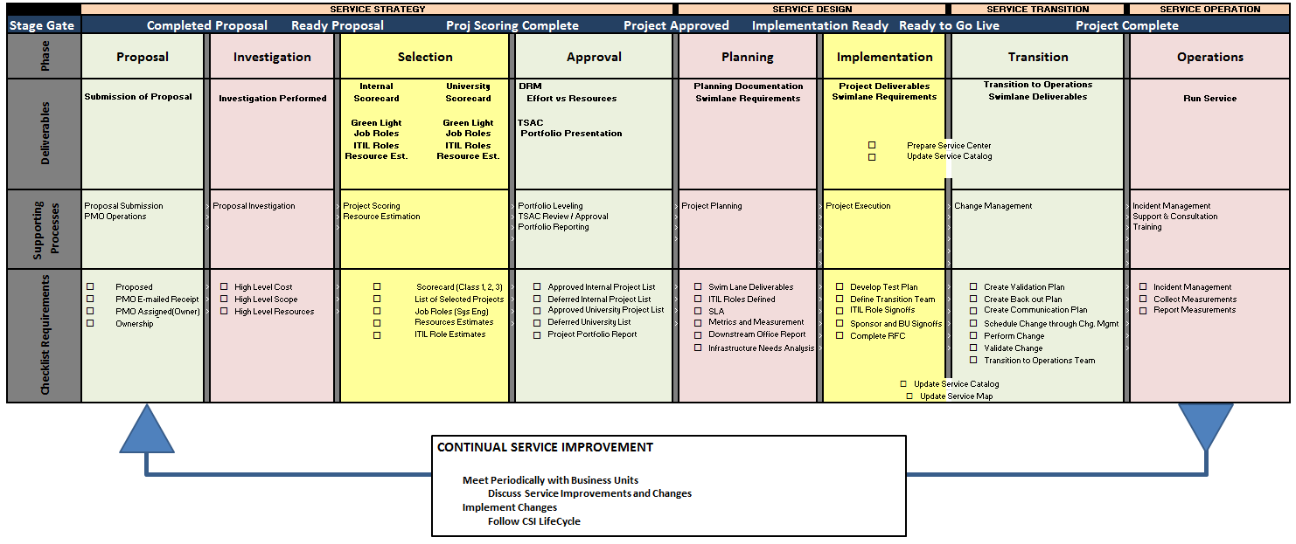
Stages: Technology Services Service Life Cycle

Slide 24
INFORMATION SYSTEM: PPM

Slide 25
INFORMATION SYSTEM: PPM
Consider the Following…
Web thin client – nothing installed (why in this day and age?)
Aggregate Reporting & Dashboards
Custom reports & custom data
MS Project-like schedule interface (via Web client)
Ability to import / export Project files
Capacity Planning (a must)
Outlook integration / team member home
Mobile device integration
BIASED

Slide 26
Support Strategy

Slide 27
Support Strategy – Doing the Right Thing
Project Support Center
PMO Project Consultants
Community of Practice

Slide 28
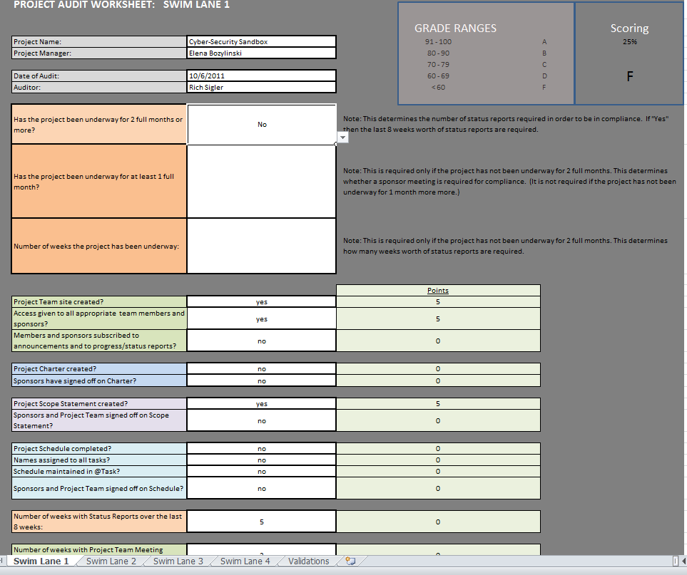
Support Strategy – Doing it RIGHT
Project Audits
Project Intervention (can be SUBTLE or DIRECT)

Slide 29
Project Portfolio
PM Process
Information System (PPM / PM Info Sys)
Support Strategy

Slide 30
QUESTIONS?

