Slide 1
From Facebook to Flickr: Getting Started with Social Media
EXPERIENCE
IT
Shannon Ritter
And
John Dolan
The Pennsylvania State University
#MARC12

Slide 2
Introductions and Contact Info:
Shannon Ritter – Penn State School of Theatre
Social Media Coordinator
shannon@psu.edu
@micala
John Dolan – College of the Liberal Arts
Director of Digital Media and Pedagogy
dolan@psu.edu
@dolanatpsu

Slide 3
Social Media Revolution

Slide 4
The
Plan
The
Plan
Cover four social media tools
Be quick about it
Answer questions
Help You!

Slide 5
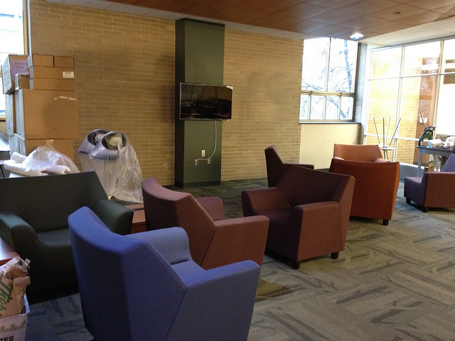
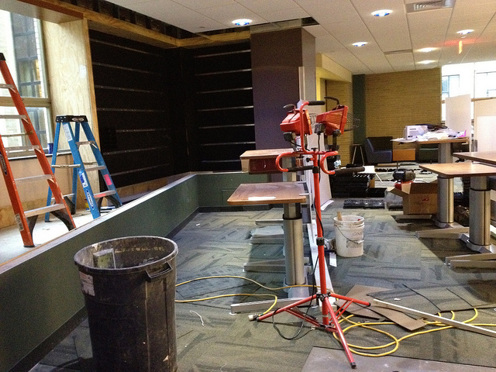
Flickr
Penn State Libraries – http://www.flickr.com/psulibs

Slide 6
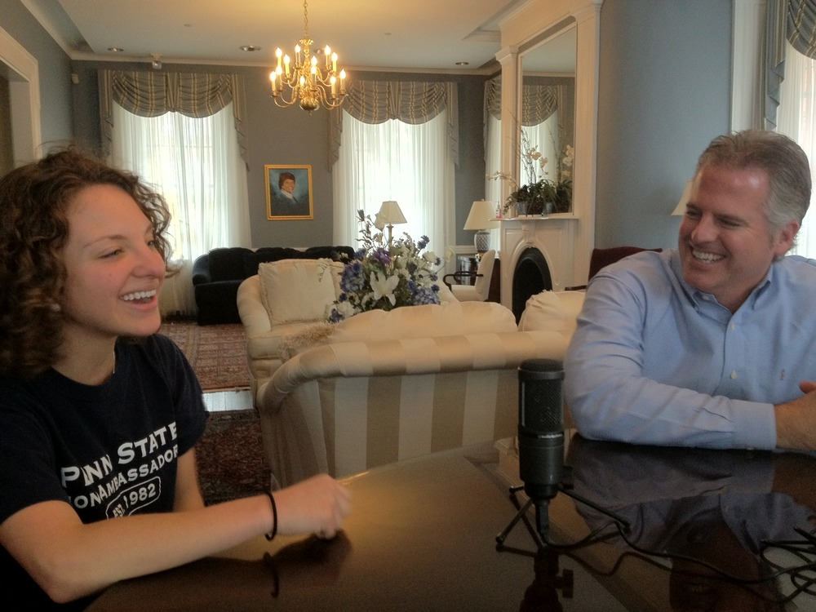
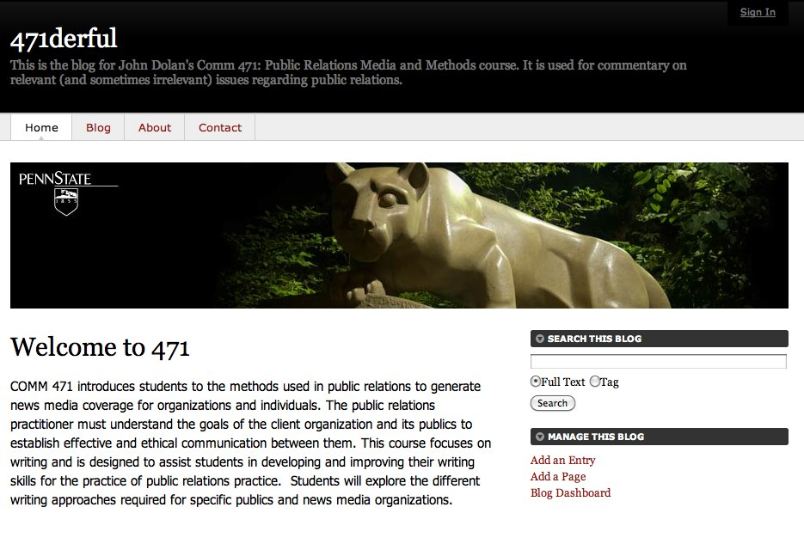
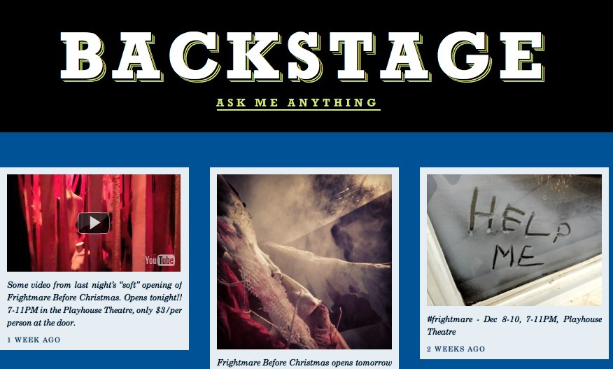
Examples:
The U Report –
http://theureport.posterous.com
471derful - http://www.personal.psu.edu/jjd24/blogs/471derful/blog/
Backstage – http://psutheatre.tumblr.com
Blogs

Slide 7
Facebook

Slide 8
Twitter

Slide 9
How Do I Get Started?
UP!!
SIGN

Slide 10
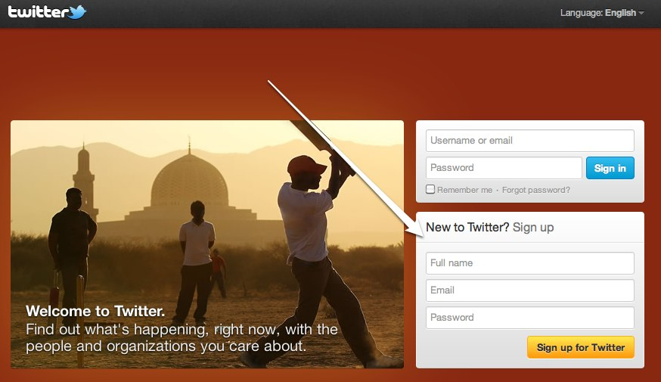
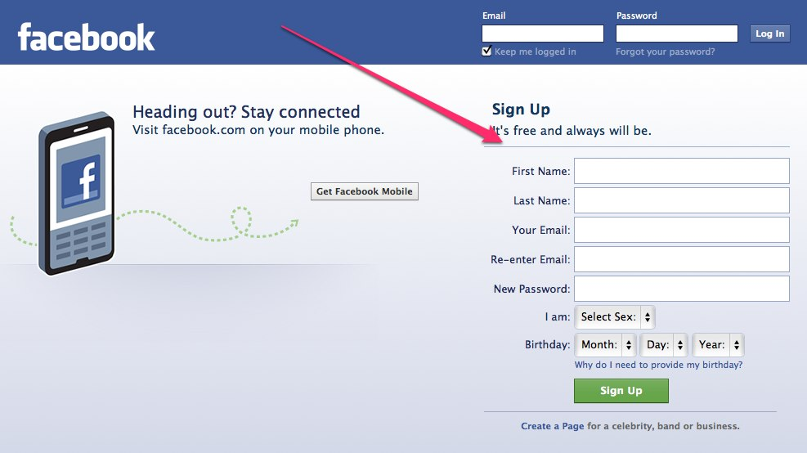

Slide 11
Have Questions?
We have answers!
Ask away!!
John
Shannon
Contact:
John - @dolanatpsu
Shannon - @micala
#MARC12
THANK YOU!!

