Slide 1
EDUCAUSE Mid-Atlantic 2012 SharePoint: 7 Views and Uses from around campus
Matt Immordino
Harris Otubu
Princeton University

Slide 2
Chartered in 1746 in New Jersey
In the nation's service and in the service of all nations
≈ 5000 undergraduates
≈ 2500 graduate students
≈ 1100 faculty
≈ 3800 staff
Home of the Princeton Tigers

Slide 3
OIT & TCS
OIT has about 290 employees
Another 100 or so distributed around campus
Technology Consulting Services
Technology Needs Assessment & Recommendations
Process Improvement Facilitation
Personalized Technology Consulting

Slide 4
SharePoint @ Princeton
Currently running SharePoint Enterprise 2007
Deployed in September 2007
Department space (sp), Personal (mysite) & Project (project)
QA & Production environment
Currently in the process of moving to SharePoint 2010

Slide 5
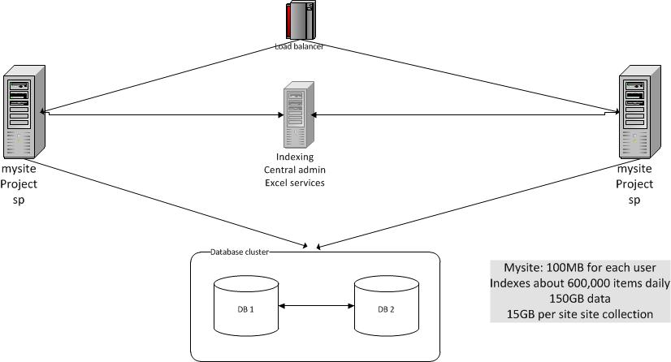
High-level architecture of SharePoint @ Princeton

Slide 6
Interdepartmental Project Portfolio - Requirements
Previously used MS Excel & custom built PHP application
Enhance the process for submitting, reviewing, tracking proposals & projects
Automate pieces of the process e.g. sending e-mails and status updates
Tag and classify projects in several different ways
Create reports

Slide 7
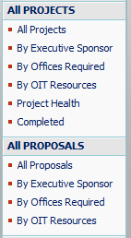
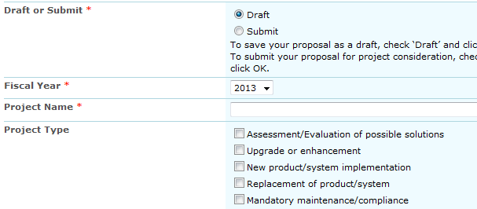
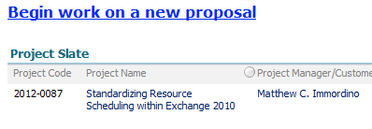
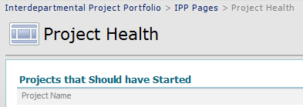

Slide 8
Interdepartmental Project Portfolio – Under the hood
Custom lists for submitting and tracking project information
“Person” columns for tagging and filtering
Workflows for moving items between lists, sending e-mails & updating list items
Views for reporting and framing the data
Webparts and Webpart pages for creating dashboards
Versioning for keeping track of changes

Slide 9
OIT Internal site - Requirements
Previously used Blackboard
Post information(pictures, announcements, tools & links)
Allow easy creation & maintenance of workgroup sites
Provide appropriate security & confidentiality

Slide 10
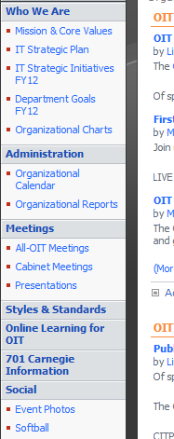

Slide 11
OIT Internal site – Under the hood
Picture libraries
Announcement lists for OIT news & announcements
Document library & alerts for Cabinet meeting minutes
RSS reader for streaming headlines & outages
Links
Departmental sub sites
Calendar for organizational events

Slide 12
Job Description Repository - Requirements
Previously used Blackboard
Create a template for our descriptions
Limit what employees can see
Keep track of changes to descriptions
Need something more dynamic than documents in a shared folder
Report on the positions in our workforce

Slide 13
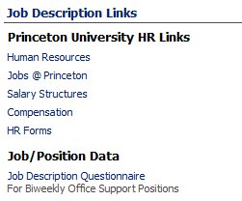
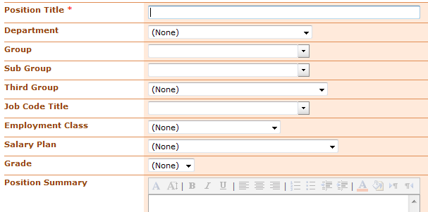
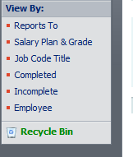
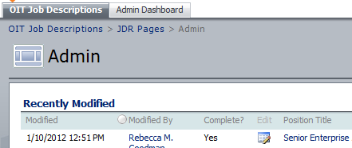

Slide 14
Job Description Repository – Under the hood
One custom list to hold all of the data
“Person” columns for tagging and filtering
Several webparts for creating a dashboard
Important HR links
Views for reports
A webpart page for administrative maintenance
Custom permission levels

Slide 15
Softball Sites - Requirements
Campus intramural league
Previously used Google docs
Place to keep track of scores & standings
CTRL+ALT+DEL
No previous site
Place to keep pictures, stats & schedule

Slide 17
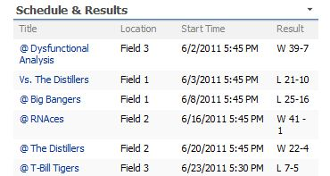
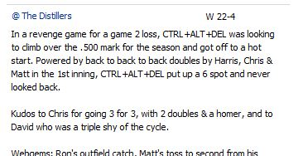

Slide 18
Softball sites – Under the hood
Campus intramural site
SharePoint canned template (sports league)
Calculated column for winning %
CTRL+ALT+DEL site
Picture gallery
Custom list created from spreadsheet for stats
Calendar for schedule, results & recap
Webpart & filters for creating a dashboard-like homepage
Surveys to determine availability for makeup games & social outings

Slide 19
Psychology Department Student Records - Requirements
Previously used custom application
Track student grades throughout their time in the undergraduate program
Calculate grades based on custom grade-point system
Secure records
Easy data entry
Easily find a particular student

Slide 20
Psychology Student Records

Slide 21
Student Records – Under the hood
Custom list to hold student records
Over 100 columns (40+ calculated)
Custom lists for supporting information like course offerings and professors
Webparts for dashboarding
Views for easy data entry & reporting
Permissions

Slide 22
Broadcast Center - Requirements
Previously used FileMaker Pro
Calendaring & scheduling
Request for work
Billing
Integrated notifications
Invoicing

Slide 23
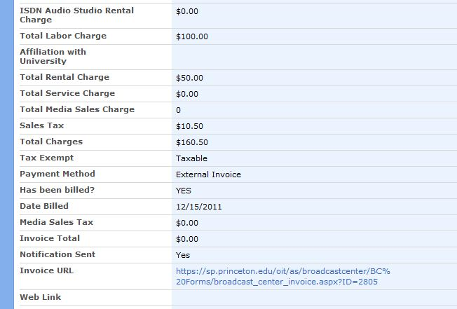

Slide 24
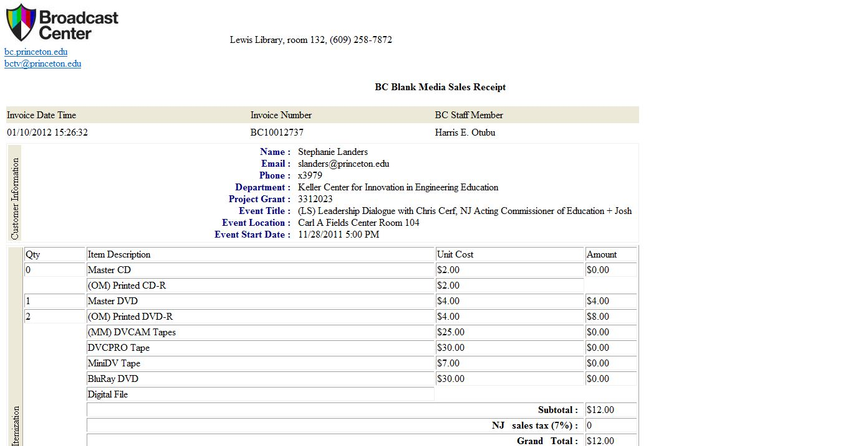
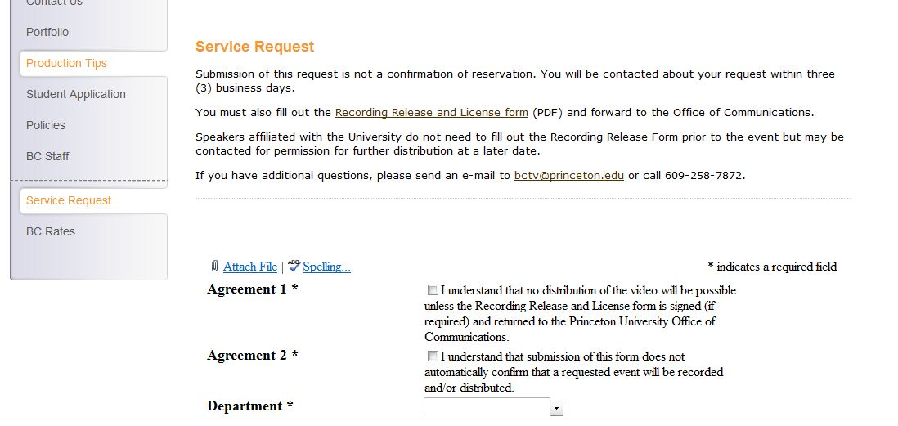

Slide 25
Broadcast Center – Under the hood
Calendar for custom fields & calculated columns
Workflows for notifications, creating custom ID & generating urls
Filters
SharePoint Designer was used to create a custom submission page, modify new event page & develop invoice receipt
Alerts for new requests

Slide 26
New and Separating Employee Tasks - Requirements
Previously used a paper checklist
Organize all of our tasks related to new and separating employees
Track progress on tasks
Remove the burden of tracking tasks from our administrative assistant
Remind hiring managers what they’re responsible for & who can help them
Make sure we don’t miss any steps

Slide 27
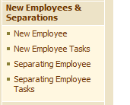
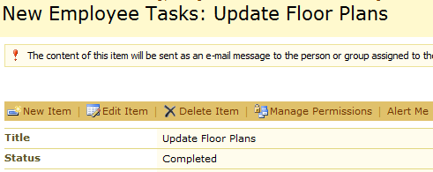
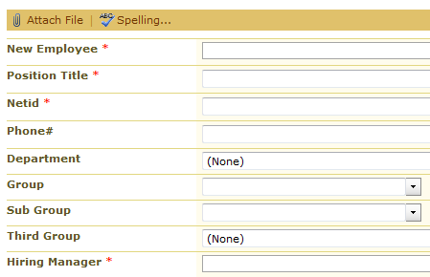
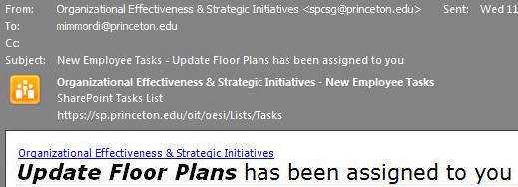

Slide 28
Employee Tasks – Under the hood
Two custom lists for entering employee information
Two task lists for tracking everything
Workflows for creating tasks
Alerts for notifying people about their tasks
Views for grouping tasks by employee

Slide 29
Other uses of SharePoint on campus
InfoPath forms for Athletics
Several purchasing systems
Departmental intranets
Documentation
Lab animal compliance tracking
Inventory tracking
Contacts management
External collaboration via GAP

Slide 30
Recap
Amount of specialized training Matt & Harris have
SharePoint can be used as a simple web-based tool for document sharing
Canned sites and templates can be easily tweaked to suit your purposes
With a little more work, pseudo applications can be built without programming

Slide 31
Questions/Comments
mimmordi@princeton.edu
otubu@princeton.edu

