Slide 1
Copyright Jill Forrester, 2012. This work is the intellectual property of the author. Permission is granted for this material to be shared for non-commercial, educational purposes, provided that this copyright statement appears on the reproduced materials and notice is given that the copying is by permission of the author. To disseminate otherwise or to republish requires written permission from the author.

Slide 2
Experience it: mobile technologies
Jill Forrester, Dickinson College
Christopher Higgins, University of Maryland

Slide 3
Scenarios for consideration
Participants in the session discussed a number of the scenarios given in this presentation.
Participants were asked to evaluate each scenario and respond using http://polleverywhere.com/.
The collective response was discussed by the participants.
Scenarios 1,2, and 8 were discussed during the session. The other scenarios are provided for your reference.

Slide 4
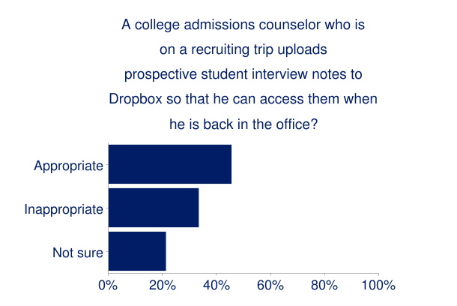
Scenario 1
A college admissions counselor who is on a recruiting trip uploads prospective student interview notes to Dropbox so that he can access them when he is back in the office?
Appropriate
Inappropriate
Not sure

Slide 5
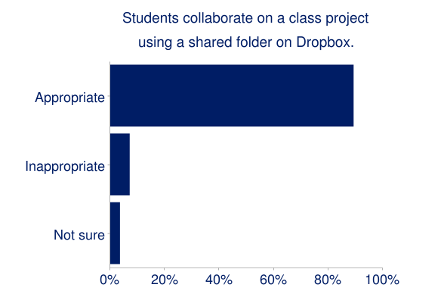
Scenario 2
Students collaborate on a class project using a shared folder on Dropbox.
Appropriate
Inappropriate
Not sure

Slide 6
Scenario 3
To help student’s study for an upcoming test, a professor uses the Evernote Peek app (with the apple smart cover) to create flashcards.
Appropriate
Inappropriate
Not sure

Slide 7
Scenario 4
A financial aid administrator stores all meeting notes on Evernote. These notes are stored in a private folder.
Appropriate
Inappropriate
Not sure

Slide 8
Scenario 4
A financial aid administrator stores all meeting notes on Evernote. These notes are stored in a private folder.
Appropriate
Inappropriate
Not sure

Slide 9
Scenario 5
A research assistant stores the data collected to support a NSF grant on Box. This is done to facilitate collaboration with researchers at other institutions. This is the only copy of the data set.
Appropriate
Inappropriate
Not sure

Slide 10
Scenario 6
Professor Higgins shares a Box folder with his history students. The students are then asked to upload their assignments to the folder and to provide feedback on each other’s work. All students can see the feedback.
Appropriate
Inappropriate
Not sure

Slide 11
Scenario 7
Professor Pehlman stores a copy of her class roster in a private folder on Box.
Appropriate
Inappropriate
Not sure

Slide 12
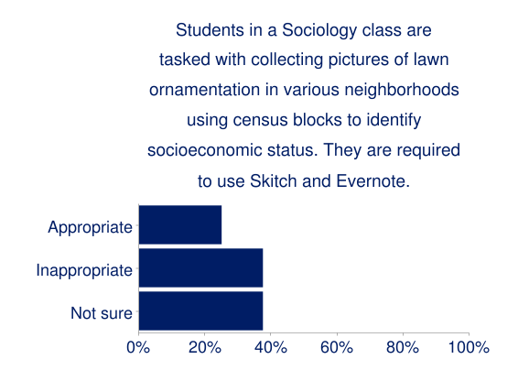
Scenario 8
Students in a Sociology class are tasked with collecting pictures of lawn ornamentation in various neighborhoods using census blocks to identify socioeconomic status. They are required to use Skitch and Evernote.
Appropriate
Inappropriate
Not sure

Slide 13
Scenario 9
Professor Forrester wants to be able to access his grade book from anywhere. He creates a Dropbox account with a private folder. He then uploads the file containing the grades to this folder.
Appropriate
Inappropriate
Not sure

Slide 14
THANK YOU

