Slide 1
Welcome!
Please have a seat around one of the game boards
4 people
to game board please

Slide 2
Project Management Gaming: Learn Project Management with a Team-Based Game Approach
Richard Sigler, Elena Bozylinski, Scott Sax | 1/12/12

Slide 3
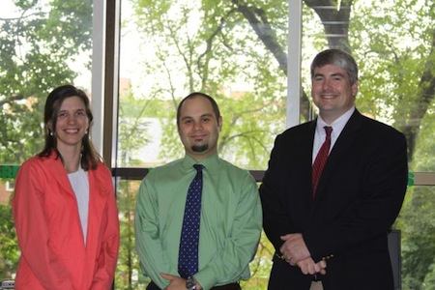
Loyola Project Management Office
Elena Bozylinski
Richard Sigler
Scott Sax

Slide 4
Teaches basic fundamentals
Project Management
Risk Management
You are the project manager
Actively manage risks
Complete your project
on time
on budget
on scope
Time
Risk
Cost
Quality
Scope

Slide 5
Game Materials

Slide 6
Game Set up

Slide 7
Winning the Game
Finish your project within 12 turns using the allocated budget.
Your project manager must complete all of the steps and must progress past step 52 (Release Team).
Tally up your score.
1 point for every project budget chip remaining
2 points for every management reserve chip remaining
10 points per team member remaining
-20 points per period over 12 turns
* No bonus for finishing early.
** Game is over if you run out of project budget chips AND management reserve chips OR if you lose all of your team members

Slide 8
Standard Turn – THE PLANNED APPROACH
Collect 10 Chips for each funding milestone you cross
Read risk card
Move 1 step per team member
Pay for spaces you move
Roll the Risk Die
Identified
unidentified
Choose Mitigate, Avoid, Transfer, Accept
Play risk strategy
Negative
Place card on the triggered stand
Risk Occurs immediately
End Turn
Choose Enhance, Exploit, Transfer, Accept
Positive

Slide 9
THANK YOU
Loyola University Maryland Project Management Office
pmo@loyola.edu
Richard Sigler
rgsigler@loyola.edu
Elena Bozylinski
ebozylinski@loyola.edu
Scott Sax
sssax@loyola.edu

