Slide 1
The Economics of Enterprise Governance, Risk, and Compliance (GRC)
Chrisan Herrod/13 January 2012

Slide 2
Overview of Presentation
  Current/Changing View of E-GRC
  What Survey Data Tells Us
  Assessing Manual Costs
  Why Invest in IT GRC Automation
  Resources to Help

Slide 3
Real World Observations
Back into Governance
Manage Risk Haphazardly
Unwillingly accept that we must (to some degree) comply because we are audited:
PCI/FERPA/HIPAA etc.

Slide 4
Current/Changing View of GRC
A poll by Deloitte Consulting from 450 directors of publicly traded companies reveal the following:
Eleven percent of boards discuss IT Governance issues at every meeting
Fourteen percent of boards are “completely and actively involved” in IT strategy.
  Source: Deloitte Presentation January 2011

Slide 5
Why Enterprise GRC?
The absence of eGRC, especially in large organizations, can disrupt even the best efforts to build integrated compliance initiatives
Maintaining governance, risk, and compliance process continuity across locations is labor intensive, time consuming, and overly complex
Central management of policies and compliance is complicated by the lack of a common operating picture
The introduction of new compliance requirements generally must be replicated manually across numerous systems
Maintaining common policy and compliance across physical and virtual domains is nearly impossible due to the numerous disparate systems involved in GRC
Governance
Risk
Compliance

Slide 6
Strategic Role of IT –GRC Program Responsibilities
Enable better risk management more cost effectively and predictably throughout the organization.
Facilitate compliance with regulations by providing a means and a framework/platform to put in place broader measures such as document and record management.
IT itself must adhere to best practices around IT governance, risk management and compliance using available frameworks

Slide 7
Defining an IT GRC Program
An IT GRC program is the continuous monitoring of processes, services and documentation that indicate an organization’s level of compliance
Compliance is often measured in terms of whether or not an organization follows a set of standards or a code of best practices and actually adheres to those standards or codes.

Slide 8
The Operational Hierarchy of Governance, Risk, and Compliance
eGRC
Integrated IT Governance, Risk, and Compliance Management
Risk Assessment
Risk Correlation
Risk Metrics
Risk Management
Policy Management
Common Control Framework
Compliance Management
Control and Compliance
Threats
Vulnerabilities
Incidents
Aggregated Asset
and Security Information
People
Processes
Technology
Facilities

Slide 9
The Regulatory Underpinnings of Governance, Risk, and Compliance
eGRC
NIST SP 800-39
Managing Information Security Risk
Common Control Framework
NIST SP 800-53, R3/IRM 10.8.1
Governance–The process by which executive management sets the objectives for an organization and oversees progress toward those objectives
Risk Management–A process, carried out by management and employees, designed to identify potential events that may affect the organization’s strategic, operational, legal, and regulatory objectives, and to manage those risks to the risk appetite of the executive management
Compliance Management–The process that establishes proof that governance and risk management are being carried out consistent with the organization’s own required procedures

Slide 10
What survey data tells us
2010 GRC Strategy Survey by The Open Compliance and Ethics Group (OCEG)
  Found that 65% of their respondents claimed fragmented GRC caused serious business problems though duplication of efforts, redundant solutions, higher costs, and increased risk.
  OCEG’s findings are consistent with current thinking from industry analysts, (aka Forrester, IDC & Gartner) and research studies (Aberdeen) that cite fragmentation as a primary driver for GRC automation.

Slide 11
Lack of Consensus on Costs and Responsibilities
True cost of compliance is difficult to estimate through modeling because there are so many variables and the rate of change among those variables tends to be high.
  One estimate put the cost to the U.S. economy for federal regulatory compliance in 2010 at 1.14Billion or is it Trillion?
  The number of regulations and the rate at which they change is often used as a measure of the magnitude of the burden for example:
    In 2008 the Code of Federal Regulations (CFR) totaled 135,000 pages in over 200 volumes and since has grown to ????.
Source: Compliance: Moving Beyond Manual Projects—to an integrated Automated Program—FEB 08 White Paper

Slide 12
Lack of Consensus on Costs and Responsibilities
2010 Survey data indicates that 80% of survey participants thought that compliance is too costly and that knowing the costs is important.
  Estimates of what aspect of compliance is most costly were widely dispersed among legal (23%); technology (19%); policy (17%), documentation (14%), and assessment (9%).
Data Source: Polivec/Mainstay Partners, GRC Survey 2010

Slide 13
Lack of Consensus on Costs and Responsibilities
Same survey showed that there is no consensus on who has or should have responsibility for compliance management.
  26% Executives
  19% Other
  16% Operations/Legal
  15% Finance
Data Source: Polivec/Mainstay Partners, GRC Survey 2010

Slide 14
Value Proposition of an Integrated Approach to GRC
Methods currently employed to manage compliance and governance are predominantly paper-based, including spreadsheets, folders, and manual systems (ranging from 43 to 47 %)
Integrated solutions should encompass all organizational compliance requirements, rules, and processes
Simplify and streamline compliance reporting allowing the organization to realize cost savings
Reduce reaction time in dealing with new regulations
  Data Source: Aberdeen Group, Feb 11

Slide 15























Before eGRC
How we are tasked with work
Where We Keep Our Work
Phone Call
Email
Post
-
It
Help Desk Tickets
Access
Word
Applications
Databases
Spreadsheets
Docs
Service Requests
Meeting
Tap on the Shoulder
Note Pad
Intranet
File Drawer
File Share
How Others Know the Status of our Work
How We Prioritize Our Work
Help Desk Tickets
Meetings
Phone Call
Post-It
Phone Call
Deadline
Tap on the Shoulder
Share Point
Email
Service
Requests
Status
Our Brains
Tasks
To Do List

Slide 16
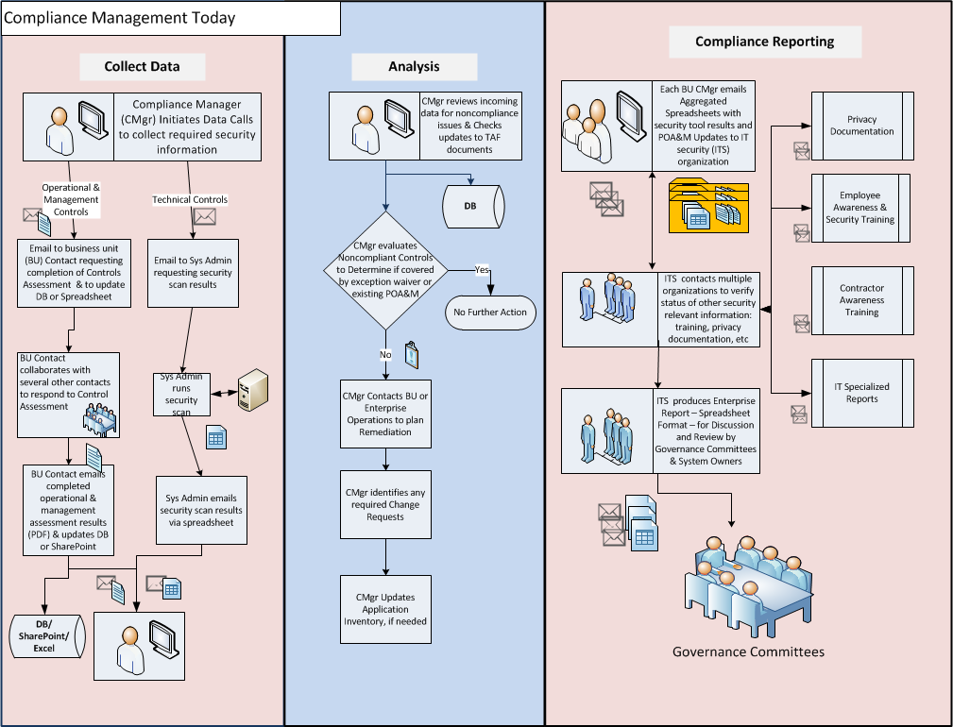

Slide 17
Cost of Manual IT-GRC Program
Large Public University/State Audit started May 2011 and is not over YET.
Audit focus: Network Security/Financials
3 State auditors +150 separate audit requests, approx 20% redundant/overlapping in context and requirements
10 University employees involved in providing responses
3 University employees full time (3,840 hours)/7 part time (2,240 hours)
Cost: 400K as of 13 January 2012
NOTE: Costs do not include response time or tracking of audit finding to conclusion
Cost to automate approximately 80-150K first year
Maintenance 20% for the remaining years

Slide 18
IT-GRC Best Practices in automation
  IDC suggests that systems of record automate repeatable processes and handle exceptions and demonstrate compliance/support audit. With this approach a single point of control (a single decision that is managed) can be used to show compliance with many directives and regulations.
  According to CFO magazine: GRC Software
  “at its core, remains a tracking system, capturing data on various compliance requirements as they affect a specific company and chronicling how the company does (or does not) satisfy those requirements.”
  Data Source: IDC March 08
  CFO Magazine Feb 08

Slide 19
What Organizations say they need
Feb 08 report included findings from 800 global organizations
  What organizations Need in a IT GRC Solution
    42% Risk Analysis and management
    34% Automated process for identifying, measuring, and monitoring operational risk
    32% Feature aligning IT Policy, risk, operations management with business initiatives
    29% Documented Policies and Procedures
    22% Business process modeling
  Data Source: Aberdeen Group, Feb 08

Slide 20
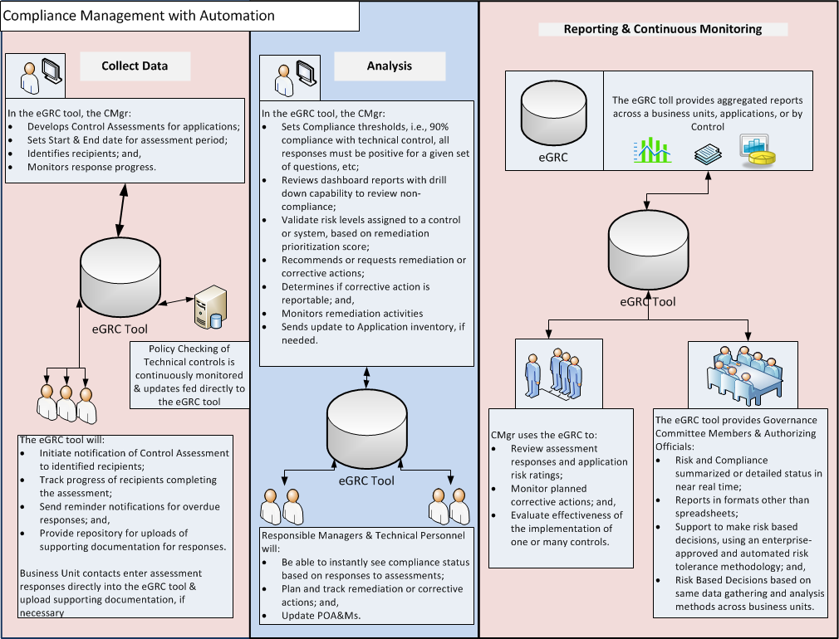

Slide 21
Enterprise Governance, Risk & Compliance Management Model
PCI
NIST
HIPAA
HIPAA
State
ITIL
Create a single, common control standards and procedures repository…
Control Framework
and Policy Library
1
2
..a comprehensive compliance evidence ‘locker’..
Compliance Evidence
Repository
4
…with automated mapping to common controls …
3
Collect, Aggregate, and Store results from all Cybersecurity tools ..
Technical Scan Results
6
5
Normalize compliance evidence and technical scan results to produce true risk scoring
eGRC
Leverage eGRC workflow and automation to enhance business processes..
21
Reports
7
Enhanced reporting for: Continuous Compliance Monitoring, Risk Based Decisions, and Governance..
Metric measurement to support: ITIL services, compliance management, risk mitigation, etc..
8
21
21

Slide 22
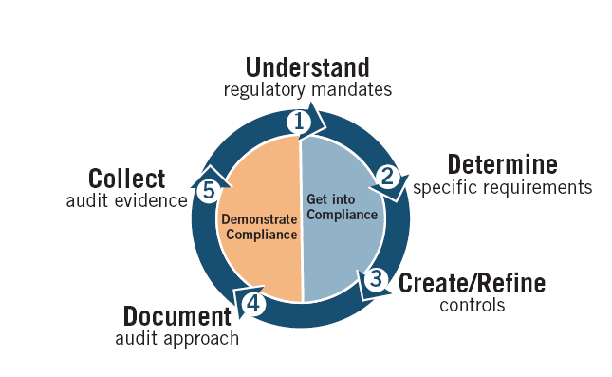
The End Result—IT GRC Maturity
Policy Management
Document Retention/retrieval
Information Technology Security Program
Financial Controls at System level
Integrated Auditing programs
Automated processes and programs across the Enterprise

Slide 23
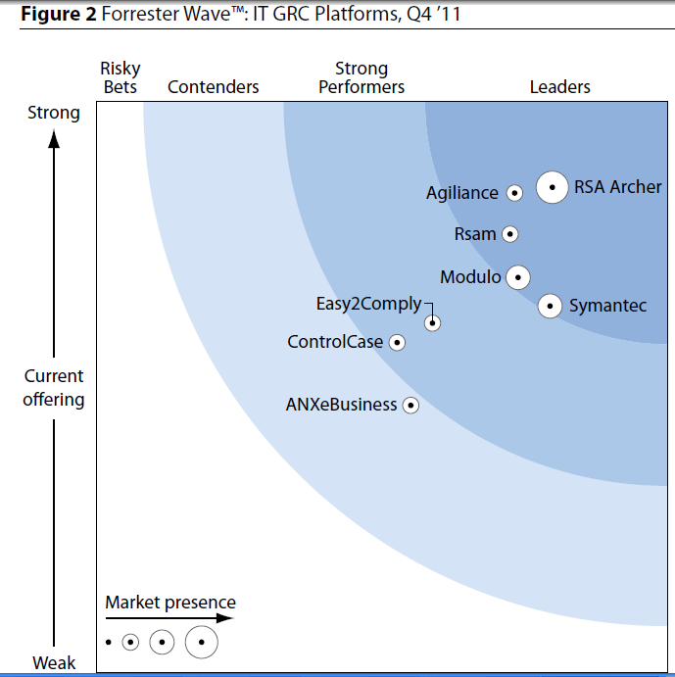
GRc Tool contenders
According to The Forrester Wave, a top technology and market research company:
  These companies focus on collecting the daily barrage of information and translating it into relevant metrics
  content management, risk and control management, and workflow management, making it one of the best overall technical platforms assessed in the IT GRC space.
  Workflow management capabilities are particularly impressive, offering predefined workflows for a wide range of core IT GRC solutions with the flexibility for customers to define their own processes using drag and drop development features.*
* Ref: The Forrester Wave™: IT Governance, Risk, And Compliance Platforms, Q4 2011, December 1, 2011

Slide 24
Resources
Governance, Risk, Compliance (GRC) Systems, Tips and advice from Educause colleagues as of January 2012
  https://wiki.internet2.edu/confluence/display/itsg2/Hot +Topics
IT-GRC Tools
  www.metricstream.com
  www.brinqa.com
  www.archer.com
  www.lockpath.com
  www.modulo.com
  Risk Management
    Nist SP 800-30

Slide 25
THANK YOU

