Slide 1
Lose the Bullets
Effective Presentation Design
Notes:
This powerpoint was originally created by Christopher Petruzzi at Seton Hall University. He is a wonderful creative!

Slide 2
understanding
design
Notes:
To create effective visuals for presentations we must first understand the basics of design. To do this, we can pull inspiration from everywhere, print, web, TV, art, movies, etc. Once you understand the principles, you will see them everywhere!

Slide 3
BALANCE
Achieve Visual balance by arranging elements on the page. Balance can be asymmetrical or symmetrical.
Notes:
You want your design and it’s balance to have some sort of purpose.

Slide 4
Notes:
This poster design is symmetrical. If we cut this straight down the middle, it is perfectly balanced. Sometimes they are completely identical (often seen in architecture).

Slide 5
Notes:
Asymmetrical (Informal) Balanced: Asymmetrical balance occurs when several smaller items on one side are balanced by a large item on the other side. Or, one darker or lighter larger item needs to be balanced by several lighter items.
In this slide, the larger, lighter item (background) is balanced by the darker, smaller (heavier) items at the bottom. This also gives the poster “weight” towards the bottom portion of the design.
This poster design is very clever when combined with the notion of a see-saw in the imagery.

Slide 6
Proximity & Unity
How close together or far apart elements are placed suggests a relationship (or lack of). Unity is also achieved by using a third element to connect distant parts.
Notes:
How close together or far apart elements are placed suggests a relationship (or lack of) between otherwise separate parts. Unity is also achieved by using a third element to connect distant parts (heart).
A much more subtle method of unifying objects involves the use or continuation of line, edge or direction from one object to another. Continuation is often used in books and magazines to tie the elements of a page together with the use of rules, and by lining up edges of copy, headlines and graphics as seen in the bottom example.

Slide 7
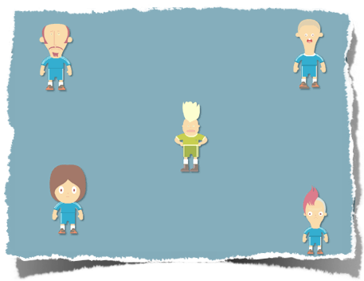
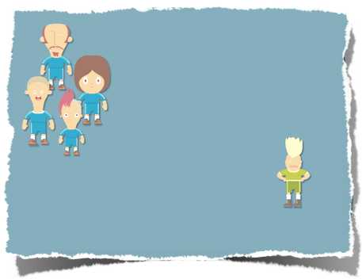
Notes:
Here is an example on how you can infer a relationship just by the way you place things in your design. The simplest method of making objects appear to belong together is to group them closely together.
Repetition of color, shape, texture or object can be used to tie a work together … all these characters are similar in style and color. Note the different color of the shirt in the figure in the middle (green). He belongs to the group however we notice there is something different about him because of his green shirt.

Slide 8
Alignment
always use guides and rulers
Notes:
Make sure your items are aligned and have some sort of order. Using guides can help you out here. Using proper alignment will help direct the viewers eye and keep your design from looking sloppy. Don’t just place items haphazardly.

Slide 9
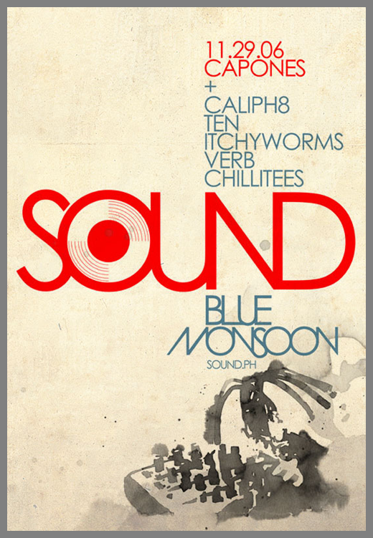
Notes:
Alignment of text items. Example. This is example of vertical alignment … all the type is lined up vertically. Notice when items are not lined up (i.e. Monsoon) that your eye automatically is drawn to that object. This picture also contains an example of horizontal alignment. Can you find it? (Answer = “sound ph” is aligned with the top of the image of the watercolor sound equipment.

Slide 10
Repetition & Consistency
Repetition & Consistency
Repetition & Consistency
Use the same fonts, colors, and images/design elements throughout. Repeating design elements and consistent use of type and graphics styles shows a reader where to go and helps them navigate.
Notes:
This also means using the same color palette, fonts, and other design elements on your layout.
Principle One: Limit your fonts. This sounds like a limiting factor however most fonts come in bold and italic with some also being available with different weights. This gives you more options than you think. Just remember, if you use a bold font for titles, make all the same titles bold!
Fancy or artistic fonts are best used only once or very sparingly … they would work best for a title of a presentation or as an art element.
The second font should be very basic.

Slide 11
It was a dark and stormy night ...
It was a dark and stormy night ...
Notes:
Type is more than text on the screen. It determines how easy the viewer will be able to read the letters on the screen and can set the tone for your work. Let’s look at an example.
<lynda.com>

Slide 12
dog
DOG
Notes:
Many people use all caps for a word however there are some disadvantages of doing so.
Here is a word in all caps with 50% of it blocked. Do you know what this word is?
Here is the same word in lowercase with 50% of it blocked. Do you know what this word is now?
When we learn to read, we actually memorize the shape of the word. Each word has a distinct shape because of the assenders/descenders (i.e. d and g).
When you use all caps for a word, you take away the distinct shape of a word, making it harder to read.
If you are using all caps for a design element, well, that is one thing however best not to use them.
<lynda.com>

Slide 13
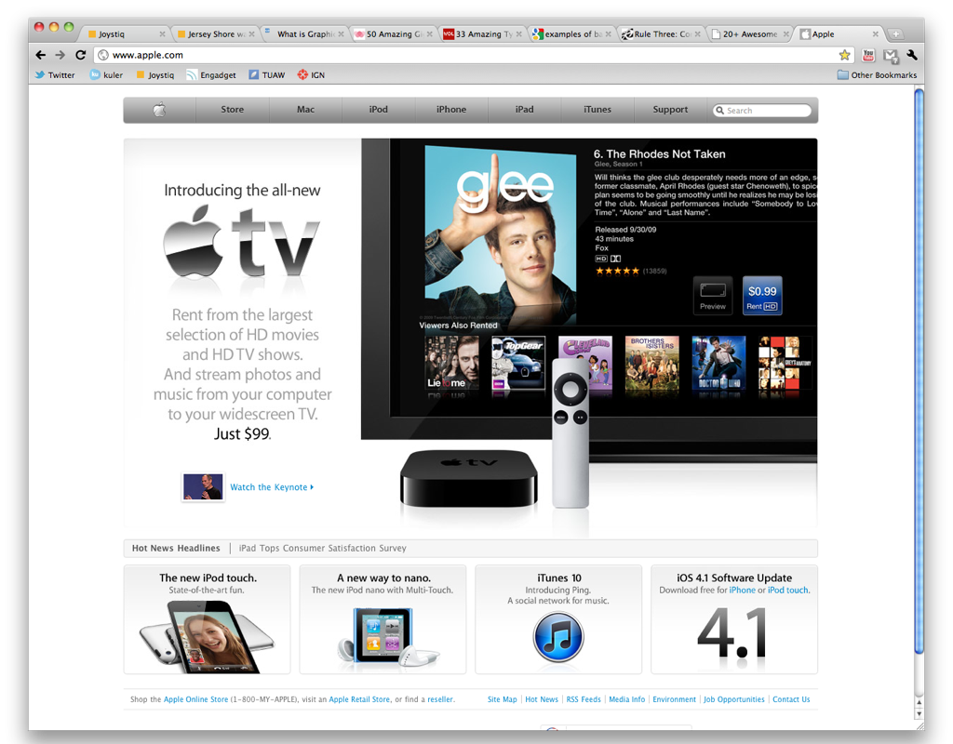
Notes:
Apple Website. Only 1 maybe 2 fonts used throughout. Color scheme stays the same throughout all their branding! White/Silver/Modern/Sleek.
Look at how the elements at the bottom are organized. Through repetition and consistency Apple designers guide us through their site. Notice how the titles and descriptions in the boxes are similar along with the link colors which remain a shade of blue.

Slide 14
CONTRAST
Notes:
Contrast can be seen in the size of an item, color, font, brightness... anything can create contrast. The most common element you’ll see used to create contrast is color.

Slide 15
GO
PIRATES
Notes:
Some designers make the mistake of using color difference to produce contrast instead of value difference.
For starters lets talk about color values. A color’s value is how bright or dark the color is. A yellow for instance is fairly bright. A purple is fairly dark. Of course, a color can have a range of values.
For instance… a medium value blue sitting on top of a medium value red produces some contrast.
But when you have two colors together of the same value – it produces what is known as “vibrating.”
A quick way to evaluate your design to see if there is sufficient contrast is to convert the entire thing to grey scale momentarily and see if the design still looks clear and easy to read.

Slide 16
GO
PIRATES
Notes:
In this example, there is a large difference between the two shades of blue to create contrast and this works.
A quick way to evaluate your design to see if there is sufficient contrast is to convert the entire thing to grey scale momentarily and see if the design still looks clear and easy to read.

Slide 17
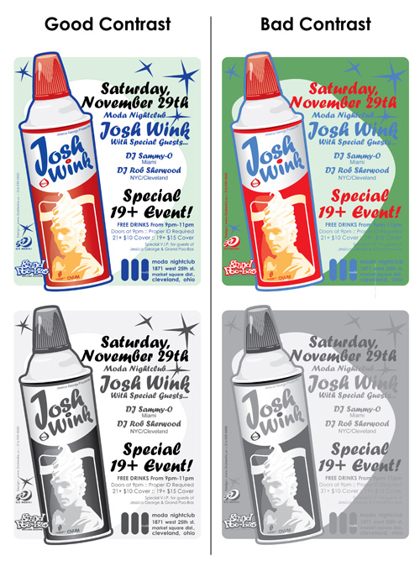
Notes:
You can clearly see how much easier it is to read the text in the design on the left, particularly when it’s converted to grayscale. The design on the right uses less contrast (the values of the colors are closer … the blue and green …and more color difference to define the shapes.

Slide 18
White Space
Designs that cram too much text and graphics are uncomfortable and may be impossible to read.
White space gives your design breathing room. Leave some empty space.
Notes:
Designs that try to cram too much text and graphics onto the page are uncomfortable and may be impossible to read.
“White space” is a term that doesn’t actually refer to the white space on a slide rather it means the “absence of content” (which is really a gives your design breathing room). Don’t be afraid to leave some empty space on your layout. It gives the eye a space to “rest” and can have power of its own. In this example, notice how the use of white space draws you eye down to the text, thus becoming a design element.

Slide 19
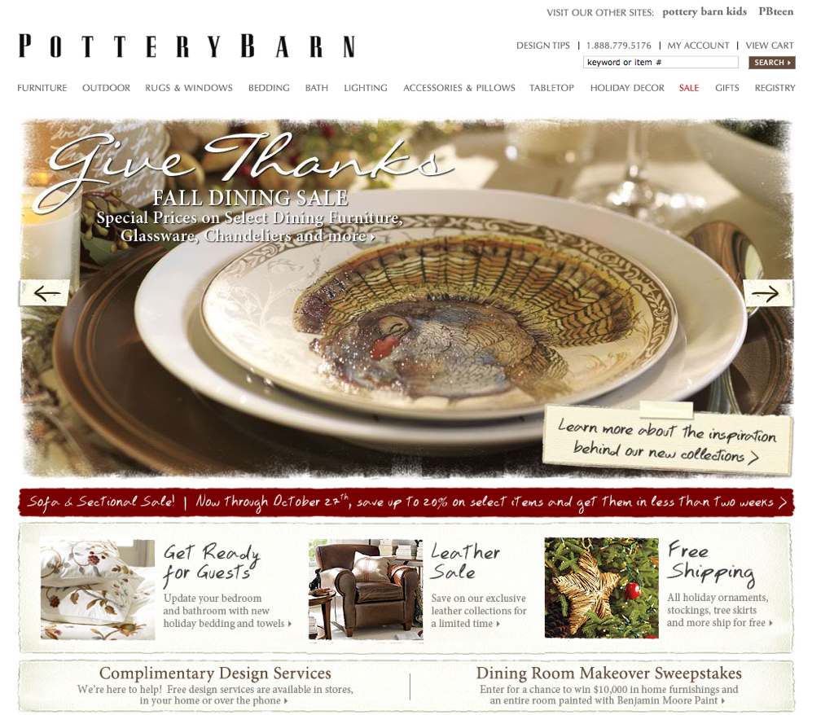
Notes:
Your designs can convey an image of sophistication and elegance. Pottery Barn uses lots of white space between the various elements. Notice even the logo uses large amounts of whitespace between each character.

Slide 20
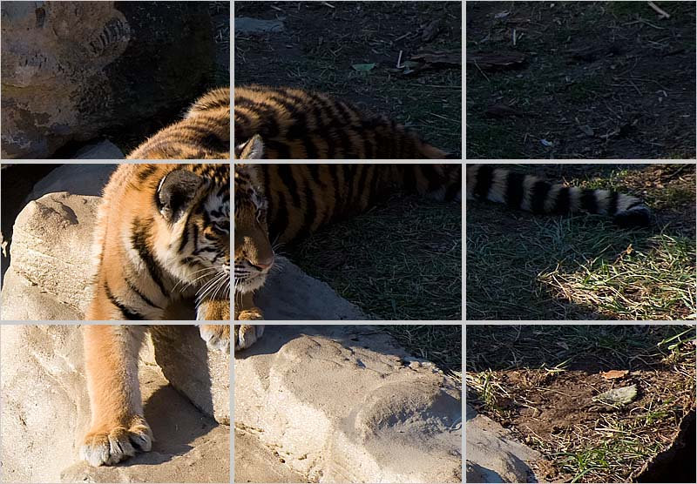
The Rule of Thirds
The rule of thirds is a compositional rule of thumb in visual arts such as painting, photography and design.
The rule states an image should be imagined as divided into nine equal parts by two equally-spaced horizontal lines and two equally-spaced vertical lines, important compositional elements should be placed along these lines or their intersections.
Notes:
The rule states that an image should be imagined as divided into nine equal parts by two equally-spaced horizontal lines and two equally-spaced vertical lines, and that important compositional elements should be placed along these lines or their intersections. Notice also the use of alignment (text on the right), contrast (“Thirds”) and consistency (use of color and font). Can you also see the use of balance here?

Slide 21
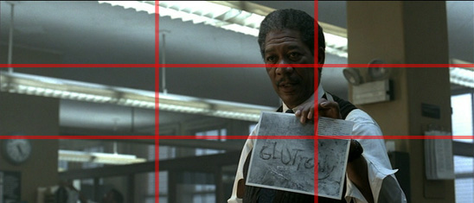
Notes:
Seven: Director David Fincher
In simple terms, the Rules of Thirds states that there are certain “hotspots”, areas of intensity that exist within any given image, and if one were to align the subject within the range of influence of these hotspots, it will make for a more energetic and interesting composition. The image above illustrates the rule; the 4 “hotspots” where the red lines intersect, and where Detective Somerset ( Morgan Freeman ) stands.

Slide 22
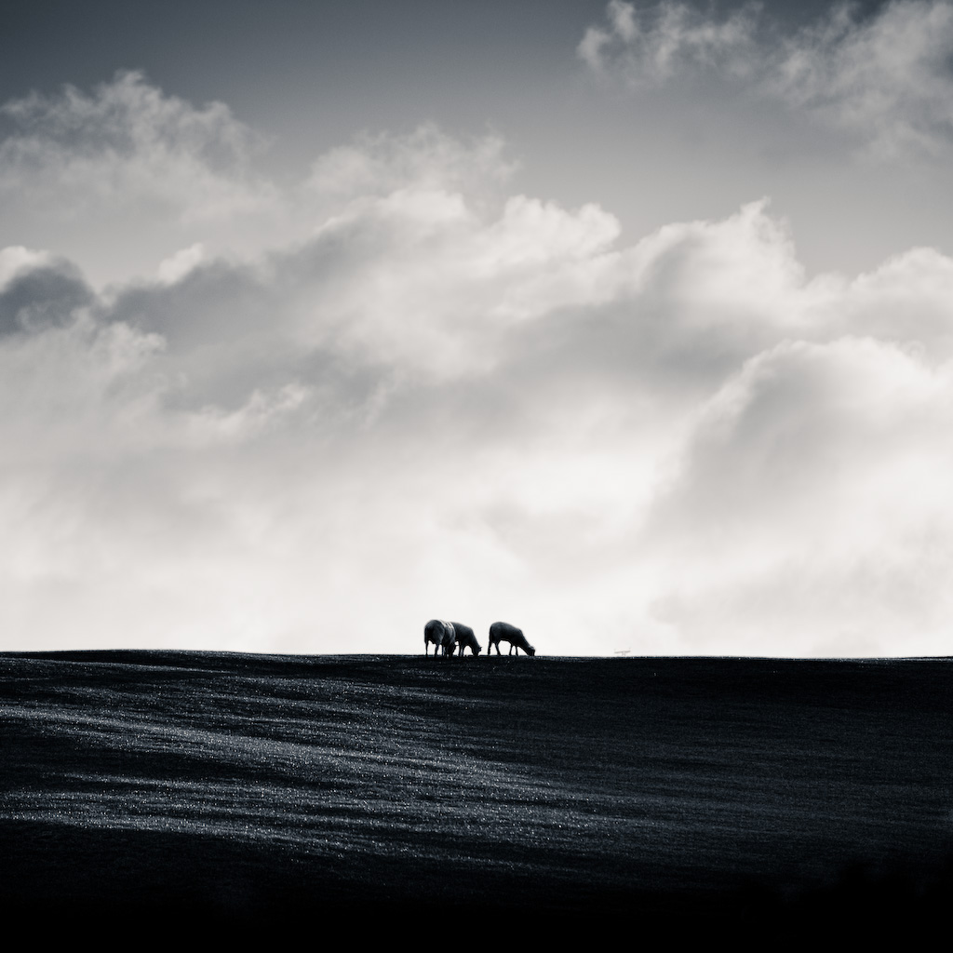
Directing the eye with images
People are Visually Stimulated
Place images strategically.
Notes:
What other principles of design that we have covered do you see here?

Slide 23
Before And After
Losing the Bullets: Exercises
Act III
Notes:
So, let’s piece everything together by looking at some examples of actual Powerpoint slides … this is the audience participation part!

Slide 24
Tigers on the Verge of Extinction
Number of tigers is dwindling
Less than 3,200 in the wild
More tigers in United States zoos than are actually living in the wild.

Slide 25
less than
3200
in the wild
Notes:
Like this better? What improvements did we make?
First of all we stretched the photo so it is taking up the entire width of the screen. This is a powerful photograph and making it bigger takes advantage of that. Notice we now have room for the text which we have narrowed down to our key message (no bullets). Also notice that we have placed our text right were the tiger is looking so the viewer’s eye follows from the tiger to the text, connecting them. We have used the colors from the tiger for the text, using color to tie the elements together (repetition)… and there is contrast between the colors of the background and the texts so we can read the message. In addition, we have lined up the text on the left side. This is another graphic design principle. Our eyes LOVE for things to be lined up.
Now there is just one other thing I want you to notice … where the tiger is.
The rule states that an image should be imagined as divided into nine equal parts by two equally-spaced horizontal lines and two equally-spaced vertical lines, and that important compositional elements should be placed along these lines or their intersections.

Slide 26
Dolphin Intelligence
Dolphin Brains Are
-big relative to body
size
-intricate, with a
neocortex
-more highly
convoluted than our
own

Slide 27
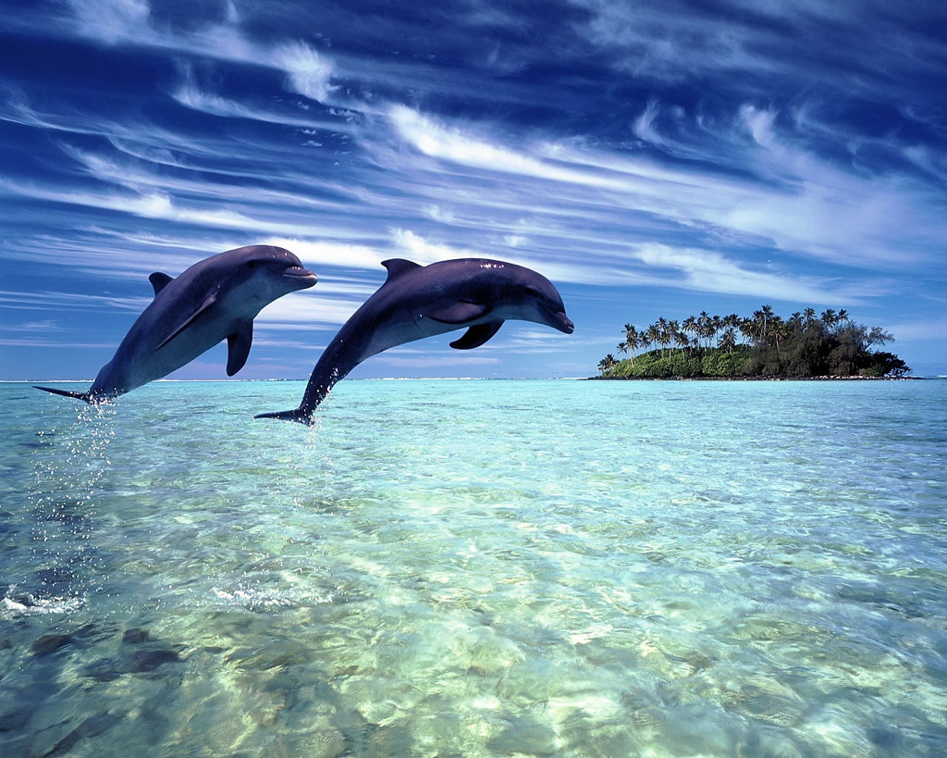
Dolphins second to humans as most intelligent animals
Notes:
There is really no need for a title.
This is a terrific photo .. The dolphins are almost jumping into the text. The text is also aligned up with the island. No fancy font, just straight black text … we quickly get the core message this slide is trying to make.
When we enlarge the photo, it has this wonderful space in the lower right for text!

Slide 28
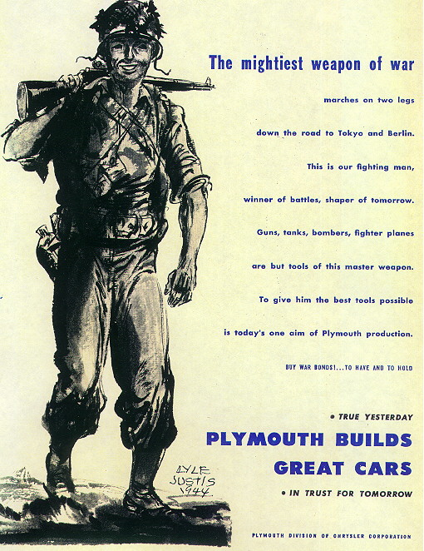
Some Propaganda posters bordered on profiteering
Notes:
Sometime people blow up a picture to make it as large as possible.
< Taken from lynda.com>

Slide 29
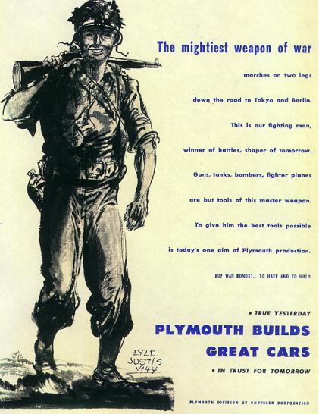
Some Propaganda posters bordered on profiteering
Notes:
Smaller text with breathing room does a better job — even from far away. If something is too small use a “call out”. Remember that your eye will be attracted to something out of alignment.
< Taken from lynda.com >

Slide 30
Weak visual relationships
Bad Symmetry
Misplaced emphasis
Poor use of size, space, and color
Notes:
The problem with this standard format is this … the centered headline conflicts with the left-justified bullet points.
The left-justification makes a strong vertical line and your eye is drawn there because of the yellow bullets. So, we are not quite sure that is the most important piece of information here … is it the headline or the information contained within the bullet points?
I’m also not quite sure that the ocean template has to do with the content of the slide.
[taken from lynda.com]

Slide 31
But the tools are there for strong design
Good layout creates visual relationships
Alignment links or separates objects on screen
Empty space gives the eye room to move and see
Color and emphasis guide and focus the reader
Notes:
Alignment, empty space, and the intentional use of color and emphasis are your friends.
I’m not a fan of having this much text on the slide, but if I did, this is a better way to do it.
The headline has the most contrast and is largest type. I want you to look there first.
The sub heads are less contrast — the text is a light blue and the font size is smaller. They are aligned on the left so they are a group but separated by enough space so the viewer thinks they are separate points.
[lynda.com}

Slide 32
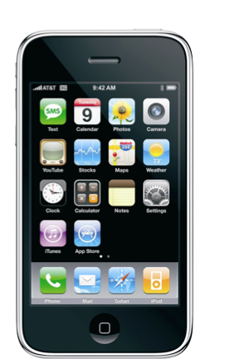
iPhone
Market Share
A new survey of U.S. smartphone owners found that 28 percent use a device running the iPhone OS, compared with just 9 percent on Google's Android mobile operating system.
Apple is ahead of Windows Mobile, which had a 19 percent market share in the first quarter, down 2 percent from the previous quarter. Google's Android came in fourth, with 9 percent. Palm took fifth with 4 percent, Linux sixth with 3 percent, and Nokia's Symbian came in seventh in the U.S> with 2 percent.

Slide 33
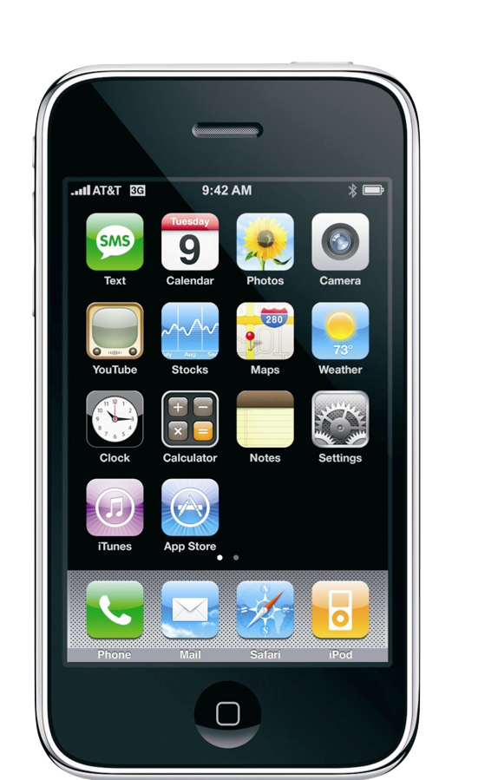
28%
market share
Notes:
Contrast (28%)
Identification of key message
Effective use of images … don’t be afraid to blow up images, or crop. Just make sure to get them big enough so that they do not become blurry.
Notice alignment

Slide 34
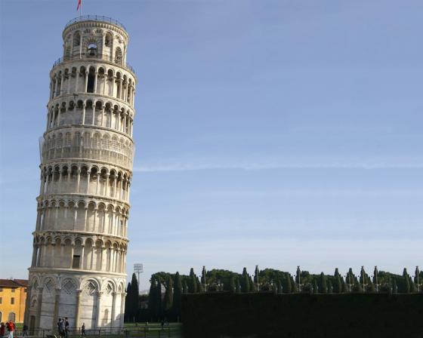
The Leaning Tower of Pisa
Angle of slant: 3.97 degrees
Although intended to stand vertically, the tower began leaning to the southeast soon after the onset of construction in 1173 due to a poorly laid foundation and loose substrate that has allowed the foundation to shift direction.
The height of the tower is 55.86 m (183.27 ft) from the ground on the low side and 56.70 m (186.02 ft) on the high side. The width of the walls at the base is 4.09 m (13.42 ft) and at the top 2.48 m (8.14 ft). Its weight is estimated at 14,500 metric tons (16,000 short tons).

Slide 35
3.97º
Although intended to stand vertically, the tower began leaning to the southeast due to poorly laid foundation.
Notes:
Discuss use of themes, Papyrus (font), image use.
Discussion of choice of images … look for ones with “copy-space” for text. Stretched picture so it takes up the whole screen … makes the image (and it’s message) more powerful.

Slide 36
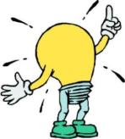
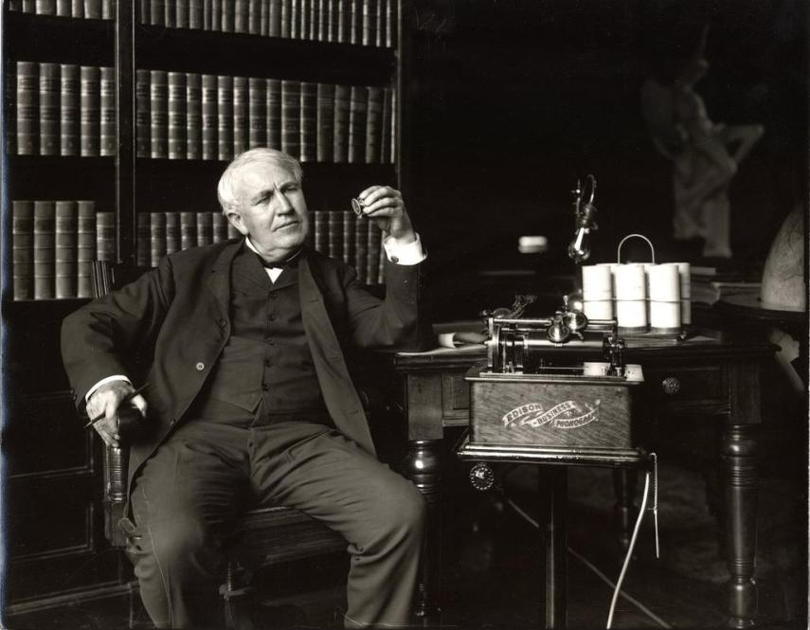
Thomas Edison
“The Wizard of Menlo Park
The modern world is an electrified world. The electric light, one of the everyday conveniences that most affects our lives, was invented in 1879 by Thomas Alva Edison.

Slide 37
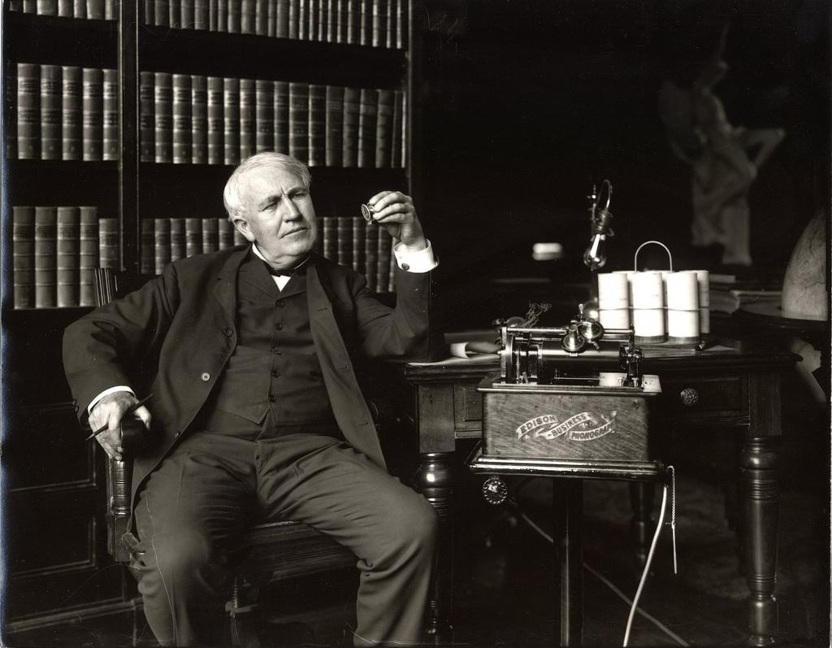
Thomas Alva Edison
Invented the light bulb in 1879
and held 1093 patents
Notes:
Ditch the clip art … sticking clip art up in the right hand corner always looks like an afterthought and weakens the slide. Get rid of the theme … overdone. Boil the message down to its key components.
Here we used a transparent “shape” made in Powerpoint in the back of the text so that it is easier to read.

Slide 38
Faith and Economics
The (U.S. financial) system filters out the thoughtful and replaces them with the faithful," according to an anonymous financial analyst explaining in The Economist what made the recent financial crisis inevitable.
Jesus said," The truth will make you free." But what if we can't handle the truth?
Notes:
This is an example of a typical slide in a slide deck. There are really two thoughts here that are quite complex. Lets see what would happen if we eliminated the bullet points, split up the two thoughts and made them graphically more pleasing. Best to only put one idea on a slide.

Slide 39
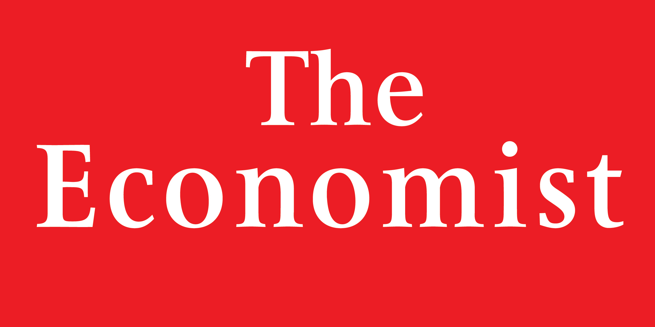
"The (U.S. financial) system filters out the thoughtful and replaces them with the faithful,"
Notes:
This is a redo of the first bullet point. Notice that we have a simple background, used two red boxes (The Economist branding is red) and connected the two boxes. We used a simple font and a similar treatment to both boxes, placing them close to each other because they are related. If we placed the quote farther away, the viewer would not be so sure the two were connected.

Slide 40
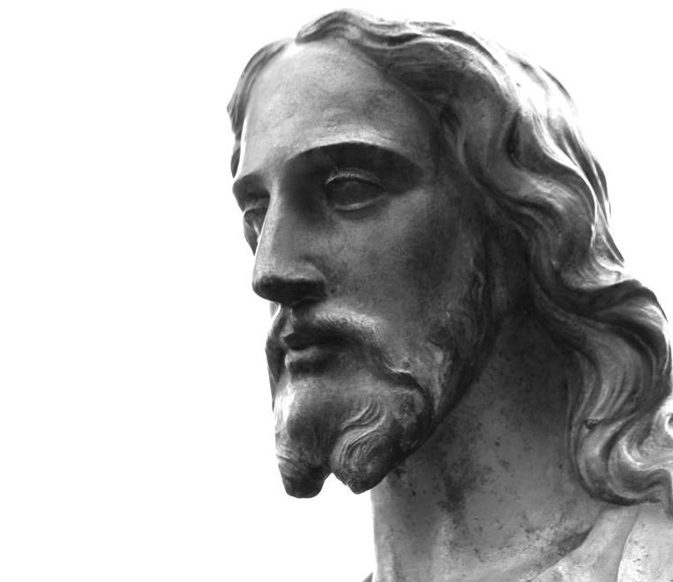
“The truth will make you free.”
Notes:
This is the redo of the second bullet point. We could eliminate the words “Jesus said” with a picture. We also eliminated the text … “but what if we can’t handle the truth?”. This line would be so much more effective if delivered verbally. Using a larger image, we could safely stretch the photo. We placed the photo over to the right for more interest, following the rule of thirds.
Notice that I have plenty of white space … our eye needs quiet space!

Slide 41
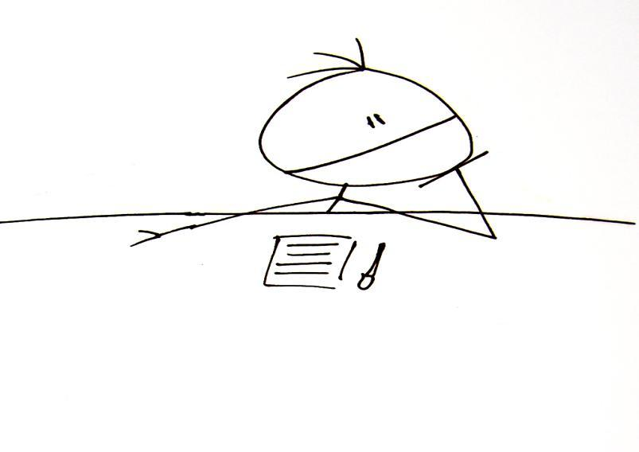
Contact:
Heidi Trotta heidi.trotta@shu.edu
973-275-2882 Resources:
http://heiditrotta.wordpress.com/presentations-2/effective-presentations/

