Slide 1

MARC 2012
Standing OUT in a Crowd
Notes:
Standing Out in a Crowd
1 hour and 30 minutes
Are you presenting at this conference or back on campus? Join this lively workshop to learn graphic design secrets, tips on creating better presentations, and best practices for working with images and text. Bring your laptop and your presentation, if available.
MARC – 2012
Heidi Trotta
Seton Hall University
Teaching, Learning and Technology Center
trottahe@shu.edu
973-275-2882

Slide 2
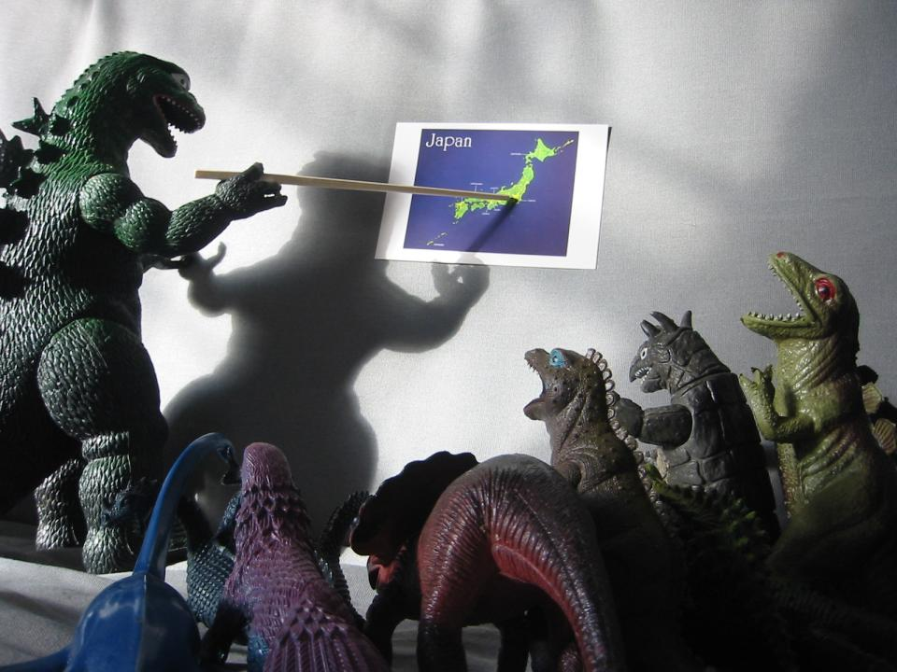
Notes:
When called upon to present a topic to a class or group of people, most of us create a presentation similar to what we have seen others do. However, the truth is that the majority of presentations are poorly designed. Aside from the lucky few who have a background in the creative arts, rarely do college courses cover design concepts or graphic fundamentals.
Transition: Without this background it is very easy to let available software, such as PowerPoint and its functions lead us down the wrong path, one where our presentations are not as effective as they could be in communicating our ideas and thoughts.
http://www.flickr.com/photos/76074333@N00/318034222/sizes/l/

Slide 3

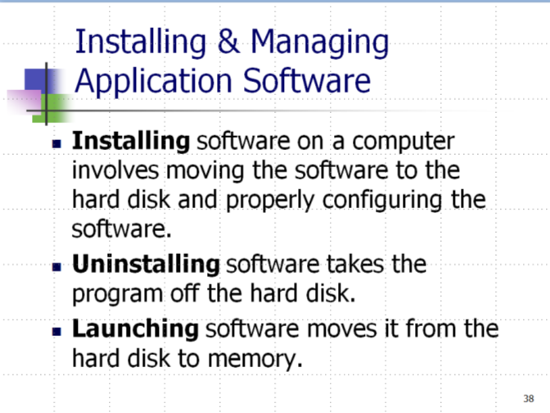
Notes:
Our tendency is to tell the audience ALL we know about a topic in the time frame allotted, so, we try to squeeze in as much information as we can, listing the items in bulleted lists, slide after slide.
Transition: Our slides start to look like this … lots and lots of text that goes on for slide after slide
Copyright © 2011 Pearson Education, Inc. Publishing as Prentice Hall

Slide 4

Notes:
And our audience, well, they start to look like this.
http://www.flickr.com/photos/silkegb/2885319688/sizes/z/in/photostream/

Slide 5
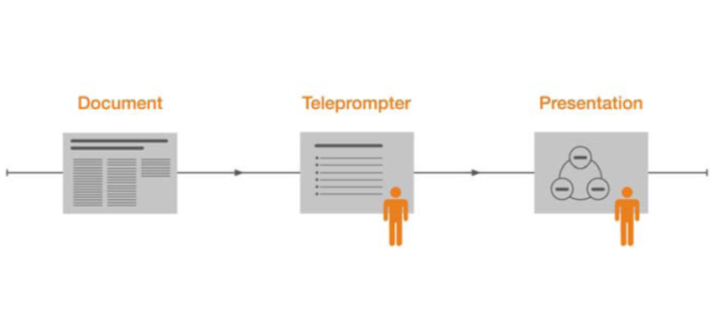
Most
Presentations
Notes:
Our presentations start become more of a document, or a report in which we, in turn, use as a teleprompter instead of a true presentation.
Transition: It is easy to blame everything on the tool (i.e. “Death by PowerPoint”).
(Image by Nancy Duarte)

Slide 6
Using the Same Skills
1
5
Hour
Years
To Learn PowerPoint
Notes:
Others rationalize their habits by thinking they wouldn’t have built in the bullet function if we weren’t suppose to use it.
The truth is that most of us really don’t even know even know the tool well. We spend 15 minutes on the average learning the tool and then practice the same skills for the next 5 years.
Transition: It is easy to get overwhelmed …

Slide 7
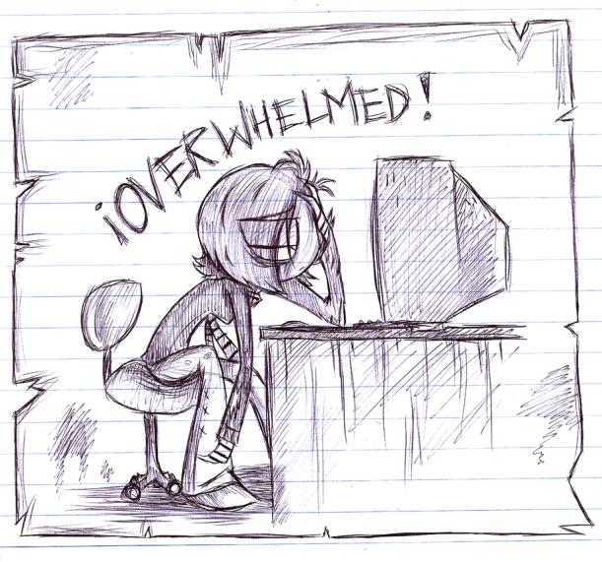
Notes:
We have so much we want to say. Then we have to format it, arrange it on the screen, choose colors, find images … it is just too much and we fall back on old habits. Most of my faculty will say, “I just can’t do it”.
Well, my mission for this workshop is to simplify this process for you by giving you some principles to use along with tips and tricks to ensure you communicate your thoughts and ideas effectively in your presentations … be it to sell an idea, process or product, for training or to inspire others.
http://vivzmind.deviantart.com/art/OVERWELMED-120414807

Slide 8
Process
Design Principles
Pulling It Together
Thinking Visually
Support Materials
End of Act I
Notes:
During today’s session we will be looking at:
The Process
Thinking Visually
Preparing and Posting Resources and Support Materials
Graphic Design Principles and Inspiration
Tying it all together – Before and After
Transition: Through it all, I want you to keep 4 Principles in mind …

Slide 9
Clarity
Simplicity
Brevity
Humanity
Act II
Notes:
These 4 principles will act as threads, binding ideas and concepts together regardless if we are talking about color, fonts, images or actual content.
Clarity - Be clear as to what you want you are saying, what you are saying and not saying.. Choose wisly.
Simplicity - Keep it simple, leave out the complicated jargon, complex examples
Brevity - Be brief – remove all redundancy … don’t use two words when one will do (one example vs. two)
Humanity - though honesty, telling stories, showing your connection to the rest of the audience and human race … this is actually your strongest asset you bring to your presentation!!
Though out this presentation, you will see that these 4 principles will act as threads, binding ideas and concepts together regardless if we are talking about color, fonts, images or actual content.
Transition: So let’s get started.
From: William Zinzer from the audio tape that accompanies his book “On Writing Well.”

Slide 10
3-4 points
Audience Focused
Key Message
Story
1
Notes:
First identify what ONE key message you want your audience to remember. The length of a Twitter message – 140 characters is perfect – ONE sentence. All your material in your presentation should support this one message.
Think carefully about why people are attending your presentation. What are they like? Why are they attending your session? What do they want? Focus your attention on filling that need.
Think of your presentation as a story with three acts ..
Act 1 – you are setting the scene
Act 2 - here is where the action occurs, the meat of your presentation
Act 3 - your call to action …
Your story supports your mission, what you want your audience to do as a result of listening to your presentation (be it to invest, institute a new policy, perform a task or buy a product).
Start outlining your presentation. Identify 3-4 key points that support your message. Resist the temptation to tell them EVERYTHING about the topic … it is impossible for them to remember anyway. If you want to add more information for yourself or your audience, do so in the Notes section of your presentation or a handout.

Slide 11

1
idea per slide
Notes:
Place only one idea per slide. This part is sometimes the most challenging because it forces you to select and eliminate because we usually have too MUCH data to sort through, rather than too little.
I’m not even thinking about images, colors or fonts at this point … instead, I’m thinking Headlines which I might later edit or replace with an image.
Then I start to write out my script in the notes sections, including any notes to myself. Often, I’ll keep my research for a topic in a Word document and then cut and paste supporting facts into my Notes so my notes becomes a “working” space.
As my story develops, I go back and make sure I have provides a connections between the slides so the presentation hangs together as a whole.
Script
Notes to self [ ]
Bolding notes
Transitions
Working area
Don’t think visuals yet
Can edit notes master

Slide 12
Notes:
Resist the temptation of putting bullets points on the slide. Nothing makes us fall asleep faster than a slide full of bullet points. The truth is that bullets were originally designed for print for a way to list items with uniform spacing between them.
Remember that regardless of our good intentions, research as shown us that it is impossible for people to read that is on the slide and listen to us too. Your audience can read your slides faster than you can read it to them. Once there are bullets on your slide you are going to turn around to read them. Bullets work great in reports and documents, but use them only in the NOTES section of your presentation.

Slide 13
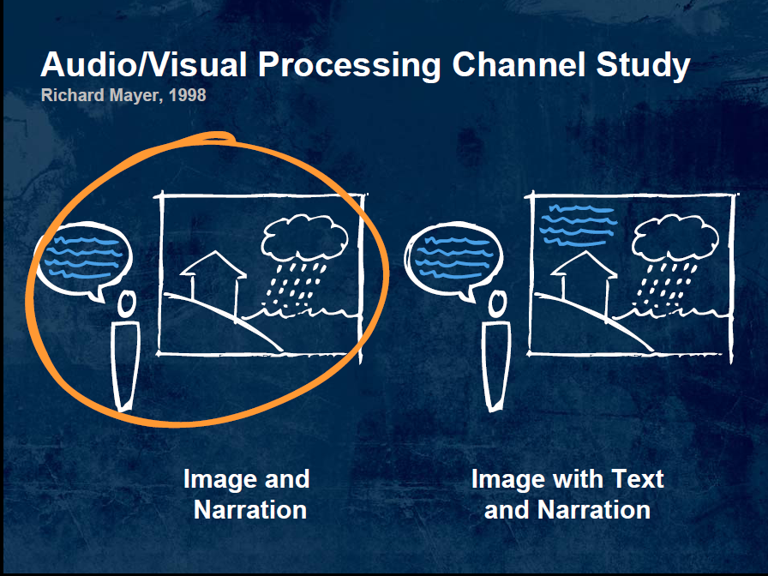
Notes:
In Richard Mayer’s famous work on Multimedia Learning in 1998, he discovered that people learn best though image and narration vs image, text and narration so once I have my one idea on a slide I start to think visually.
(Slide by Nancy Duarte)

Slide 14


We are
Visual
Notes:
In formal education, unless you are in the visual arts or advertising, the focus has been on verbal or written communication vs. visual communication.
However, I would argue we are inherently VISUAL communicators. Corporations spend hundreds of dollars on advertising, marketing and PR to attract and retain their consumers.
Images carry not only meaning but convey emotion. Remember, your audience will act based on emotion. Through the choice of images we can connect with our audience and the rest of our world (the humanity principle).
Let’s look at an example:

Slide 15
London Eye
Big
Round
Spokes like bike
Glass pods on the outside
Ride it standing up
Rotates and never stops
Notes:
Do you know what this is as I describe the object and from reading the bullet points on the screen? Probably not.

Slide 16

Notes:
But now, you have a much better idea of what I am talking about … Notice that with the use of an image, I wouldn’t need to use as many words to describe this subject thus improving communication, allowing me to focus on what is important, with the added benefit that I don’t have to use as many words on the slide! You can use the note section of your Powerpoint to right out detailed descriptions.
Notice also that, as the viewer I can feel a sense of height and, depending on my past experiences, I remember what it was like to ride a farris wheel.
http://www.flickr.com/photos/netlancer2006/879436400
(The largest Farris wheel in the world)
Transition: When you are thinking about images, try to think out of the box.

Slide 17
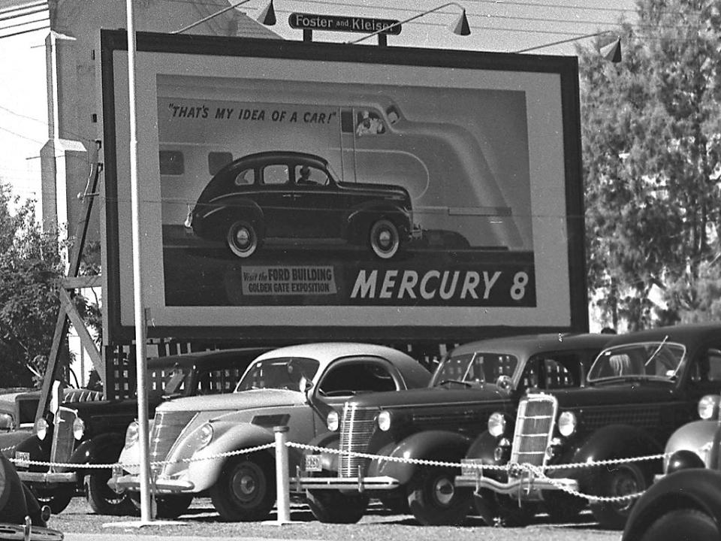
Notes:
Think of your slides more like a billboard or backdrop. Represent your ideas with images. How many words on a slide? Only as many as absolutely necessary to get the idea across and eliminate the bullets!!!!!!!!!!!!!!!!!!!

Slide 18

©
Avoid
Notes:
Avoid clip art and overused cliché images if you can and discard any cheesy metaphors … they have all been done before!
No Logo on Every Slide -- If you are 20 minutes into a presentation and your audience doesn't know who you are and what company you are with, then you have a major problem. This problem isn't going to be solved by placing your company logo on every slide in your presentation. These logos add extra noise and distract from the story you are trying to tell. This also means not to use a logo with a template and ditch the copyright statement. If you unwilling to share your powerpoint, then don’t.
If your company insists on the logo … place it in the lower right hand corner, grayed out.
(weak slide … redo the next time)

Slide 19
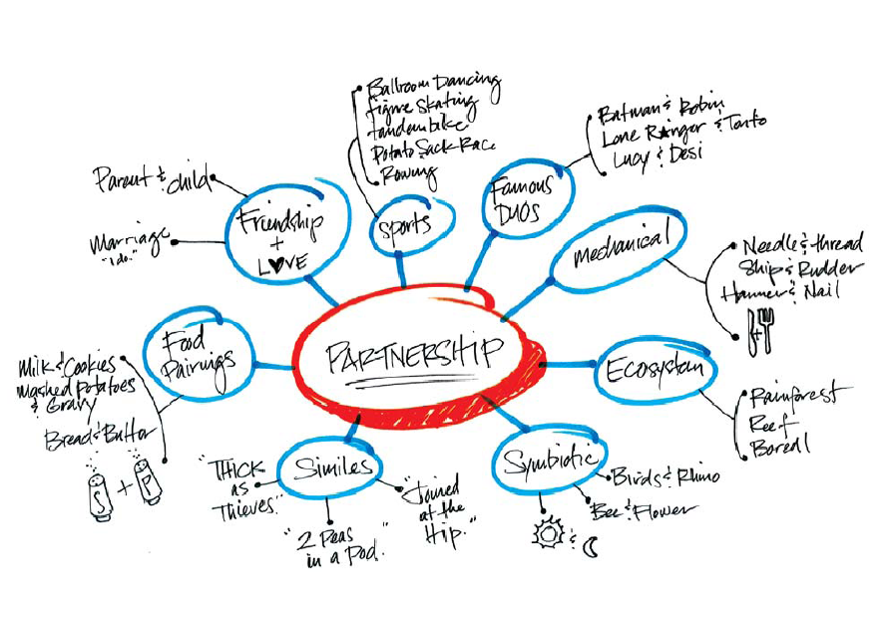
Notes:
Think more like a designer. Often ideas come to us right away and that is good however, avoid the pitfall of going with the first thing that comes to mind. Force yourself to think through several more ideas. Often our best idea comes later after some thought. Explore words and word associations to generate SEVERAL ideas. One approach is to try “word mapping” as seen here. A stronger solution frequently percolates to the top after time.
Take the time and spend the creative energy to have a inspiring presentation.
(Slide by Nancy Duarte)

Slide 20
Notes:
No, we are not quite finished yet …. I wanted to remember to tell you about the power of a black slide … this is a technique that can be used very effectively. If you want your audience to look at you, and not at the screen, insert a black slide.

Slide 21
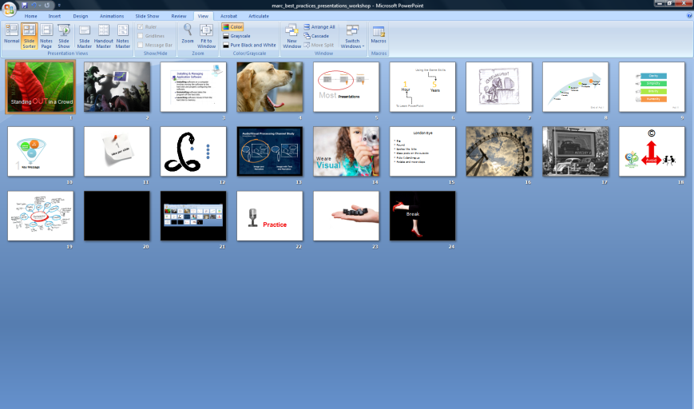
Notes:
Once you have completed all your slides, take a final look at them as a whole. They should all “hang” together … making a cohesive whole. An easy way to look at them together is through the slide sorter view.

Slide 22

Practice
Notes:
When your slide deck is finished, you will want double check to see if they will fit within the allotted time (2 minutes per slide is a good rule of thumb), print your slides with the notes and then practice, practice, practice.
Remember to allow for questions and any interaction with the audience.

Slide 23

Notes:
NEVER, NEVER print out your slide deck for your audience. If your audience can get the same information from your slides, then why attend?
Consider instead printing your Note pages, providing online support resources via a blog, wiki or website and or printing a white paper for the audience.

Slide 24

Break
Notes:
Letting go of text and slide junk is hard at first. After all, there is sooooooooo much to say. Changing the way we look at the delivery of our presentation requires time, patience and practice. However, keep in mind that YOU are the presentation. There is something that people need from you or they would not be taking the time to attend your presentation.
Let’s take a 5 minute break and then we will continue on with looking at some graphic design principles and before and after examples.

