Slide 1
How to Foster Agile Working Teams at Your Institution
Veronica Longenecker
Assistant VP of Info Technologies
Millersville University
Josh Hartranft
Director of Computing Support Services
Millersville University

Slide 2
www.agile-process.org -
Agile Software Development – A gentle introduction
“The most important thing to know about Agile methods or processes is that there is no such thing. There are only Agile teams. The processes we describe as Agile are environments for a team to learn how to be Agile.”
Wikipedia –
“Agile software development is a group of software development methods based on iterative and incremental development, where requirements and solutions evolve through collaboration between self-organizing, cross-functional teams. “
Disciplined Agile Software Development: Definition –
“An iterative and incremental (evolutionary) approach to software development which is performed in a highly collaborative manner by self-organizing teams within an effective governance framework with “just enough” ceremony that produces high quality solutions in a cost effective and timely manner which meets the changing needs of its stakeholders.”
Agile Software Development

Slide 3
Why do we need agile teams in IT?
Wave of Change in Higher Ed

Slide 4
Student Demographics
Society – What is the value of higher education?
Declining state and federal funding for public institutions
Consumer Technology Increasing
Disruptive
Innovation
Change in delivery methods of educational materials
Increasing costs of Higher Education
Shift towards performance based funding
Declining loyalty to a single institution

Slide 5
Are our support staffs ready for the tidal wave of change? How do we prevent a wipeout?

Slide 6
Which service organization is yours?
Methodical – Process Driven
Innovative - Agile
Thinks linearly
Respond based on past experiences and procedures
Likes best practices
Looks for established protocols
Communicates / shares
Empowered to explore new solutions
Comfortable with new approaches
Embraces creative, non-standard solutions
Notes:
Linear progression – where are you on the continuum
Balance of both type of workers
What are your departments strengths / weakness? Inventory of skill sets
Activity opportunity???

Slide 7
Which service organization is yours?
Innovative - Agile
Methodical – Process Driven
Notes:
Linear progression – where are you on the continuum
Balance of both type of workers
What are your departments strengths / weakness? Inventory of skill sets
Activity opportunity???

Slide 8
Balance on the board, maneuver swiftly, and ride the wave using skills we’ve mastered over the years.

Slide 9
Physical Changes in Office Space
Ride the Wave with Agile Teams

Slide 10
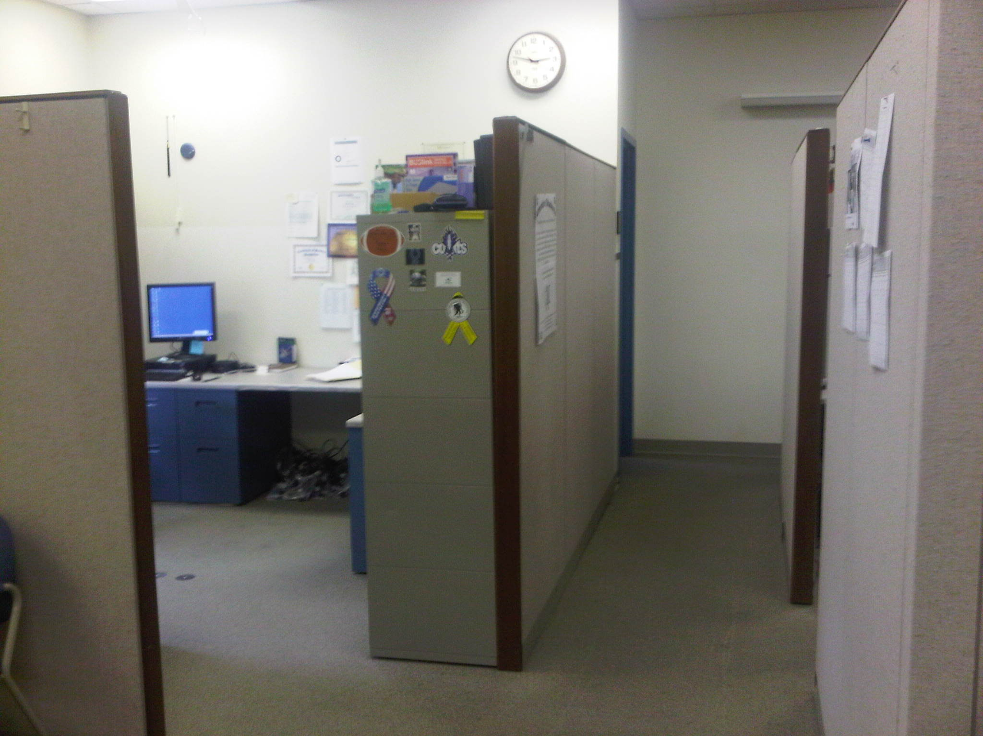
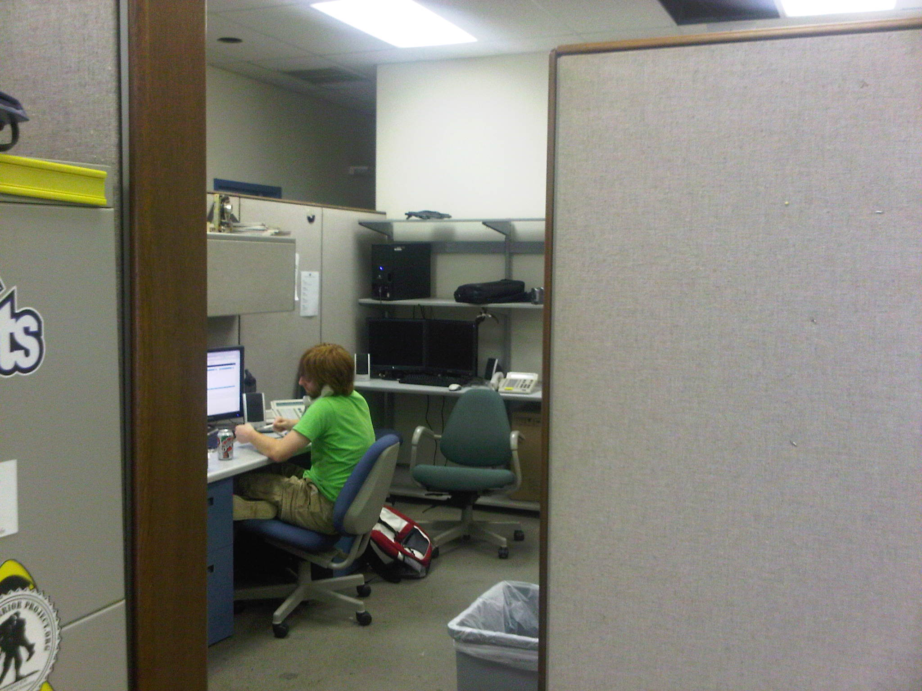
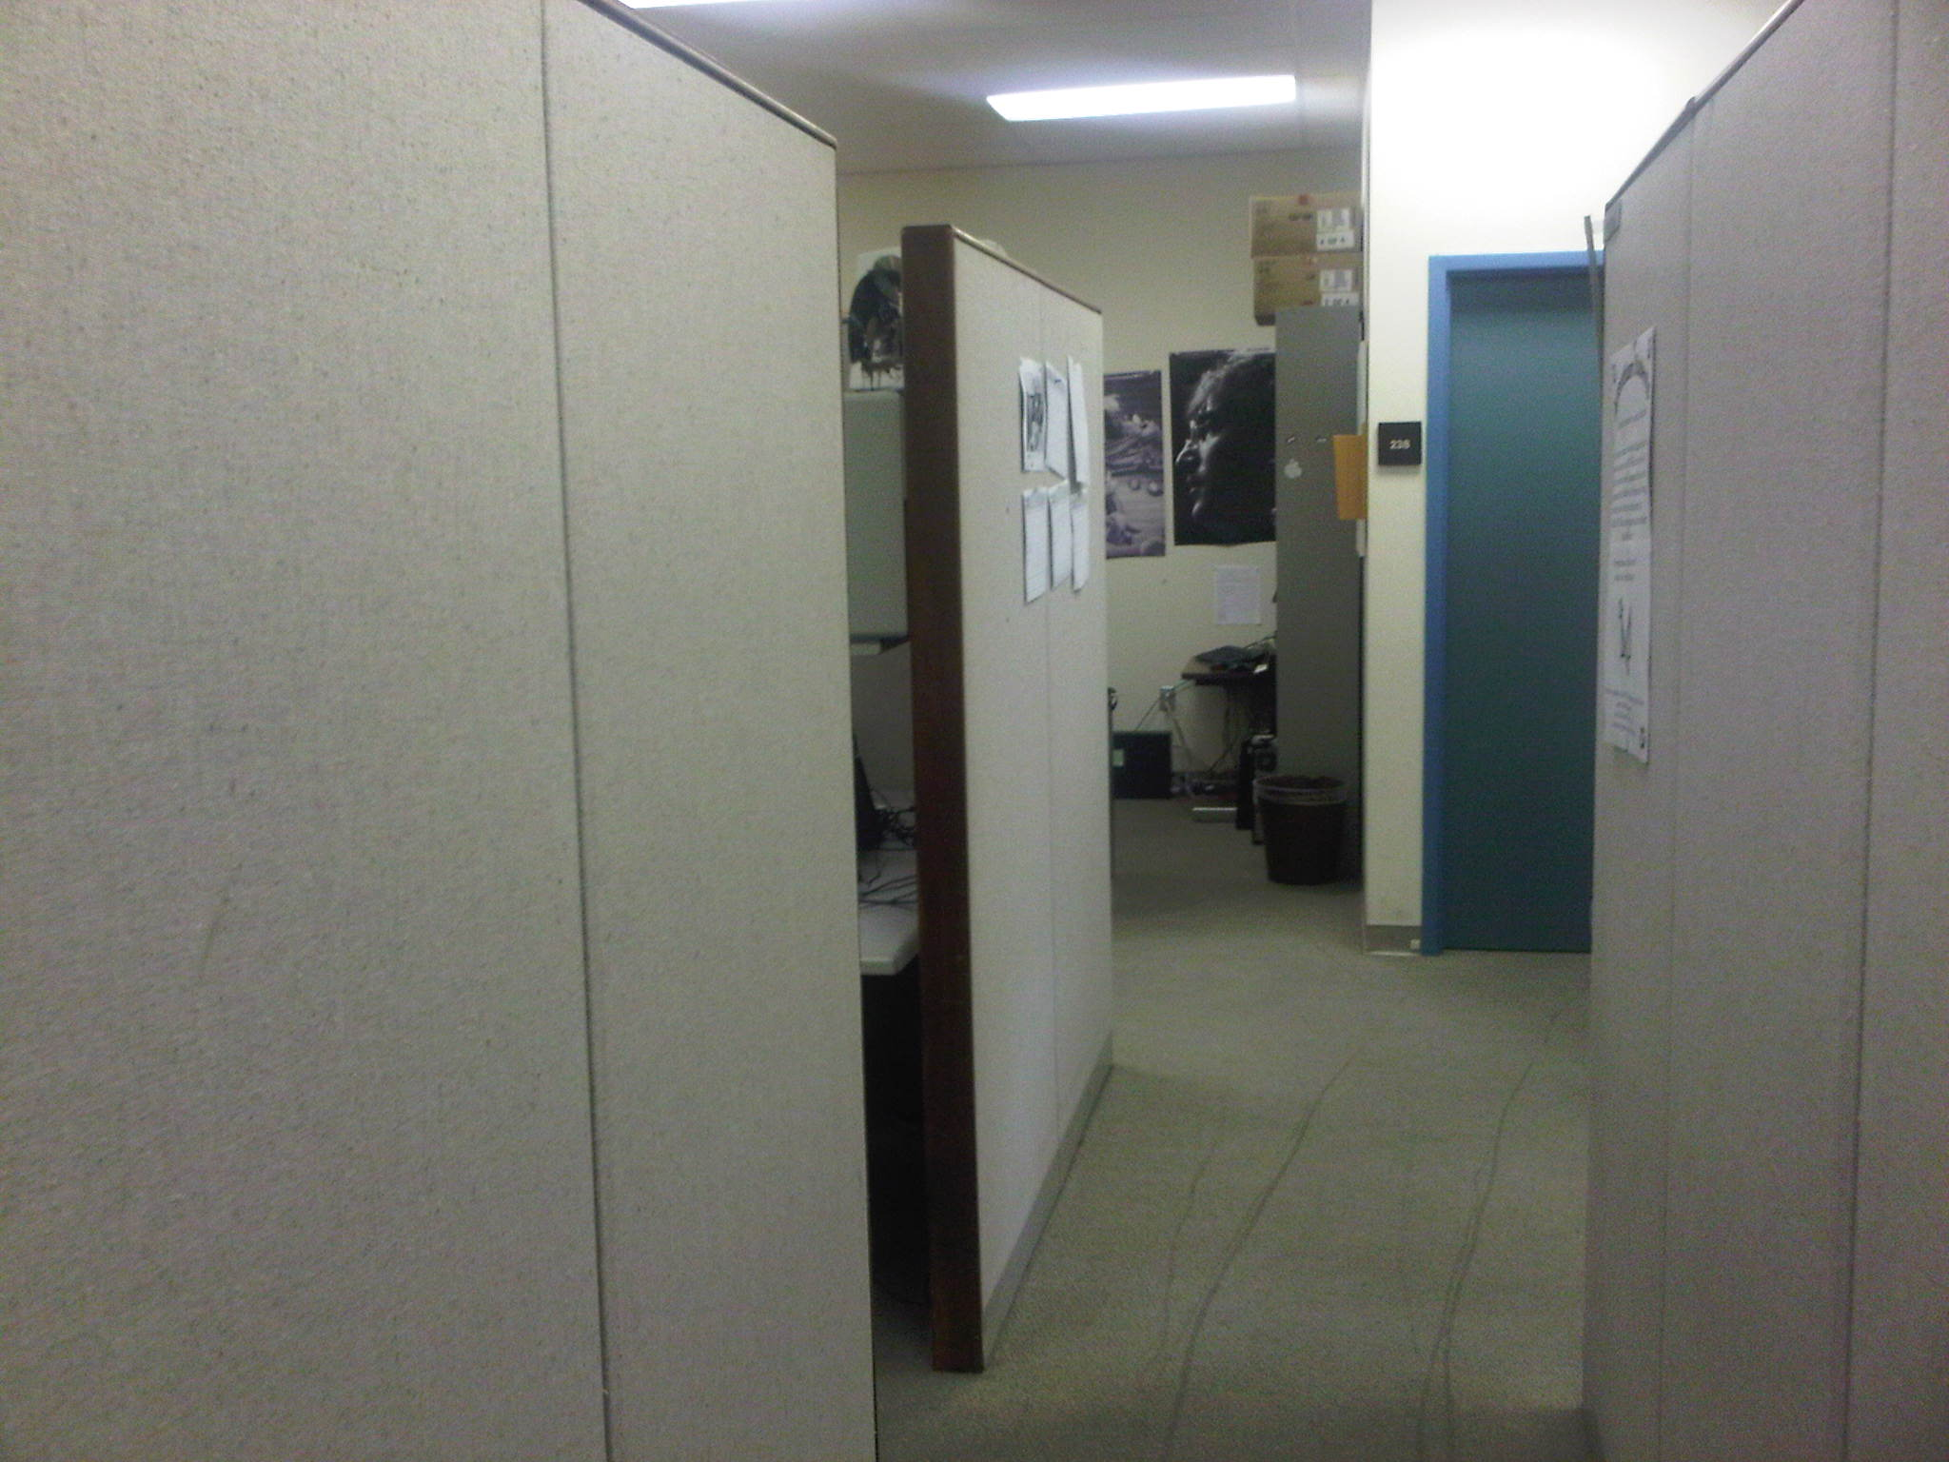
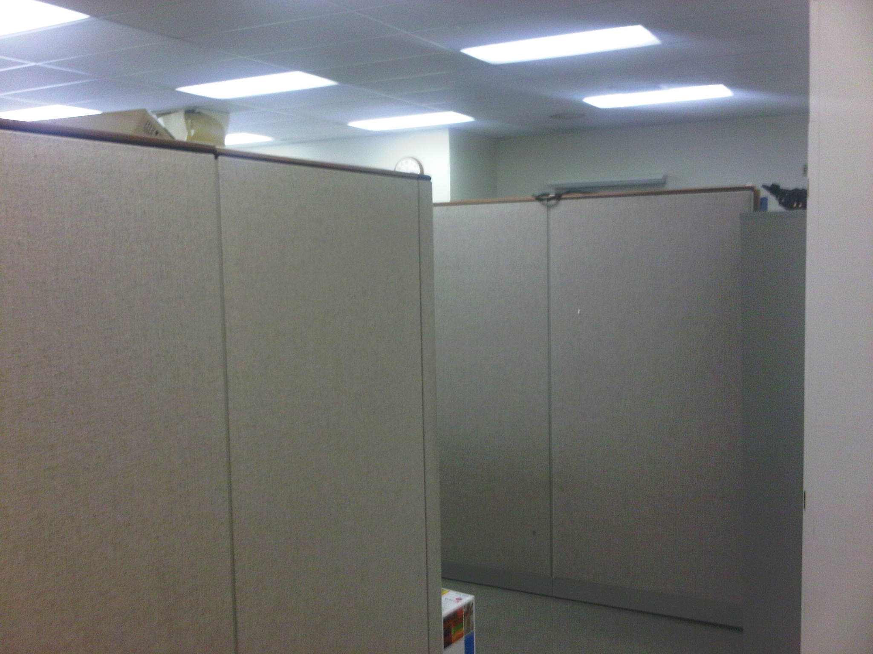
Millersville Support Services Before

Slide 11
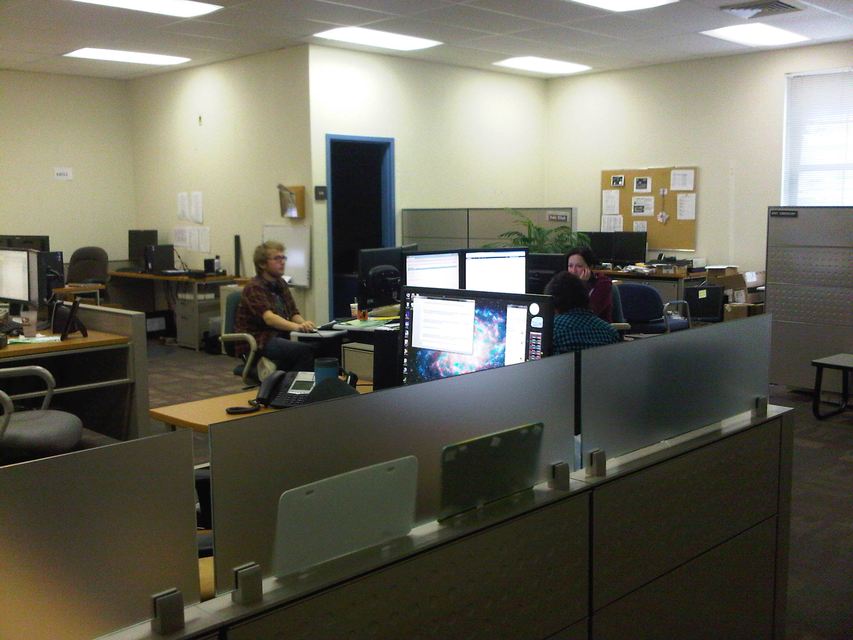
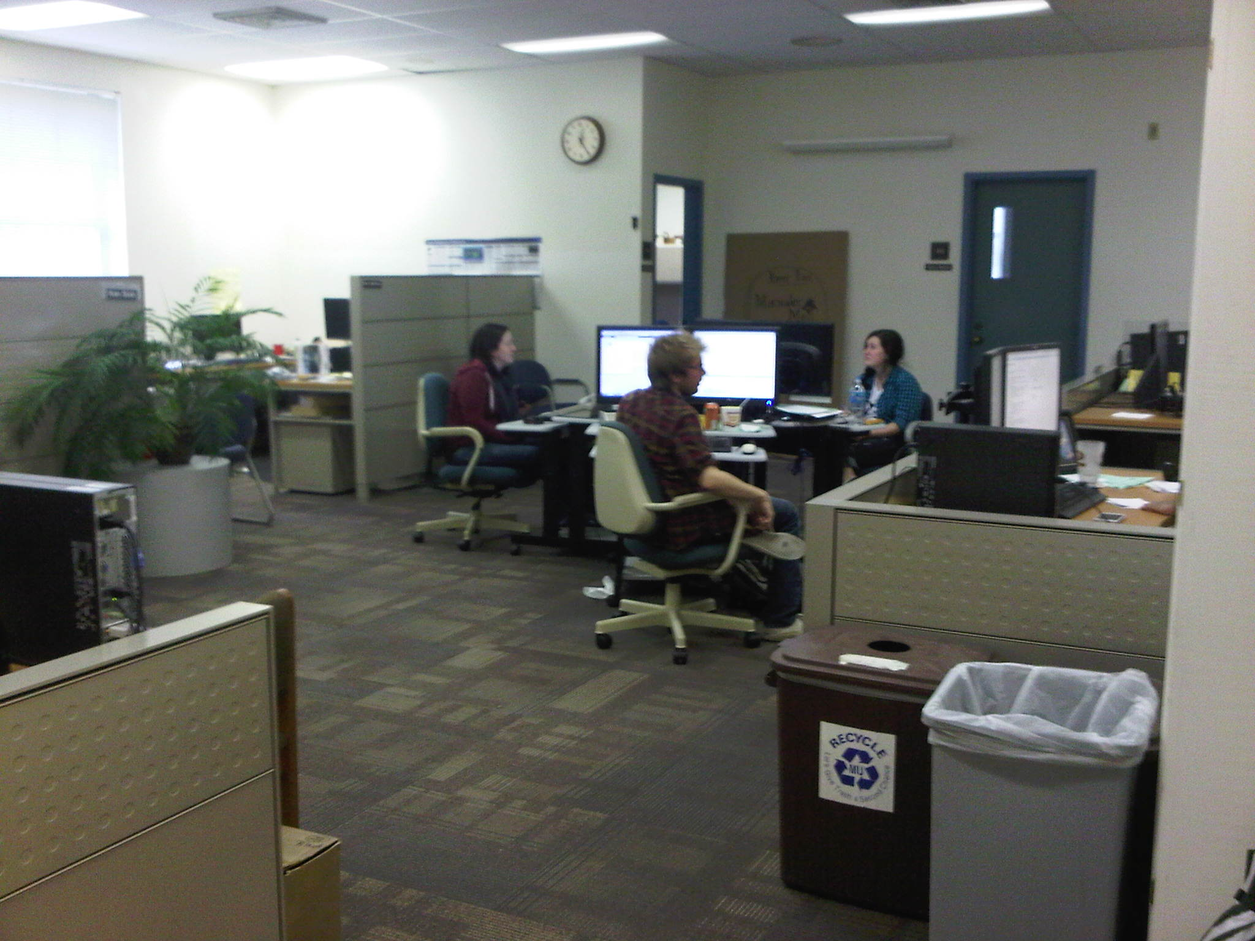
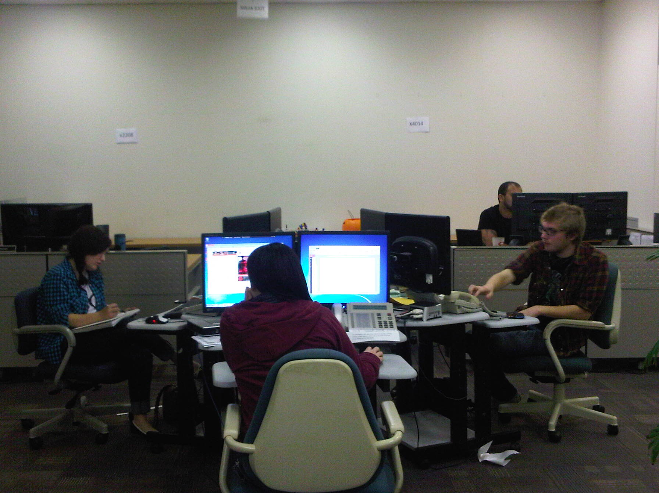
Millersville Support Services Now
Notes:
Combined our desktop support and help desk into same physical location – support services
Created a collaborative space – removed partitions
Use the same approach – teaching and learning team (instructional designers) will be in the same physical location as the Center for Academic Excellence in our renovated library
Advantages –
36% real-time resolution – space change – more efficiency
Check with Josh if we have something along statistics
Faculty – staff can sit and have a conversation – others can help and contribute
start conversation within earshot of others – start to hear about other projects / ideas
Plug for Josh’s / Aaron’s poster session
Cleanliness – keeping areas more inviting
Not only pure technical skills but also about building relationships

Slide 12
Realignment within IT Organization
Ride the Wave with Agile Teams

Slide 13
Investigation Pre-work
Explored Work Team Definitions
Self-Directed, Self-Managed, Agile, Shared Leadership
Review Current Job Descriptions
New Duties?
Different Essential Functions?
Conflicts with assignments or qualifications?
We found no conflicts with team members current job descriptions
Notes:
Last year – had 4 discussions with IT staff – strengths, challenges, to do’s
Major concerns – priorities, seeing change, projects

Slide 14
Connecting with HR
Initial Meeting
AVP Human Resources, Classification Manager, Director of Training
Presented the idea of shared leadership, agile teams
Pilot Team Project
HR Recommendations
Meet with Union leaders – thanks for info and part of process
Review Job Descriptions
Create small planning team before total implementation
Notes:
Last year – had 4 discussions with IT staff – strengths, challenges, to do’s
Major concerns – priorities, seeing change, projects

Slide 15
Millersville IT Organization
Created an IT Project Services Office –
Moved our Networking Manager to Director of IT Project Services Office
Created an IT Security Coordinator –
Moved our Systems Manager to the IT Security Coordinator
Merged the Networking, Telecomm and Systems into a single Infrastructure team
Created a Shared Leadership Environment
Notes:
Last year – had 4 discussions with IT staff – strengths, challenges, to do’s
Major concerns – priorities, seeing change, projects

Slide 16
Fall 2012 Shared Leadership
Network and System Admin
Integration
Support Services
Collaboration
Spring 2013 Shared Leadership
Network and System Admin
Storage Wars
Support Services
Communication
Notes:
Created 4 teams – Support Services, Network and Systems Admin (NASA), Integration, and Collaboration
Each individual belongs to two teams
Each team meets twice a week for 15 minutes
More management by walking around
Created directions / goals based on services
EMPOWERED TEAMS – don’t need to ask permission to attend one day sessions
Maine – included word SERVICE – providing something – building relationships – not just toys
reorganization from about 18 months ago

Slide 17
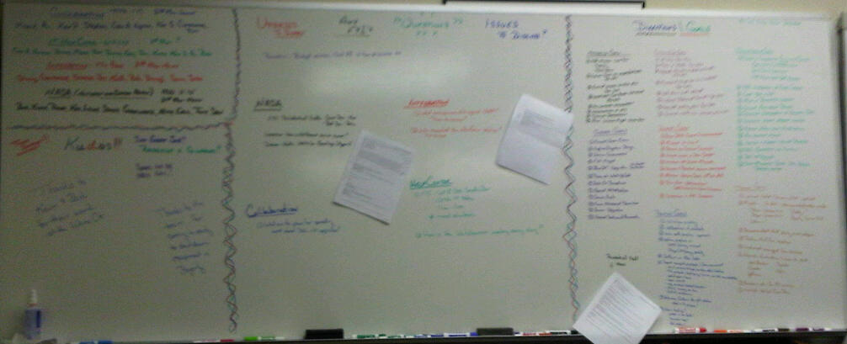
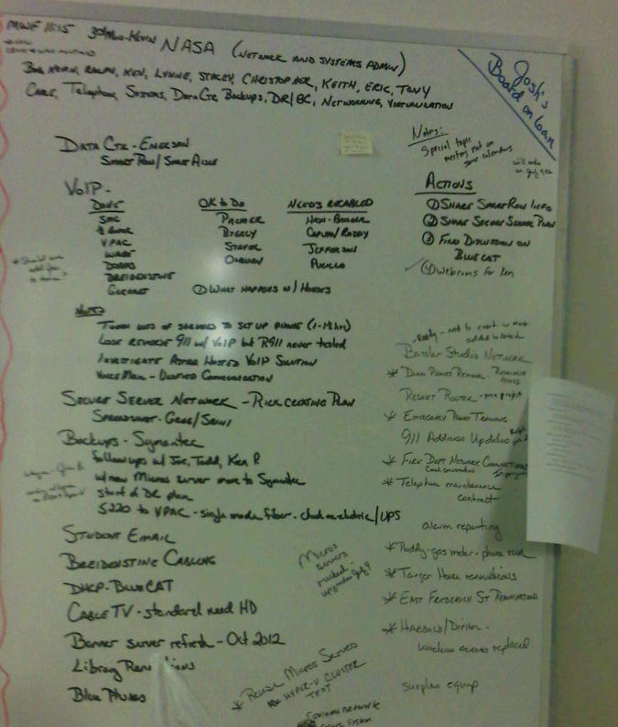
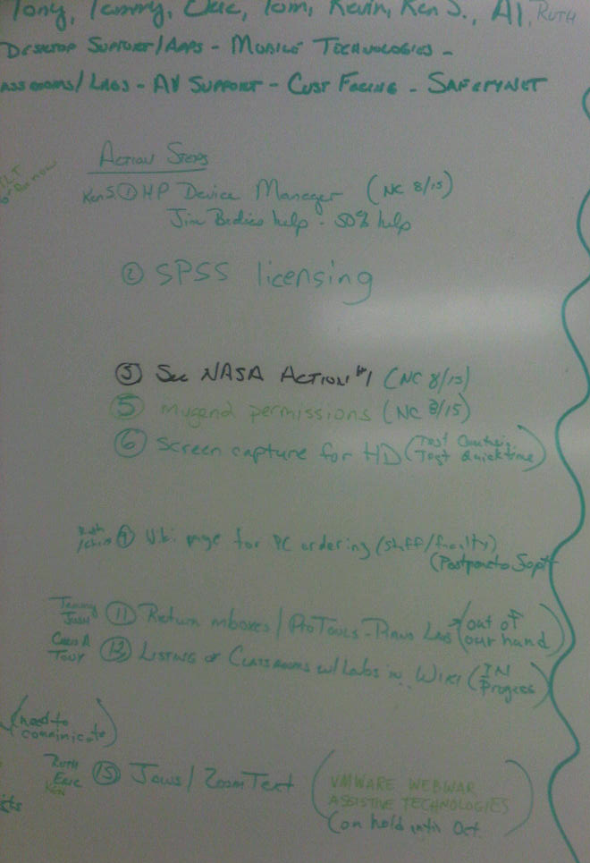
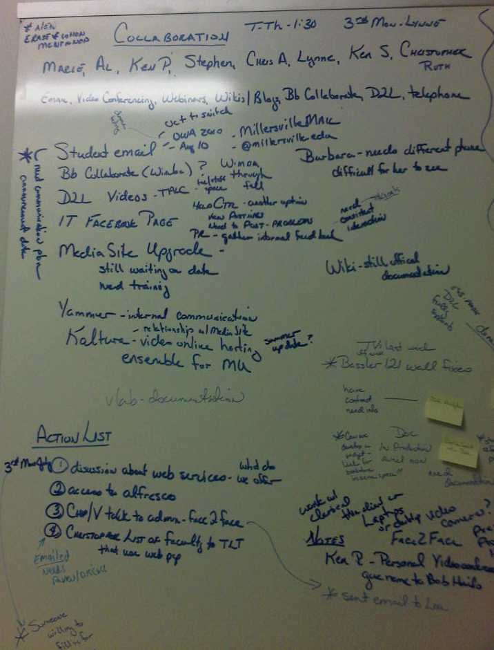

Slide 18
What teams would you create at your campus?

Slide 19
Involvement throughout the campus
Ride the Wave with Agile Teams

Slide 20
Millersville Campus Involvement
Created cross-disciplinary teams to accomplish specific tasks –
Camp IDEA – librarian, EDFN professor, IT Instructional Designers
More direct involvement with faculty and students
Interact with Student Senate
Meet IT Table in our Student Activities Building
Involved in Discussions earlier
BYOD philosophy
Arranged visits to newly renovated areas – VPAC and Broadcast Studios
Arranged for presentations about upcoming projects – Residential Halls

Slide 21
Managers / Directors Understanding the Need
Ride the Wave with Agile Teams

Slide 22
Understanding the Need
Managers / Directors –
More of Coaching role than a Manager Role
Participate in Committees
Attend conferences / workshops / webinars
Educause Management and Leadership Institutes
Attend campus presentations
Notes:
Maine - Advisors for undecided majors
Maine – committees they can get involved
- staff together from other campuses
Maine – write a blog entry that goes on the web site
Professional development – intentional – Educause Management and Leadership Institute

Slide 23
Lessons Learned Thoughts to Consider
Ride the Wave with Agile Teams

Slide 24
Lessons Learned
Right people on the bus and in the right seat
Involved Dir of Pro Development and Training
Involved HR and Union Leaders at the beginning
Water Cooler talk is critical
Benefits with student interaction – creates empathy
Keep motivated and making progress
Set directions / goals / expectations
Question everything / Don’t question everything
Communicate – Communicate - Communicate

Slide 25
Future Ideas
Ride along philosophy
Apple Genius Bar approach – appointments – sit down chat – walk up
Create a physical open work environment for infrastructure team
Pulling all the teams together and letting them create the 2.0 version

Slide 26
Thank You for your Participation!
Veronica Longenecker
Assistant VP of Info Technologies
Millersville University of Pennsylvania
Veronica.longenecker@millersville.edu
717-871-5891
Josh Hartranft
Director of Computing Support Services
Millersville University of Pennsylvania
Josh.hartranft@millersville.edu
717-871-5889

