Slide 1
Protection your inbox from phishing
Rob Thompson
Wayne State University
Notes:
[title screen]

Slide 2
The trouble with phishing
No clean definition
No easy answers
  Requires a host of different tactics to combat
  Will likely never eliminate 100%
Notes:
The term “phishing”, at least on the surface, sounds too benign to convey the gravity of the problem.
Phishing is a problem that defies a simple definition or a simple solution. We know it poses a grave threat to the security of our institutions, but often we can do little more than to combat phishing in a reactionary sense.
If there were a clean solution for phishing, we would have vendors out here at Educause Midwest, selling neat “anti-phishing” hardware appliances…… With shiny aluminum bezels, adorned with a glowing sea bass.
The solutions are difficult, and some involve ideas that are not likely to resonate with the ethos of programmers, analysts and administrators.
To make it worse, there is a general understanding that we will never be able to eliminate the problem all together.
What I hope to establish, is that there are some proactive things that we can do, as IT professionals, to combat phishing.
Also, I hope to plant a seed for a community of IT organizations, so that we can share information regarding this evolving problem.

Slide 3

About Wayne State University
Location: Detroit, Michigan
Students: ~32,000
  70 countries, 49 states
  Diverse campus
IT Department: 130 employees
Notes:
First, a little background about where I am from:
Wayne State University is located in the fantastic and diverse city of Detroit, Michigan.
We have a thriving campus in the heart of Detroit, which caters to around 32,000 students.
Our IT organization consists of around 130 full-time employees.

Slide 4

About Zimbra
Full featured Collaboration Suite
  Email
  Calendaring
  Tasks
  Document Publishing
  Community Oriented
Notes:
About 2 years ago, we implemented the Zimbra Collaboration Suite, for which some of the anti-phishing solutions that I am talking about today relate to. I’ll talk more about these later.

Slide 5
Terms and definitions
Phishing: An identity crisis
  Email based phishing
  Web based phishing
  Is phishing = SPAM?
  Is phishing = identity theft?
  Is phishing = social engineering?
Notes:
The term “phishing” has an identity crisis. It means different things to different people, depending on their role in IT
The general public does not have a clear sense of what it means technically. The identity crisis has many facets:
First of all, there is email-based phishing and web-based phishing, which manifest themselves in different forms.
Then, there are questions:
Is phishing SPAM?
Is phishing related to “identity theft”?
Is phishing considered “social engineering”?
The short answer is “YES”. But, I’ll go through these different topics first

Slide 6
Terms and definitions
Phishing = con
  con (a “con man”)
  confidence trick
  confidence scam
  social engineering
Notes:
There have been a wide variety of terms created to better define phishing, but at the end of the day, phishing of any sort is a “confidence trick” or “con”. This is where the term “social engineering” entered the vocabulary used to defined phishing.
Cons have been around long before Al Gore invented the Internet, and “cons” are a byproduct of social life in modern society.
We rely on the authority of others, to live successfully with each other.

Slide 7

Confidence tricks
General Gregor MacGregor
December 24, 1786 to December 3, 1845
Founder and Ruler of the Principality of Poyais
Notes:
This is General Gregor MacGregor. He was a Scottish soldier and adventurer who spent quite a bit of time fighting in South American wars for independence.
Upon his return to Europe in 1820, he proudly spoke of himself as the ruler of a new principality called Poyais which covered 12,500 square miles.
He attracted investors, and encouraged settlers to help colonize his new territory.
He commissioned a 350 page book titled “Sketch of the Mosquito Shore, including the Territory of Poyais”
This book described the wondrous natural wealth and flourishing establishment that he ruled.

Slide 8
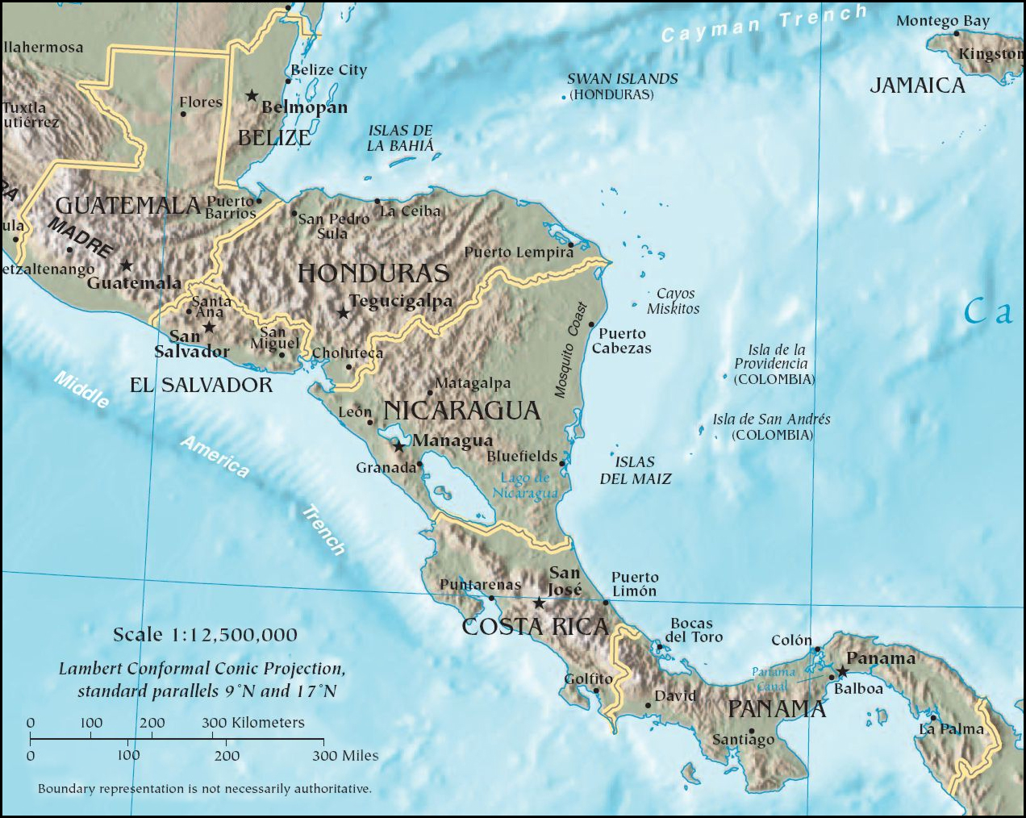
Notes:
Poyias was located in what is now near the eastern border of Honduras and Nicaragua facing the Caribbean sea.

Slide 9

Notes:
This is a sketch from MacGregor’s book.
It shows Poyias, with a bustling harbor and rows of buildings in the background.
The settlement shows a protected bay where you can safely harbor your vessel.

Slide 10


Confidence tricks
Notes:
Poyais had a national flag, as well as a more locally established state flag. These flags symbolized a system of territorial governance, as well as a national identity.
Poyais also had a coat of arms, printed currency, a national seal and other symbols of a flourishing nation.
When MacGregor returned to Europe, he wanted to attract settlers and investors. He sold these land grants, signed by himself, which were good for 250 acres to be redeemed in Poyais…. Just hop on a boat toward America, walk right up to the Poyais City Hall and start your new life in America..
Of course, you see where this is going… When the first boat of settlers arrived in Poyais, (by the way, which were filled with a chests full of "Poyais Dollars”), this what they found:

Slide 11

Notes:
There was no settlement, no protected bay…. In fact, there was nobody there at all. The land grants were as worthless as the paper they were printed on. The settler’s boat was swept away by a storm, as there was no protection from the sea.

Slide 12
Confidence tricks
180+ of the 240 settlers died
MacGregor was never convicted of a crime
Notes:
In the end more than 180 people died. Some survived, were rescued by surrounding nations, and were able to return to Europe. Some testified against MacGregor, but Macgregor was never convicted of a crime for the Poyais scam.
MacGregor exploited a vulnerability in our social structure. We inherently trust authority and symbols of authenticity. We need to, to live in civil society.
So, trust in authority is not entirely a bad thing, as the alternative is to trust nobody. In fact, if we had no trust in any authority, we would likely be living in caves, still beating each other with sticks.
So here in lies the root of the problem: We require authority, and symbols of authority to live in civil society. However, there are cons in our (now global) society, who are willing to exploit these very same symbols for their own personal benefit.

Slide 13
What is phishing?
The confidence scam of the 21st century
IT-based con (confidence scam)
  Email
  Web
First signs of danger between 2000 and 2004
Spring of 2004 saw the first signs of an epidemic
Notes:
So, back to Phishing….
Phishing is the “con” or “confidence scam” of the 21st century. It started in 2000 and saw a drastic increase in 2004. 2004 is when you could first call it an epidemic.
Confidence scams flourish in areas that are shrouded in mystery.
Just as the untamed and largely unknown “New World” fascinated Europe, the work that we do in IT is often a complete mystery to our customers.
This is what makes IT-based cons believable.
Our customers have little choice but to trust our authority, so it is very important that we educate our users about what it is that we do, and describe to our customers in explicit terms, the limits of what is we will ask them to do.

Slide 14

What is phishing?
Phishers often use symbols to gain confidence
  Icons
  Wordmarks
  Names of known departments
  Names of known people
Believable situations
  System upgrades
  Out of disk space
Notes:
Like any other con, Phishers use symbols of your authority to gain the confidence of their victims.
They will lift symbols of your authority right off of your web pages and use the names and titles of people within your organization to build a comfort level with their victims.
Usually, the scheme will involve a plausible problem, that any IT organization could experience, perhaps one that customer themselves have dealt with on their personal computers, such as upgrading software or disk spaces problems.
System upgrades are a common theme in phishing messages. IT organizations routinely send out announcements regarding “upgrades to email systems”, which detail the steps that we expect the customer to take, in order to conform to the new system. This is expected by our customers, and we expect our customers to reasonably comply.

Slide 15
What is phishing?
$929 million taken from banks and customers as of May 2005 (Scams and Swindles, Silver Lake Publishing)
Notes:
Phishing is a huge business.
Even 5 years ago, it was close to a billion dollar business.

Slide 16
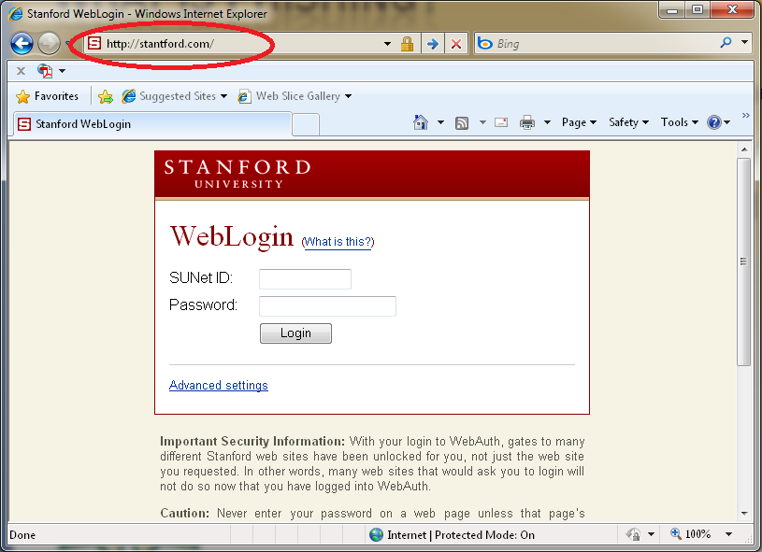
Phishing types: Web based
Notes:
I have been talking about email-based phishing, but there is another branch of the phishing con that deals in “link deception”. This is where the victims are asked to click on a link, which brings them to a web page that looks official and utilizes the symbols of authority of an institution. This is an easy way to get a victim to supply their user ID and password to the phisher.
This problem is just as large, if not larger than email-based phishing schemes and has a largely different set of preventions steps. But, my talk is mostly centered on just email-based phishing.

Slide 17
Phishing types: Email based
Dear WSU Subscriber,
This mail is to inform all our {Wayne.edu} webmail users that we will be upgrading our site to help block spam. We are also having congestion due to the anonymous registration of accounts so we are shutting down some accounts and your account is among those to be deleted.
….
To confirm your active account, you are require to send us your E-mail account details listed below, these information would be needed to verify your account and to avoid being closed;
* E-mail:
* User ID:
* Password:
* Re-type Password:
* Date of Birth:
Warning!!! Account owner that refuse to send this information after one weeks of receiving this warning will lose his/her Wayne.edu account permanently.
Notes:
Email-based phishing messages often look like this.
It warns that we (Wayne State’s IT department) are going to permanently delete our customers’ email accounts,
The threat is premised on the idea that our systems are overloaded and congested. Unless they verify their account with us by sending their login and password details, we are going to delete it.
Outside of their username and password, phishers will attempt to gather personal details from the victim, including stuff like their “date of birth” like in the message above.
Having something like a birth date is very useful for a confidence scammer, because it allows them to be perceived as someone who has some verifiable information “in their system”, which further lets the victim’s guard down.
For the victim, their birthdate would likely be used in subsequent and unrelated emails to gain even more confidence in a different context.

Slide 18
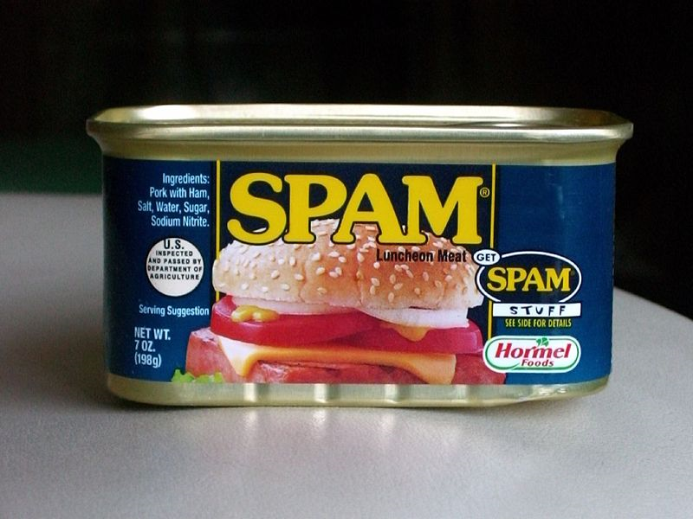
Phishing types: Email based
Phishing is Spam
  The same tools that help you filter SPAM and keep the ham, will also cut down on phishing
OR
Notes:
One, if not “the”, most important takeaways, that I will talk about today, is simple: “Phishing is spam”
Better protection from spam equals better protection from phishing.
This involves filtering for spammy content, as well as filtering the IPs of known spammers at your front door. You need to make sure to do both in order to limit the effects of phishing.

Slide 19


Email phishing
Notes:
[[Describe how email-based phishing propagates]]

Slide 20
What phishers want
Make money
  Selling personal information
  Spamming from your servers
Bragging rights
Access your SIS and HR systems
Notes:
So, what is it that phishers really want?
It comes down to two things: money and bragging rights.
The motive for money is the most powerful, but it can’t be ignored that phishers also enjoy the sense of power and control that is gained from scamming.
For the phisher, the end goal is to gather as much personal information about your students, faculty and staff as possible.
If someone at your institution send their username and password to a phisher, and that person is an employee with access to your SIS or HR systems, the phishers may try and access those systems to get a vast database of personal information about other people.

Slide 21
What phishers want
Personal information about your employees and students that will deceive your customers’ confidence in another contexts
Abuse your good reputation
  Email server reputation
  Institution’s reputation
  Leverage your authority and your symbols for their own schemes
Notes:
The information gathered from phishing message responses, are usually re-used in different contexts.
One day, a phisher may simply try to get access to your email, but that same information may be sold to other groups of hackers, who may attempt telemarketing fraud or even another email-based scam that tries to gather their bank account information.
They do so by abusing the good reputation of your institution, by sending spam from your servers, which have an established and good reputation, and are likely to be trusted by the security systems at other institutions.

Slide 22
Phishing at wayne state university
2004: ~40 accounts compromised per year prior to anti-phishing strategy and Zimbra
Largely employees to blame
  Older populations not aware of phishing
2006: WSU launched a comprehensive anti-phishing and user education strategy
5th year of anti-phishing tactics
Notes:
Since we started our anti-phishing program at Wayne State, we have seen an overall reduction in the number of compromised accounts.
In 2004, we had around 40 compromised accounts per year.
One of the most alarming trends was that over 50% of people who responded to phishing attempts were employees, even though employees only make up around 20% of our customers. This, we think is due to the fact that employees are not from the younger generation, who better understand that IT-based scams are prevalent.
In 2006, we decided to take on phishing from many different angles. This included a wide-spread user education campaign.
We are currently in our 5th year of the program.

Slide 23
Phishing at wayne state university
2008 - Implementation of Zimbra and Cisco Ironport
  Enacted wide-spread security lock downs
2009 – Antiphishing reporting at WSU and anti-phishing Zimlet introduced
2009 to 2010 – only 4 compromised email accounts, only 10% of previous years
Notes:
In 2008, we implemented Zimbra and a Cisco Ironport appliance.
In addition, we implemented increased password strength policies with minimum lengths and mandatory password changing for students and employees.
In 2009, we implemented tools to help users report phishing to us.
Currently, and in contrast to 2004, we have seen a 90% reduction in compromised accounts due to phishing.
……Now, I will talk a bit about some of the difficulties involved in preventing phishing attacks and about issues of security in general.

Slide 24
DIFFICULTIES: convenience VS. risk
Conflict between convenience and risk
  Best to keep email passwords separate from SIS system for employees
  Challenge questions for password resets: A danger
  Password life
Notes:
Protecting your institution from phishing will probably result in some level of inconvenience for your users.
In IT, there is always conflict between convenience and risk. The more you choose to align your systems with single-sign-on, your risks increase.
Since student databases are of particular interest to phishers, it makes the most sense isolate the login credentials of these systems.
Another security issue is self-service password resetting. If you do use challenge questions, to allow people to reset their own passwords, make sure that the questions are not easy ones.
Also, consider only making this feature available to students, who do not also hold the keys to student data.
In general, your customers will not make the connection between your security policies and the risks to their own personal information. They will simply trust you to both make their IT lives easy, and protect their personal information. A good system of policy will have some level of compromise on each end of that scale, which also takes into account the danger posed by each system.
Being transparent, and clearly explaining the risks, will make it easier for your customers to understand any increased inconvenience.

Slide 25
Difficulties: full email headers
Extracting email headers can be difficult for users
Necessary for reporting phishing attempts
Notes:
Another difficulty specifically related to phishing message reporting, is the difficulties involved in getting email headers to the IT department.
Email headers will usually hold the necessary clues that IT staff want to see, but and are not part of the regular email envelope that your customer sees in an email. This information includes the sending address, and the path that the email message took on its way to your institution.
The information gathered from the headers may help you to block further attempts or to warn the sending institution that one of their accounts has been hacked.
There are plenty of web pages out there that explain how to gather headers in different email programs, however, this is one area that we have been able to apply a technical solution for that makes it easy for our customers.

Slide 26
Difficulties: revolving populations
Revolving populations make EDUs good targets for phishing.
  Need to train students
  quickly
  New student orientation
  Literature
Notes:
The fact that around 25% of our population is new every year, both makes our job of phishing prevention harder, and that of other higher-ed institutions very difficult.
Revolving populations are also one reason why higher-ed institutions are frequent targets of phishing attacks. The attackers know that they can count on a large number of “freshman” coming in every year, who have not been brainwashed by the IT department.
This makes it all the more important to train your students quickly about IT security.
WSU passes out “Invasion of the Password Snatchers” bookmarks and we have a IT representative talk to all incoming freshman about IT security. During orientation, and in front of the entire incoming student body, the speakers repeat the phrase “We will never ask you for your password”.
This phrase has become well known at WSU.
Some english professors even have it as a quote in their email signature.

Slide 27
Solutions: Holistic approach to security
Spam protection
User education (awareness)
Reporting tools
The “no” rules “No asking for passwords”
Information sharing between account admins and network security departments
Notes:
Now to the solutions part of this talk.
There are lots of different ways to reduce phishing, and I have mentioned many of these already.
However, I’ll go through them one-by-one here.

Slide 28

Solutions: awareness
Messages about computer security should be pervasive
Make computer security part of the IT experience
Offer online computer security courses
Notes:
First of all, awareness or if you prefer, “user education”, about IT security is increasingly important.
We frequently email our users about the important of computer security and invite them to take self-paced courses in Blackboard regarding IT security. Many of these email use the phrase I mentioned earlier “We will never you ask for you password”
IT security should be part of the overall IT experience.

Slide 29
Solutions: phishing reporting tools
Advertise your phishing reporting tools
Simply the existence of a reporting tool increases awareness, regardless of how your IT department uses the information gathered
Notes:
Make a phishing reporting tool, and advertise it.
The information from these tools will be useful to your IT staff to help block the flow of messages, however, we have found that the most important benefit of the phishing reporting tool is simply its existence.
An example here will hopefully better explain what I mean:
Let’s say that you give a technology nut an iPhone who has never used one before… Sure, it does have some uses beyond being a simple phone, but give them about hour, and before you know it, they can tell you exactly what each little application does, and they will also be able to tell you exactly why each application has completely revolutionized their lives.
So, just like the YouTube app on the iPhone, which has the side-effect of helping people to better understand YouTube. A phishing reporting tool will help your customers better understand phishing. This new understanding is proactive, as opposed to reactive (like the actions that can be taken from phishing report itself)…. And anything proactive that can help reduce phishing is a major achievement.

Slide 30
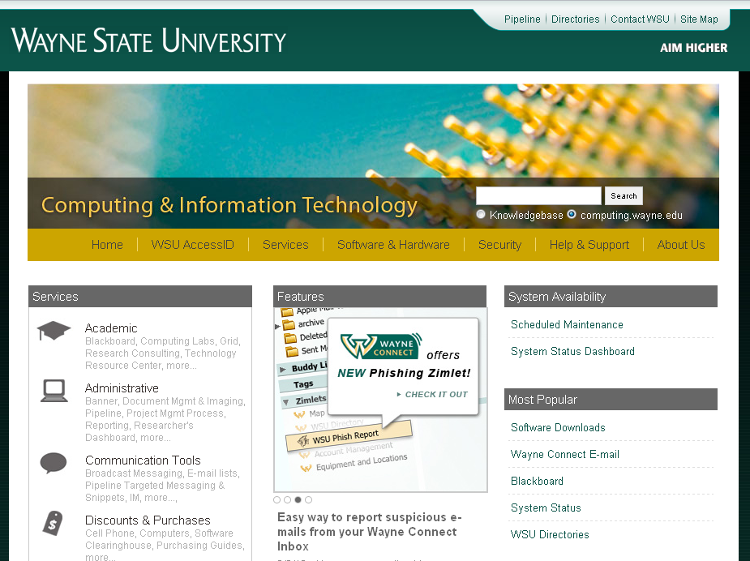
Solutions: phishing reporting tools
Notes:
This is an example of how we featured our reporting tool, on our main computing web page.

Slide 31
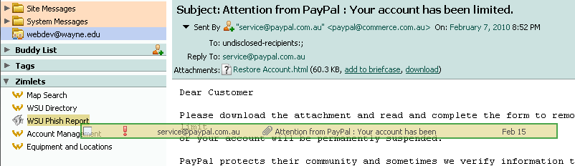
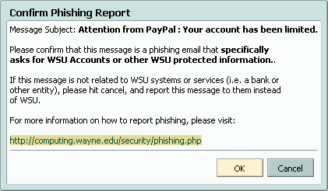
Solutions: Phishing zimlet
Notes:
In Zimbra, our phishing Zimlet is easy to use. You simply drag a phishing email ontop of the “WSU Phish Report” icon, and it lets you submit the report.

Slide 32
Solutions: Phishing zimlet
Allows account admins to take immediate action and prepare for potential threats
Provides full header information without the user needing to understand what full headers are
Notes:
The result is a that a ticket is creating in our ticketing system and the customer is sent a receipt of the report.
Full header information is gathered for the message, without the customer needing to know what full headers are.

Slide 33


Solutions: spam protection
Multiple layers of spam protection
  Cisco Ironport
  Zimbra’s built-in spam protection
Notes:
The more spam protection that you can implement the better. At WSU, we use multiple layers of spam defense, and even do outbound spam protection.
For our inbound spam protection, the first layer of defense is the Cisco Ironport, then the messages are delivered to our Zimbra implementation, where they are filtered again. The end result is that approximately 92% of all email that hits our front door are filtered as spam with near 100% accuracy.
This is of course popular with most people, as nobody likes to receive spam. However, there are some critics who don’t like their email filtered to such a level and make very vocal complaints about any false positives.
Spam is in the eye of the beholder or another way of saying that is that one man’s spam is another man’s ham.
This is one of the reasons why we let users configure their own whitelisting and blacklisting on the IronPort, as well as quarantine questionable spam and deliver it in a single digest formatted message to their inbox daily, so that they have better control over their own email delivery.

Slide 34
Solutions: no asking for passwords
Adopt a strict policy: Never ask for passwords at your helpdesk or anywhere else
Communicate this policy. Tell your students, faculty and staff directly “We will never ask for your password!”
Repeat it as often as possible
Notes:
This section is what I call the “no” rules..
It is important to adopt policies and communications that eliminate the use of passwords in written or verbal conversation.
The first “no” rule is to never ask for passwords in email or otherwise. It is amazing how much I still see or hear of this practice in the IT profession.
Use a phrase like “We will never ask for your password”, and repeat it as often as possible.
Most importantly, practice what you preach.

Slide 35
Solutions: no speaking passwords
Adopt a policy: Never say/spell a password
For password resets, use semi-secret shared information like: “It is now set to your student ID, please change it right now, while I’m on the phone.”
Notes:
Avoid ever speaking a password over the phone. This includes when your helpdesk does password resets.
As opposed to saying the password after a reset, use a shared secret that both you and your customer know, and request that your customer changes their password to something that only they know while they still on the phone.
This would sound something like: “It is now set to your student ID, please change it right now, while I’m on the phone”.

Slide 36
Solutions: all these “no” rules!
Encourages an environment where passwords never leave the brain.
  Communicating passwords, in any way, should feel uneasy, awkward and just wrong
  Fosters a healthy suspicion of anyone who asks for passwords or wants to communicate actual password information
Notes:
These no rules are all to encourage an IT culture, where passwords never leave the brain.
Your helpdesk staff, other IT employees and your customers should all feel very uneasy about passwords leaving their brain. It should feel awkward or wrong to communicate a password, and the IT staff at your institution are central to creating this culture.

Slide 37
Solutions: internal fishing
Phishing your own population (controversial)
Never implemented, but sparked interesting debate
  Morality and the “no” rules
  Highlights the effectiveness of phishing
Likely would have been very effective
Notes:
One of the more interesting debates that happened while we were constructing our anti-phishing program, regarded the idea of doing “internal phishing”. I had read that some companies were doing this, and it immediately struck me as a stroke of genius.
The idea goes like this.. “Find the people in your organization who are likely to volunteer their logins, before the con men do, then school them.”
Yeah, we never implemented that one.
In this plan, we would have periodically constructed a convincing email that looked as official as possible. In this email we would ask everyone at WSU for their username and password, just like the real phishing emails.
Then we would wait for responses. When we receive a response, either congratulate them, if the person sent an inflammatory “go to hell” type of response, or… try to educate those people who respond with actual passwords, about the danger they just posed to their own personal information.
Everyone on our anti-phishing team struck down the idea as being just-plain-wrong, and in violation of our own rule “We will never ask you for your password”. This was of course, except for myself, who’s moral foundation had obviously been eroded by the constant battle against phishing threats.
Regardless, it’s an interesting paradox to have, when perhaps the most effective way to proactively prevent phishing, is to phish yourself.

Slide 38
Solutions: network security email
Ensure that your account admins are subscribed to you network security lists, and are allowed to be first responders to:
  Spamcop
  External complaints
Suspending compromised accounts quickly is key to minimizing risk
Notes:
Usually reports of phishing from a compromised account will first be found via reports from spamcop and other organizations that work at blacklisting and reporting spam.
These reports are likely to include full header information, and getting this information to the hands of IT administrators who have access to suspend the users accounts is critical to safeguarding information.
Making sure that email admins are on the network security email list, which is often called abuse@____.edu, is also key.
For a long time at WSU, this list was the sole domain of our “security department”. The expansion of this abuse list, to include email admins, has greatly decrease the time it takes for our email and accounts admins to respond to threats and to suspend accounts.

Slide 39
Solutions: summary
Notes:
I figured, no powerpoint is complete without a pie chart, so here it is.
Here is an approximation of what I feel the effectiveness of the different anti-phishing strategies as a part of the whole are, have been in the prevention of phishing at WSU.
[[describe each pie slice]]

Slide 40
resources
Phishing: Cutting the Identity Theft Line (2005)
Scams and Swindles (2006)
The Art of Deception by Kevin Mitnick (2002)
The Art of Intrusion by Kevin Mitnick (2005)
Anti-Phishing Working Group: http://www.antiphishing.org/
Notes:
Here are some good resources.
A great one is the Anti-Phishing Working group or (APWG) for short.
Their website has tons of information regarding phishing, and has a tool to report phishing to them, so that they can track the effect of phishing on the IT industry as a whole.

Slide 41
Contact and Zimlet download
Phising List: nophish@lists.wayne.edu
Zimlet Download:
Contact Info:
  rob@wayne.edu
  http://wayne.edu/....
Notes:
Also, I’ve started a list for EDUs to share information regarding phishing attempts and tactics that are currently used to both combat phishing as well as tactics that are being used by phishers. If you are interested in joining the list, please send a subscribe email to the list…
The code to the Zimlet is available here. It has some specific ties to our ticketing system, but your IT teams should be able to adapt it fairly easily to post the email and the email headers to any system you choose.
Also, here is my contact information. Please feel free to contact me at any time to discuss anything in this talk.

Slide 42
Questions?

