Slide 1
Flexible Lecture Capture
Eric Coffman
West Virginia University Health Sciences Center
Rich Boys
TechSmith

Slide 2
Agenda
Camtasia Relay Overview
Integrating Camtasia Relay
Camtasia Relay 2.0

Slide 3
Who is TechSmith?

Slide 4
Design Goals
Easy to use
Flexible
Affordable

Slide 5
Success Factors
Presenter
Simple
Reliable
IT Administrators
Low support
Administration
Adoption

Slide 6
Enable the Conversation
Lecture Capture
Learning Objects
Training
Student Submissions or Assignments
Impromptu videos
Faculty Presentations
Flipped or Hybrid Courses

Slide 7
The Camtasia Relay Process

Slide 8
Camtasia Relay Recording

Slide 9
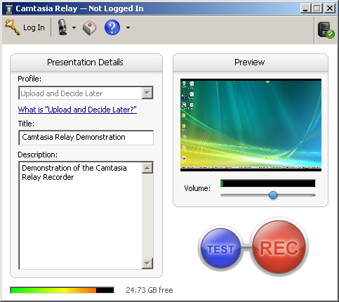
Camtasia Relay Recorder

Slide 10
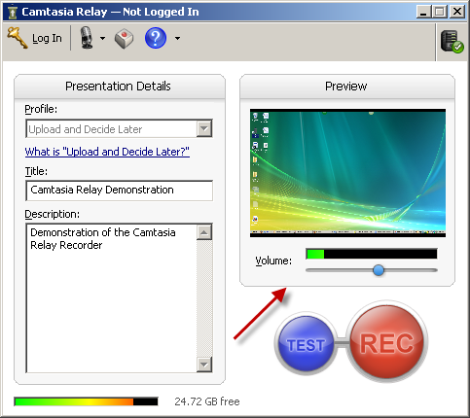
Adjust Volume

Slide 11
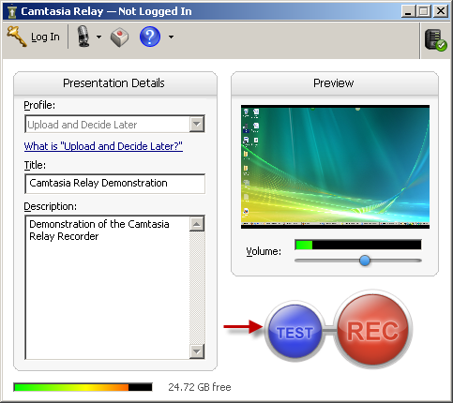
Make a Test Recording

Slide 12
Start Recording

Slide 13
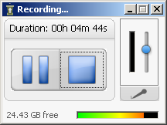
During the Recording

Slide 14
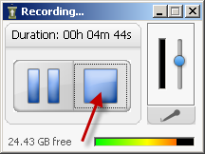
Stopping the Recording

Slide 15
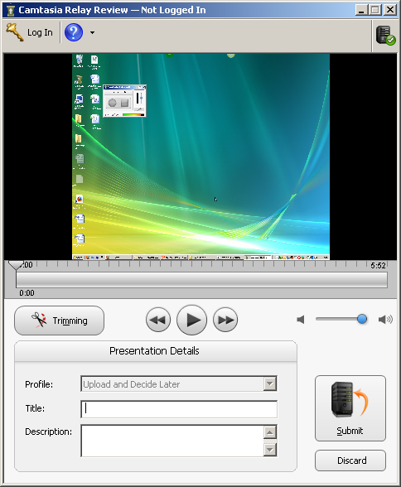
Review & Trim

Slide 16
Submit the Recording

Slide 17
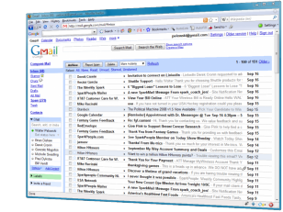
The Simplicity
Record
Submit
Use

Slide 18
Camtasia Relay Server

Slide 19
Camtasia Relay Server
Windows Server
Receives recordings from clients over HTTP/HTTPs
Converts recordings into popular industry standard media formats – MP4, WMV, Flash, MP3, etc
Publishes media files to your media servers
LDAP integration

Slide 20
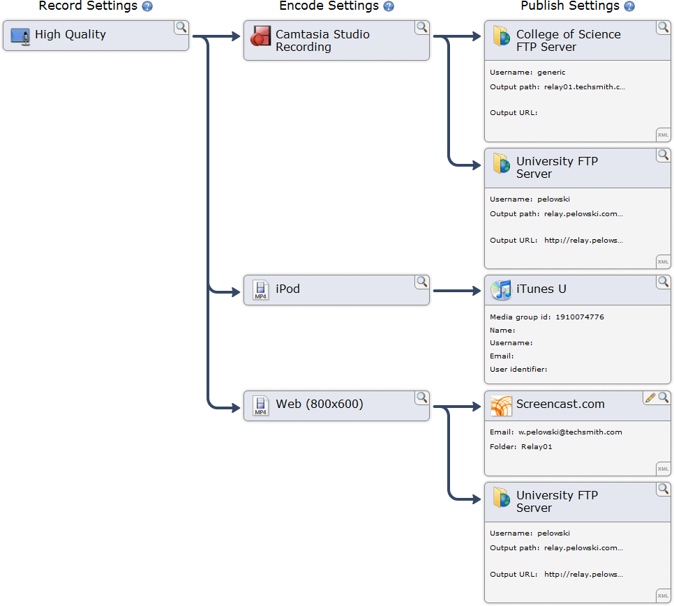
Profiles

Slide 21
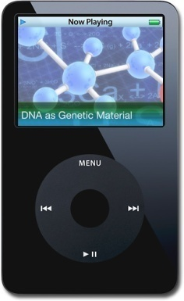
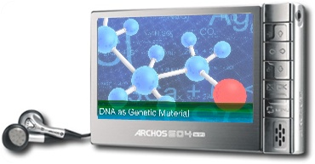
Media Types

Slide 22
Camtasia Relay Publishing

Slide 23
Your Media Server

Slide 24
Licensing
Camtasia Relay is licensed by server. There is no limit to the number of recorders used.

Slide 25
License Pricing
Simultaneous Encodings | Price
1 | $ 7,995
2-3 | $ 15,995
4-7 | $ 23,995
Simultaneous Encodings | Education Price
1 | $ 4,995
2-3 | $ 9,995
4-7 | $ 14,995
Servers can also be “teamed” together to provide more output.
3 encoding server + 7 encoding server = 10 simultaneous encodings.

Slide 26
Integrating Camtasia Relay

Slide 27
Why is lecture capture important
“In a 2008 survey of students at the University of Wisconsin-Madison, 82 percent of undergraduate respondents said they preferred courses with online lecture content, and 60 percent said they would even be willing to pay for lecture capture services.”
Campus Technology – February 2010

Slide 28
Who we are
30k student campus
Health Sciences Center is 4 of the 13 colleges on campus
~50% of University’s faculty
Laptop program and Technology Rooms

Slide 29
How did we get here
Windows Media
Impatica
Audio recorders
Camtasia Studio

Slide 30
Using Camtasia Studio
Incredible student response
Very time consuming for daily lecture capture
1.25 hours of post production work per hour of lecture
The impact capturing only 10 courses
The need for something more scalable

Slide 31
Evaluating Lecture Capture Solutions
Echo 360
CourseCast
Tegrity
Relay
MediaSite

Slide 32
Key Requirements
Ease of starting and stopping recordings
Manageable long term storage
Allow LMS integration
Handle the challenges of multi instructor courses
Avoiding vendor lock in
Student friendly
FAST turnaround
Low Overall Cost
Did we want/need scheduled recordings?

Slide 33
Scheduled vs. On Demand Recordings
Scheduled (Echo360)
Potential for zero instructor involvement
What if lecture runs over or starts late? (dead air)
Who will actually schedule the recordings (potential for error)
On Demand (Relay)
Requires instructor involvement
Start recording when the lecture starts, end when the lecture has concluded
Ability to pause recording during interruptions (fire alarm, etc)

Slide 34
Choosing Camtasia Relay
Ease of starting and stopping recordings
Manageable long term storage
Allow LMS integration
XML descriptor files make integration very simple
Handle the challenges of multi instructor courses
Avoiding vendor lock in
Student friendly
FAST turnaround
Low Overall Cost
Ease of starting and stopping recordings
As simple as it gets for recording lectures
Manageable long term storage
Allow LMS integration
Handle the challenges of multi instructor courses
Avoiding vendor lock in
Student friendly
FAST turnaround
Low Overall Cost
Ease of starting and stopping recordings
Manageable long term storage
Content resides with the LMS content.
Allow LMS integration
Handle the challenges of multi instructor courses
Avoiding vendor lock in
Student friendly
FAST turnaround
Low Overall Cost
Ease of starting and stopping recordings
Manageable long term storage
Allow LMS integration
Handle the challenges of multi instructor courses
Profiles and accounts make this possible
Avoiding vendor lock in
Student friendly
FAST turnaround
Low Overall Cost
Ease of starting and stopping recordings
Manageable long term storage
Allow LMS integration
Handle the challenges of multi instructor courses
Avoiding vendor lock in
Output is standard MP3 and MP4 files
Student friendly
FAST turnaround
Low Overall Cost
Ease of starting and stopping recordings
Manageable long term storage
Allow LMS integration
Handle the challenges of multi instructor courses
Avoiding vendor lock in
Student friendly
Standard files, iPod compatible, one website for all content
FAST turnaround
Low Overall Cost
Ease of starting and stopping recordings
Manageable long term storage
Allow LMS integration
Handle the challenges of multi instructor courses
Avoiding vendor lock in
Student friendly
FAST turnaround
10 minutes per hour of recording
Low Overall Cost
Ease of starting and stopping recordings
Manageable long term storage
Allow LMS integration
Handle the challenges of multi instructor courses
Avoiding vendor lock in
Student friendly
FAST turnaround
Low Overall Cost
Favorable in comparison to other solutions
That was easy!

Slide 35
Custom LMS
SOLE (Secure OnLine Environment)
Portal/LMS hybrid
10 years of development
13,000 users
650+ courses
250+ sites
Other integrated applications (Helpdesk, Directory, etc)
25,000,000 page views per semester
“Multiformat” lectures
Integrated Curriculum

Slide 36
SOLE Homepage

Slide 37
Today’s Content

Slide 38
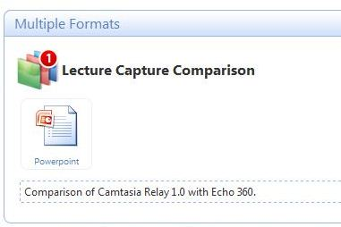
Inside a Course

Slide 39
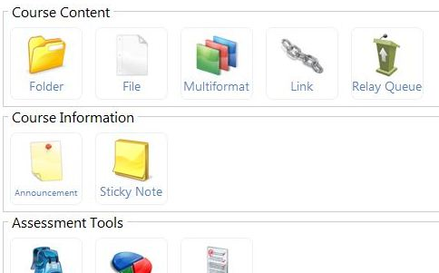
Relay Queue

Slide 40
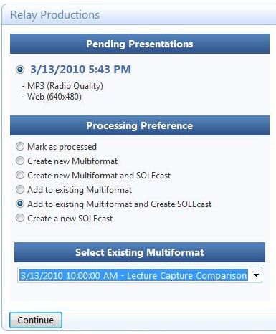
Processing the Queue

Slide 41
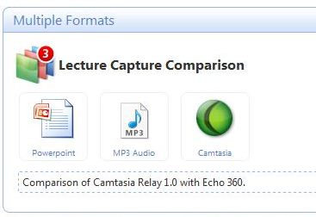
Completed Lecture

Slide 42
Current Screens

Slide 43
Current Screens

Slide 44
Overall Usage Statistics

Slide 45
Lecture Statistics

Slide 46
Real world space usage
 | Relay
1 hour of content (MP3 and MP4) | 130 MB
1 Semester, 1 Course (51 lectures) | 6.5 GB
1 hour of content (original recording) | 600 MB
1 Semester, 1 Course (original recording) | 30 GB

Slide 47
Current Deployment
51 courses
48 rooms in the HSC
20+ hours of lectures recorded per day
Regional Campuses
Professors Abroad
HSC
SOM
SON
SOP
Regional Campuses
Professors abroad
SOD

Slide 48
Relay – Advantages / Disadvantages
Advantages
Widely available to courses due to free recording client and simplicity
Produced content resides with course simplifying file retention policy
Media compatible with iPods for offline viewing
Minimal IT support required
Low cost for hardware and licensing
Minimal effort to set up a new course
Zero IT support required per lecture (unless there is editing needed)
Disadvantages
Requires instructor involvement
Output not as rich as some other systems
Search capabilities are limited (as of 1.2)
After initial submission editing must be done by IT

Slide 49
Relay 2.0
Coming soon

Slide 50
Relay 2.0 Features
Recorder Updates
Silverlight Output Format
Searchable media (Flash and Silverlight)
New Profile Management
Improved Notification

Slide 51
Relay 2.0 Recorder
Improved User Interface
Audio at a Glance
Updated persistent recorder interface
Display selection

Slide 52
Silverlight Media
Table of Contents
Searchable content
Thumbnails

Slide 53
Searchable Media
Flash and Silverlight formats
Slide content
Windows PowerPoint
Mac PowerPoint and Keynote
Full Audio Search
Slide content improves accuracy
Search data in XML file

Slide 54
New Profiles
Support for variables
More separated process
Easier to create base profile and copy
Assign formats to destinations
Output URL separated from file path

Slide 55
Improved Notification
Support for Moodle
Notification options
Single roll up notification
Support for multiple addresses
Variable support
Customizable

Slide 56
Relay 2.0 Updates
Dashboard
Thumbnails
Support for Multiple LMS systems
Improved LDAP Support
Windows 2008 R2 Support
Microsoft SQL Server 2008 Support

Slide 57
Questions / / Comments

Slide 58
Contact Information
Eric Coffman
Network Manager
ecoffman@hsc.wvu.edu
West Virginia University Health Sciences Center
Rich Boys
Camtasia Relay Product Manager
r.boys@techsmith.com
517.381.2238
Trial Request: http://www.techsmith.com/camtasiarelay/try

