Slide 1
Opportunities Found: Turning Digital Signage into an Enterprise IT Service
Thomas Kunka
University of Illinois

Slide 2
Digital Signage an Opportunity Found?
Notes:
When we think of campus IT services, digital signage isn’t one of the first that comes to mind. In fact, it is unlikely that digital signage would find its way onto anyone’s top 10 or top 20 lists. Digital signage may not even be on the radar of most IT organizations.
However, digital signs have been appearing on our campuses for some time now. Typically have been the result of one-off projects. Perhaps a construction of a new campus building or a renovation project. These projects a focus on local needs rather than a larger picture.
Industry hasn’t helped us either. The solutions and integrators that are hired to implement them originate from the AV industry and have been designed to fit the needs of specific vertical markets and not the needs of higher education. We of all people know that many of the typical models used in the so-called “real world” break when they reach our “ivory towers.”
This has led to the purchase of duplicate and usually incompatible solutions. A failure to leverage volume hardware and software purchases. A failure to integrate these systems with other types of services. And a failure to live up to their potential as a tool for communication.
So what do we do about these issues? Albert Einstein said that the definition of insanity was doing the same things and expecting different results. We needed to do something different. We needed to change the rules. We needed to turn digital signage into a commodity rather than a specialty….we needed to turn digital signage into an IT service.

Slide 3
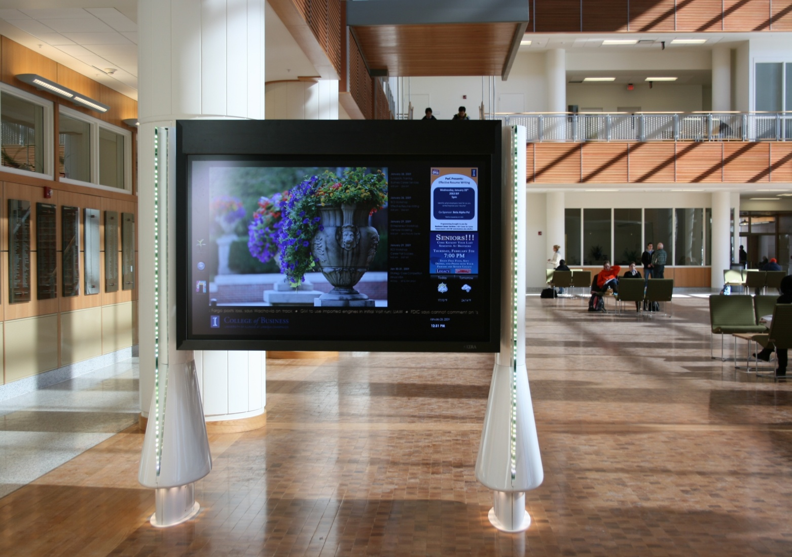
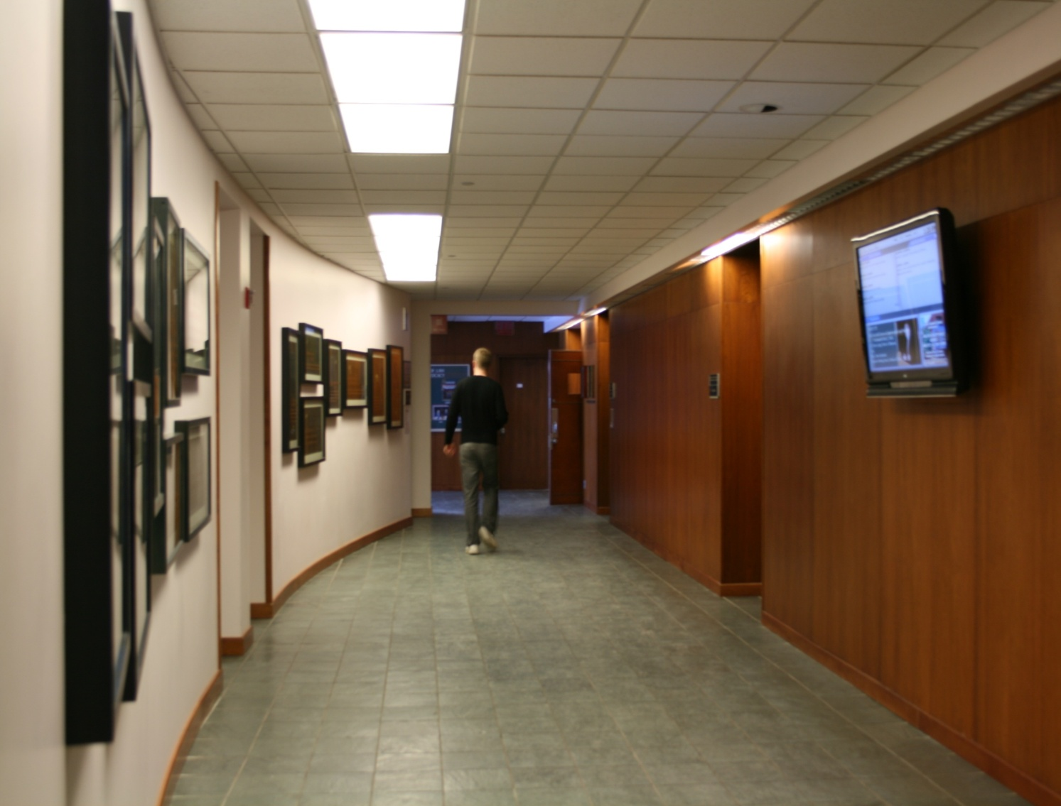
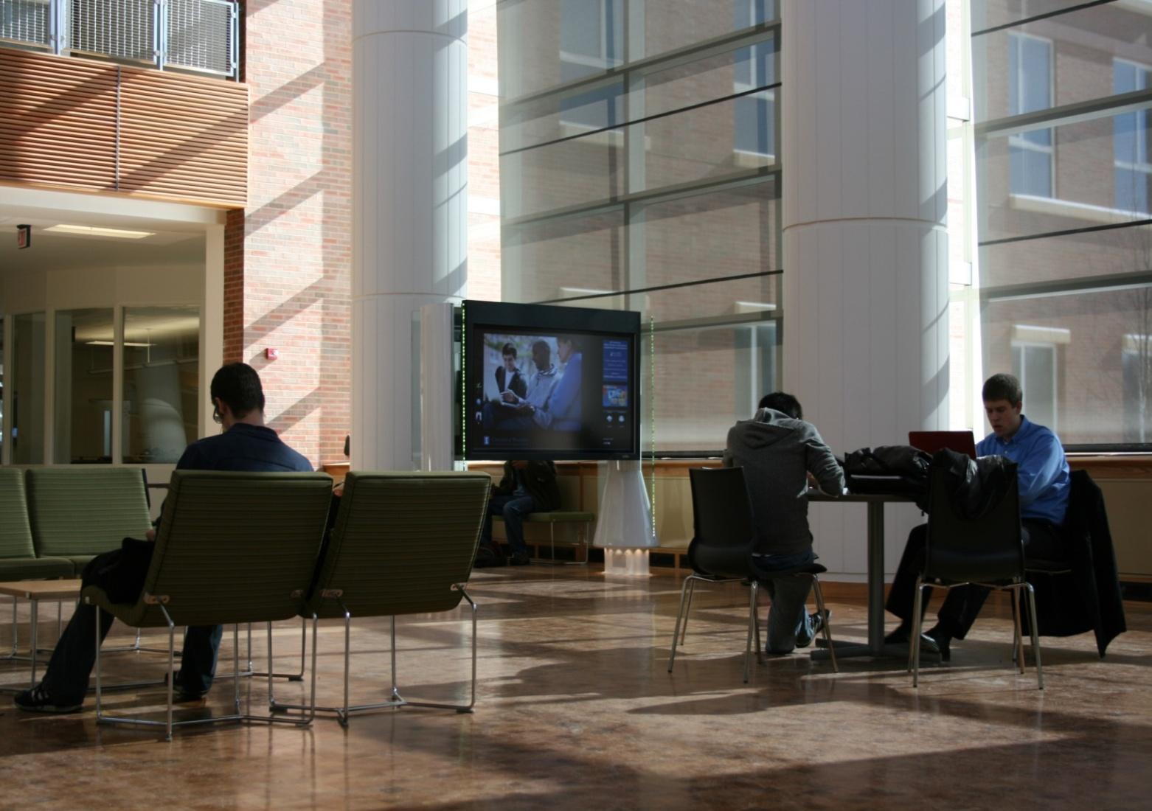
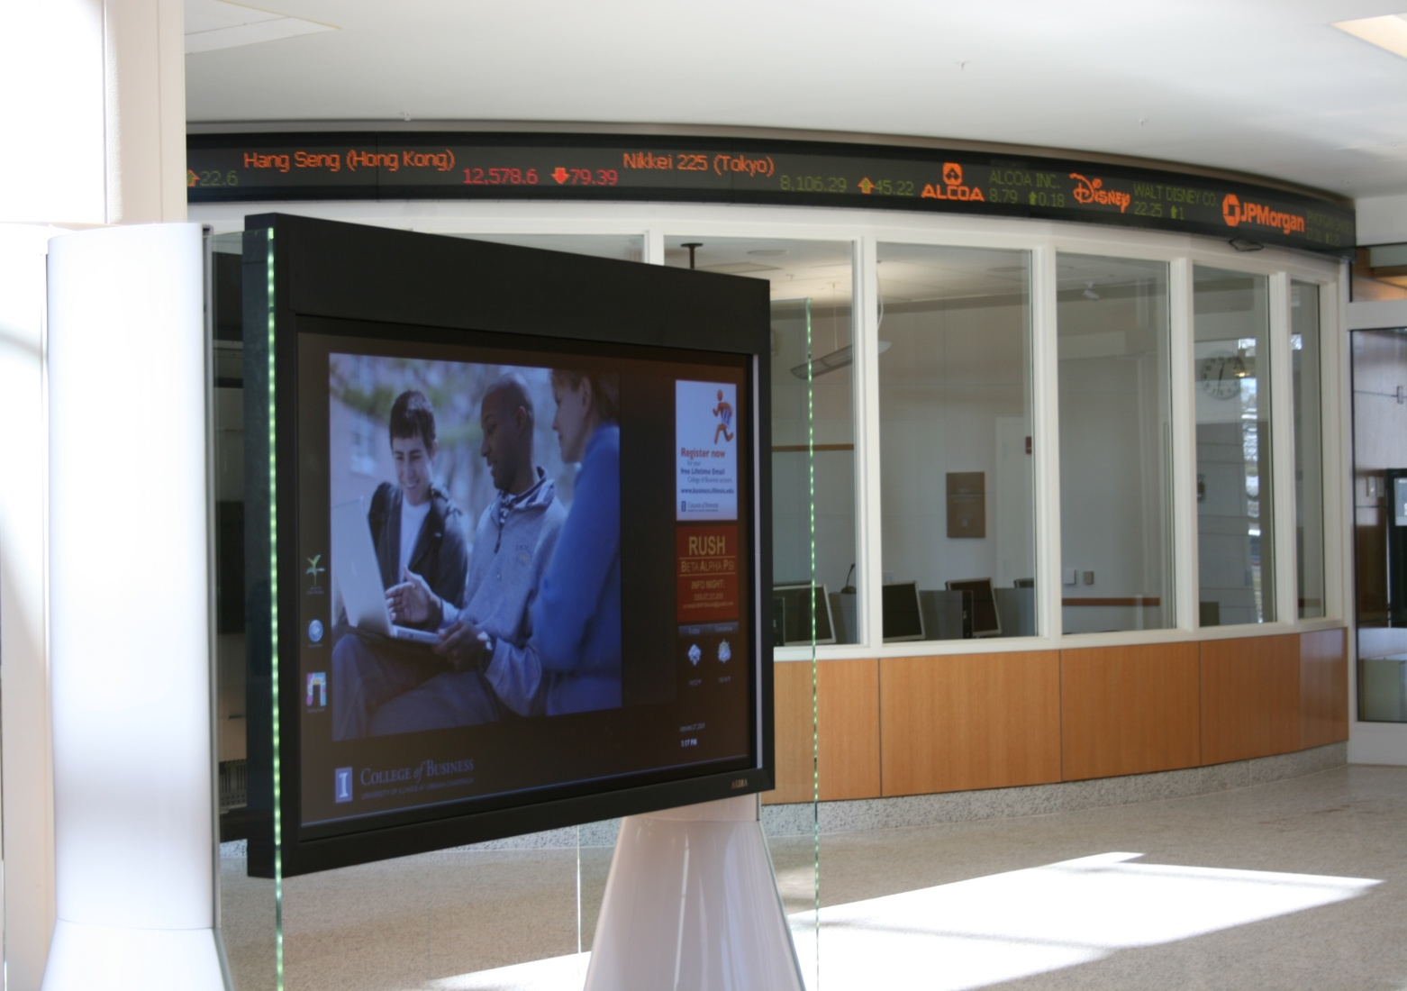
The Case?
Business Instructional Facility
Law Building
Business Instructional Facility
Marketing Information Lab
Interactive Content
Notes:
But first, a step backwards. We needed to ask ourselves, is this worth doing? Yes, we could save money by reducing duplicate purchases, leveraging hardware purchasing agreements and even consolidating support developing standards. But even so, it is always worth asking the fundamental questions.
The first questions people ask me pertain, not to the technology itself, but rather, “What’s your business case?” “With the financial situation what it is, how can we justify this expense?” “Is there any value in this activity at all let alone trying to make it into a campus service?”
These are the sort of questions that can keep us awake at night, that can make us doubt ourselves, that can cause us to pull into our shells and choose to be conservative, to choose not to take the lead because it is the easy road. These are also the questions that can help us gain perspective and understanding of what we need to do, how to shape it and the resolve to do it.
The simple fact is that my group, Network Services, a part of “central” IT really has no business case for deploying digital signage of our own. The simple fact is that our ‘customers’ is essentially the entire campus community. They are found at the ends of every campus network jack and wireless connection. Most of them will never frequent the atrium of the Digital Computer Lab. We are not connected to these people through physical space. We have no context.
The key is actually in the many departments that could benefit from digital signage.
The student union that deploys interactive digital signage to help guide visitors to its many events, shops, and restaurants.
The conference center that
The department that uses its large video wall to not only entertain and inform but as a tool to capture the imagination of potential students and faculty.

Slide 4
End to End Signage Service
AV Design & Installation
Common Platform
Easy to use
Powerful & Flexible
Cost Effective
Support & Management
Cost Recovery
Notes:
Illinois Digital Signage service is a coordinated approach to digital signage at University of Illinois. This service assists colleges, departments and auxiliary units in enhancing the Illinois experience through the delivery of real-time electronic communications and applications to students, faculty, staff, and visitors in campus public spaces.
This service is still evolving as we bring things together but

Slide 5
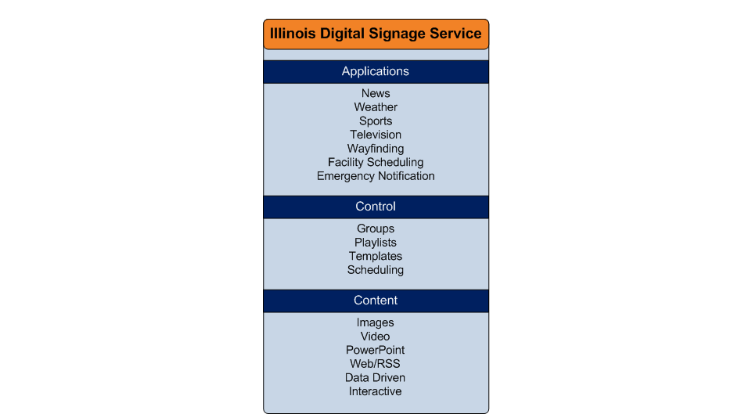
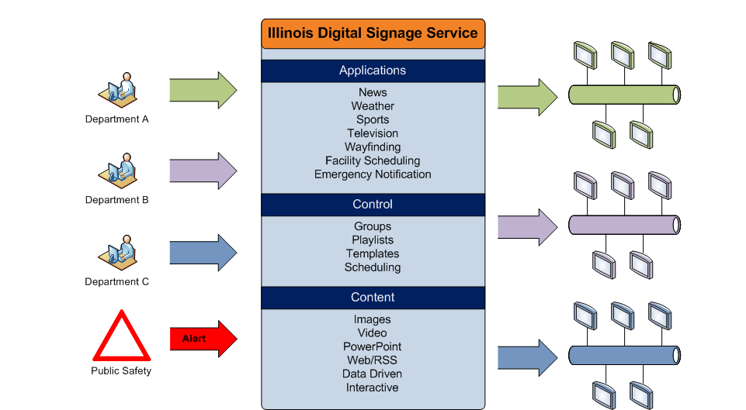
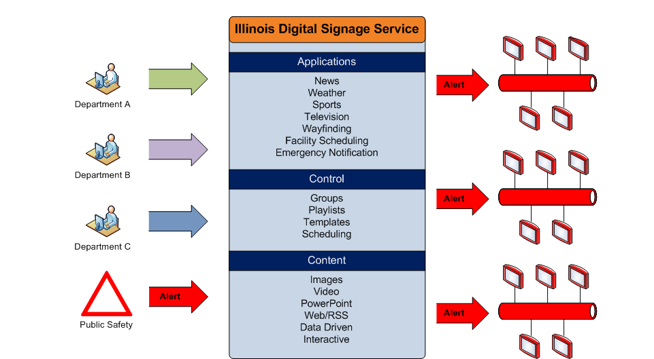
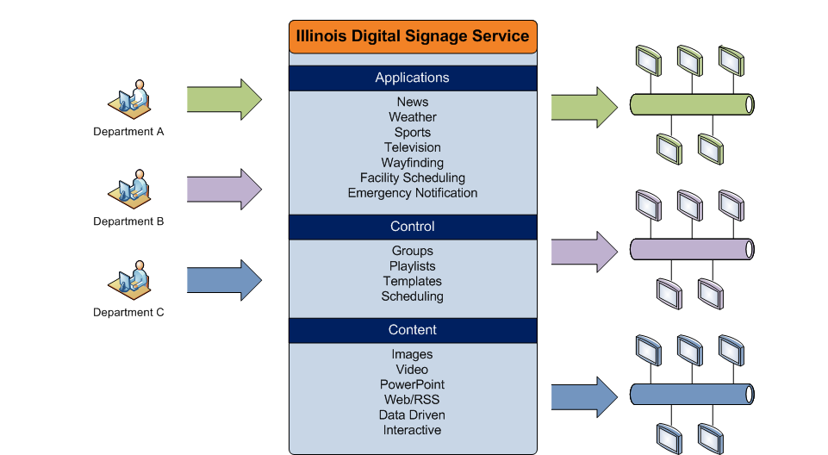
Local Focus – Central Ties
Notes:
Departments in full control of content.
Can be taken over by Public Safety.
Service provides:
Affordability
Reliability
Maintainability
Integration
Standardization
Collaboration

Slide 6
A Campus Partnership
Beckman Institute for Advanced Science and Technology
Campus Information Technologies and Educational Services*
Campus Recreation
College of Business
College of Law
College of Veterinary Medicine*
College of ACES*
College of Education*
Department of Computer Science*
Illinois Conference Center & IHotel
Illini Union*
Institute for Genomic Biology*
University Housing*
~70
* Units that have not deployed signage yet or will be deploying more.
Notes:
To date, we have 12 campus units involved with this service. These 12 units are as unique as you might expect and their use of digital signage reflects that. Each unit has their own business case. Each unit has their own needs. From small
Regardless, the same software is being used by all these groups with the same basic hardware underneath. They are becoming a part of a campus-level service that not only meets their local needs but we hope will become a platform for enhancing the campus community. People often chuckle when I say things like this. My idealism showing through I suppose.

Slide 7
A Work in Progress
Standardizing Equipment
Vetting Cost Model
Defining Processes
Planning Upgrades
Integrating Localized Deployments
Content Sharing
Communicating With Campus

Slide 8
What are YOUR Opportunities?
Notes:
With or without us, digital signage will continue to gain adoption on our campuses. It will fly under the radar as a paragraph in the audiovisual section of the programming document for a new building under construction; the TVs we watch while on the treadmill or in the waiting room of our campus healthcare facility while waiting to get our annual flu-shots. It will be the interactive guide that campus visitors use to guide their way through a campus that continued to grow and morph over the course of nearly 150 years. It will be the research project featured on a video building that captures the imagination of a brilliant high-school senior during a campus visit. It will the
Regardless of having entered the information age, how pervasive mobile computing becomes or ??????????????????? , we are inhabitants of the physical world. We live and work in our campus spaces. Digital signage can contribute to that goal through the individual and collaborative efforts of colleges, departments and auxiliary units. It is projects such as this, where we can provide the foundation for these efforts to occur, lowering costs, increasing opportunities is where IT can provide leadership. These problems are not ours, but by solving them, we put ourselves in a position to find opportunities, sometimes where they are least expected.

