Slide 1
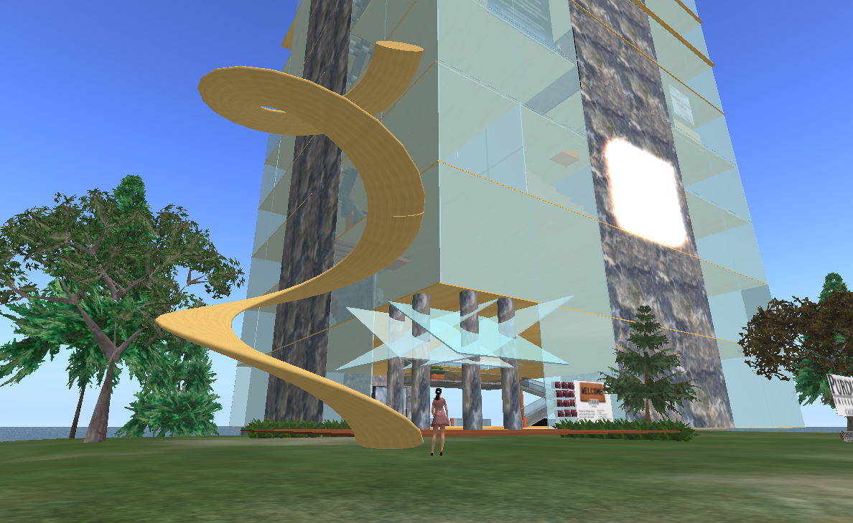
Creating and Assessing Learning Within Virtual Worlds
Anastasia Trekles
Clinical Asst. Professor
Helen Jancich
Clinical Assoc. Professor
Purdue University Calumet
Hammond, IN, USA
Copyright A. Trekles & H. Jancich, 2010. This work is the intellectual property of the author. Permission is granted for this material to be shared for non-commercial, educational purposes, provided that this copyright statement appears on the reproduced materials and notice is given that the copying is by permission of the author. To disseminate otherwise or to republish requires written permission from the author.

Slide 2
What is a Virtual World?
A 3D online environment allowing users to chat, share multimedia, and participate in virtual activities through the use of an “avatar”, or a digital representation of oneself
Avatars can mimic what the user actually looks like, but also can act as an reflection of one’s personality, lifestyle, or interests
Virtual worlds contain everything from vast re-creations of actual places to fantastical sites ripe for exploration
Each features their own in-world dynamics and culture

Slide 3
Virtual Worlds Taxonomy
Virtual worlds available for educational use include:
Second Life: http://www.secondlife.com
Active Worlds: http://www.activeworlds.com
Cobalt: http://www.duke.edu/~julian/Cobalt/Home.html
Project Wonderland: https://lg3d-wonderland.dev.java.net
Digital Spaces: http://www.digitalspaces.net
Blue Mars: http://www.bluemars.com
JumpStart: http://www.jumpstart.com
Teen Second Life: http://teen.secondlife.com

Slide 4
What Makes a Good Activity to Use with Virtual Worlds?
Interactive
Collaborative
Exploratory
Integrated
Learner-centered
Fun!

Slide 5
Virtual World Challenges
Learning curve: some users initially find navigating virtual worlds confusing and difficult
Privacy: most areas are open to anyone – and we mean anyone – so students should be advised to explore with caution
Technical issues: hardware, Internet bandwidth, and software requirements may present barriers to entry
Economic issues: some items and services cost money, although general membership is usually free

Slide 6
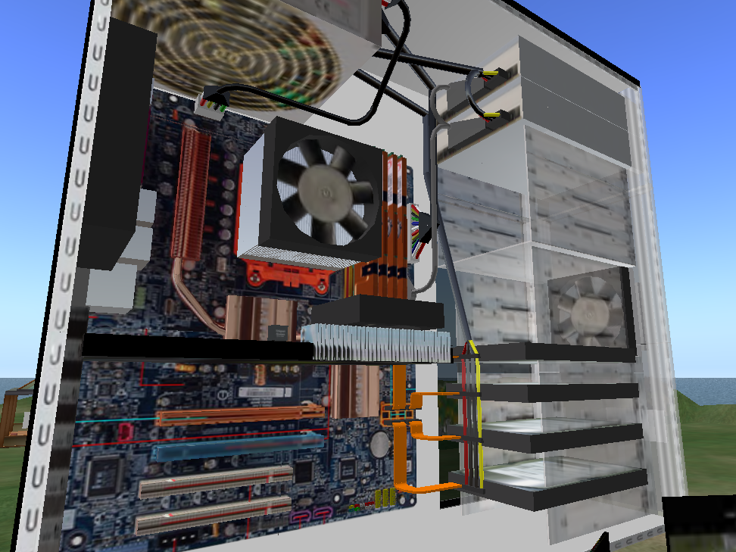
Computer Science
Students must create a build or script that meets a need or fulfills a purpose
Provides opportunities for modeling, simulation, experience, or design beyond the physical limitations of the real world
For experiential learning, they could do this with a client
Examples:
Computer Graphics students work with a School of Nursing to develop a virtual world simulation
Computer Programming students develop a learning object or activity to assist in learning of content

Slide 7
Build/Scripting Project Rubric
Is the object/build interactive and work as expected when used?
Is the build easily navigable by users?
Is the build aesthetically interesting or engaging?
Does the object/build benefit learning in a way that another, more traditional medium could not?
Does the object/build achieve the objectives set forth by the client or assignment?

Slide 8
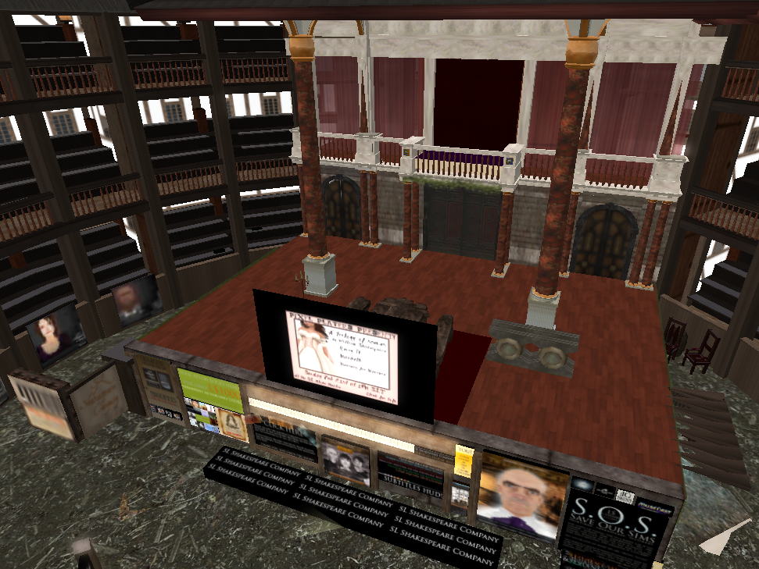
English and Languages
Students must be able to define, describe, and analyze subjects in literature and composition study
Virtual worlds can provide opportunities for reading and writing practice as well as a forum for discussion
Examples:
Live literature reading and discussion sessions can be held for a wide and diverse audience
Students in language classes can engage virtual world residents from all parts of the world to practice conversational grammar and vocabulary
Peer review student writing or presentations can be conducted live at a distance
Students can recreate scenes from literature through machinima

Slide 9
Virtual Presentation Rubric
Are the visual aides/multimedia provided directly relevant to the topic?
Are the notecards well-written and free of errors?
Are images and media clear and easy to access?
Do visual aides and text respect copyright?
Does the presentation involve and elicit participation from the audience?
Is the presentation likely to increase understanding of the work or topic?

Slide 10
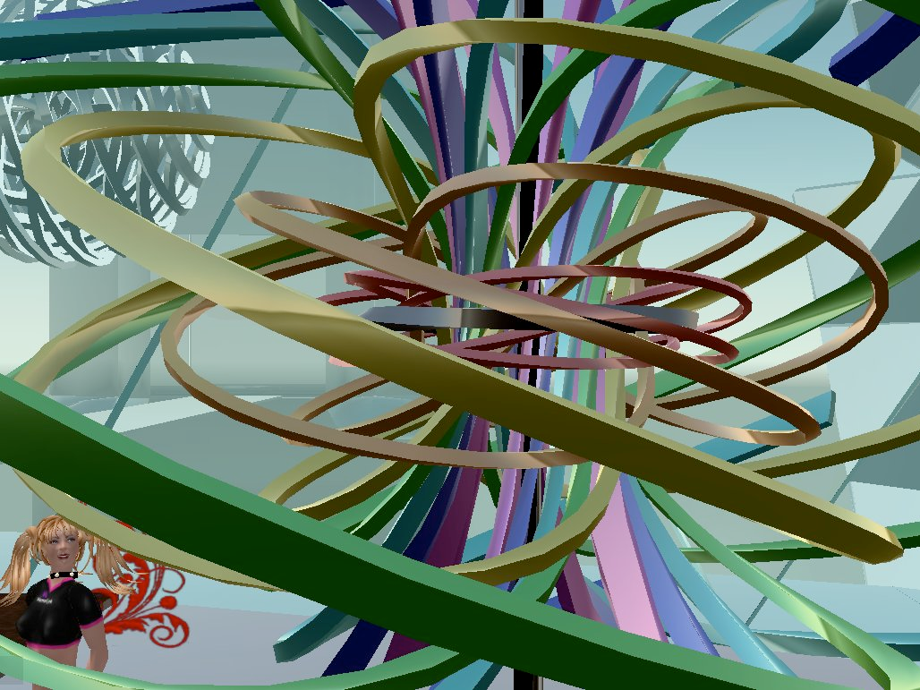
Mathematics
3D creation tools and scripting allow for many kinds of mathematical modeling, including fractals, polygon studies, trigonometric functions, and more
Objects for drill and practice, like games and quizzes, are also available
Examples:
Create a “scavenger hunt” where students can search in-world for examples of different polygons and mathematical models
Students learning the Linden scripting language can study how math formulas can create objects
Use SLOODLE quizHUB to quiz students in the immersive environment of SL, and track scores in the Moodle LMS

Slide 11
Virtual Scavenger Hunt Rubric
Did the student explore the virtual world adequately enough to discover a wide depth and breadth of information?
Did the student show evidence that he/she fully explored all requested areas?
Is the student’s reporting on findings accurate?
If follow-up analysis is required, is it insightful and demonstrative of thorough understanding?

Slide 12
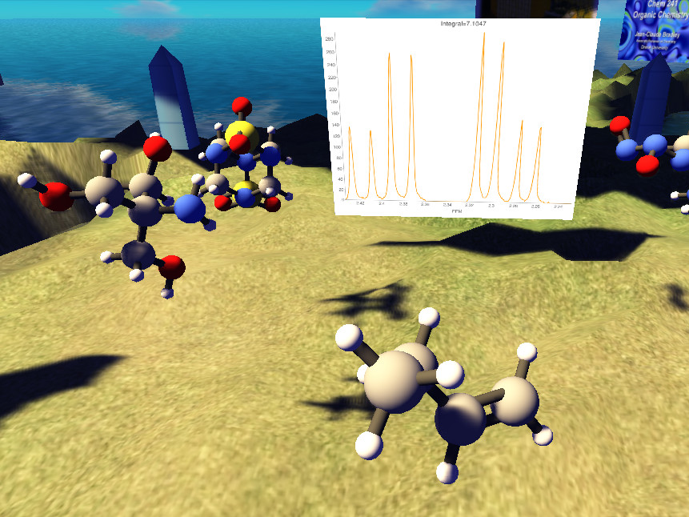
Chemistry
3D world allows for visual modeling of molecules, reactions, data, and more
Games can give students simulated environments and quiz their knowledge
Examples:
Students can play games like the Spectral Game (at Drexel University in Second Life) to reinforce critical chemistry concepts
Research exhibits and collaboration can be held in-world
Simulated labs can allow students to explore and experiment without potential dangers associated with real lab work

Slide 13
Virtual Modeling Rubric
Does the model accurately represent the given function?
Can the model be manipulated or extended easily?
Can the model be adapted or utilized by others to further a purpose or aid in understanding of a theory or function?

Slide 14
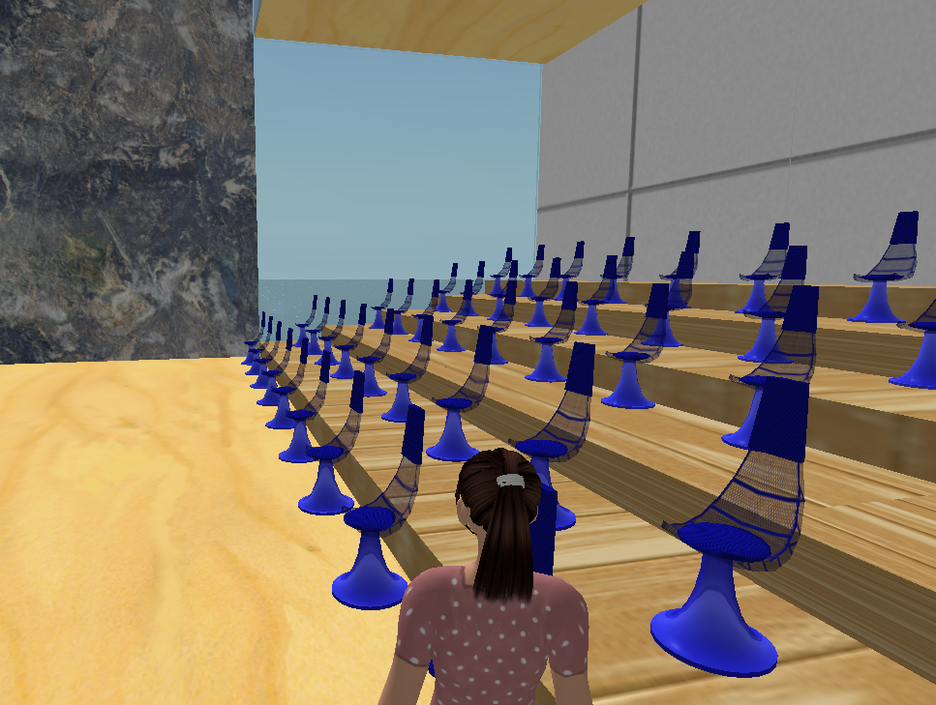
Education
The great number of tools and environments allows teachers to explore content knowledge and gather resources on any subject
Student teachers can collaborate and practice speaking and presentation skills in front of a live group
Examples:
A simulated classroom allows student teachers to give presentations and manage a “live” class
Education students can perform resource scavenger hunts based on their content areas
Teachers can take students on virtual field trips to historical and faraway locations

Slide 15
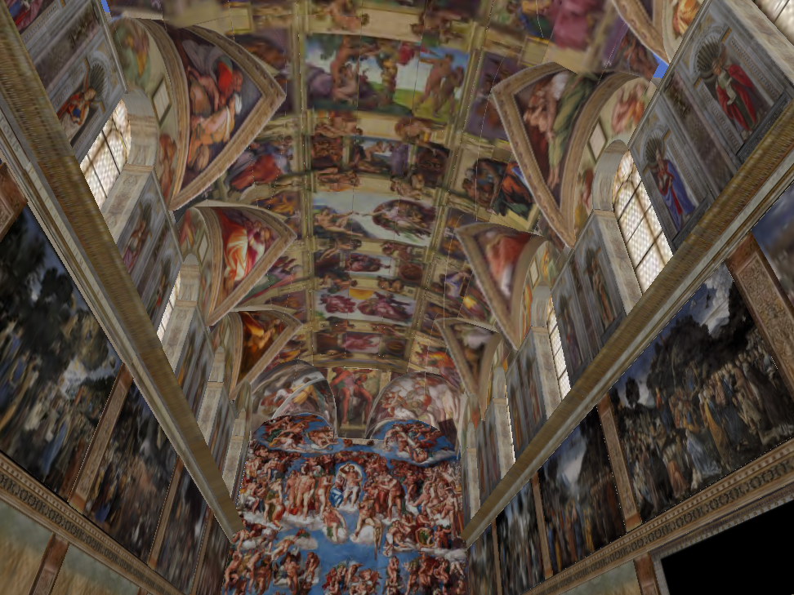
Virtual Field Trip Rubric
Was the student able to successfully navigate through the field trip location?
Did the student participate fully in field trip activities?
Did the student provide insightful analysis of what was learned during the trip?
Can the student compare and contrast the virtual environment to knowledge of similar real life places?

Slide 16
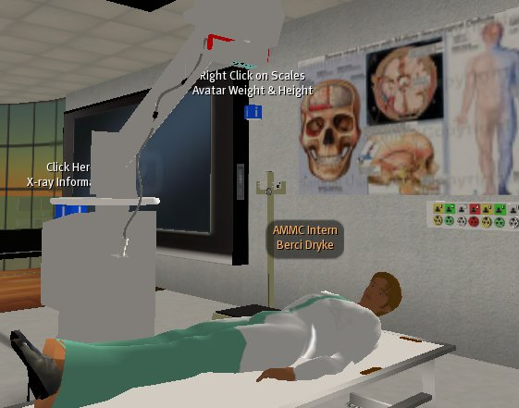
Nursing and Medicine
Virtual worlds allow medical students to practice procedures, make diagnoses, and participate in simulated case studies without fear of causing real harm to patients
Presents many options for collaboration, presentations, and information clearinghouses featuring multimedia and 3d representations
Examples:
Student nurses/doctors are given a scenario and must perform the proper procedures to help the simulated patient
Students explore simulated 3D organs by “walking through” and explain how different parts function

Slide 17
Virtual Simulation Rubric
Can the student accurately describe and analyze the components and characteristics of the given simulation?
Was the student able to successfully access the simulation and follow all given directions?
Did the student perform the correct steps or procedures to treat the patient effectively and safely?
Did the student use both critical thinking and medical knowledge to obtain an accurate diagnosis or conclusion?

Slide 18
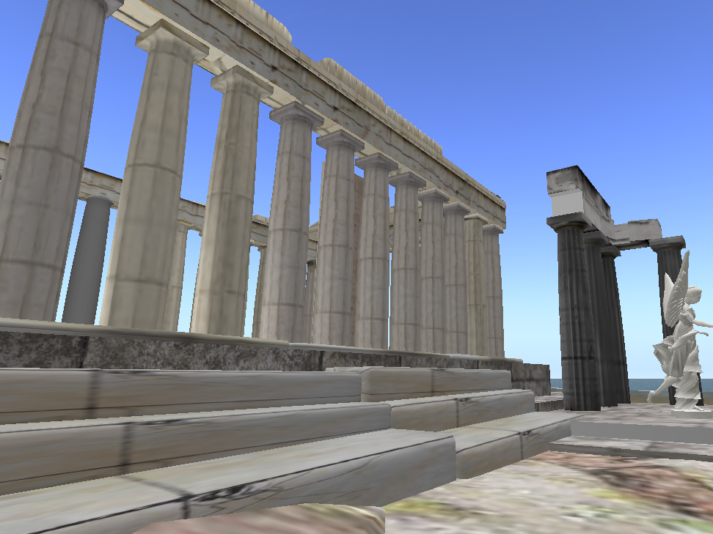
Political Science and Sociology
Provides an alternative forum for promoting civic engagement and understanding of current world issues
Broad international user base allows many options for studying culture, society, and norms, both in-world and in real life
Examples:
Use a scavenger hunt to ask students to explore issues surrounding a topic, current event, or cultural issue based on activism or government information centers and chatting with others
Students can conduct mock trials and debates virtually, leveraging the virtual world’s ability to share files and multimedia for visual aides

Slide 19
Virtual Discussion Rubric
Do students show appropriate respect when others are speaking by keeping their avatars still and quiet, and refraining from text or voice interruption?
Are students able to discuss all sides of a given issue and support claims with factual evidence?
Do students use visual media (such as slides, videos, music, demonstrations) effectively to support their points and add interest to the discussion?

Slide 20
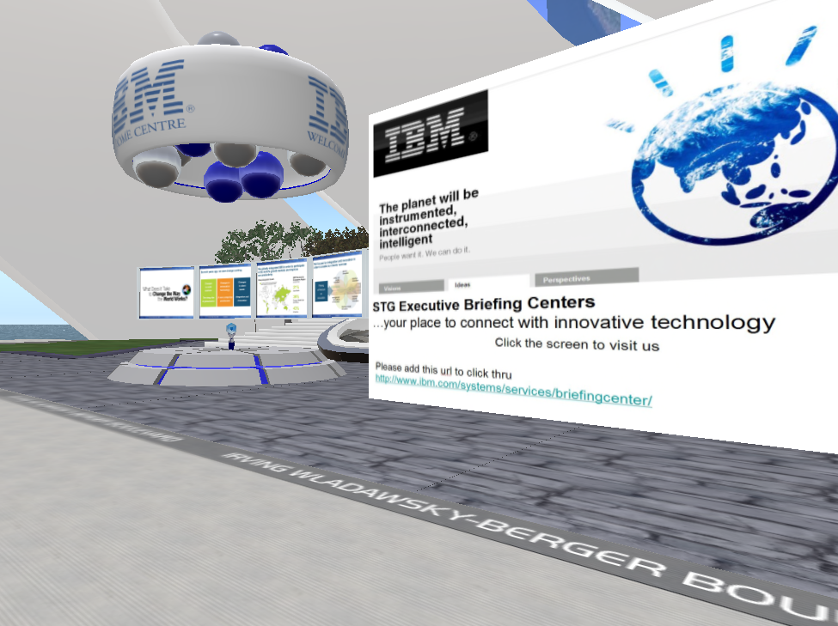
Economics and Business
Virtual worlds, notably Second Life, feature functional economies
Users can buy and sell goods and services with real money, which follows an exchange rate with in-world currency
Examples:
Students can test new business models in a virtual and relatively safe setting
Students can examine and analyze the economic structure and large and small businesses operating within the virtual world and compare them to real life

Slide 21
Virtual Business Project Rubric
How must a virtual world business model differ from the real world in order to be effective? How are the two similar?
Is the business model proposed a feasible one within the structure, norms, and rules of the virtual world?
Is the proposed model sustainable within the context of the virtual world? How does the business meet the needs of virtual world consumers?
What is the cost-benefit analysis (in both “real” and virtual world currencies) of the proposed business model in terms of start-up and sustainability?

Slide 22
Thank You
Download this presentation and contact us at either of the following:
http://education.calumet.purdue.edu/Faculty/Trekles
http://slurl.com/secondlife/Purdue%20University%20Calumet/128/128/42
Anastasia Trekles
Second Life: Andella Wozniak
atrekles@purdue.edu
Helen Siukola Jancich
Second Life: Sadie MacFanatic
jancich@calumet.purdue.edu
School of Education
Purdue University Calumet
http://www.calumet.purdue.edu

Slide 23
Resources
Second Life official site: http://www.secondlife.com
Second Life in Education wiki: http://sleducation.wikispaces.com/
Del.icio.us sites tagged with “Second Life” and “education”: http://del.icio.us/secondlife/education
Second Life Education Resources Database: http://simteach.com/sled/db/
Virtual Worlds Education Roundtable: http://virtualworldsedu.info/
RubiStar: http://rubistar.4teachers.org

Slide 24
Resources
Second Life examples for education: http://secondlifegrid.net/how/education_and_training
Sloodle Project: http://www.sloodle.org/
Get a Sloodle demo site: http://moodlefarm.socialminds.jp/
The Seven Wonders of Second Life: http://www.techlearning.com/blog/2007/07/seven_wonders_of_second_life_1.php
Top 20 Educational Islands in Second Life: http://www.simteach.com/wiki/index.php?title=Top_20_Educational_Locations_in_Second_Life

Slide 25
Further Reading
Rymaszewski, M., et al. (2008). Second Life: The official guide. San Fransisco, Ca: Sybex/Wiley.
Weber, A., Rufer-Bach, K., & Platel, R. (2007). Creating your world: The official guide to advanced content creation for Second Life. San Francisco, CA: Sybex/Wiley.
v3Image (2007). A beginner’s guide to Second Life. Las Vegas, NV: ArcheBooks.
Heaton, J. (2007). Introduction to Linden Scripting Language for Second Life. Heaton Research, Inc. (More available at the Heaton website: http://www.heatonresearch.com)

