Slide 1
Enhancing Campus Services Through Federated Identity Management Collaborations March 15, 2010
Tom Barton, Senior Director for Integration, University of Chicago
Ron Kraemer, CIO, University of Wisconsin, Madison

Slide 2
Agenda
Introduction to InCommon and federated identity management
Challenges and benefits
Enabling more services for our campuses
Learning more and getting involved

Slide 3
Full Disclosure
This presentation uses many resources from the experts in this area of work, in particular
Kevin Morooney (Penn State)
Renee Shuey (Penn State)
Jack Suess, University of Maryland, Baltimore County

Slide 4
The CIC’s Demonstrated Commitment To Identity Management
June, 2006, the CIC CIOs hosted a meeting that brought together hundreds of people from the CIC
Human Resources
Enrollment Management
Financial Aid
Medical Centers
Research Offices
ID Card Offices
Information Technology

Slide 5
InCommon Mission
The mission of the InCommon Federation is to create and support a common framework for trustworthy shared management of access to on-line resources in support of education and research in the United States.

Slide 6
What this means to me as a user…
I can use the credentials provided to me by my organization to gain access to systems and services from others in the federation

Slide 7
Overview Of Identity Management Systems
California State University definition - An identity management infrastructure is a collection of technology and policy that enables networked computer systems to determine who has access to them, what resources the person is authorized to access, while protecting individual privacy and access to confidential information.
7

Slide 8
Definition Components
Infrastructure - software and hardware
Collection - not just technology
Technology and policy – policy plays a critical role and is an essential element of the solution
Networked computer systems - implies distributed technology systems communicating over a network
Access - Who am I
Authorized - What can I do
Protecting - limiting access and protecting information

Slide 9
Identity Management Use In Higher Ed
Students, Faculty and Staff
Student/Employee directories
Learning resources (course management systems, library, etc.)
Emergency notification systems
Online student and staff administrative systems
Federal research agencies, funding, and data resources
Alumni and Donors
Email for life
Alumni directories and services

Slide 10
Identity Management Factors
Policy and Governance
Technology
Identity
Management
Ability to Implement
Information Technology Service Infrastructure

Slide 11
Federated Access in 30 seconds
4. If attributes are acceptable to resource policy, access is granted!
3. Authorization: Privacy-preserving exchange of agreed upon attributes
2. Federation-based trust exchange to verify partners and locations
1. Authentication: single-sign-on at home institution
Online Resource
Attributes: Anonymous ID, Staff, Student, …
Metadata, certificates, common attributes & meaning, federation registration authority, Shibboleth
Home Institution – user signs in

Slide 12
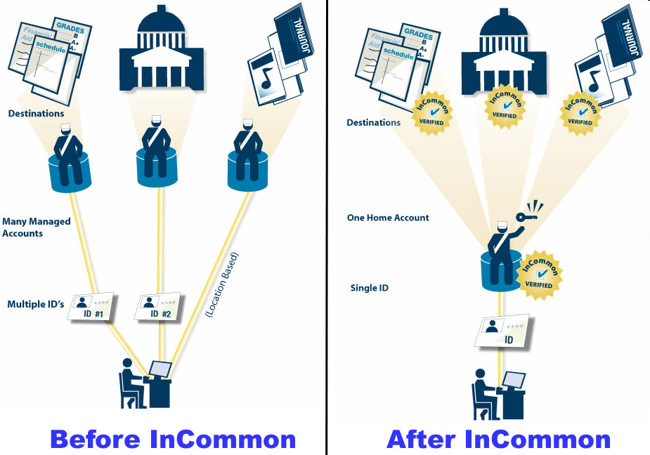

Slide 13
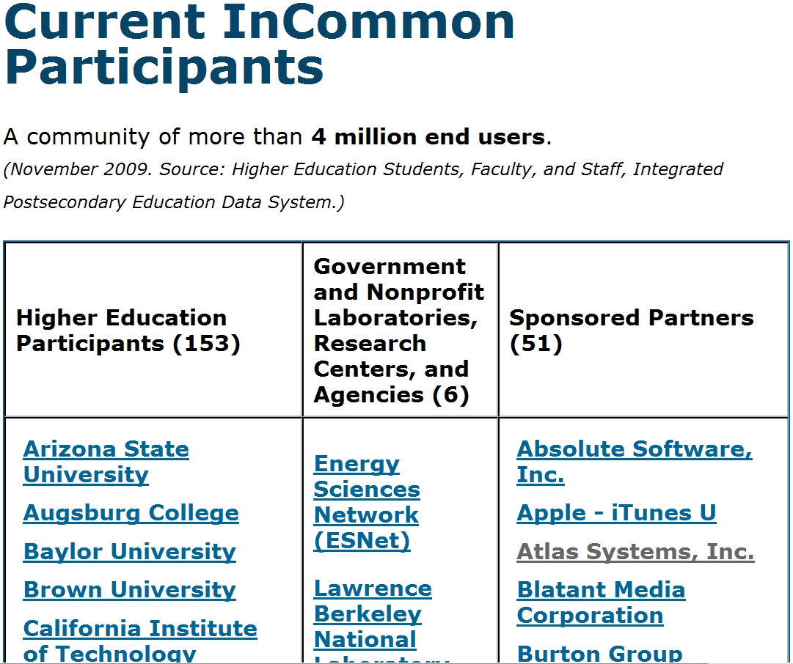
4 million end users
153 Universities
6 Labs or
Agencies
51 Sponsored Partners

Slide 14
What does a Federation Do?
Scaling beyond the technology
Rules of Engagement
Information about how to connect
Vetting organizations and representatives
Common Data/Attributes
Shared Technology
Maintain Member Information
14

Slide 15
The CIC and InCommon Silver
CIC CIOs decided in August 2009 that all CIC schools should be Silver certified by Fall 2011
Why?
Expand inter-institutional collaboration among CIC schools
Influence emerging standards & practices in cloud and above campus services and elevate prominence of the CIC in connection with that
Sustain adoption of best IdM practices at CIC schools

Slide 16
Which campus people need Silver assurance?
CIC CourseShare
later
Payroll
CIC storage cloud
Benefits
Student Loans
Timeframe
Financial aid
OSG
CILogon
sooner
NSC
Nat’l Labs
NIH
TeraGrid
caBIG
smaller
larger
User group size

Slide 17
Pieces of Silver
Piece A: Documentation of policies and procedures and standard operating practices
Piece B: Strength of authentication and shared secrets
Piece C: Registering identity subjects and issuing credentials to them

Slide 18
Silver isn’t free …
Requirements | Issues or risks
Comprehensive IdM policies and procedures | Unclear who gets to decide, weak documentation practice
Audit | Scheduling & funding
Password complexity, lifetime, account lockout | Resistance to change
Credential issuance process | Change online credential issuance process; new link with existing business processes

Slide 19
The view from Fall 2011
Energize collaborative efforts across the CIC
CIC campuses provide best possible support for scientific and scholarly collaboration
CIC campuses poised to take full advantage of cloud/shared services
For a large university, achieving Silver compliance can boost confidence on campus too

Slide 20
All CIC Schools Are Participants In InCommon
Undertaking three projects:
Enabling our campuses to support InCommon Silver
Developing a pilot with Teragrid
Enabling federated/roaming wireless among CIC campuses.

Slide 21
“The CIC’s commitment to identity management and federation of identities through InCommon is strong and our future dependency on InCommon is clear.”
From a recent letter from the CIC CIOs to Internet 2

Slide 22
Resources
http://www.incommonfederation.org
http://www.educause.edu
Google any of the InCommon steering committee or technical advisory committee names
A presentation by Dick Hardt (Sxip Identity) http://www.identity20.com/media/OSCON2005/

Slide 23
THANK YOU

Slide 24
Copyright Tom Barton and Ron Kramer, 2010. This work is the intellectual property of the authors. Permission is granted for this material to be shared for non-commercial, educational purposes, provided that this copyright statement appears on the reproduced materials and notice is given that the copying is by permission of the author. To disseminate otherwise or to republish requires written permission from the authors.

