Slide 1
Conserving Energy Through Remote Control of Your PC
Jim Chaffee & Brian Heil | Tuesday, March 16, 2010

Slide 2
Welcome
Who we are
Why we are here
Who we are trying to reach

Slide 3
The Problem
With the release of Windows XP, STSG encouraged our Faculty and Staff to use Remote Desktop to access their office computers from classrooms, at home, and while travelling. To do so they needed to leave their computers on 24/7 to have this access.
This wastes energy, and it was our fault!

Slide 4
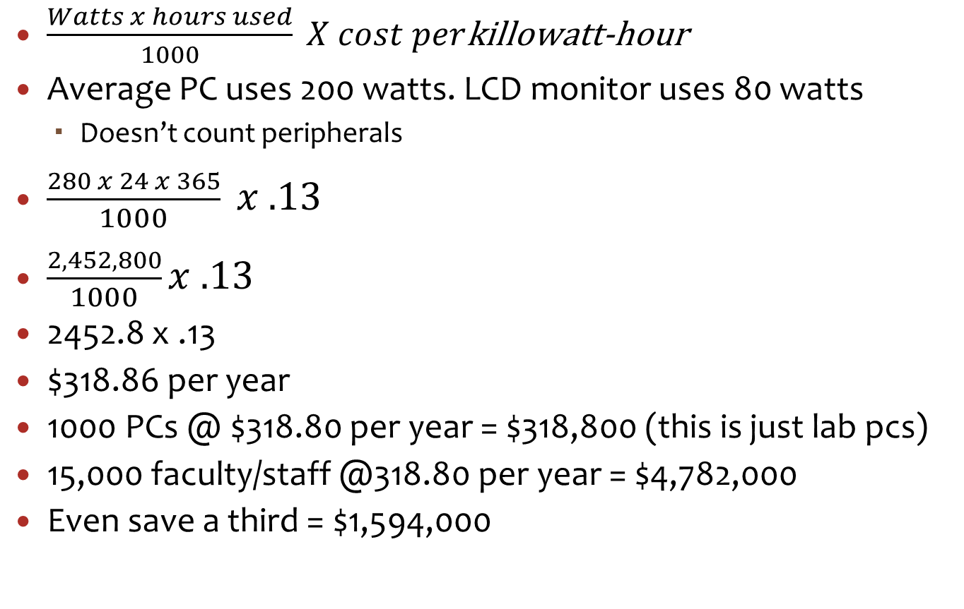
Cost
$\frac{Watts x hours used}{1000} X cost per$killowatt-hour
Average PC uses 200 watts. LCD monitor uses 80 watts
  Doesn’t count peripherals
$\frac{280 x 24 x 365}{1000} x .13$
$\frac{2,452,800}{1000}x .13$
2452.8 x .13
$318.86 per year
1000 PCs @ $318.80 per year = $318,800 (this is just lab pcs)
15,000 faculty/staff @318.80 per year = $4,782,000
Even save a third = $1,594,000

Slide 5
What did we do?
Brian came to me with solution
Now he’ll explain what happened next

Slide 6
Remote P.O.W.E.R. Project
Power On Workstation for Energy Reduction
The Remote P.O.W.E.R. Project allows our faculty and staff to power off their office computer when they leave and then power it on from home or on the road to gain remote access.

Slide 7
Goals
Create a ‘user-driven’ process – we try to avoid forcing things on our users
Create an easy to use application
Solve the %90 problem (Windows machines – little to no support for the %10 who run non-Windows OS)

Slide 8
Behind the Scenes
Technology
ASP.NET application running on college web server
MS SQL Server
ActiveX Object for workstation registration
  (required for automatic registration, but not for wake up functions)
Web Server responsible for sending WOL packets
  WOL Code found at http://www.depicus.com/wake-on-lan/
ICMP
Dynamic DNS

Slide 9
Behind the Scenes
Tech Hurdles
BIOS Settings
  DCCU (Dell Client Configuration Utility) pushed via an SCCM package
NIC Power Settings
  For Windows Machines there are NIC setting are required to enable WOL
    Allow this device to bring the computer out of standby
    Only allow management stations to bring the computer out of standby

Slide 10
Behind the Scenes
Tech Hurdles
MAC Address collection
  Required users to manage registered computers because we couldn’t guarantee user to computer relationship with our current inventory application
  ActiveX control (reasonable approach since we control target machines) - requires IE6 or above
  Needed to put application URL into Local Intranet sites list (GPO)
  Depends on Campus Private Key Infrastructure for secure installation of signed ActiveX object

Slide 11
Behind the Scenes
Tech Hurdles
Firewall
  We routinely block ICMP Echo Requests on our workstations
  We now allow them from the web server IP address (via GPO)
Macintosh and Linux clients
  We have a few users not using a Windows OS – option still available but not supported by STSG
  Website allows manual registration (users must know the MAC address and computer name)

Slide 12
Behind the Scenes
Tech Hurdles
Vista IE Issues
  To install the ActiveX control IE must be started with Run as administrator - UAC elevation does not work
  x64 Vista– users must temporarily modify IE security to allow installation of ActiveX control.
    Enabled Protected Mode must be turned off
    Security Level for Local Intranet should be set to Low
  We currently have few Vista users, and even fewer x64 Vista users
  We’ve just begun Windows 7 rollout – Vista issues apply

Slide 13
Behind the Scenes
Tech Hurdles
Power state Determination
  Uses ICMP echo request/reply (Ping) to determine if computer is powered on
  Dynamic DNS record purges cause an issue where we can no longer determine power state for computers that have been powered off longer than the purge cycle.
  Not a big issue – once powered on, DNS registration will happen and the ping will succeed and report the correct power state (most of the time!)
  User education alleviates problems.

Slide 14
Demo
https://tippie.uiowa.edu/power

Slide 15
Questions?
james-chaffee@uiowa.edu
brian-heil@uiowa.edu

Slide 16
THANK YOU

