Slide 1
Using Champions to
Make Change Happen
Overcoming Past Failures and
Making Change Happen
Martin Klubeck, Strategy & Planning Consultant
Don Padgett, Program Manager
University of Notre Dame
March 16, 2010
"Copyright Martin Klubeck, 2010. This work is the intellectual property of the author. Permission is granted for this material to be shared for non-commercial, educational purposes, provided that this copyright statement appears on the reproduced materials and notice is given that the copying is by permission of the author. To disseminate otherwise or to republish requires written permission from the author."

Slide 2

Using Champions to
Make Change Happen
Why do organizations fail at Enterprise-wide improvement efforts?
  What is Organizational Immaturity?
  CMM – and the five levels of maturity
  (no level 0)
  Previous failures increase likelihood of
  future failures
  Partial successes don’t increase likelihood
  of future successes

Slide 3
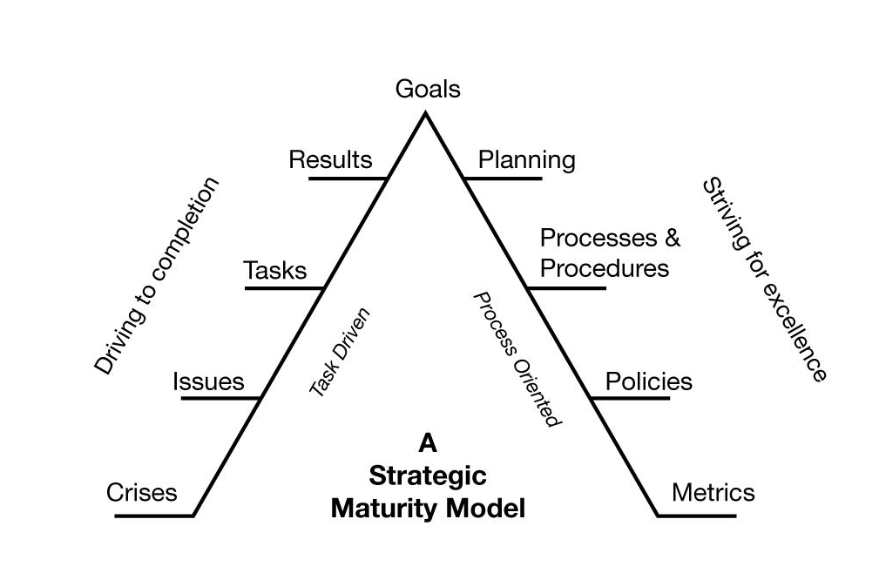
Using Champions to
Make Change Happen

Slide 4
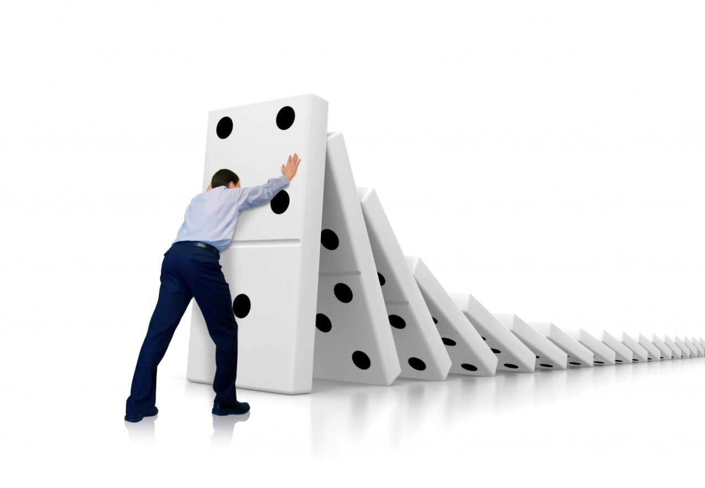
Using Champions to
Make Change Happen
If suffering from Organizational Immaturity …what can you do?
  Identify Champions
    Identify what they want to improve
    List of possibles
Performance Measurement
Process Asset Library
Metrics
Professional Development
Reward and Recognition
Career Planning
Training Plans
Coaching
Quality Assurance
Setting Expectations
Process Improvement
Maintaining Expectations
Process Definition
Strategic Planning

Slide 5
Using Champions to
Make Change Happen
If suffering from Organizational Immaturity …what can you do?
  Identify Champions
    Identify what they want to improve
    List of possibles
    Assist them
    Stay out of their way
    Applaud their success

Slide 6
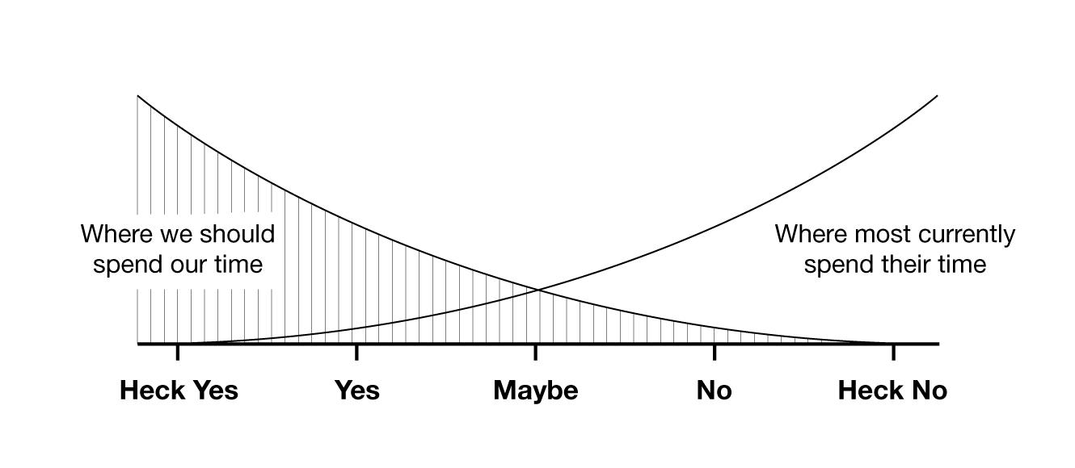
Using Champions to
Make Change Happen

Slide 7

Using Champions to
Make Change Happen
If suffering from Organizational Immaturity…what can you do? (continued)
  Where are the internal leaders with mature teams?
  Who is already doing good things?
  Identify Pockets of Maturity

Slide 8

Using Champions to
Make Change Happen
Developing Champions
  People are truly your most valued assets
  Focus in on their strengths not weaknesses
  Support vs. manage
  Encourage and promote formal training plans
  Get out their way
  Do Nothing!

Slide 9
Using Champions to
Make Change Happen
Hiring and Retaining Champions
  Build it and they will come
    Job Families
    Qualification Matrix
  Performance Management
  Culture of Recognition

Slide 10

Using Champions to
Make Change Happen
Achieving Critical Mass
  Letting Champions sell to other Champions
  Staying out of the way
  When to step in and mandate
  Realize even with critical mass –
  you may not succeed

Slide 11

Using Champions to
Make Change Happen
Questions?

Slide 12
Using Champions to
Make Change Happen
Recommended Reading:
First, Break All The Rules http://www.tmbc.com/mb/books/first
Good To Great
http://www.jimcollins.com/books.html
The Tipping Point http://www.gladwell.com/tippingpoint/index.html
The Carrot Principle
www.carrots.com
Why Organizations Struggle So Hard To Improve So Little
www.org-immaturity.com

Slide 13
Using Champions to
Make Change Happen
Contact Us:
  We’re happy to answer future questions via email or phone:
  klubeck.1@nd.edu, 574-631-5447
  dpadgett@nd.edu, 574-631-3556

Slide 14
THANK YOU

