Slide 1
Implementing Unified Communications in Higher Education
Dan Smith Senior Director IT Services
Victor Martinez Windows Engineer and Lead

Slide 2
Unified Communications
What is it?
The integration of communication methods and technologies
Why are we doing it?
Legacy telephone infrastructure is end of life
UC can provide increased productivity
Improved collaboration
Cost savings/avoidance

Slide 3
Gartner's Top Predictions for 2009 and Beyond*
Unified Communications
By 2013, 40% of knowledge workers worldwide will have abandoned or removed their desk phones
By 2012, 20% of new telephony licenses will be sourced as a software application in a unified communications portfolio
*Gartner
Gartner's Top Predictions for IT Organizations and
Users, 2009 and Beyond: Where Is the Money?
4 February 2009

Slide 4
No Desk Phone
In reality, in many organizations today, the desk phone could be easily removed with little or no impact to the performance of the individual
The smarter knowledge workers will be the ones who recognize that they are no longer using their desk phones and will remove desk phones and the costs associated with operating and maintaining them
*Gartner
Gartner's Top Predictions for IT Organizations and
Users, 2009 and Beyond: Where Is the Money?
4 February 2009

Slide 5
If a Desk Phone is Needed
Companies will needlessly spend too much money on IP screen phones, merely for aesthetic reasons, when there's already a PC screen on their desks
Instead, to improve productivity, they should use it to purchase low-cost IP phones and unified communications applications.
Gartner: Don't Purchase IP Screen Phones If You Have a PC on
Your Desk
Publication Date: 9 August 2006

Slide 6
Unified Communications
Graphic Removed

Slide 7
Corporate Telephony
Graphic Removed

Slide 8
Why are we doing it
This project will
Implement VoIP for two new buildings from the ground up.
Replace the legacy PBX system with Voice over Internet Protocol (VoIP) and incorporate other features of Unified Communications (UC).
In addition other features of UC will provide much needed audio and Web conferencing solutions for the University.

Slide 9
The start
Started with the idea to move campus to VoIP
Needed to find a common voice mail platform that Siemens, Cisco, and OCS could use
We started 2 years ago by moving voicemail from OCTEL to Exchange 2007
Single most well received project we have ever done

Slide 10
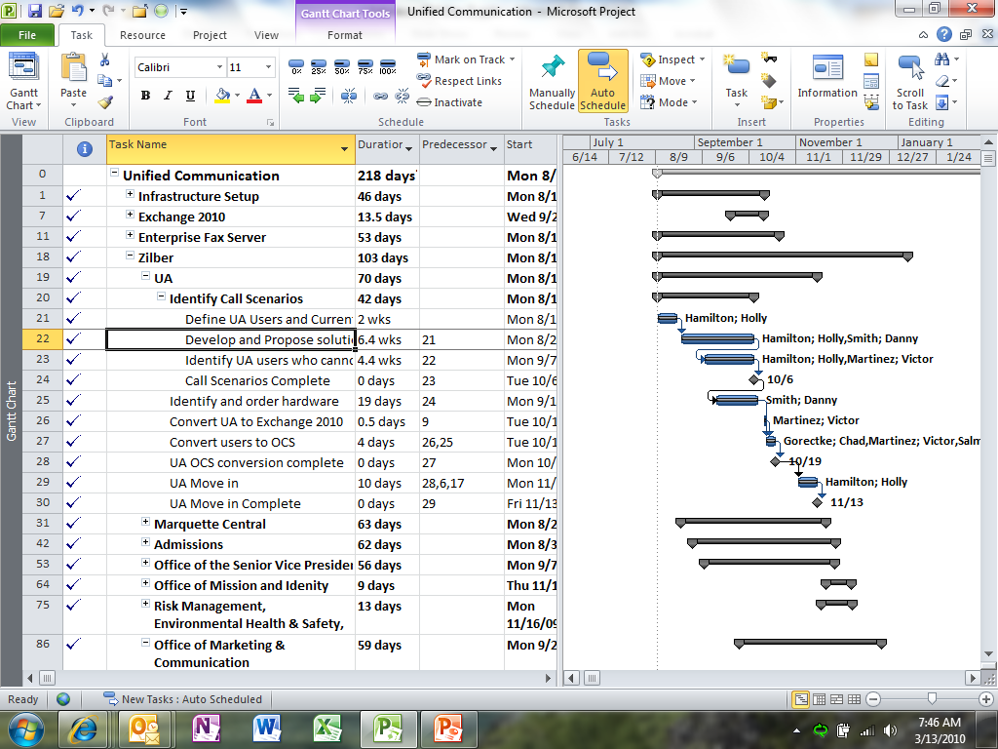
New path
Between time of vision and funding Unified Communication came to the fore
We were funded to move 4 legacy buildings to VoIP
New buildings were designed from the ground up as VoIP
No analog lines, needed gateways
Student services (Nov 09) and Law (July 10)
New building schedule dictated it be the first building to use UC

Slide 11
Technology Selected
We researched vendors and solutions for the best solution at an affordable cost
Cisco Call Manager (IP-PBX) solution
Microsoft Exchange 2010
Microsoft Office Communication Server 2007 R2.
On the front-end, we implemented Office Communicator (softphone) with limited deployment of Cisco IP phones.
The best hybrid of back- and front-end technologies.

Slide 12
OC Voice vs. Cisco Voice
Feature |  | Office Communicator Voice | Cisco
Mobility |  | Yes | No
Call forwarding |  | Yes | Limited
Presence |  | Full | Limited (no indication in a call or conference)
One Touch Calling |  | Yes | No
Dial from Outlook |  | Yes | No
Caller ID |  | Yes* | Limited (number vs. name)**
Conference Call |  | Yes up to 31 | Limited and no GUI
Call Center |  | Limited | Yes
Non-Windows |  | No | Yes
* If a caller is in the GAL or you contacts you will see the name
** Currently Cisco will get names from other Cisco users

Slide 13
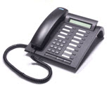
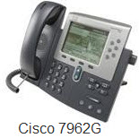
Transition
Running three phone systems
Legacy Siemens
Cisco Call Manager
OCS R2

Slide 14
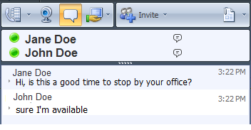
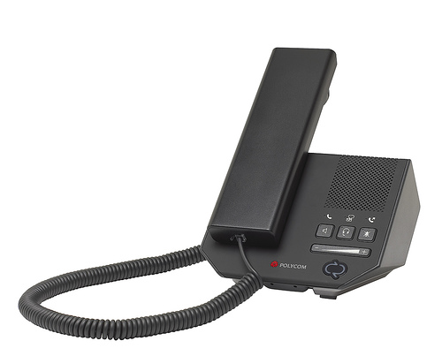
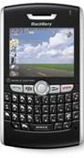
IM
Presence
Voice
Applications
UC
Voice Mail
E-mail Calendar
Audio Conferencing
Desktop Sharing
Web/Video
conferencing

Slide 15
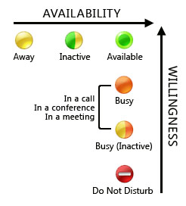
Office Communicator
Presence is the key
The presence icon represents a user’s availability and willingness to communicate

Slide 16
Features and functionality
Good News
Bad News
Lots of features
Presence
IM to call
Forward calls
Team Call groups
Multiple calls
Ad hoc Conferencing
Scheduled Conferencing
Group levels
Tagging
Lots of features
Performance dependent on PC/OS
PC only

Slide 17
Most Productive Features of OCS

Slide 18
The Project
Implement Exchange 2010
Next move people to VoIP/UC/Exchange 2010
IT Services & Zilber completed ~400 users
All Fac/Staff/Students moved to Exchange 2010
4 legacy buildings + Law School remain ~700 additional users
Upgrade Straz Tower Network Wed 3/17/10
Upgrade Straz Hall Network Fri 3/19/10
Today
March 1
April 1
May 1
June 1
July 1
Start Fri 1/15/10
College of Engineering Fri 1/15/10 - Fri 2/19/10
Straz Hall/COB Wed 3/17/10 - Wed 4/28/10
Cudahy Hall (MSCS) Thu 5/27/10 - Tue 7/6/10
Finish Tue 7/6/10
Straz Tower Mon 2/15/10 - Wed 3/24/10
Eckstein Hall Thu 4/22/10 - Thu 6/3/10
COE conversion complete Fri 2/19/10
Straz Tower conversion complete Wed 3/24/10
COE conversion complete Wed 4/28/10
Eckstein conversion complete Thu 6/3/10
Cudahy conversion complete Tue 7/6/10
PBX Decom complete Thu 4/22/10

Slide 19
User Reaction
Presence is the key
It will change the way you work
People making great use of IM
Great features with Enterprise Voice
“The Marquette Central staff really like the IM and presence features. We use it ALL the time.”
Marquette Central Manager
“We do love not having to ‘dial’ when someone in our contact list or in the global directory.”
Registrar Marquette University

Slide 20
Cost Savings
PBX Maintenance $31/line/year
End point devices save 42% – 63%
CX 300 – $150
Cisco IP Phone 7962G – $410
Cisco IP Phone 7911G – $260
So for Zilber
$44,000 in endpoint cost avoidance
$12,400 in PBX Maintenance (annual)
$120,000 in SIP vs PBX connection savings (annual)

Slide 21
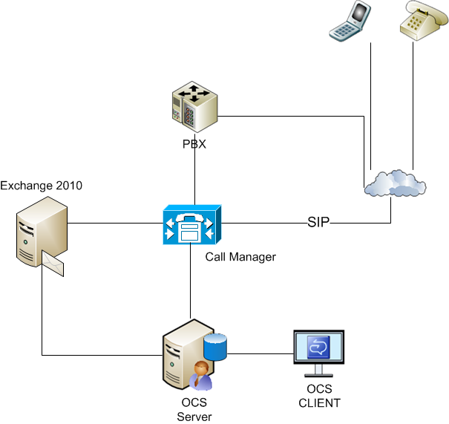
Infrastructure
OCS R2
Enterprise voice
Instant Messaging
Audio conferencing
Live Meeting
Desktop/Application sharing
Exchange 2010
E-mail, calendar
Voicemail for OCS, Cisco, and Siemens
Cisco Call Manager
IP PBX
UCC
Some Cisco phones
Legacy Siemens PBX system

Slide 22
Current OCS Users
Fac/Staff
Students
We have ~ 450 Enterprise voice users.
These are primarily faculty/staff users, but we do have a few student employees.
They use IM, voice, and live meeting.
Primary client is Office Communicator.
We have ~ 11,500 student OCS users.
They are not enterprise voice enabled.
They use IM and live meeting.
Their primary client is the IM web client via Outlook Web App on Exchange 2010.

Slide 23
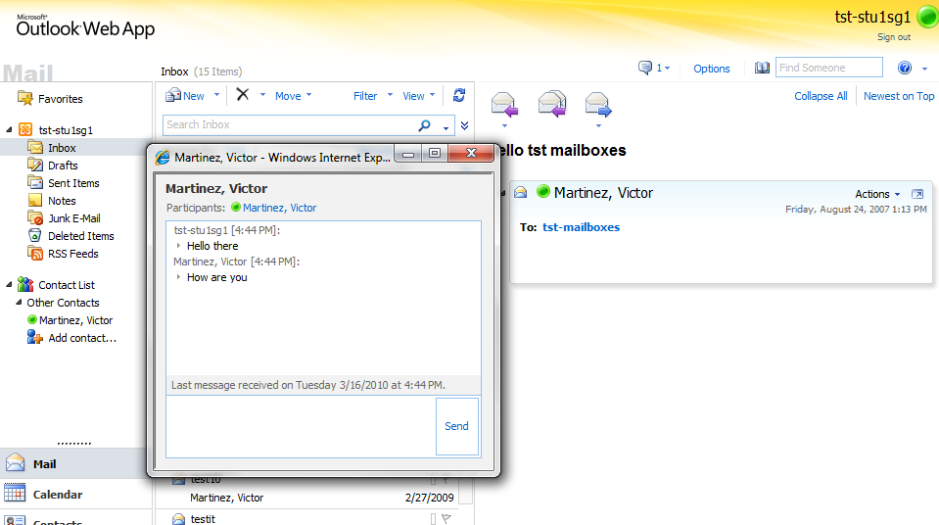
OCS Client via OWA

Slide 24
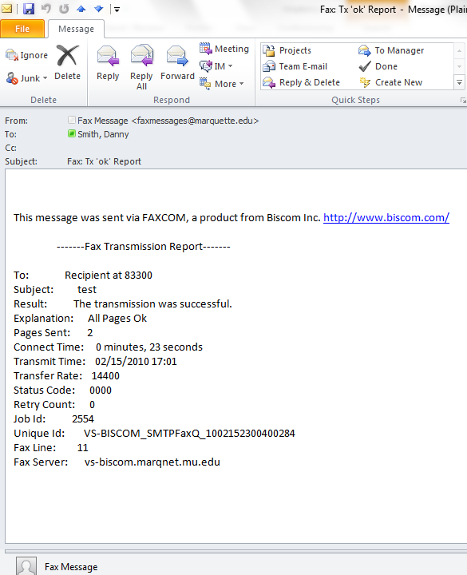
FAXING
Had to find an IP faxing solution. Selected Biscom’s Faxcom
Send outbound faxes via email by attaching a file
Receive faxes to their individual mailbox, shared mailbox, or email enabled SharePoint site.
Notes:
Virtualized the server. Integrated it with Microsoft Exchange, Cisco Call Manager, and Microsoft SharePoint.

Slide 25
Technical Challenges
Edge infrastructure was the biggest challenge due to its configuration complexity
Integrating with existing legacy infrastructure
Redundancy and failover scenarios are not as robust as other applications like Exchange
Call functionality, specifically hotdesk (multiple users sharing a desk phone) and common area phones, not up to par with other solutions
Dependency on PC for telecommunications

Slide 26
Functional Challenges
Specific scenarios
Student workers
Common area phones
Masking outgoing numbers
Training
Roadshow overview
Training the week of conversion
Follow-up training

Slide 27
Solution to these Challenges
Hoping these challenges will be met with next version of OCS.
Others have publicly blogged about the next version of OCS “Wave 14”. There are rumored to be enhancements to resiliency and reliability, as well as “Branch Survivability” and “PSTN Failover”
Marquette University is in the TAP program and can’t say much other than we are happy and excited with what we have seen so far.

Slide 28
THANK YOU

