Slide 1
Creativity and Consistency in Online Courses: Finding the Appropriate Balance
Keri Dutkiewicz
LuAnne Holder
March 17, 2010
Copyright Keri Dutkiewicz and LuAnne Holder, 2010. This work is the intellectual property of the authors. Permission is granted for this material to be shared for non-commercial, educational purposes, provided that this copyright statement appears on the reproduced materials and notice is given that the copying is by permission of the authors. To disseminate otherwise or to republish requires written permission from the author.
Notes:
Start activity– hand out note cards and ask them to customize…. No supplies, no time.

Slide 2
Overview
Davenport U Research Project on English 311 PDC
Why pre-designed courses?
Research methodology and results
Implications
Connecting to your institution
Course criteria
Staffing/ key roles
Processes and communications

Slide 3
Placard Template Specifications
Fold the card
Identify your name and city
Use color appropriately
Block lettering is preferred
The card should be placed in front of you facing the center of the table

Slide 4
Pre-designed Course Model at Davenport University

Slide 5
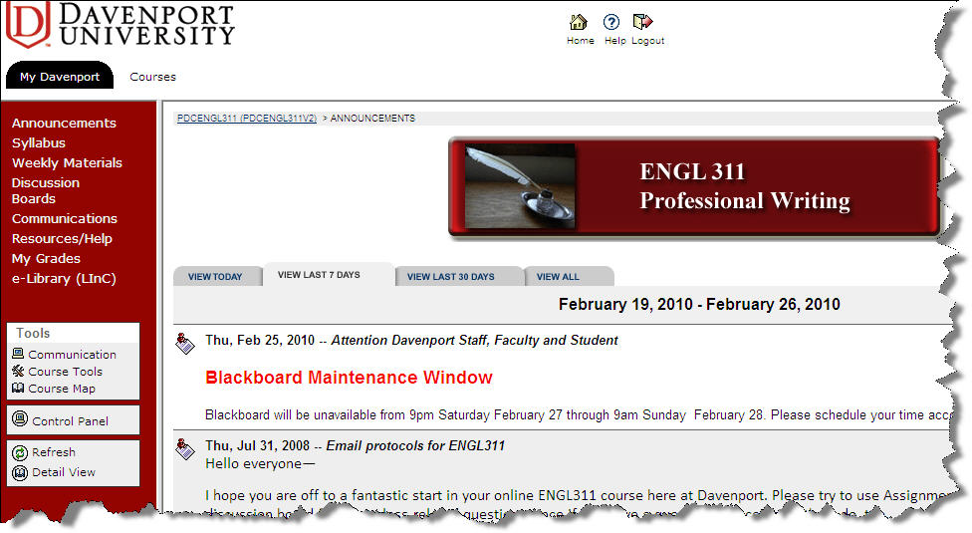
What is a PDC?
Pre designed course = master course = course template
Notes:
Different configurations/ levels of customization across course elements: Explain DU’s approach to PDCs– relatively little flexibility outside DBs, announcements, responses to papers.
Syllabus, calendar, assignments, and course navigation are consistent among sections.

Slide 6
Why DU Uses PDCs
Consistent navigational template
Instructional quality
Appropriate workload
Appropriate timing
Allows more time for engaging directly with students
On-boarding new faculty
Administrative streamlining
Cross-functional course development teams

Slide 7
Staffing PDCs with Course Coordinators
Course Coordinator (CC) role
Implemented with PDCs
CCs mentor 7 sections/ faculty per term
New faculty paid mentoring
Formal course check-ins weeks 3 and 5 of 7-week term
Web meetings several times per year
Email and phone availability
CCs design, update, and maintain PDCs
New course calendar for each term
Technical fixes
Pedagogical enhancements
Notes:
Bring copies of CC job description for anyone interested

Slide 8
Creativity and Consistency– Balanced Approach to PDCs
Realities: Time pressure, PT faculty, repetitive nature of course construction
Goal: Creative, customized instruction
Notes:
Begin with higher levels of creativity coupled with increased sharing on what faculty are doing in sections
Draw from best practices to implement shared approach focusing on consistency– build from what faculty are doing
Morph back to increased levels of creativity once faculty expertise and systems enable effective use of learning object model

Slide 9
DU English 311 PDC Research Project
How can PDCs maintain core areas of consistency while enabling instructional flexibility and autonomy through the inclusion of appropriate instructional elements?
Notes:
Explain what ENGL311 is/ course overview and why this class

Slide 10
DU English 311 PDC Research Project
What strategies of faculty communication, structure, and professional development support maximum consistency as well as creativity and autonomy in online course development?
Do PDCs result in increased student perceptions of learning?

Slide 11
Research Methodology
Online surveys
26 instructors (out of 49)
46 students (out of approx 200)
LiveClassroom web meetings with faculty
Review of online courses
Notes:
Hand out copies of survey so others can use if they want

Slide 12
Key Results: Faculty Preferences Time/ Customization
Notes:
26 faculty responded to the survey.

Slide 13
Key Results: Faculty
Use PDC “as is”
Enable greater customization
Clarification of parameters for changes
Notes:
What can I change?
PDCs first used PDC “as is”
Over time, department leadership and course coordinators began to enable greater levels of customization
Survey reveals that communication of this shift in expectations was insufficient.
Faculty haven’t been clear about acceptable parameters for changes or customizations

Slide 14
Key Results: Faculty Perception vs. Behavior
Faculty correctly identified what they can and cannot change:
Announcements 96%
Agendas
Adding resources 70%
Assignment details
Synchronous sessions 91.7%
Discussion board interaction 96%
Notes:
Although comments suggest faculty do not FEEL clear on what they can change, large percentage of respondents correctly identified elements that they are encouraged to customize
Faculty correctly indicated elements that should not be modified such as the agenda and the assignment details.
In other words, while faculty felt they had an unclear understanding of how a PDC could be customized, they intuitively knew what the parameters were.

Slide 15
Key Results: Students
No Customization
Noted
88%
Instructor Personality Evident
84%
YET
Notes:
Students do not understand what we mean by customization– and, they probably don’t need to know.

Slide 16
Key Results: Students
Elements perceived to improve learning:
Detailed Assignment Sheets: 76.2%
Text Lectures: 62.5%
Small Group Collaboration: 61%
Individual Guidance & Help from Instructor: 55.8%
Links to Outside Sites: 54.7%
Notes:
Customized elements perceived to improve learning

Slide 17
Key Results: Students
Customization and personalization within pre-designed elements:
Feedback on student assignments
Announcements
Discussion board postings

Slide 18
Discussion Boards
Pre-Designed Element
Questions pre-populated in course
but also
Customized Element
Encourage participation & interaction
Reflect personality & pedagogy
Post mini-lessons when needed
Share personal stories
Offer real-life application of content

Slide 19
Faculty Web Meetings: Goals
Report on survey data
Recognize benefits PDC approach has delivered
Reinforce English/ Communications online community of practice
Motivate faculty to re-engage in conversations about PDC design and development
Notes:
Reassure faculty that they are valued and respected as academic professionals; they are more than the “facilitators” of the pre-designed class, they are the instructional expertise that helps students learn and makes the PDC a success

Slide 20
Session Impact on Faculty
At the conclusion of the session:
71% indicated a better understanding of the PDC goals, processes, and approach
57% indicated they would increase communication & collaboration with course teaching team & course coordinator
Notes:
57% indicated they would increase communication & collaboration with course teaching team & course coordinator to improve the PDC and share their teaching expertise

Slide 21
Name Placard Activity?
Clearly defined template….. Or not?
Resources/ time…. Enough?
Purpose of template?

Slide 22
Maintaining Effectiveness with PDCS
PDC approach
Faculty Prep
Admin
Continual Evolution and Quality Enhancement

Slide 23
Lessons Learned: Implementing PDCs
Determine your PDC approach
Provide instructor preparation and training
Administer PDCS via assigned staff role
Plan for continual evolution
Communicate, communicate, communicate
Notes:
Determine your PDC approach – consider how you will balance creativity and consistency
Instructor preparation and training to teach with PDC and participate on cross-functional, geographically dispersed team
Administer PDCS - Staff for mentoring and administration of PDC, not just one-time development
Plan for continual evolution of PDCs

Slide 24
PDC Approach Suggestions
Read literature, talk to colleagues to identify options
Identify elements to remain consistent and why
Identify elements allowed for customization and why
Align with required assessment
Assign development team
ID
IT
SME
Students(?)
Notes:
Hand out list of our core sources on PDCs

Slide 25
Instructor Preparation and Training
Require online training for all faculty teaching online including:
Technical
Pedagogical
Collaborative
Formal mentoring program
Ongoing sessions to enhance skill level

Slide 26
Staffing
Course Coordinator role essential
PDCs will not be valuable if not maintained
Leadership of community of practice
Instructional design and IT resource person
Single point of contact for all faculty

Slide 27
Plan for Change
PDCs should evolve based on new ideas and faculty input:
How will you solicit ideas for needed changes?
Who will make the changes?
Review/ sign off process?
Cross-functional team involvement

Slide 28
Communicate
Information alone not enough
Affective domain is important to change
Collaborative communications processes
Include all stakeholders
Faculty
IT
Advisors
Library

Slide 29
Wrap Up
PDCs valuable tool to effective online teaching
Must be implemented consciously, with attention to:
Technical aspects
Instructional design
Mentoring/ Training
Communications
Ongoing administration and maintenance

