Slide 1
Increasing Adoption of a Web Conferencing System
EDUCAUSE Midwest Regional Conference 2010
Michelle Goeders
Director of Academic Computing
National-Louis University – Chicago, IL
michelle.goeders@nl.edu

Slide 2
Agenda
About our Innovation
About National-Louis University
What happened without a plan
Actions to Increase Adoption
Innovation Diffusion
CBAM Model
The results
What’s next?

Slide 3
Centra Web Conferencing

Slide 4
National-Louis University
Urban, Commuter University founded in 1886
3 Colleges: NCE, CAS, CMB + Library
Total enrollment (Fall 2009): 6,385
Graduate: 901 full-time
4,012 part-time
Undergrad: 1,023 full-time
449 part-time
Faculty Total: 583
251 Full Time (43%)
332 Part Time

Slide 5
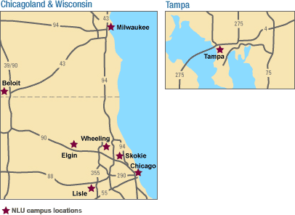
National-Louis University
8 Campuses:
Chicago
Skokie
Wheeling
Elgin
Lisle
Beloit
Milwaukee
Tampa

Slide 6
OIT: Academic Computing
Staff Members
Director of Academic Computing
Technology Trainer
Instructional Analyst
SunGard Higher Education

Slide 7
Saba Centra Web-Conferencing
Hosted on-site
All Faculty/Staff have accounts
Student accounts created easily
Training Required for Leader Account

Slide 9
My Sources
Diffusion of Innovations, 2003
Everett M. Rogers
Taking Charge of Change, 2006
Shirley Hord, William L. Rutherford, Leslie Huling-Austin, Gene Hall
The Tipping Point: How Little Things Can Make a Big Difference, 2000
Malcolm Gladwell

Slide 10
Original Adoption Strategies 2004 - 2006
Pilot Group in 2004
Training Offered by Centra
Yearly? Announcement
Mentioned Occasionally?
Technical Problems!
Users = Leaders
 | Admin Users | Acad Users
2004 | 6 | 1
2005 | 9 | 3
2006 | 8 | 3

Slide 11
This isn’t working.

Slide 12
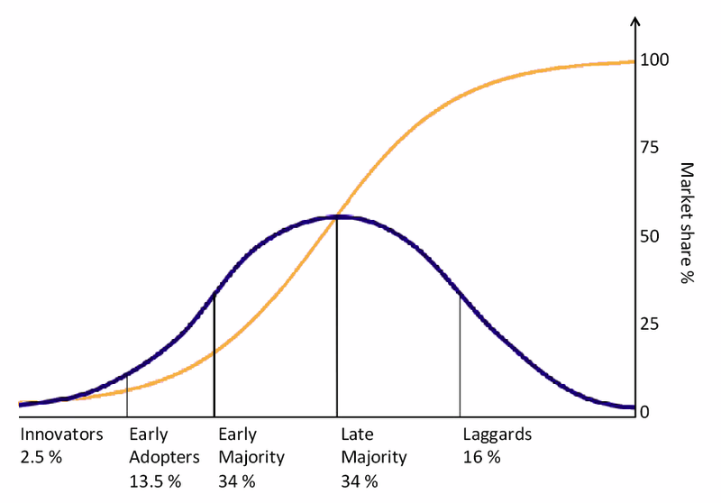
The Adoption-Diffusion Process
Adoption is a process
It can take years
Mandates help
Notes:
The first thing to understand about the process of adoption of an innovation is that it is a process. It can take time.
Mandates will speed things up. Now… I don’t know about your institution, but at mine, mandates do not go over well. Ok, so not really an option. I think that some pressure from administration would help, but they are not in my sphere of influence and I still need to make them see the advantage of using Centra.

Slide 13
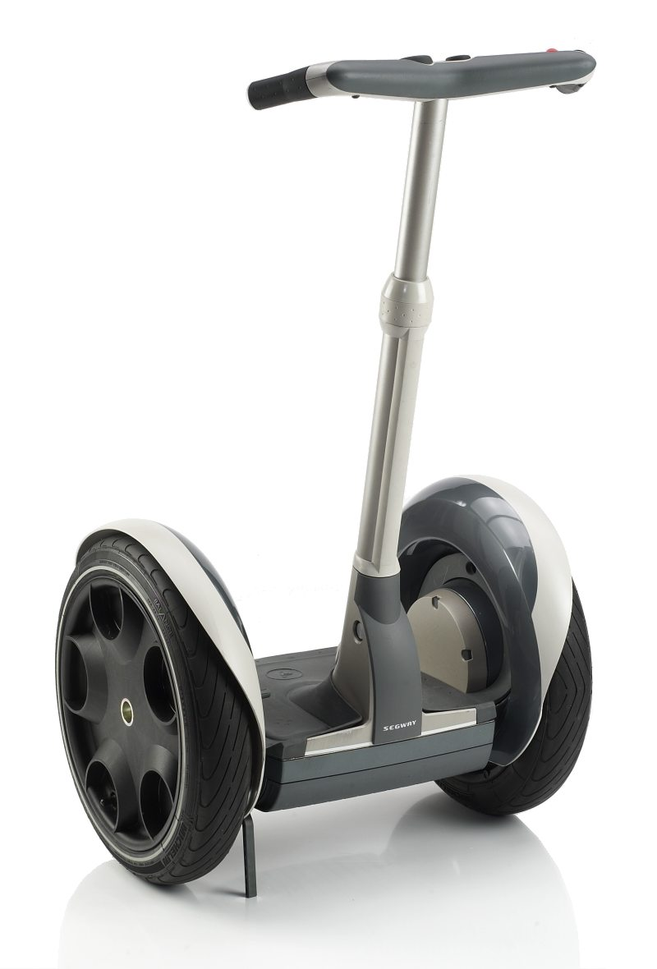
Why do people adopt innovations?
Relative Advantage
Compatibility
Complexity
Trialability
Observability

Slide 14
What drives you?
CDs and DVDs
Smart Phone
Hybrid Vehicle
Text Messaging
Facebook
Twitter
Digital Camera
Solar Panels
Skinny Jeans
Google Voice
Tivo/DVR
HDTV
Smog-eating Cement
Brain-based Learning

Slide 15
CBAM 7 Stages of Concern

Slide 16
“Law of the Few”
Human Behavior is contagious
Diffusion of Innovations spreads like an epidemic
Make use of the right people
Socialite
Opinion Leader

Slide 17
Innovation-Decision Process

Slide 18
Knowledge Phase
Make it visible.
Used it myself (applying best practices)
Monthly Lunch & Learn Sessions
Blackboard Training & Webinars
Technology Training Sessions
Use it for large university-wide events
Get Opinion Leaders to use it
Talk about it
Notes:
First is the Knowledge Phase.
Before anyone can adopt an innovation, they must hear about it. I had to get the word out about Centra.
Announcements
Meetings
Training Sessions
Use It Yourself
Get Others to Use It
“Mass Media” important at this stage
Speed it up: communicate information more rapidly and adequately

Slide 19
Persuasion Phase
Send Announcements
Correct Misconceptions
Show relative advantage
Time it right
Use Peer Pressure
Announce Improvements
Include Training Session Dates/Times
Target the right people/groups
Provide Individual Attention
Use Your Opinion Leaders

Slide 23
Linking Announcements to Requests for Training
Everybody’s Doing It!
New & Improved!
Avoid the Flu!
Use Centra!
New Topics
No Trainer

Slide 24
Decision Phase
Allow Trialability
Demonstrations by Opinion Leaders
Make it look easy
Follow-through
Not pushy
Honesty

Slide 25
Implementation Phase
Allow/encourage reinvention
Support
Training
Hand-holding
Job aids
On-demand resources/help

Slide 26
Confirmation Phase
Improved Support
Expand Topics
Centra Listserv
Follow-thru

Slide 27
Results

Slide 28
Results
 | Yearly Minute Totals | % increase | Live Events | Live Users
2004 | 14416 |  | 175 | 147
2005 | 43408 | 201 | 260 | 388
2006 | 29047 | -33 | 167 | 263
2007 | 78415 | 170 | 224 | 441
2008 | 140950 | 80 | 438 | 1033
2009 | 159993 | 14 | 485 | 1240

Slide 29
Individuals Regularly Using Centra
 | For Meetings | For Class
2004 | 6 | 1
2005 | 6 | 1
2006 | 8 | 3
2007 | 13 | 2
2008 | 20 | 8
2009 | 26 | 9
2010 | 19 | 12

Slide 30
Number of “Leaders” by Year
 | New this Year | Total | Actively Using
2004 | 15 | 15 | 7
2005 | 5 | 20 | 7
2006 | 2 | 22 | 9
2007 | 11 | 32 | 14
2008 | 20 | 45 | 25
2009 | 40 | 91 | 30
2010 | 19 | 108 | 29

Slide 31
What more could I do?
Push-down from Administration
Case Studies
Research supporting Synchronous Learning
Catchy Slogan
Turn my evangelists into trainers

Slide 32
What’s Next?
Critical Mass
Telephony Bridge?
Recorded Tutorials
Relaxation of Requirements?
End of ITV?
Increase in license?
Integration with LMS?
Investigate ROI?
New Tool?

Slide 33
Thank You!
Please fill out survey online.
michelle.goeders@nl.edu

