Slide 1
What's Your Message? Presenting with a Purpose
Bruce A. Montes | March 14, 2011

Slide 2
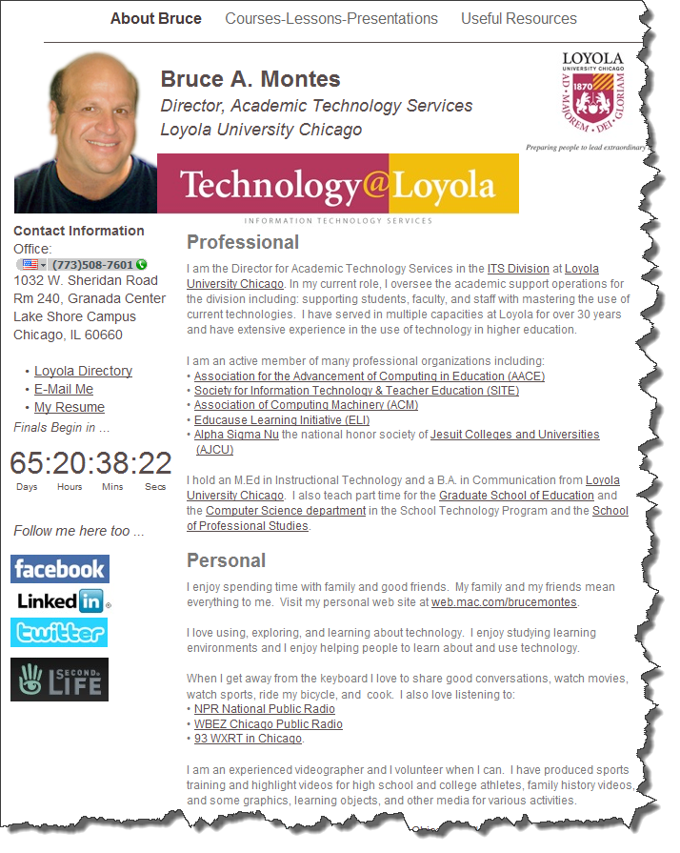
Bruce Montes
bmontes@luc.edu
(773)508-7601
http://homepages.luc.edu/~bmontes/MontesLoyola/About_Bruce.html

Slide 3
Thank you Fr. Zak!
Give me the answer!
Tell me how you got the answer!
Tell me the answer again!

Slide 4
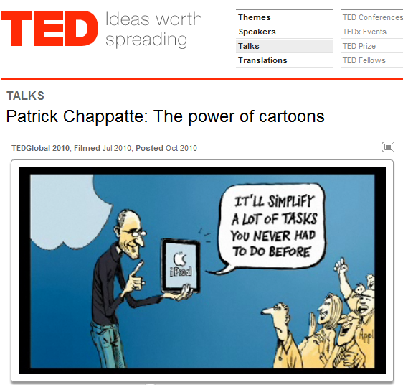
Objectives …
Examples of Presentations
Components of Effective Presentations
Considerations for Presentations
Collaborate!
http://www.ted.com/talks/patrick_chappatte_the_power_of_cartoons.html

Slide 5
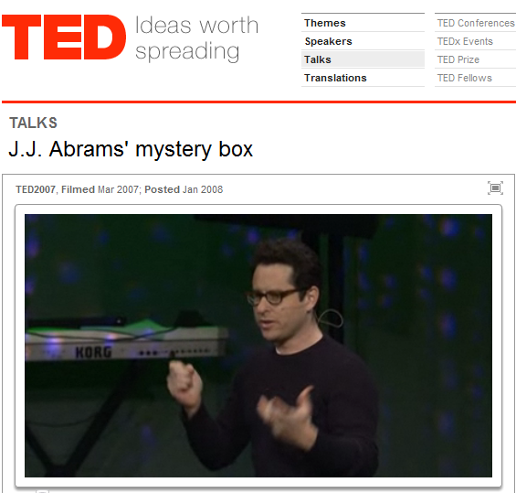
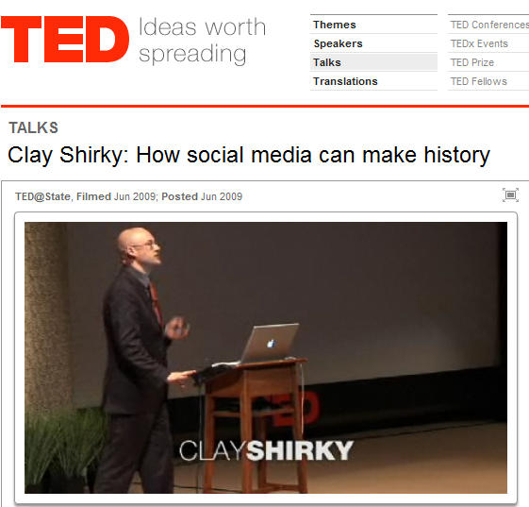
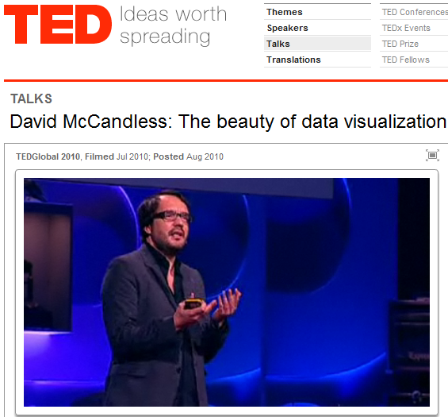
Examples …
http://www.ted.com/talks/j_j_abrams_mystery_box.html
http://www.ted.com/talks/clay_shirky_how_cellphones_twitter_facebook_can_make_history.html
http://www.ted.com/talks/patrick_chappatte_the_power_of_cartoons.html
http://www.ted.com/talks/lang/eng/david_mccandless_the_beauty_of_data_visualization.html
http://www.ted.com/talks/ali_carr_chellman_gaming_to_re_engage_boys_in_learning.html
http://www.ted.com/talks/seth_godin_on_the_tribes_we_lead.html

Slide 6
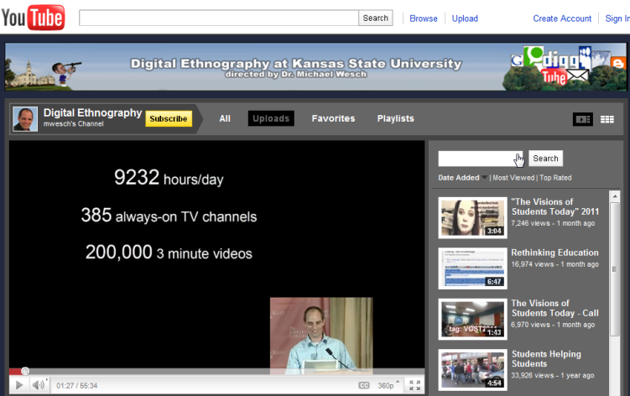
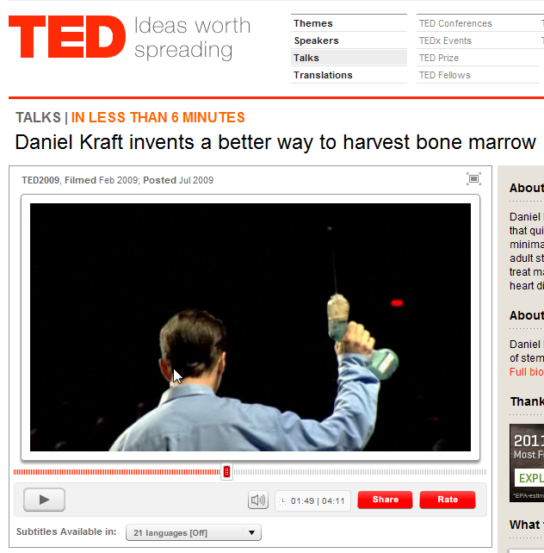
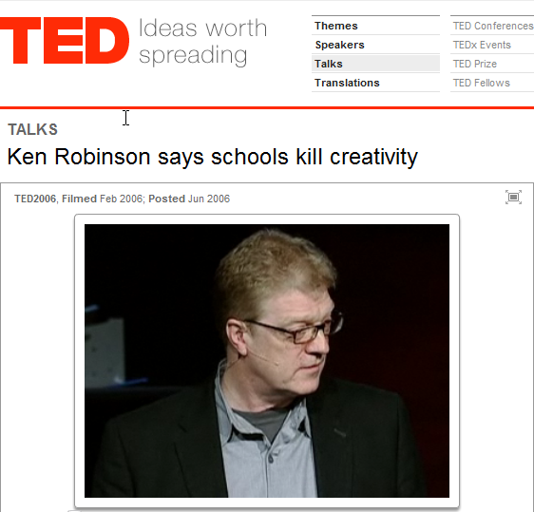
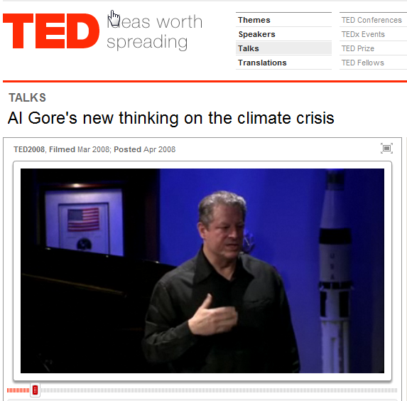
Examples …
http://www.youtube.com/user/mwesch?blend=6&ob=4
http://www.ted.com/talks/lang/eng/lessig_nyed.html
http://www.ted.com/talks/daniel_kraft_invents_a_better_way_to_harvest_bone_marrow.html
http://www.ted.com/talks/ken_robinson_says_schools_kill_creativity.html
http://www.ted.com/talks/lang/eng/al_gore_s_new_thinking_on_the_climate_crisis.html

Slide 7
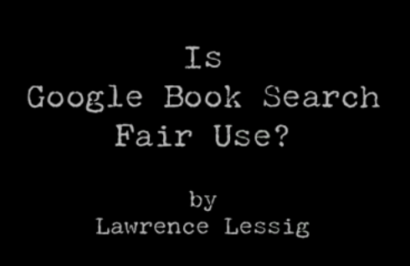
Presentation Styles
http://www.edwardtufte.com/tufte/books_be
http://sethgodin.typepad.com/seths_blog/2007/01/really_bad_powe.html
http://www.youtube.com/watch?v=5l2nrbmBQXg
http://www.garrreynolds.com/
Notes:
Let’s take a look at four different other perspectives on presenting information. As we look at these references, let’s think about how, if at all we can look at the principles that Clark and Mayer have forwarded to date. Do these principles such as the Redundancy and Coherence principles apply here?

Slide 8
Components …
Presenter
Audience
Message
Format

Slide 9
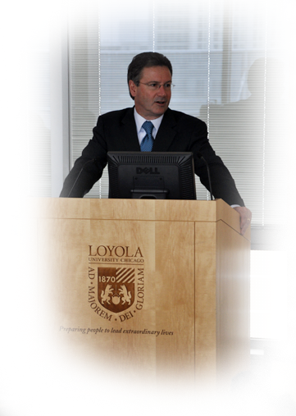
Presenter …
Be yourself.
Establish yourself with the audience.
Remember your message.
Know your subject.
Solicit Feedback.
Don’t over prepare.

Slide 10
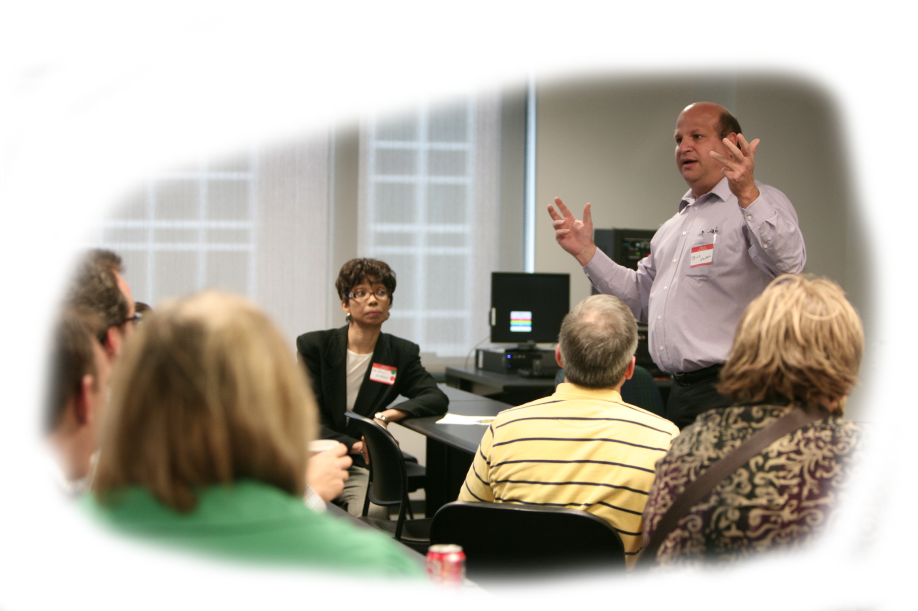
Presenter …
Dan, we can roll out of bed and do this presentation!

Slide 11
Audience …
What type of presentation are you making?
They are not all going to like you.
An “engaged” audience will learn.
What do they expect from me?

Slide 12
Message …
Focus on your main points.
Make your message relevant.
Give your audience something of value.
Give of yourself.
What’s your central point?

Slide 13
Format …
Don’t get hung up on the medium.
If you’re going to use technology have a backup plan.
Consider using handouts so you don’t cram everything into your visuals.

Slide 14
Considerations …
Design
Instruction

Slide 15
Design …
Simple Design vs. “Super Graphic”
“Live Story” vs. Reading Documents
Creativity (we are all creative!)
Time limits are an ally.
Think Simplicity, Clarity, Brevity.

Slide 16
Instruction …
How do people learn?
Remember “cognitive load theory”
Multimedia Principle
Modality Principle
Redundancy Principle
Coherence Principle
Personalization Principle
Use of Examples

Slide 17
How Do People Learn?
Learning is Facilitated Through Motivation!

Slide 18
Cognitive Load Theory
Miller, 1956
7 + or – 2
Sweller, 1988
Cognitive Load Theory (CTL)
cognitive process bogs down
Short term memory
Expands on Cognitive Information Processing Theory
Chase, Simon, 1973
Schema Construction
Chunk Information
Atkinson and Shiffrin, 1968
Information Processing Theory (CIP)
Sensory Input
Working Memory
Sensory Memory
Long-term Memory
Miller, G.A. (1956). "The magic number seven plus or minus two: some limits on our capacity to process information”
Chase, W.G. & Simon, H.A. (1973). "Perception in chess". Cognitive Psychology 4 (1): 55–81.
Sweller, J. (1988). "Cognitive load during problem solving: Effects on learning". Cognitive Science 12 (2): 257–285.

Slide 19
Multimedia Principle “Use words and graphics rather than words alone.”
Notes:
Chapter three of our text and our first discussion board activity for this term is based on the multimedia principle. Clark and Mayer start the chapter by telling us that there is growing evidence that well-designed visuals and text can particularly benefit learners with less experience in the lesson content.

Slide 20
Rationale for Multimedia …
Learners engage in “active” learning as graphics make mental connections
Learners may Engage in “shallow” learning. No connections
Words and Graphics
Words Alone

Slide 21
Graphics that Support Learning …
Visuals that …
Decorative
Add aesthetic appeal or humor
Representational
Illustrate the appearance of an object
Organizational
Relational
Transformational
Interpretive
Show qualitative relationships
Summarize quantitative relationships
Illustrate changes over time
Make intangible phenomena visible and concrete

Slide 22
Modality Principle “Present words as speech, rather than on-screen text.”

Slide 23
Redundancy Principle … “Explain visuals with words in audio or text: Not Both.”
Clark and Mayer assert that when graphics or animations are present, explanations should be made via spoken narration alone. They believe that viewing both graphics and text alongside the spoken narration, is not only redundant but also detrimental due to overloading of the visual channels. Can you recall a highly effective presentation or teaching style from your past or present? Did redundancy or lack thereof play any part?

Slide 24
Coherence Principle … “Adding interesting material can hurt learning.”
Clark and Mayer recommend avoiding “extraneous” graphics, video, and words in e-lessons. How would you decide what is extraneous and what is essential as you design a lesson?

Slide 25
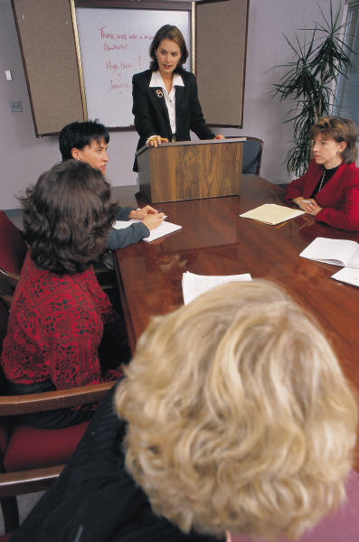
Personalization Principle … “Use conversational rather than formal style.”
Research shows that people work harder to understand material when they feel they are in a conversation rather than simply receiving information. (Beck, McKeown, Sandora, Kucan, & Worthy, 1996).

Slide 26
Collaborate …
What do you think?

Slide 27
Additional Resources …
http://www.stresscure.com/jobstress/speak.html
http://www.edwardtufte.com/tufte/courses
http://www.garrreynolds.com/
http://www.sethgodin.com/sg/

Slide 28
Review …
Examples of Presentations
Components of Effective Presentations
Considerations for Presentations
Collaborate!
http://www.ted.com/talks/patrick_chappatte_the_power_of_cartoons.html

Slide 29
Thank you Fr. Zak!
Give me the answer!
Tell me how you got the answer!
Tell me the answer again!

Slide 30
What's Your Message? Presenting with a Purpose
Bruce A. Montes | March 14, 2011
THANK YOU
and
HAVE A GREAT CONFERENCE

