Slide 1
Managing a Collaborative Building Project with Graduate Students in a Virtual Learning Environment
Anastasia Trekles
Clinical Asst. Professor
Purdue University Calumet
Hammond, IN, USA
atrekles@purdue.edu
Download these slides: http://slideshare.net/andella

Slide 2
The Setting
Graduate-level instructional design course in advanced Web applications for instruction
Summer term, 4-week unit on virtual worlds in education
Seven students at Purdue University Calumet (Hammond, IN, USA)
Students come from K-12, higher ed, and business backgrounds

Slide 3
The Project
Students were asked to build a virtual learning space for the Department of Graduate Studies in Education at Purdue Calumet
Objectives for the assignment stipulated that students would be able to:
  Create and design 3D items and environments using Second Life;
  Work with a team in coordinating the design and layout of a virtual learning space;
  Enhance presentation visual aides and skills in a 3D virtual environment.

Slide 4
The Team Approach
All members of the class had to work together as a team
They used a BlackBoard discussion forum to devise an action plan, including what the goals for the space would be, who would take on what role, and how workflow would be handled
Students met synchronously during class and virtually in-world to plan and coordinate work, and help one another
Students also worked independently when appropriate

Slide 5
Working as a Team
One person quickly emerged as the “project manager,” and others became researchers, builders, and technical experts
Each individual contributed unique ideas and executed them in different sections of the space, so that each student had his/her own “corner”
Students helped each other learn how to use the Linden scripting language, build objects, and find existing objects for free in-world to use and modify

Slide 6
Teamwork Challenges
As with all teamwork, not everyone agreed on every aspect of the learning space
Even though each had his/her own section of the space to build, some students wanted to help others
This occasionally led to disagreements and a feeling that others were “meddling” too much
Also, some students continually forgot to change permissions on items they did or did not want to be modified, causing difficulty and confusion

Slide 7
Technical Challenges
Multimedia:
  Students wanted a multimedia board to show YouTube videos, but only the owner of the space can make streaming URLs function
  I had to intervene on many occasions to help get the video working
Textures and other purchases:
  I stipulated that students should not use their own money to purchase things (free marketplace items were acceptable)
  However, uploading textures costs L$10
  I used my own funds to upload textures for students at their request

Slide 8
Technical Challenges
Ownership
  When working collaboratively, students must be aware of ownership properties of objects
  Sometimes, students modified others’ open-access items without asking, seeing them as “fair game”
  Other times, students wanted someone’s help with making a script work, getting a built prim “just right,” and so forth, but would forget to update the permissions accordingly

Slide 9
Lessons Learned
This was a fun project and all students were proud of their achievements at the end
Collaboration generally went well, although firm ground rules for all team members must be established early on
The instructor must be prepared to be an active participant to help multimedia and scripts work properly
Instructors must decide on the issue of money, including texture uploads (L$10 each)
Students must be fully aware of item ownership privileges and how to set them

Slide 10
Learn More
Second Life Build assignment description and rubric: http://education.purduecal.edu/Faculty/Trekles/SLassignment.html
Purdue University Calumet Second Life island: http://slurl.com/secondlife/Purdue%20University%20Calumet/128/128/42
Download these slides: http://slideshare.net/andella

Slide 11
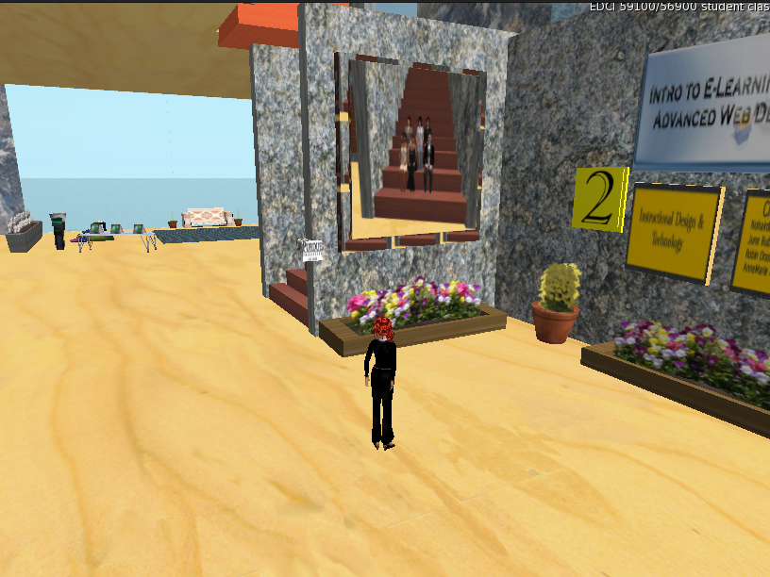
Entryway
The “founding builders” added a group photo and a name plaque to commemorate their accomplishments.

Slide 12
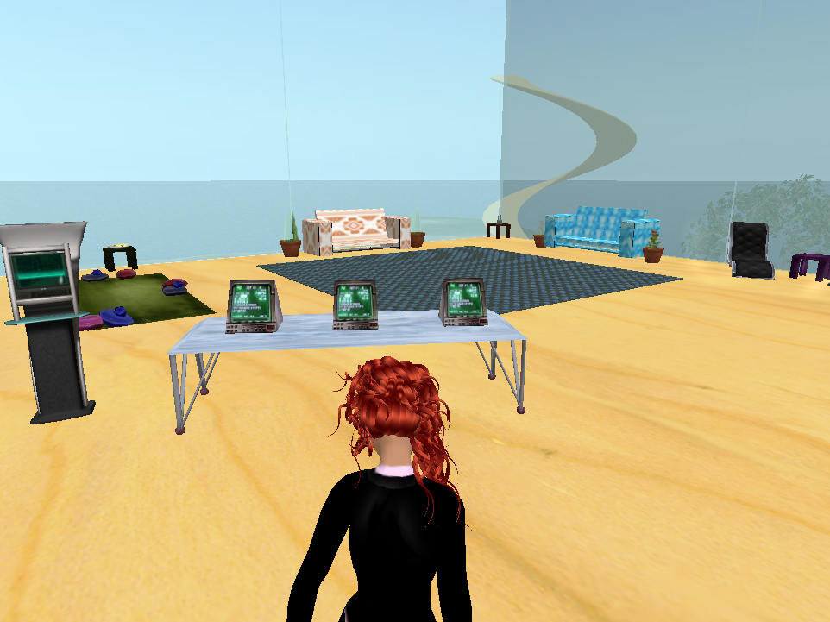
Showcase area
Visitors may click the kiosks and computers to learn more about our program and to view samples of student work, including websites, multimedia, and presentations.

Slide 13
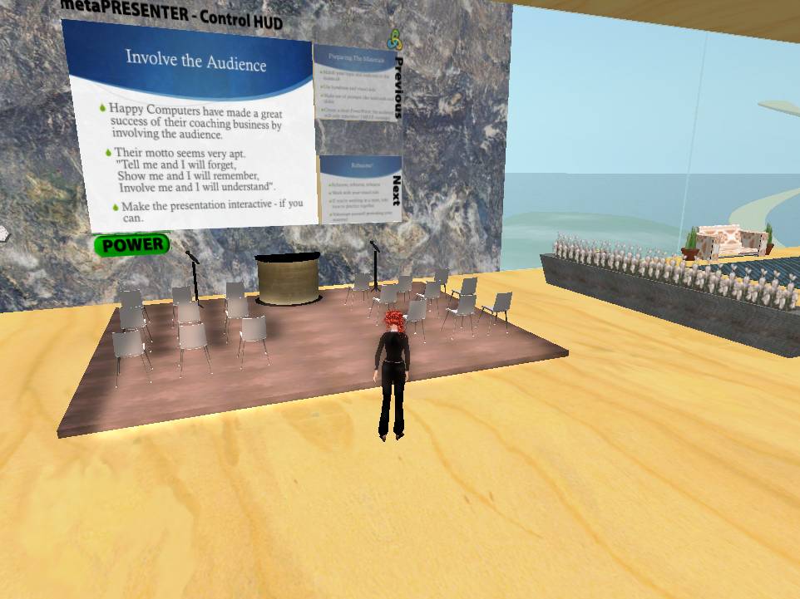
Presentation Area
We occasionally hold virtual classes here, where students may sit and discuss, as well as use textures converted from their PowerPoint slides in the metaPresenter.

Slide 14
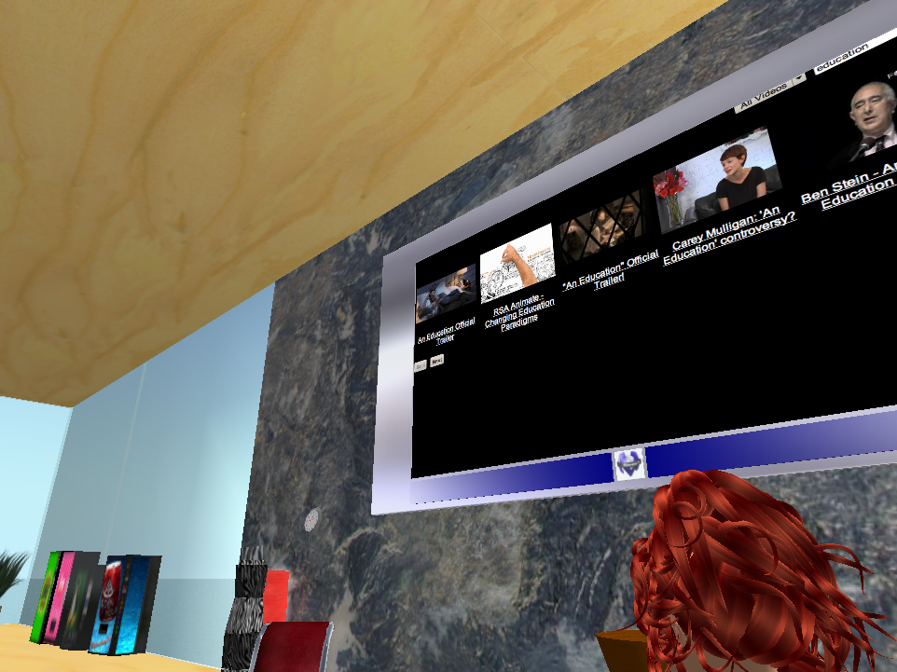
Video Screen
The video screen is capable of searching YouTube and displaying videos directly on the screen.

Slide 15
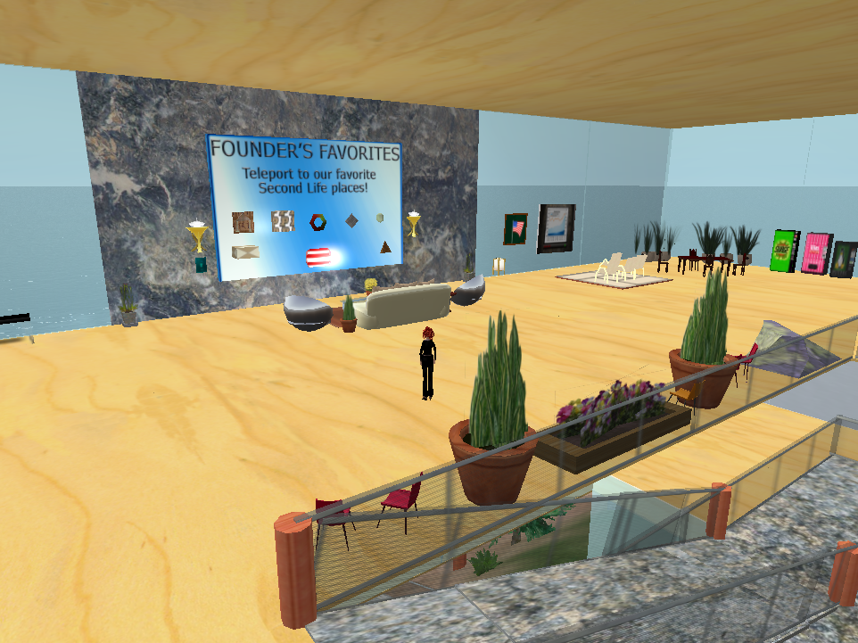
“Founder’s Favorites”
Students used landmark-giving scripts to share their own favorite educational places in Second Life.

Slide 16
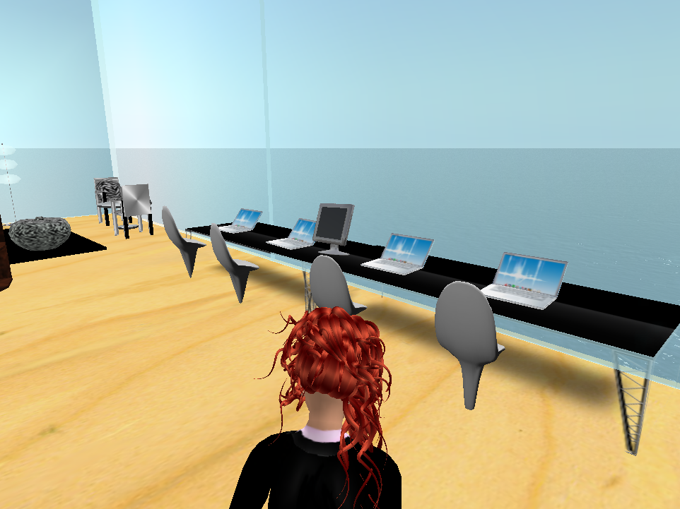
“Workstations”
One student devised a script to allow one to write an email and send it through these “laptops”.

Slide 17
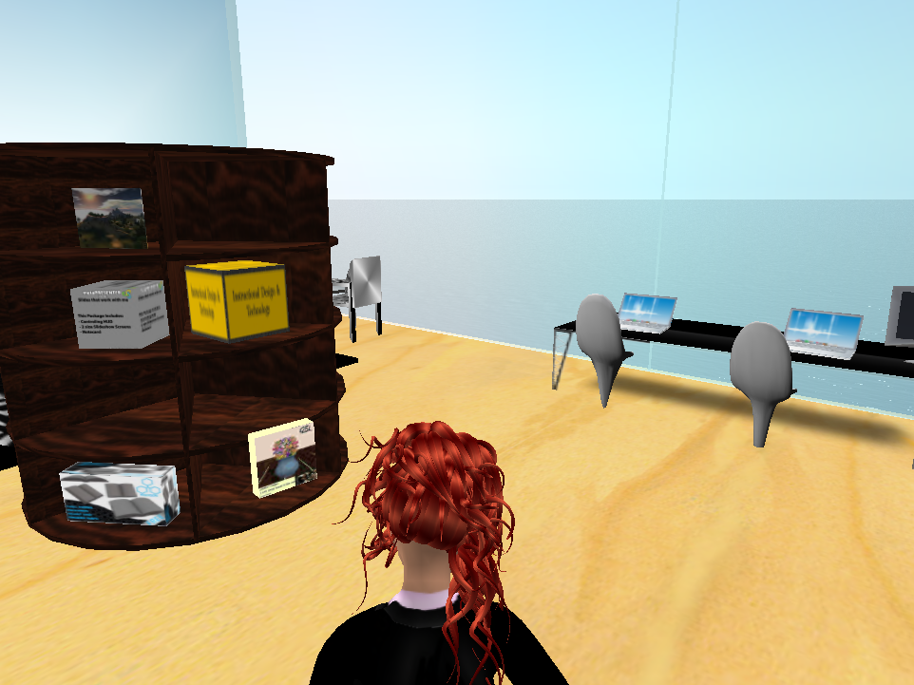
“Sharing Shelf”
Students share their favorite items, such as virtual teaching tools and presentation boards, with visitors (at no cost)

Slide 18
References
Aldrich, C. (2009). Learning online with games, simulations, and virtual worlds: Strategies for online instruction. San Francisco: Jossey-Bass.
Annetta, L., M. Klesath, and S. Holmes. (2008). V-learning: How gaming and avatars are engaging online students. Innovate 4 (3). Retrieved from http://www.innovateonline.info/index.php?view=article&id=485.
Beard, L., Wilson, K., Morra, D., & Keelan, J. (2009). A survey of health-related activities on Second Life. Journal of Medial Internet Research, 11(2). Retrieved from http://www.jmir.org/2009/2/e17/HTML.
Bronack, S., Sanders, R., Cheney, A., Riedl, R., Tashner, J., Matzen, N. (2008). Presence pedagogy: Teaching and learning in a 3D virtual immersive world. International Journal of Teaching and Learning in Higher Education, 20(1). 59-69.

Slide 19
References
Cheong, D.U., Yun, S. & Chollins, C. (2009). Is Second Life effective for pre-service teachers’ teaching practice?. In I. Gibson et al. (Eds.), Proceedings of Society for Information Technology & Teacher Education International Conference 2009 (pp. 1418-1421). Chesapeake, VA: AACE.
Collins, F. (2008). Digital selves: Preparing graduates for the virtual workplace. In Proceedings of World Conference on Educational Multimedia, Hypermedia and Telecommunications 2008 (pp. 5853-5858). Chesapeake, VA: AACE.
Diener, S., Windsor, J., Bodily, D. (2009, May 9). Design and Development of Medical Simulations in Second Life and OpenSim. Paper Presented at the EDUCAUSE Australasia Conference, Perth, Australia.
Gee, J. P. (2005). Learning by design: Good video games as learning machines. E-Learning, 2(1). 5-16. Retrieved from http://www.jamespaulgee.com/node/17

Slide 20
References
Graetz, K. A. (2006). The psychology of learning environments. In D. Oblinger (Ed.), Learning Spaces (pp. 6.1-6.14). Boulder, CO: EDUCAUSE. Retrieved July 16, 2007, from http://www.educause.edu/learningspaces.
Hobbs, M., Brown, E., & Gordon, M. (2006). Using a virtual world for transferable skills in gaming education. ITALICS, 5(3). Retrieved from http://www.doaj.org/doaj?func=fulltext&passMe=http://www.ics.heacademy.ac.uk/italics/vol5iss3/hobbsbrowngordon.pdf.
Jarmon, L., Traphagan, T., and Mayrath, M. (2008). Understanding project-based learning in Second Life with a pedagogy, training, and assessment trio. Educational Media International, 45(3).157 - 176.
Ke, F. (2008). Computer games application within alternative classroom goal structures: Cognitive, metacognitive, and affective evaluation. Education Technology Research Development, 56. 539-556.

Slide 21
References
Mesko, B. (2007, June 17). Top 10: Virtual medical sites in Second Life. ScienceRoll. Retrieved from http://scienceroll.com/2007/06/17/top-10-virtual-medical-sites-in-second-life/.
Moreno, R., & Mayer, R. (2007). Interactive multimodal learning environments. Educational Psychology Review, 19. 309-326.
Moschini, E. (2006). Designing for the smart player: Usability design and user-centered design in game-based learning. Digital Creativity, 17(3). 140-147.
Pisha, B., & Stahl, S. (2005). The promise of new learning environments for students with disabilities. Intervention in School and Clinic, 41(2). 67-75.
Rice, J. W. (2007). New media resistance: Barriers to implementation of computer video games in the classroom. Journal of Educational Multimedia and Hypermedia, 16(3). 249-261.

