Slide 1
PART OF THE SOLUTION: BLURRING THE LINES BETWEEN TEACHING AND LEARNING ROLES
Matthew Schmitz | March 14, 2011

Slide 2
Copyright Matthew Schmitz, 2011. This work is the intellectual property of the author. Permission is granted for this material to be shared for non-commercial, educational purposes, provided that this copyright statement appears on the reproduced materials and notice is given that the copying is by permission of the author. To disseminate otherwise or to republish requires written permission from the author.”

Slide 3
Introduction
Who is Matthew Schmitz?
What’s his problem?
Notes:
10 years working with faculty and students assisting with various parts of the teaching and learning processes.
If there is a problem, the other party is always at fault; neither faculty or student want to admit they might be part of the problem.

Slide 4
Teaching and Learning
Courses
F2F
Blended
Online
Instructional Models
Top-down
Shared
Bottom-up
Notes:
MODELS
TOP-DOWN: instructor-driven (EX: traditional lecture course – passive learning)
SHARED (negotiated, bi-directional learning): a joint construction of knowledge (EX: seminar)
BOTTOM-UP: student-driven (EX: independent study)

Slide 5
Stop Being Part of the Problem
How can faculty and students overcome the problems inherent in certain courses and instructional models?
How can teaching and learning become blended and symbiotic?

Slide 6
Gallery
Image, multimedia, and document storage and management application
“Make it your own”
“It takes all kinds”

Slide 7
Gallery at SIUE

Slide 8
Gallery at SIUE

Slide 9
Gallery at SIUE

Slide 10
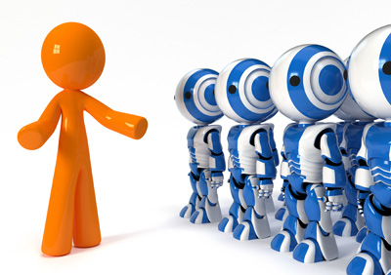
Face to Face Course
Teaching and learning in a F2F course
ANTH 170 FR2 Freshman Experience

Slide 11
Changing the F2F Culture
Traditional
Top-down
Proposed
Shared
What’s the solution?

Slide 12
F2F Solutions
Alternate between top-down and bottom-up models

Slide 13
Blended Course
Teaching and learning in a blended course
HIST 111b Western Civilization

Slide 14
Changing the Blended Culture
Traditional
Top-down
Proposed
Bottom-up
What’s the solution?

Slide 15
Blended Solutions

Slide 16
Online Course
Teaching and learning in an online course
ANTH 304 Symbols and Culture

Slide 17
Changing the Online Culture
Traditional
Top-down
Proposed
Shared
What’s the solution?

Slide 18
Online Solutions
Portfolios (individual)
Discussion Boards (group)

Slide 19
Findings
Interaction
Collaboration
Substitution
Role-reversal

Slide 20
Parts of the Solution
http://gallery.menalto.com

Slide 21
THANK YOU

